Slide 1
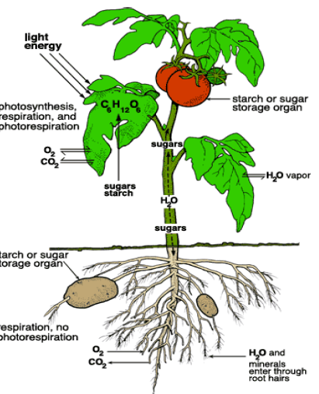
l
وَعِنْدَهُ مَفَاتِحُ الْغَيْبِ لَا يَعْلَمُهَا إِلَّا هُوَ وَيَعْلَمُ مَا فِي الْبَرِّ وَالْبَحْرِ وَمَا تَسْقُطُ مِنْ وَرَقَةٍ إِلَّا يَعْلَمُهَا وَلَا حَبَّةٍ فِي ظُلُمَاتِ الْأَرْضِ وَلَا رَطْبٍ وَلَا يَابِسٍ إِلَّا فِي كِتَابٍ مُبِينٍ (59)
صدق الله العظيم
سورة الأنعام 59

Slide 2
Plant duration:
According to duration, the flowering plants classified to:
1. Annual: A plant completing its life cycle in a single season, from seed to germination, reproduction and death, e.g. Anagallis (AIN ALJAMAL).
2. Ephemeral: A plant which completes its life cycle in a very short time say within some weeks single season, e.g. Chenopodium (RIGHELA).
3. Biennial: A plant which completes its life cycle in two seasons e.g. Raphanus sativus (AL-FIJIL تور).
4. Perennial: A plant which grows for several years, e.g. most trees, shrubs, and some herbs.

Slide 3
ROOTS
The root is the underground organ of the plant. Its primary function includes uptake of water and minerals and anchorage of the above-ground (aerial) portions of the plant.
Origin of roots;
The first root to develop in a vascular plant is the radicle of the embryo.
1. Primary root & Lateral roots: Formed by radicle, as in
most Dicots. Taproot system.
2. Adventitious roots. Formed by any other part of a plant except radicle, as in Monocots.
Root system;
1. Normal roots Taproot system (Allorrhyzy, Dicot roots)
2. Fibrous root system (Homorrhyzy, Monocot roots).
Modified Roots;
Some roots are modified to carry out specialized functions of mechanical and physiological nature.
Some taproots are modified for food storage as fleshy or succulent tap roots.
Some adventitious roots are modified for other functions also.
PLANT TAXONOMY

Slide 4
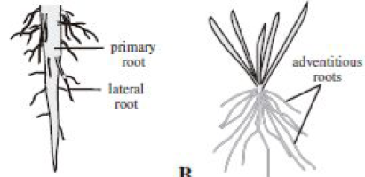
Root system;
4
PLANT TAXONOMY

Slide 5
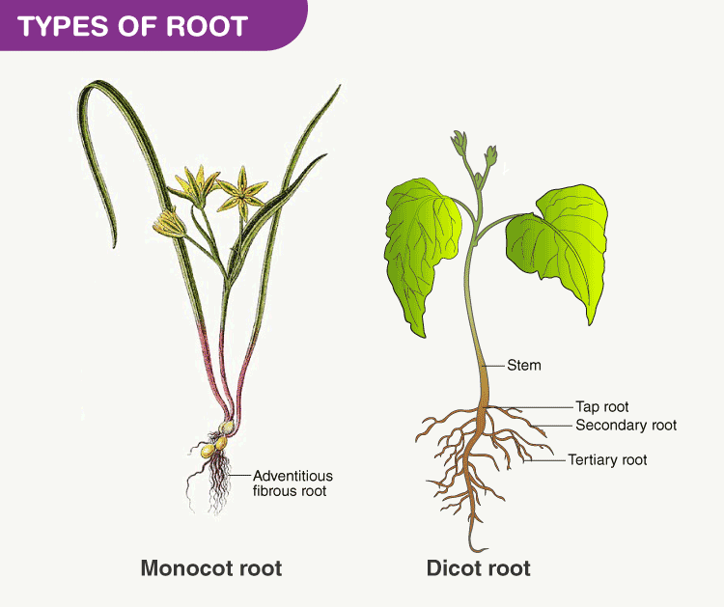

Slide 6
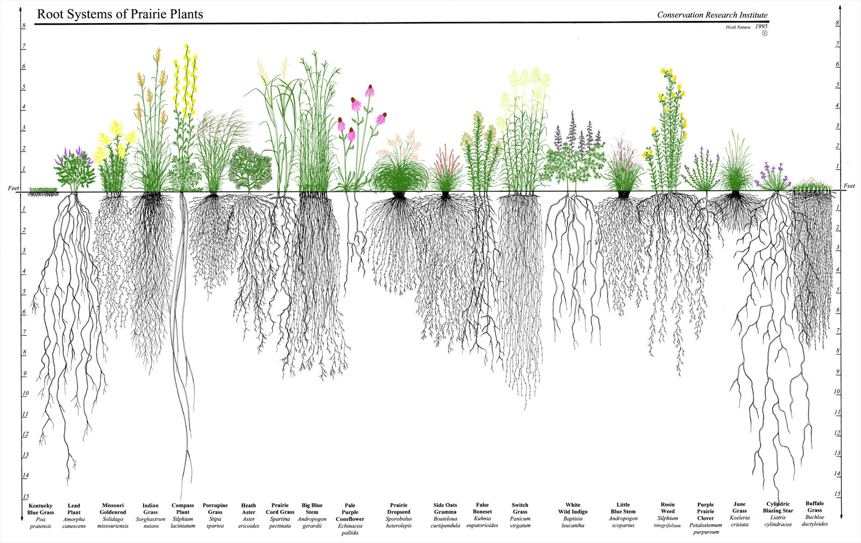

Slide 7
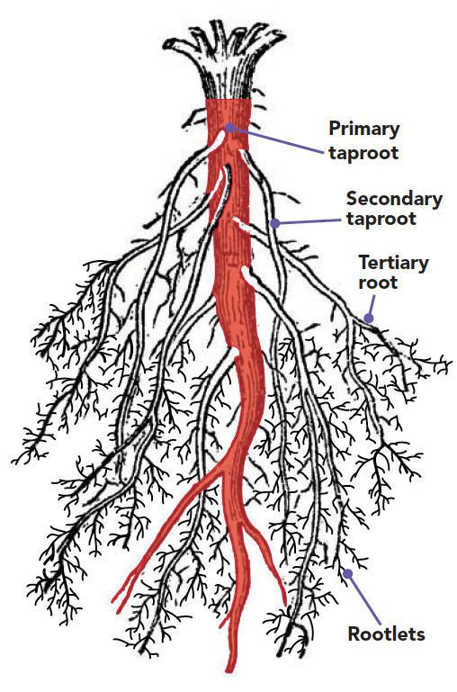

Slide 8
STEMS (Shoot System)
Stems function both as supportive organs (supporting and usually elevating leaves and reproductive organs) and as conductive organs (conducting both water/minerals and sugars through the vascular tissue between leaves, roots, and reproductive organs). As mentioned earlier, a shoot is a stem plus it’s associated leaves. Sporophytic shoots that are branched and bear leaves are an apomorphy for all vascular plants; the leafy shoot like structures of mosses and some liverworts are gametophytic and not directly homologous with shoots of vascular plants.
Stem is the axis of a plant bearing leaves with buds in their axils. It is formed by the plumule of the seed.
8

Slide 9
Stem
Origin of stem;
The first shoot of a seed plant develops from the epicotyl of the embryo. The epicotyl elongates after embryo growth into an axis (the stem) that bears leaves from its tip, which contains the actively dividing cells of the shoot apical meristem. Further cell divisions and growth results in the formation of a mass of tissue that develops into the immature leaf, called a leaf primordium.

Slide 10

Part of a stem;
Shoot tip;
Node;
Inter node;
Bud, A terminal bud;
Monopodial and Sympodial system of branching;
Monopodial; indeterminate A branching pattern in which a given axis is derived from a single apical meristem, as fined in Prunus and Pinus.
Sympodial; determinate, A branching pattern in which a given axis is made up of several unites, each of which derived from a separate apical meristem, the units themselves determinate or indeterminate, as fined in Vitis.
10
PLANT TAXONOMY

Slide 11
Stem habit types;
Aerial (Terrestrial) stem:
Stems function both as supportive organs (supporting and usually elevating leaves and reproductive organs) and as conductive organs (conducting both water/minerals and sugars through the vascular tissue between leaves, roots, and reproductive organs).
Modified stems;
Arial modifications; Many modified types of stems that are aerial (aboveground) also have specific functions. For example, a cladode is a flattened, photosynthetic stem that may resemble and function as a leaf, found, e.g., in prickly-pear cacti, Asparagus, and Ruscus.
Underground modifications ( Subterranean stems ) ; Rootstocks function as storage and protective organs, remaining alive underground during harsh conditions of cold or drought. When environmental conditions improve, rootstocks serve as the site of new shoot growth, sending out new adventitious roots and new aerial shoots from the apical meristem or from previously dormant buds.

Slide 12
Buds
Buds are immature shoot systems that develop from meristematic regions. In deciduous woody plants the leaves fall off at the end of the growing season and the outermost leaves of the buds may develop into protective bracts (modified leaves) known as bud scales. The bud of a twig that contains the original apical meristem of the shoot (which by later growth may result in further extension of the shoot) is called the terminal or apical bud. Buds formed in the axils of leaves are called axillary or lateral buds.
A given bud may be vegetative, if it develops into a vegetative shoot bearing leaves; floral or inflorescence, if it develops into a flower or inflorescence; or mixed, if it develops into both flower(s) and leaves. In some species more than one axillary bud forms per node. If the original terminal apical meristem of a shoot aborts (e.g., by ceasing growth or maturing into a flower), then an axillary bud near the shoot apex may continue extension growth; because this axillary bud assumes the function of a terminal bud, it is called a pseudoterminal bud.
12
PLANT TAXONOMY

Slide 13
LEAF
Leaf is a lateral appendage of the stem born at the node and bears an axillary bud in its axil. It is usually expanded and concerned with the manufacture of food (photosynthesis).
Origin of leaf;
The leaf primordia arise exogenously at the growing point as lateral protuberances or transverse ridges, initially undifferentiated.
1. The cotyledons;
The cotyledons, the life of which is usually only short, are almost always less complex in form than the normal leaves. In the Germination of the seed they may remain enclosed within the testa and concealed beneath the surface of the soil (hypogeal germination), e.g. Quercus, Pisum, and Vicia faba. In (epigeal germination), the cotyledons burst through the testa and appear above the surface of the earth, e.g Phaseolus vulgaris and most genus of the Poacea family.
PLANT TAXONOMY

Slide 14
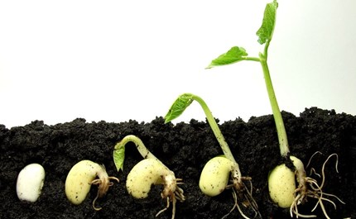
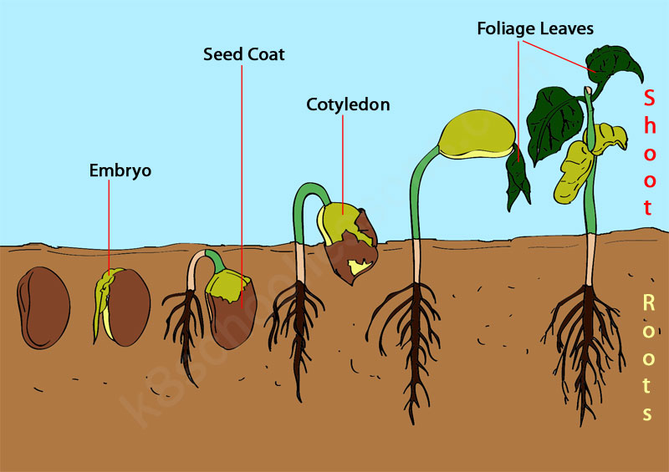
Epgeal germination
Hypogeal germination

Slide 15
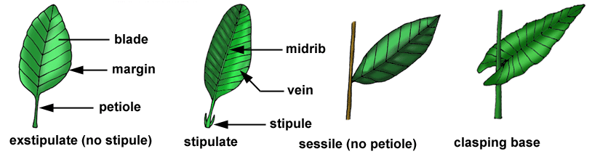
2. The foliage leaves;
The foliage leaf usually consists of number of parts. Thus we can recognize the flat, green, frequently very thin, expanse or lamina of the leaf, the stem-like petiole (petiolule for leaflet stalks), and the leaf base. This may be differentiated as a leaf sheath, or may bear stipules.
15

Slide 16
Phyllotaxy or Leaf arrangement (number of leaves at a node);
It is a mode of arrangement of leaves on the stem includes;
Alternate; leaves are produced alternately or spirally on the long axis or stem. As in Eucalyptus and most Poaceae.
Opposite; Leaves occurring in pairs at the node, they may be –
a. Decussate : Leaves that stands at right angle to next upper or lower pair eg. Silene and Dianthus.
b.Superposed : Successive pairs of leaves stand directly over a pair in the same plane, in some Onagraceae, and some Labiatae.
Whorled or verticillate; in which 3 – 5 leaves form a whorl in each node as 3 leaves in Nerium oleander and 5 in Galium.

Slide 17
Leaf incision (simple & compound leaves);
Indentation of the lamina margin is called leaf incision. Accordingly two main categories are recognized; Simple leaf & Compound leaf.
1- Simple leaf;
A leaf having entire margin (not divided), as in Vinca and Punica.
2- Compound leaf;
The leaf has incised margin, and the incision goes so deep, touching the midrib, so that lamina breaks up into lobes or segments called leaflets. A compound leaf may be pinnate or palmate.
A- Pinnate compound;
The midrib (or rachis) directly bears the leaflets or pinnae along both the sides. It may be simple pinnate, bi-pinnate, tri-pinnate and decompounds.
i- Simple pinnate or uni-pinnate ▬ leaflets born directly on rachis, and may be paripinaate- leaflets present in pairs as in Tamarindus indica and Acacia. Or may be Imparipinnate – rachis is terminated by an odd leaflets as in Rosa and Melia azadirachta.
ii- Bi-pinnate ▬ a compound leaf with main segments again pinnately divided into pinnules i.e., leaflets born on the rachis but on its branches as in Acacia arabica and Mimosa punica.
iii- Tri-pinnate ▬ incision goes to the 3rd order so that leaflets are found on secondary branches of the rachis, as in Prosopis.

Slide 18
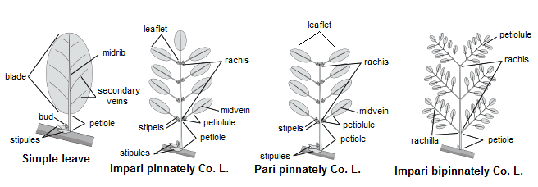
A- Pinnate compound;
18
PLANT TAXONOMY

Slide 19
In such leaves, rachis does not differentiate and the lamina appears articulated or attached to a point on the top of the petiole. Such compound leaves may be of following types; i- Uni-foliate ▬ single leaflet attached to the top of the petiole, as in Citrus. ii- Bi-foliate ▬ only two leaflets articulated to the rachis, as in Bignonia grandiflora. iii- Tri-foliate ▬ three leaflets articulated at the top of the rachis, as in Oxalis. iv- Quadri-foliate ▬ (it is a rare type) four leaflets articulated at the top of the rachis, as in Paris quadrifolia and Marsilea quadrifoliata. v- Multi-foliate ▬ more than four leaflets attached at the top of the rachis, as in Acanthopanax.
B- Palmate compound;

Slide 20
Leaf parts (of foliage leaves);
A- Leaf base attachment; The point of attachment of the leaf to the stem. In general, leaves may be petiolate, with a petiole, or sessile, without a petiole. Leaflets of a compound leaf are, correspondingly, either petiolulate or sessile.
B- Stipules;
A pair of lateral outgrowth present at the base of the leaf. Leaves possessing stipules are called stipulate and lacking are exstipulate as in Melia azadirachta .
C- Petiole; Stalk of the leaf, a leaf having a petiole is called petiolate, and without petiole is called sessile. The petiole shows, sometime modifications, as it is winged (Citrus), spongy (Eichhornia), flattend (Acacia), spinous (Quisqualis).
20
PLANT TAXONOMY

Slide 21
Lamina (Blade);
The most important part of the leaf and a seat of gaseous exchange for photosynthesis, respiration, transpiration . . . etc.
Several features of leaf are considered regarding appearance of lamina, such as shape, base, margin, apex, surface, texture, venation, incision and simple or compound . . . etc.
Leaf Vination:
The pattern of arrangement of vascular system in the lamina is called venation. It is mainly of two types:
Reticulate venation;
Netted or reticulate, in which the ultimate vein-lets form an interconnecting netlike pattern, e.g., most dicot flowering plants.
Reticulate leaves can be;
Pinnately veined (pinnate netted), with secondary veins arising along length of a single primary vein (the midrib or, in a compound leaf, mid-vein); as in Lactuca and Myrtus.
Palmately veined (palmate-netted), with four or more primary veins arising from a common basal point; as in Vitis and Ricinus.
Ternately veined (ternate-netted), with three primary veins arising from a common basal point, As in Cinnamomum.
21
PLANT TAXONOMY

Slide 22
Reticulate venation;
22
PLANT TAXONOMY

Slide 23
Parallel venation;
Similar to parallel venation in having transverse ultimate veinlets are
penni-parallel (also called pinnate-parallel), with secondary veins arising from a single primary vein region, the former essentially parallel to one another (e.g., Phoenix reclinata);
palmate-parallel, with several primary veins (of leaflets or leaf lobes) arising from one point, the adjacent secondary veins parallel to these (e.g., Washingtonia filifera ; fan palms).
PLANT TAXONOMY

Slide 24

Thanks for listening

Slide 25
Quiz - 4
List only
Adventitious roots
2. Underground modifications (Subterranean stems )

Slide 26
Roots absorb water and minerals from the soil and transport them to the upper parts like stem and leaves of the plant. The water and minerals are carried from roots to the upper parts of the plants in an upward movement, against the gravity. Therefore, it requires some force. This force is provided by the transpirational pull due to the process of transpiration going on in the leaves.
Roots also provide anchorage to the plants and keep them attached to the soil by binding the soil around the roots. This is the reason why it is difficult to uproot a plant by hands.
Roots are used to store food; for example, fleshy roots like Carrot, Radish, Beet, Turnip, and Mirabilis.
Roots play an essential role in binding the soil. Roots help in preventing soil erosion and land sliding in the hilly areas.
Roots of plants like Corms, Stem Tubers, Rhizomes, and Stolon participate in vegetative reproduction.
In some week stemmed plants, roots help in clinging and, hence, climbing roots; for example, Money Plant, Betel, Ivy, etc.
Roots also take part in nitrogen fixation with the help of nitrogen-fixing bacteria present in the soil. For example, nodulated roots Of Pea, Bean, Gram, Fenugreek, etc.
Roots of some plants are present above the ground and known as Aerial Roots. For example, pneumatophores are the type of specialized aerial roots present in Mangrove plants. They help the plant to breathe.
Roots of mangrove and epiphytic orchids play a significant role in the photosynthesis. They become green upon exposure to light and start producing energy. There is even a leafless orchid (Dendrophylax lindenii) which solely depends upon its roots for energy production.

Slide 27
