Slide 1
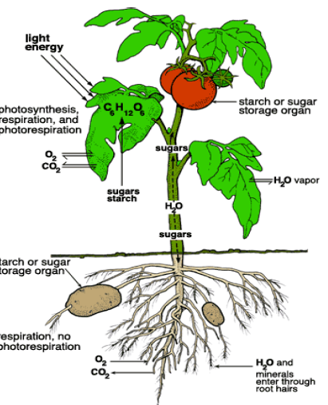
l
وَهوَ الّّّّّذي مدّ ألأرض و جعل فيها رواسي و أنهاراَ و من كلّ الثمرات جعل فيها زوجين اثنين يغشي اللَّيل النَّهار اِنّ في ذلك لآيات لقومِ يتفكرون ۞
صدق الله العظيم

Slide 2
INFLORESCENCES;
An inflorescence is a collection or aggregation of flowers on an individual plant. Inflorescences often function to enchance reproduction.
Inflorescence parts:
Several terms deal with leaf-like structures found in the inflorescence. An inflorescence bract is one that subtends not an individual flower but an inflorescence axis or a group of flowers. (Bracts that subtend an individual flower should be termed floral bracts; however, some sources do not make the distinction or will use inflorescence bract to refer to either.) A group or cluster of bracts subtending an entire inflorescence is termed an involucre (adjective involucrate); a similar group of bracts subtending a unit of the inflorescence is an involucel.
2
PLANT TAXONOMY

Slide 3
INFLORESCENCES;
Other terms deal with various (stem) axes in an inflorescence. A peduncle (adjective pedunculate) is the stalk of an entire inflorescence.
A compound receptacle (also called a torus) is a mass of tissue at the apex of a peduncle that bears more than one flower.
A peduncle that lacks well-developed leaves, arising from a basal rosette of vegetative leaves is termed a scape (adjective scapose, as in Allium and Narcissus), the plant habit in such a case being acaulescent.
A rachis is a major, central axis within an inflorescence. However, the central axis of a grass or sedge spikelet is a rachilla. Finally, a ray is a secondary axis of a compound umbel.

Slide 4
Inflorescence development:
1. A determinate inflorescence is one in which the apical meristem of the primary inflorescence axis terminates in a flower; typically, the terminal flower matures first, with subsequent maturation occurring from apex to base. Determinate inflorescences are characteristic of cymes "Cymose".
2. An indeterminate inflorescence is one in which the apical meristem of the primary inflorescence axis does not develop into a flower; typically, the basal flower matures first, with maturation occurring from base to apex. Indeterminate inflorescences "Racemose', include a number of types, such as spikes, racemes, and panicles.

Slide 5
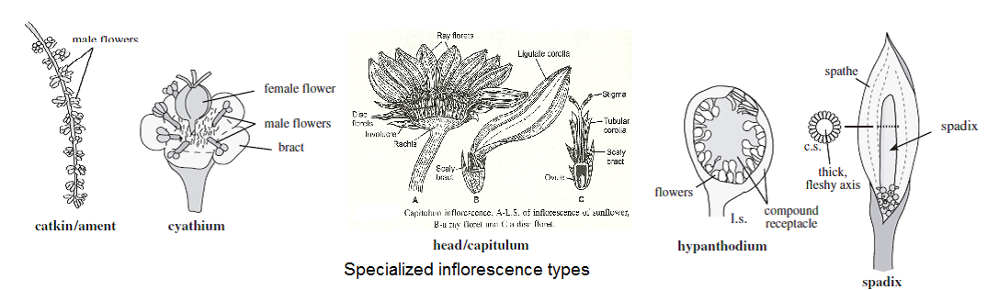

Specialized inflorescences;
Some inflorescences are quite specialized and often restricted to certain taxonomic groups as:
I. Catkin (also called an ament) in Quercus and Salix.
II. Cyathium as in Euphorbia helioscopia Euphorbia pilulifera.
III. Head or capitulum are typical of the Asteraceae and Dipsacaceae (and some other groups.
IV. Syconium or Hypanthodium in Ficus. And Spadix is a spike with a thickened or fleshy central axis, typically in the Araceae, e.g. Arum sp.
5
PLANT TAXONOMY

Slide 6
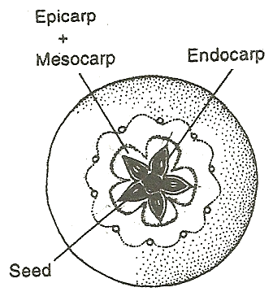
FRUITS;
Fruits are the mature ovaries or pistils of flowering plants plus any associated accessory parts. Accessory parts are organs attached to a fruit but not derived directly from the ovary or ovaries, including the bracts, axes Ficus, receptacle Malus domestica, compound receptacle (in multiple fruits Fragaria chiloensis and Ananas, or perianth (calyx in Punica, and corolla in Cucurbita moschata. The term pericarp (rind, in the vernacular) is used for the fruit wall, derived from the mature ovary wall. The pericarp is sometimes divisible into layers: endocarp, mesocarp, and exocarp.

Slide 7
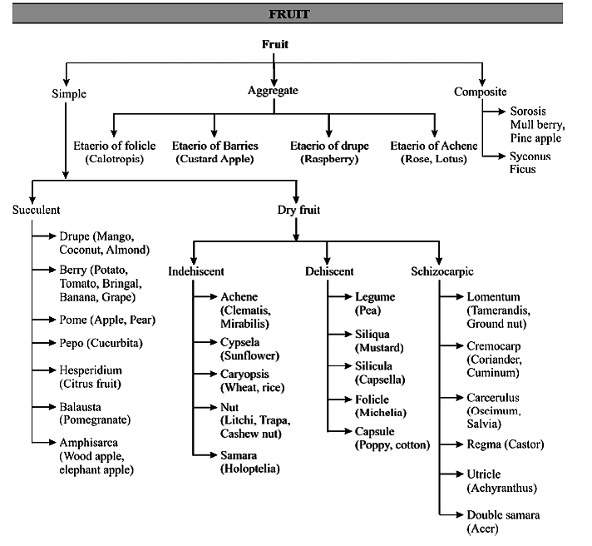
Fruit types;
are based first on fruit development. The three major fruit developments are:
PLANT TAXONOMY

Slide 8
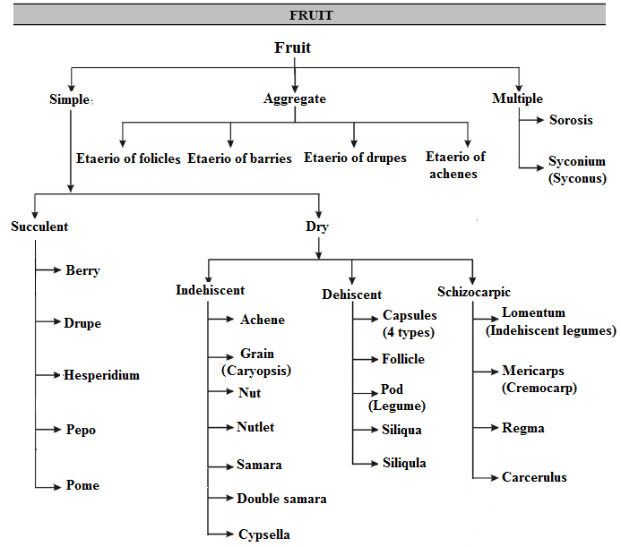
Fruit types;
are based first on fruit development. The three major fruit developments are:
PLANT TAXONOMY

Slide 9
Simple fruit types;
The simple fruit type, as well as unit fruit types of aggregate and multiple fruits, are classified based on a number of criteria, including:
1'- Fleshy (succulent) simple fruits:
A. Berry; is the general, unspecialized term for a fruit with a succulent pericarp, as in Vitis, Phoenix and Lycopersicon.
B. Drupe; is a fruit with a hard, stony endocarp and a fleshy mesocarp, as in Prunus amygdalus, P. percicu, P. armenica, Juglans spp. Olea europaeus, etc.
C. Hesperidium; is a septate fleshy fruit with a thick skinned, leathery outer pericarp wall and fleshy modified trichomes (juice sacs) arising from the inner walls, as in Citrus spp. (orange, lemon, grapefruit, etc.).
D. Pepo; is a nonseptate fleshy fruit with parietal placentation and a leathery exocarp derived from an inferior ovary, the fruit type of the Cucurbitaceae (Benincasa hispida and Cucurbita maxima.
E. Pome; is a fleshy fruit with a cartilaginous endocarp derived from an inferior ovary, with the bulk of the fleshy tissue derived from the outer, adnate hypanthial tissue, as in Malus and Pyrus
9
PLANT TAXONOMY

Slide 10
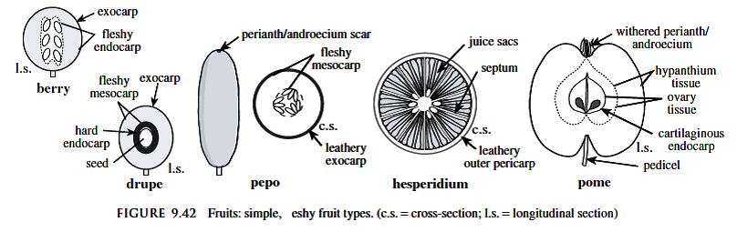
Fleshy Simple Fruits

Slide 11
1''- Simple dry at maturity;
I. Indehiscent (not splitting open at maturity);
A. Achene is a one-seeded, dry, indehiscent fruit with seed attached to the pericarp at one point only, such as the unit fruits of sunflowers.
B. Grain or caryopsis is a one-seeded, dry, indehiscent fruit with the seed coat adnate to pericarp wall; grains are the fruit type of all Poaceae (grasses).
C. Nut is a one-seeded, dry indehiscent fruit with a hard pericarp, usually derived from a one-loculed ovary, as in Quercus sp., Corylus sp.
D. Nutlet is a small nutlike fruit; for example, the mericarps of the Boraginaceae and Lamiaceae are termed nutlets.
E. Samara is a winged, dry, usually indehiscent fruit, as in Isatis.
F. Double samara, the fruit develops from bicarpellary, syncarpous, pericarp develops into two wings, as in Acer.
G. Cypsella, the fruit develops from bicarpellary. Syncarpous, inferior ovary with basal placentation. Fruits are unilocular and single seeded. Persistent hairy calyx (pappus) is found at the apex of fruit, as in fruits of Compositae members (e.g. Erigeron sp., Taraxacum officinale, Tragopogon sp. and Onopordum).
H. Lomentum or indehiscent legumes, the fruit develops from monocarpellary, unilocular. It’s a modification of legume. These are bisutural fruits which are constricted or divided into one seeded mericarps, as in Mimosa Prosopis sp., and Tamarindus etc.
PLANT TAXONOMY

Slide 12
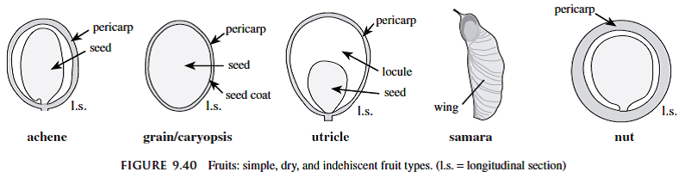
Indehiscent Simple Dry Fruits;
PLANT TAXONOMY

Slide 13
Dehiscent Simple Dry Fruits;
II. Dehiscent (splitting open along definite pores, slits, or sutures);
Dehiscent, i.e., will open with force (by various mechanisms), functioning to eject the seeds.
A. Capsules are generally dry (rarely fleshy), dehiscent fruits derived from compound (multicarpeled) ovaries. Four types of capsules can be recognized based on the type or location of dehiscence.
i. Loculicidal capsules have longitudinal lines of dehiscence radially aligned with the locules (or between the placentae, if septa are absent), as in Hibiscus esculentus.
ii. Septicidal capsules have longitudinal lines of dehiscence radially aligned with the ovary septa (or with the placentae, if septa are absent). Both loculicidal and septicidal capsules split into valves, a portion of the pericarp wall that splits off, but does not enclose the seed(s); valves may remain attached to the fruit or may fall off, depending on the taxon, as in Linum.
iii. Circumscissile capsules (also called a pyxis or pyxide) has a transverse (as opposed to longitudinal) line of dehiscence, typically forming a terminal lid or operculum, as in Plantago and Hyoscyamus.
iv. Poricidal capsules have dehiscence occurring by means of pores, as in Papaver, (POPPOY-E).

Slide 14
Dehiscent Simple Dry Fruits;
B. Follicle is a dry, dehiscent fruit derived from one carpel that splits along one suture, such as in the unit fruits of Delphinium.
C. Pod or Legume is a dry, dehiscent fruit derived from one carpel that splits along two longitudinal sutures; legumes are the diagnostic fruit type of the Fabaceae, the legume family, e.g.Vicia faba.
D. Silicles and siliques are dry, dehiscent fruits derived from a two-carpeled ovary that dehisces along two sutures:
i. Siliqua is about as broad or broader than long, e.g. Sinapis arvensis.
ii. Siliqula is longer than broad; both are characteristic fruit types of the Brassicaceae, e.g. Capsella bursa pastoris.

Slide 15
Dehiscent Simple Dry Fruits;
E. Schizocarp is a dry, dehiscent fruit type derived from a two or more loculed compound ovary in which the locules separate at maturity.
i. Schizocarp of mericarps (cremocarp), is one in which the carpels of a single ovary split during fruit maturation, each carpel developing into a unit mericarp, as in the Apiaceae. Mericarps are portions of the fruit that separate from the ovary as a distinct unit completely enclosing the seed(s); in the Apiaceae the two mericarps are typically attached to one another via a stalk-like structure called the carpophore.
ii. Regma, the fruit develops from tricarpellary (multicarpellary), syncarpous. The fruit is multilocular, on maturation, after splitting, these divided into as many parts as the number of carpels, and has one seed, as in Ricinus, Erodium and Geranium.
ii. Carcerulus, the fruit develops from bi or polycarpellary, syncarpous, and is multilocular, number of locules may increase due to false septation, on maturation, single seeded mericarp splits away, as in Althea, Ocimum and Malva.

Slide 16
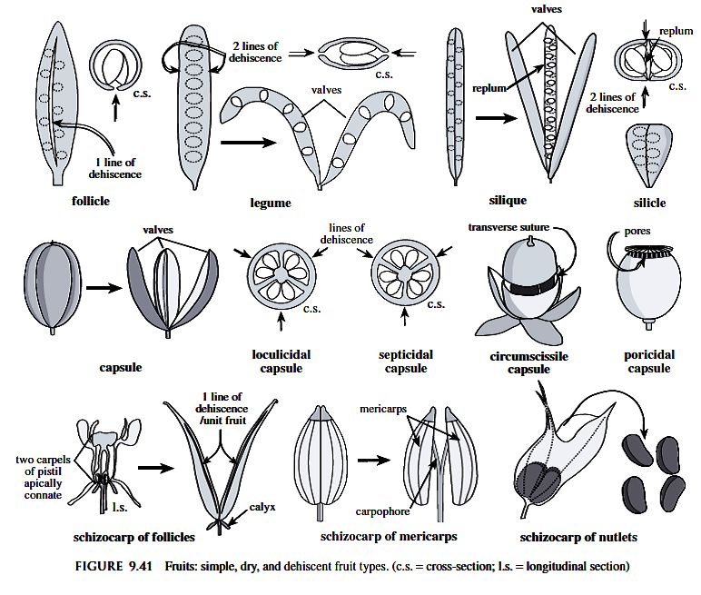
Dehiscent Simple Dry Fruits;

Slide 17
Fruits;
2. EAggregate fruit types :
An aggregate fruit is one derived from two or more pistils (ovaries) of one flower, as in Ranunculaceae and Rosaceae (e.g. Rosa, Fragaria, and Rubus).
3. Multiple fruit types:
A multiple fruit is one derived from two or more flowers that coalesce.
Some specialized multiple fruit types are as follows:
i. Sorosis is a multiple fruit in which the unit fruits are fleshy berries and are laterally fused along a central axis, as in Ananas, (pineapple) and Morus.
ii. Syconium is a multiple fruit in which the unit fruits are small achenes covering the surface of a fleshy, inverted compound receptacle (derived from a hypanthodium), as in Ficus,

Slide 18
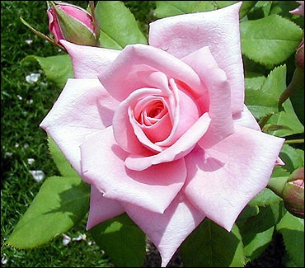
Thank You

Slide 19
Quiz - 6
Count only :
1. Aestivation types
2. Five types of Specialized inflorescences

