Slide 1
SURVEYİNG ENGİNEERİNG Lab. Pacing and Rectangular 2nd lecture By: Ali A. Mahmod
Salahaddin university
Engineering college
Civil department
2nd class
2020_2021

Slide 2
Contents
2nd lecture
Class rules
Surveying
Pacing
Rectangular
Homework
2

Slide 3
Class rules
2nd lecture
While in lecture, please :
Turn off cell phones.
Do not talk and have conversations.
Do not eat (water allowable).
Ask questions when anything is not clear.
Engage in the discussions.
Fully participate in in-class exercises
3

Slide 4
Surveying
2nd lecture
Surveying is the process of determining the relative position of natural and manmade features on or under the earth’s surface.
A more modern definition is “the collection, processing, and management of spatial information”.
4

Slide 5
Pacing
2nd lecture
WHAT does pacing mean?
HOW can we determine it?
WHY is it important?
5

Slide 6
Pacing
2nd lecture
Is the simplest method of measuring distance in the field. By determining one's own pace, distance can easily be estimated. A pace is generally equal to one natural step.
6

Slide 7
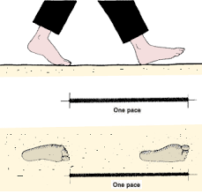
Test 1: Pacing
2nd lecture
Purpose of the test: Determining one's own pace.
Figure 1
7

Slide 8
Test 1: Pacing
2nd lecture
Apparatus:
Tape.
Two pegs.
Procedure:
Locate pegs in points A and B.
Measure the distance between the points (x m).
Count your steps as you walk across that distance.
Repeat step (3) n times.
8

Slide 9
Test 1: Pacing
2nd lecture
Calculation:
Avg. paces = No. of paces / n
Length of pace (cm) = (x / Avg.) * 100
9

Slide 10
Rectangular
2nd lecture
Setting out of a Rectangular: It is the process of developing the physical positions of corners of a rectangular, and it's done by transferring dimensions from the layout plan to the ground.
10

Slide 11
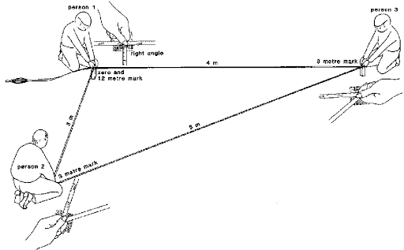
Test 2: Rectangular
2nd lecture
Purpose of the test: Learning how to set out right angles or perpendicular lines on the field.
Figure 2
11

Slide 12
Test 2: Rectangular
2nd lecture
Apparatus:
Tape.
Four pegs.
Procedure: Using Pythagoras theory (3-4-5 method)
A. Divide the rectangular to 2 triangles; to set out the triangle, three persons are required.
The first person holds together, between thumb and finger, the zero mark and the 12m mark of the tape.
The second person holds between thumb and finger the 3m mark of the tape.
The third person holds the 8m mark. When all sides of the tape are stretched, a triangle with lengths of 3 m, 4 m and 5 m is formed, and the angle near person 1 is a right angle.
B. Repeat steps 1, 2 and 3 to set out the second part of the rectangular
12

Slide 13
Homework
2nd lecture
Report about pacing test, including answers of:
How many paces in 216 m distance, if you know that 18 m distance was crossed by 25 paces.
If the dimensions of the rectangular are 20*15m, the diagonal distance will be -----.
13

