Slide 1
SURVEYİNG ENGİNEERİNG Lab. Fly (differential) leveling 5th lecture By: Ali A. Mahmod
Salahaddin university
Engineering college
Civil department
2nd class
2020_2021

Slide 2
Contents
5th lecture
Introduction
Objective
Apparatus
procedure
Calculation
Homework
2

Slide 3
introduction
5th lecture
Leveling: Is the art of determining and representing the relative height or elevation of different objects/ points on the surface of earth.
Fly Leveling: Is the method of direct leveling to determine difference in elevations of two points, when it may be necessary to setup the instrument several times.
3

Slide 4
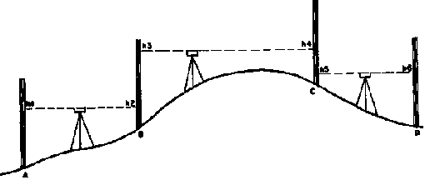
introduction
5th lecture
Figure 1
4

Slide 5
5th lecture
introduction
Bench mark (B.M.): Is a definite point of which the elevation & location of it are known.
The datum: Most commonly used is mean sea level.
The height of instrument (H.I.): Is the elevation of the line of sight of the telescope above the datum when the instrument is leveled.
Reduced Level (RL): A distance recorded as a height above or below the datum. This height is in meters.
5

Slide 6
5th lecture
introduction
Back sight (B.S.): Is a staff reading taken on a point of known elevation, as a bench mark.
Foresight (F.S.): Is a staff reading taken on a point the elevation of which is to be determined.
Intermediate Site (I.S.): These are the sights taken at nominated position, known as stations. The sights are then converted to reduced levels.
Turning point (T.P.): Is a point which foresight and back sight staff readings are taken on it.
6

Slide 7
Objective
5th lecture
Fly leveling is used when it may be necessary to setup the instrument several times.
This method of leveling is used when; distance so far, large difference in elevations or there is an obstacle between points.
7

Slide 8
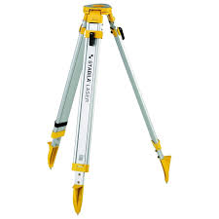
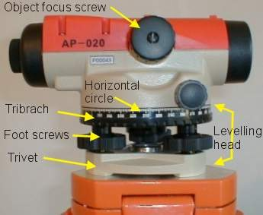
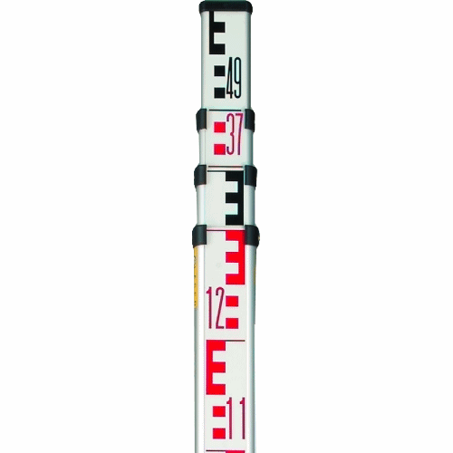
Apparatus
5th lecture
Fig. 2:Level instrument.
Fig. 3: Tripod
8
Fig. 4: Staff

Slide 9
Procedure
5th lecture
When 2 setup needed,
Setup instrument at convenient position that you can take (B.S) reading on B.M.
F.S reading is taken on stable location that will be T.P.
Instrument is shifted and setup at other place (between T.P and last point)
Take B.S. reading on T.P, and F.S on the required point.
*T.P. has 2 readings (F.S and B.S).
9

Slide 10
Calculation
5th lecture
HI= B.M + BS,
RL= HI – FS
St. | Reading |  |  | HI | Reduced Level
 | Back sight BS | Intermediate sight IS | Fore sight FS
10

Slide 11
Calculation
5th lecture
Arithmetic Check:
Σ B.S - ΣF.S = Last RL - First R.L
Errors and corrections:
Error = determined elevation – actual elevation
Correction (C) = - Error/n,
n: number of setup
* Correction value is distributed cumulatively.
R.L | Correction C | Corrected R.L
11

Slide 12
Homework
5th lecture
Report about fly leveling test, discussion includes answers of following questions:
Keep foresight and back sight distances as equal as possible. Why?
Always start and finish a levelling run on Benchmark (BM) or close loops levelling. Why?
12

