Slide 1
SURVEYİNG ENGİNEERİNG Lab. Profile leveling 6th lecture By: Ali A. Mahmod
Salahaddin university
Engineering college
Civil department
2nd class
2020_2021

Slide 2
Contents
6th lecture
Introduction
Objective
Apparatus
procedure
Calculation
Homework
2

Slide 3
introduction
6th lecture
The process of determining the elevations of points at short measured intervals along a fixed line is called profile leveling.
Pegs are placed at regular intervals along a fixed line, usually the center line, during the location and construction of highways, railroads, canals, and sewers.
Interval distances (stations):
Full stations, most commonly: 100 (1+00), 200 (2+00), 300 (3+00) ….. etc.
Plus stations, for example: 150 (1+50), 225 (2+25), 380 (3+80) …..etc.
3

Slide 4
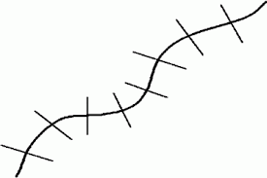
introduction
6th lecture
Cross sections: Is deﬁned in terms of vertical heights (levels) at horizontal distances each side of the center line.
4

Slide 5
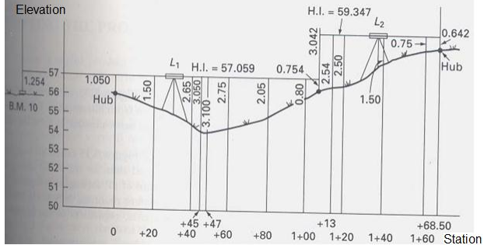
Objective
6th lecture
Purpose of the test: plotted profile and cross sections on paper for specified horizontal and vertical scales
5

Slide 6
Apparatus
6th lecture
Level instrument.
Tripod.
Staff.
Pegs.
Tape.
6

Slide 7
Procedure
6th lecture
Divide center line to stations and place pegs on them.
Pegs are placed on cross section points (in both sides of stations and in right angles).
Instrument level is setup at convenient positions.
Readings (BS, IS, FS) are took on stations and cross sections (last reading on turning point).
Instrument is shifted to take other readings.
7

Slide 8
Calculation
6th lecture
HI= B.M + BS, RL= HI – FS
Arithmetic Check:
Σ B.S - ΣF.S = Last RL - First R.L
Errors and corrections:
Error=determined elevation – actual elevation
Correction (C) = - Error/n,
n: number of setup
* Correction value is distributed cumulatively.
8

Slide 9
Calculation
6th lecture
Plotting results:
Choose suitable scale to plot profile and cross sections:
Horizontal scale: horizontal distances.
Vertical scale: elevations of points.
St. | BS | IS | FS | Rise | Fall | R.L | Correction C | Corrected R.L
B.M
1+00
L
R
1+20
L
R
1+30
L
R
9

Slide 10
Homework
6th lecture
Report about profile leveling test.
For profile graph use scales:
1:500 horizontally.
1:10 vertically.
For cross section graphs use scales:
1:100 horizontally.
1:10 vertically.
10

