Slide 1
SURVEYİNG ENGİNEERİNG Lab. Contour lines 7th lecture By: Ali A. Mahmod
Salahaddin university
Engineering college
Civil department
2nd class
2020_2021

Slide 2
introduction
7th lecture
contour line is an imaginary line which connects points of equal elevation. Such lines are drawn on the plan of an area after establishing reduced levels of several points in the area. The contour lines in an area are drawn keeping difference in elevation of between two consecutive lines constant. For example, Fig.1 shows contours in an area with contour interval of 1 m. On contour lines the level of lines is also written.
2

Slide 3
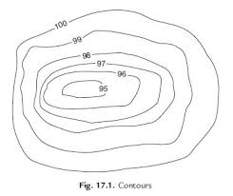
introduction
7th lecture
Figure 1
3

Slide 4
introduction
7th lecture
Contour line characteristic:
A contour cannot have an end within the map. It must either close on itself, or commence and end at the edges of the map.
A series of closed contours represents either a hill or a depression.
It is incorrect, as two contours are meeting and continuing as a single line.
4

Slide 5
introduction
7th lecture
It is incorrect, or at least unusual when several contours are merging and continuing as a single line. This would be correct only in the case of:
1. Vertical slope
2. Retaining wall.
3. Cave
A series of equally spaced contour lines represents a constant slope along a line normal to the contours.
5

Slide 6
introduction
7th lecture
General definition:
Vertical interval: The height between successive contour lines.
Index contour: Each fifth contour is drawn as a heavier line.
Horizontal equivalent: The horizontal distance between two successive contour lines.
Gradient of the ground: The ratio between the vertical interval and the horizontal equivalent the same two contour lines.
Gradient$=\frac{Verical interval}{horizontal equivalent }$
6

Slide 7
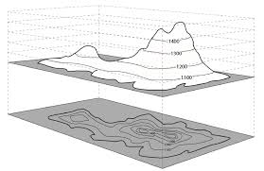
Objective
7th lecture
Purpose of the test: Drawing contour lines to produce a topographic map.
Figure 2
7

Slide 8
Procedure
7th lecture
The methods of contouring:
Direct method by hand drawing.
Indirect methods using software programs.
• Drawing contour lines to produce a topographic map requires the ability to interpolate between points.
• Interpolation is required because contour lines are lines of constant elevation and the station elevations that are measured in the field seldom fall on the desired contour elevation.
• Interpolating is finding the proportional distance from the grid points to the contour line elevation.
• Logic or intuitive reasoning would conclude that when the grid points are at 102 m elevation and 98 m elevation, then a contour line of 100 m elevation would be half way in between.
• Proportional distance is calculated using an equation
Proportion $=\frac{high eelevation−contour elevation}{high elevation−low elevation}$
8

Slide 9
Homework
7th lecture
Report about contour lines.
9

