Slide 1
Iraqi Kurdistan region University of sallahaddin-Erbil College of science Department of Geology
Sediments and Sedimentary Rocks
Prepared by :- Dr. Ali Mahmood Sordashy
Prof. in Sedimentology
3rd year Geo.
Lec No. 5
Processes of Transportation & Sedimentation
Date:- /10 / 2013

Slide 2
Process of transportation and sedimentation
Almost all sedimentary deposits are created by the transport of material. Movement of detritus maybe due to gravity. But more commonly it’s the result of flow of (water, air, ice or dense mixtures of sediment and water). The interaction of sedimentary material with the transporting medium results in the development of sedimentary structures. These sedimentary structures are preserved in the rocks and provide a record of the processes occurring at the time of deposition
Transportation medium
Aqueous medium (water) : transportation happen by traction current, turbidity current , suspention current
Eolian medium (air): traction and suspention current
Glacial medium (Transported by traction suspended loading
Gravitational medium (transported by rolling and traction)

Slide 3
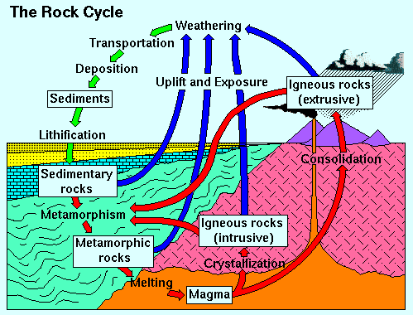
Sediment transport and deposition
Fig,1.

Slide 4
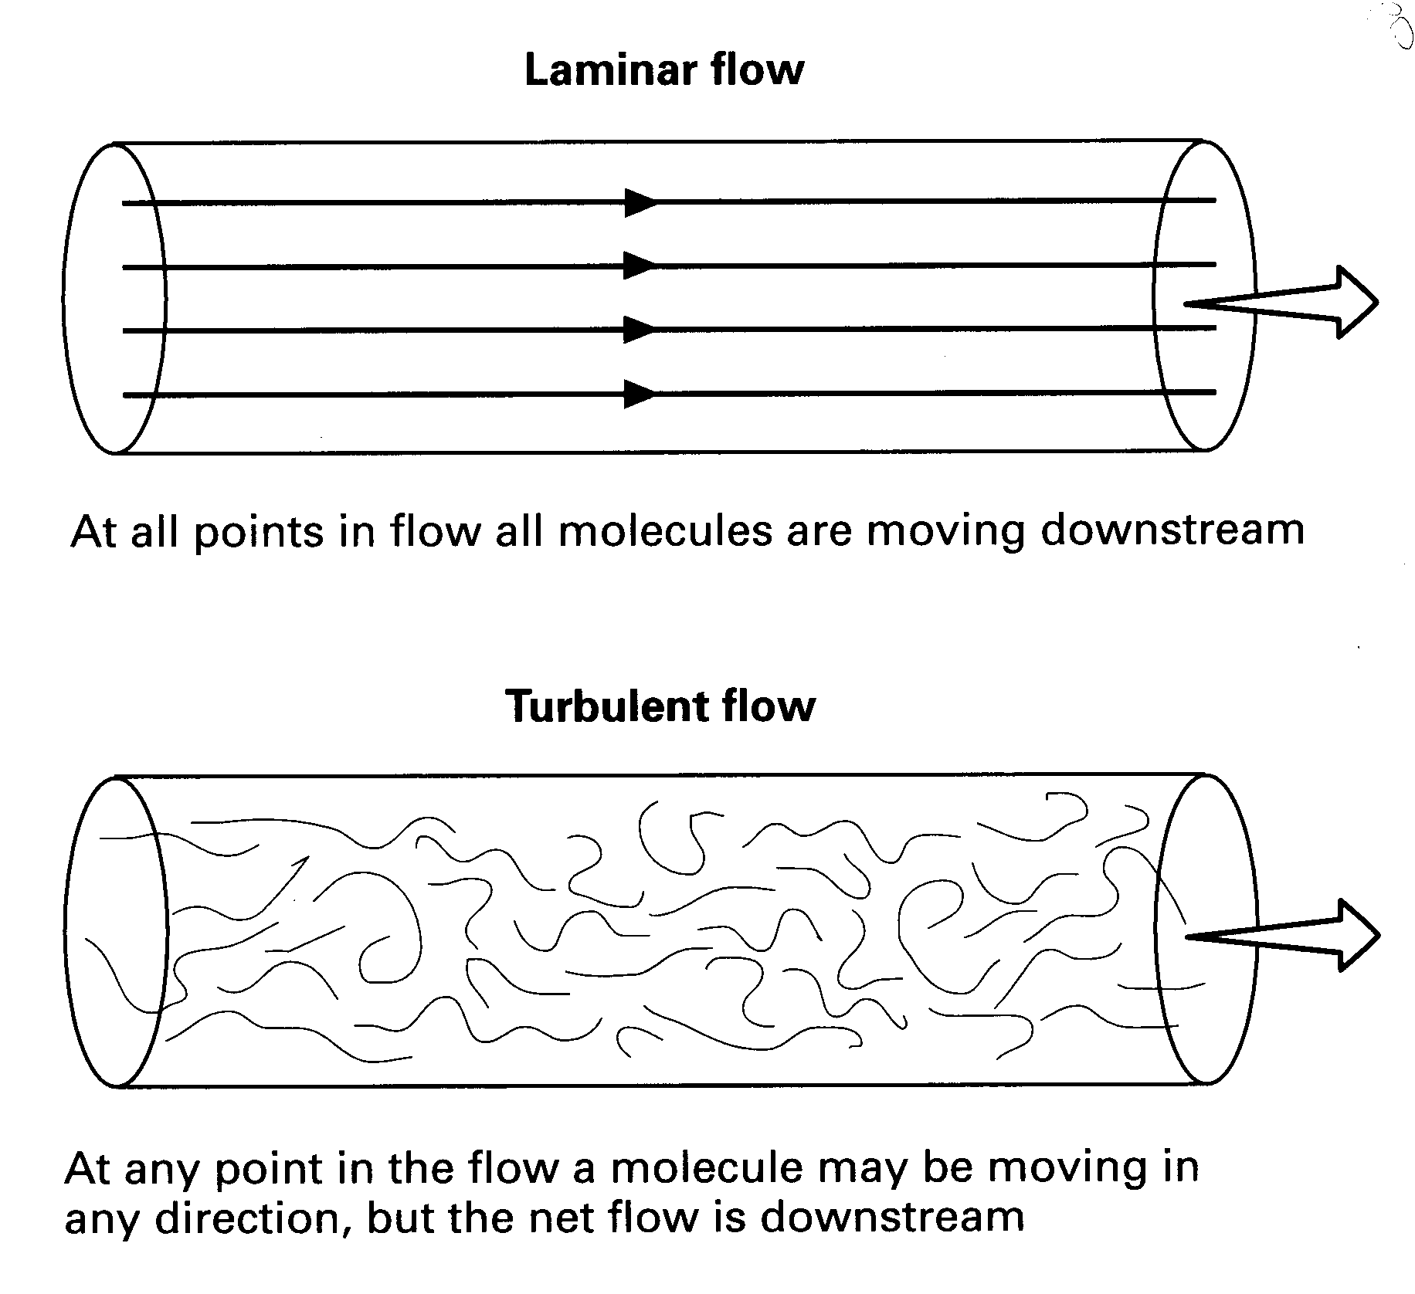
Sedimentary processes
In fluids, there are two types of flow: laminar & turbulent
Laminar flow- no mass transfer between layers
Turbulent flow- transfer of mass & momentum. Turbulence entrains particles & keeps some of them in suspension.
Fig,2.

Slide 5
1- Reynolds number
The Reynolds Number (Re) demonstrates whether flow is laminar or turbulence.
Reynolds number
u=flow velocity;
l=characteristic length (flow depth);
υ=kinematic viscosity (dynamic viscosity/fluid density)
Turbulence is promoted by high flow velocities and flow depths, and low viscosities (Re>2000);
laminar flow occurs when the reverse is the case (Re<500)
Air and water are nearly always turbulent;
ice or mud-supported debris is laminar.
ul
V
Re=

Slide 6
2- Froude number
The Froude Number (Fr) is used to compare the wave making resistance between bodies of various sizes and shape. In free-surface flow, the nature of the flow (supercritical or subcritical) depends upon the Froude number is greater than or less than unity.
Froude number (subcritical vs. supercritical flow)
u=flow velocity;
d=flow depth;
√gd=celerity (wave velocity)
Flow velocities exceeding wave propagation velocities (Fr>1) yield supercritical flow,
lower velocities (Fr<1) cause subcritical flow
A spatial transition from subcritical to supercritical flow (or vice versa) is characterized by a ‘hydraulic jump’
u
gd
Fr=

Slide 7
3- Stokes’ Law
Stokes’ Law expresses the setling velocities of small spherical particles in a fluid medium.
Stokes’ Law (settling velocity in a static fluid)
v_{g}=settling velocity;
D=grain diameter;
ρ_{g}=grain density;
ρ_{f}=fluid density;
μ=dynamic viscosity
Stokes’ Law only applies to fine (<100 μm), quartz-density grains in water
gD2 (ρ_{g-}ρ_{f )}
₁₈ μ
v_{g}=

Slide 8
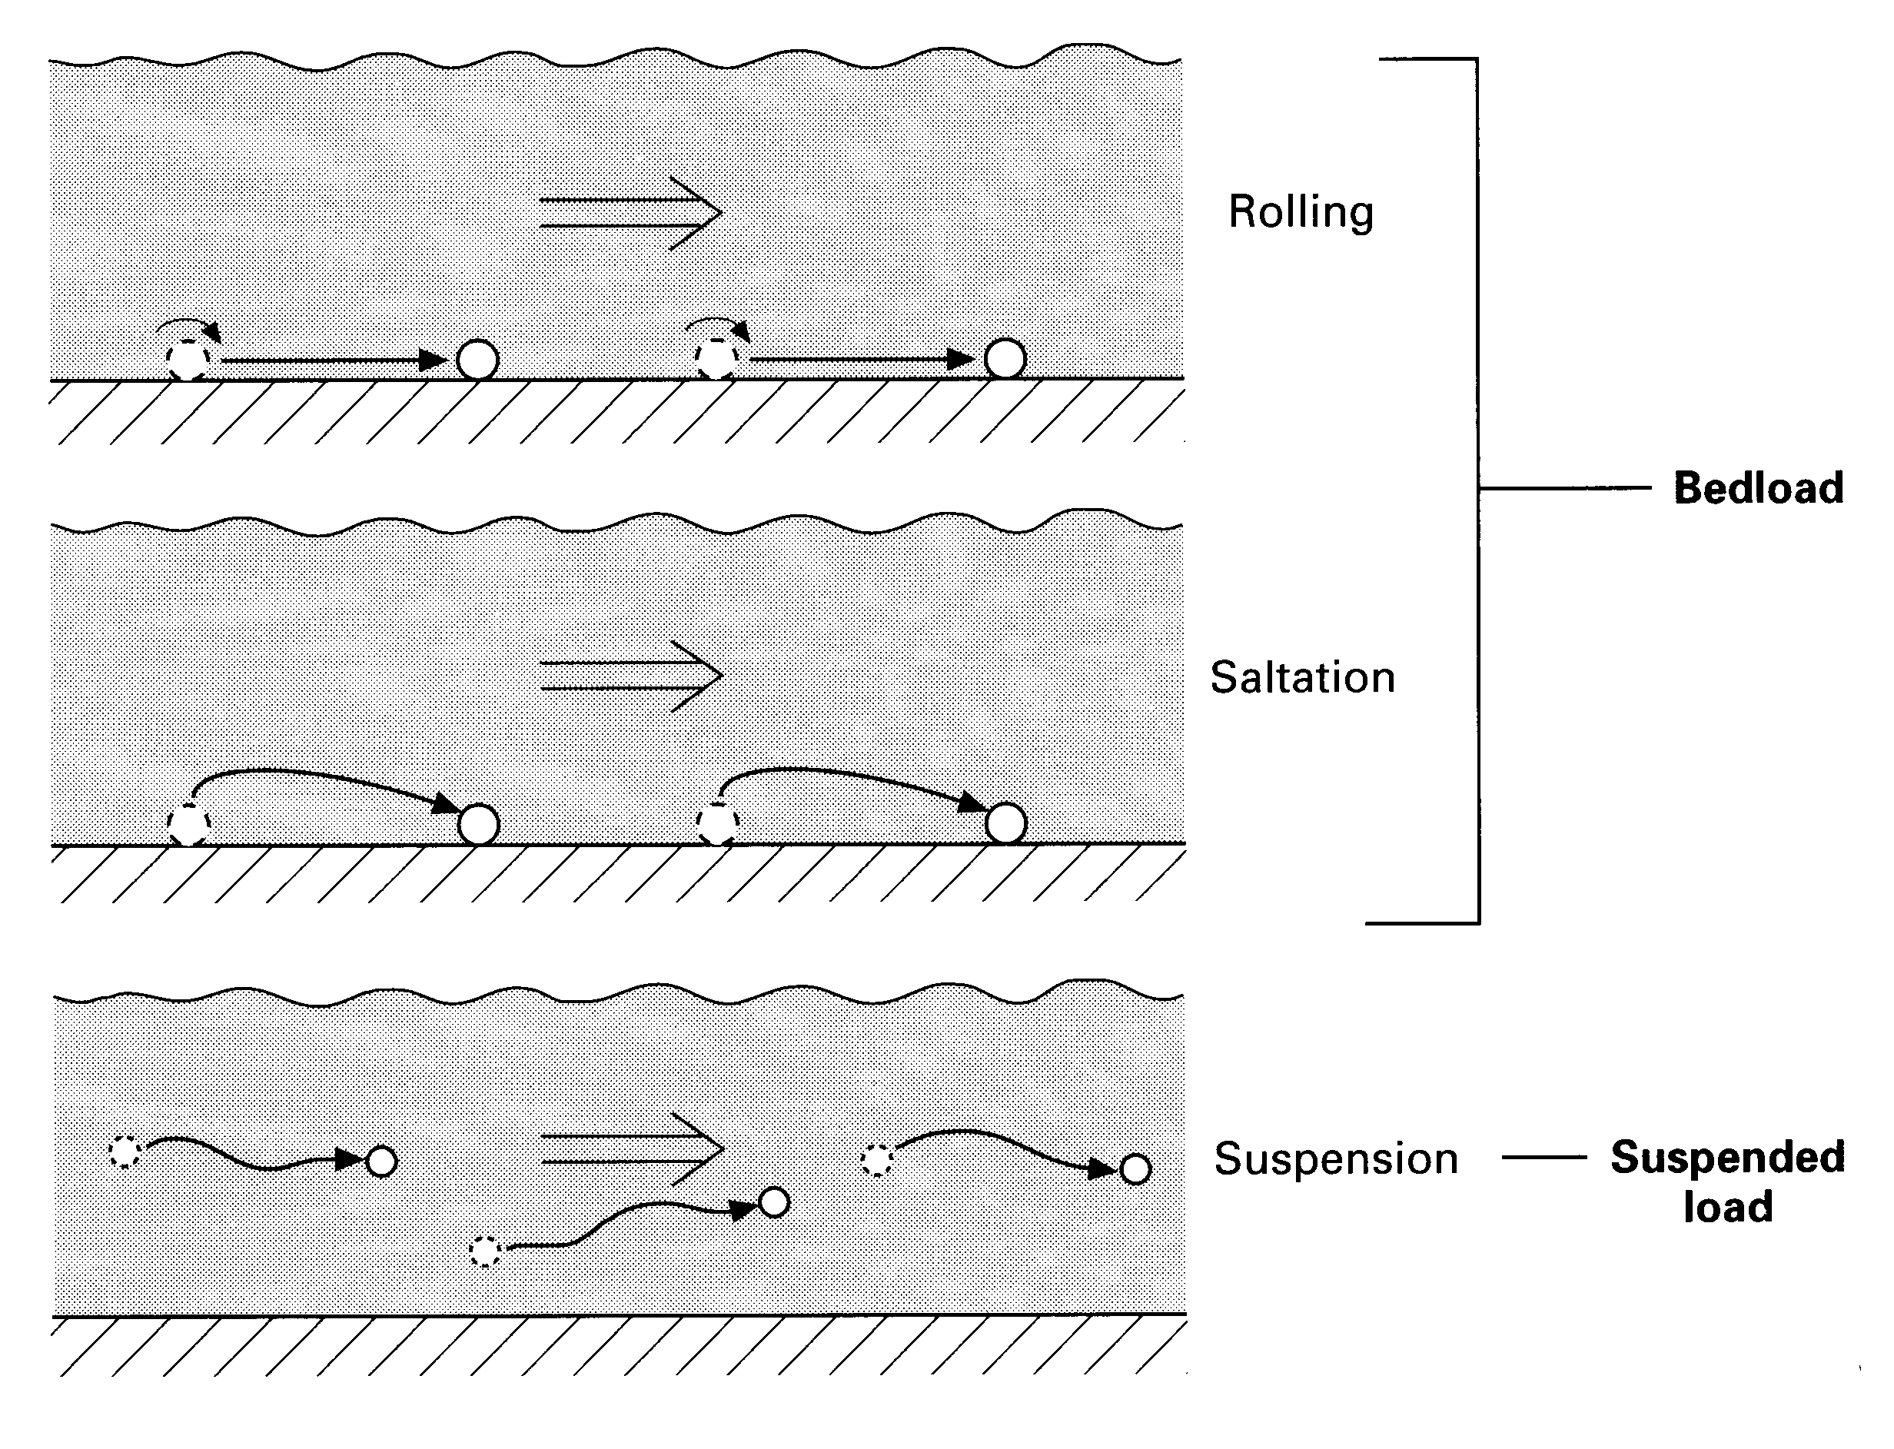
Mechanism of Particle transport by fluid
Trancation (rolling over the bed surface)
Saltation (jumping over the bed surface)
Suspension (permanent transport within the fluid)
Solution (chemical transport)
Fig,3.

Slide 9
critical velocity
Critical velocities are different for sediment entrainment and deposition, especially in the finer fractions
Fluid density and viscosity play a key role in determining which particle sizes can be transported
The amount of sediment transport is not only related to flow velocity (or bed shear stress) and grain size, but also to:
Grain density
Grain shape
Viscosity of particles
The critical fluid flow increase with grain size, an exception to this rule is noted to cohesive clay bottoms. Because of their resistance to friction, they need rather higher velocity to erode them and to Start movement than of silt and very fine sand. This anomaly termed (Hjulstrom effect) is responsible to presentation of delicate (thin) clay laminae in tidal deposit (tidal flat).

Slide 10
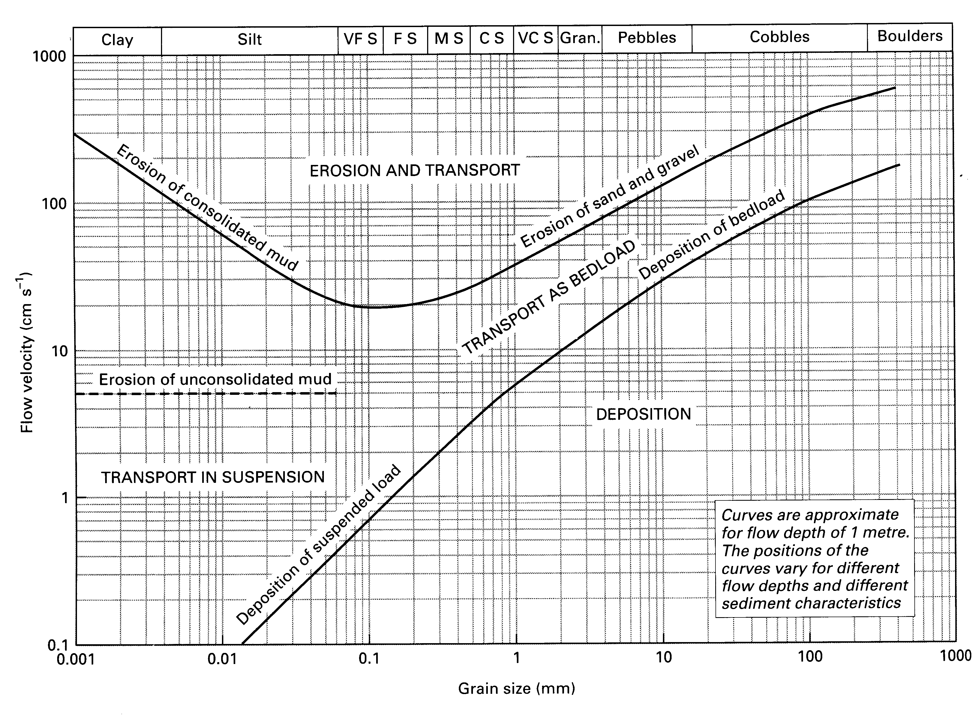
critical velocity

Slide 11
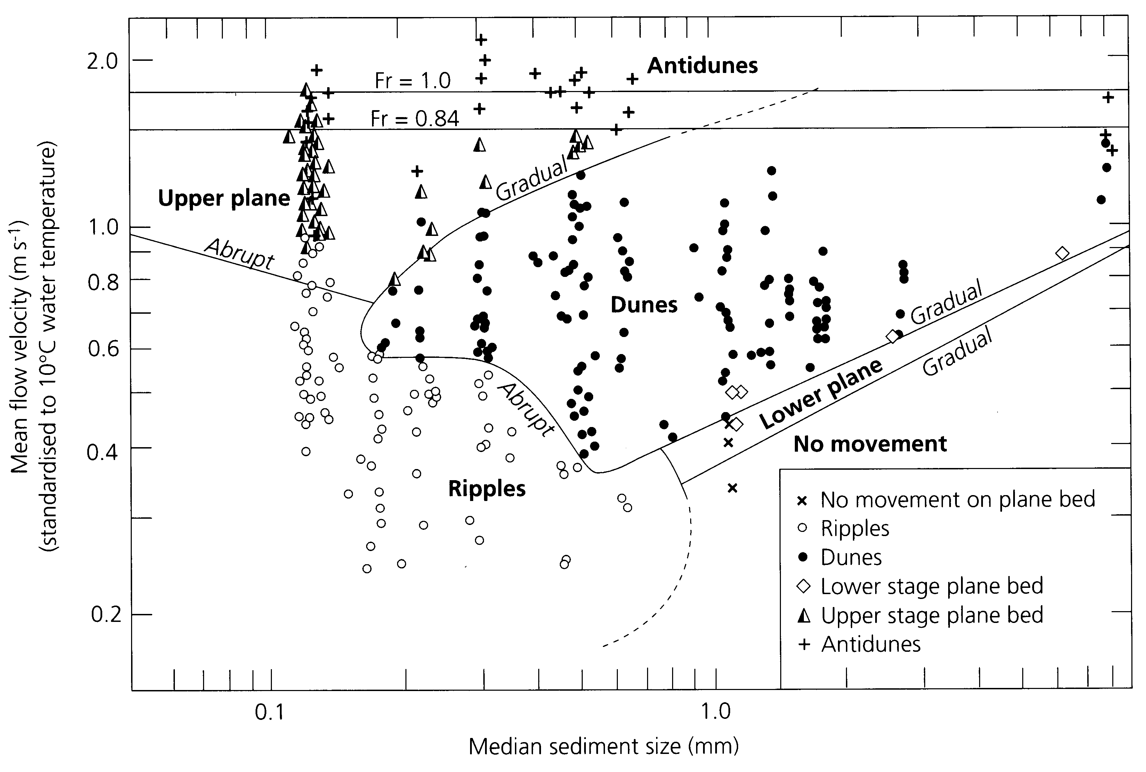
Bed form
Move
antidunes
Move
Upper plane
Move
ripple

Slide 12
Fig,4.

Slide 13
Fig,5

Slide 14
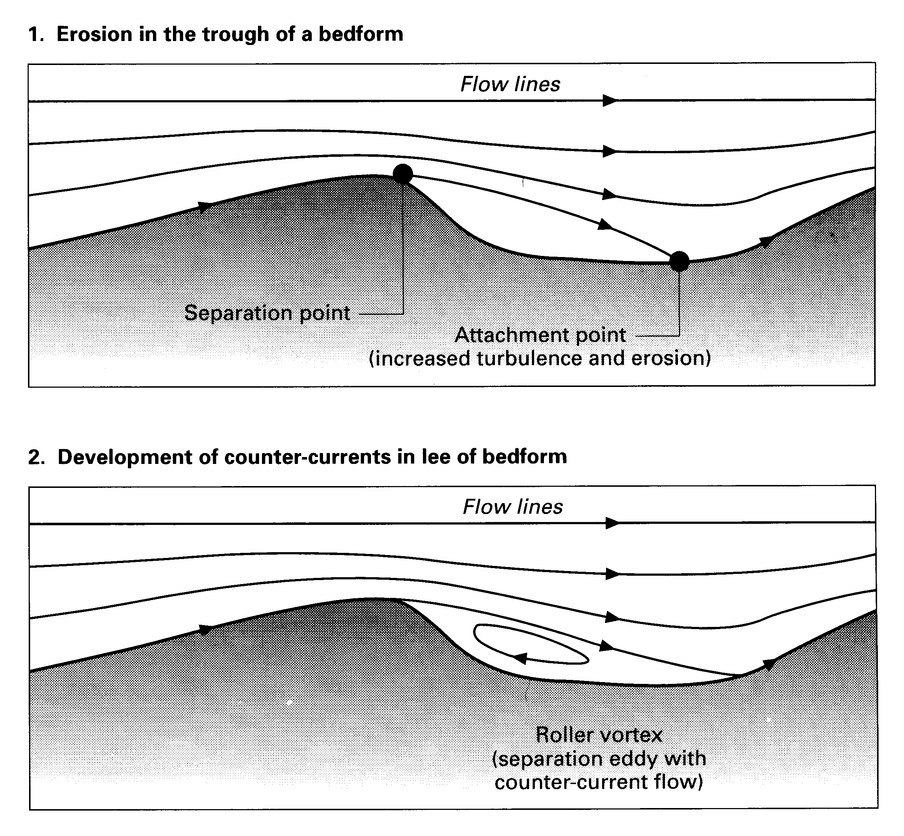
A) Current ripples
Once movement of sand grains (<0.7 mm) occurs, current ripples are formed as a result of boundary layer separation, commonly known by a separation vortex
Current ripples have
a trough side (erosion and transport), Fig,6a
lee side (deposition), the latter with a slope of ~30° (angle of repose), Fig,6b.
Current ripples only form under moderate flow velocities, with a
grain size <0.7 mm
Height: 0.5–3 cm;
wavelength: 5–40 cm
Fig,6a)
Fig,6b)

Slide 15
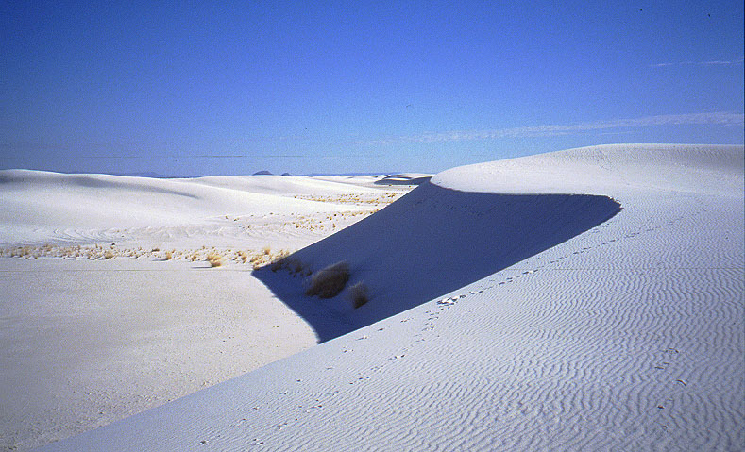
B) Dunes
Dunes are distinctly larger than current ripples
There is a relationship between
boundary-layer thickness (flow depth in rivers) and the dimension of dunes
Dunes only form in grain sizes >0.2 mm
Low flow velocities (bed shear stresses) yield straight-crested bedforms (valid for both dunes and current ripples);
higher shear stresses result in sinuous to linguoid crest lines
Sand waves constitute the largest category of subaqueous dunes ,Fig,7a.
Fig,7a)

Slide 16
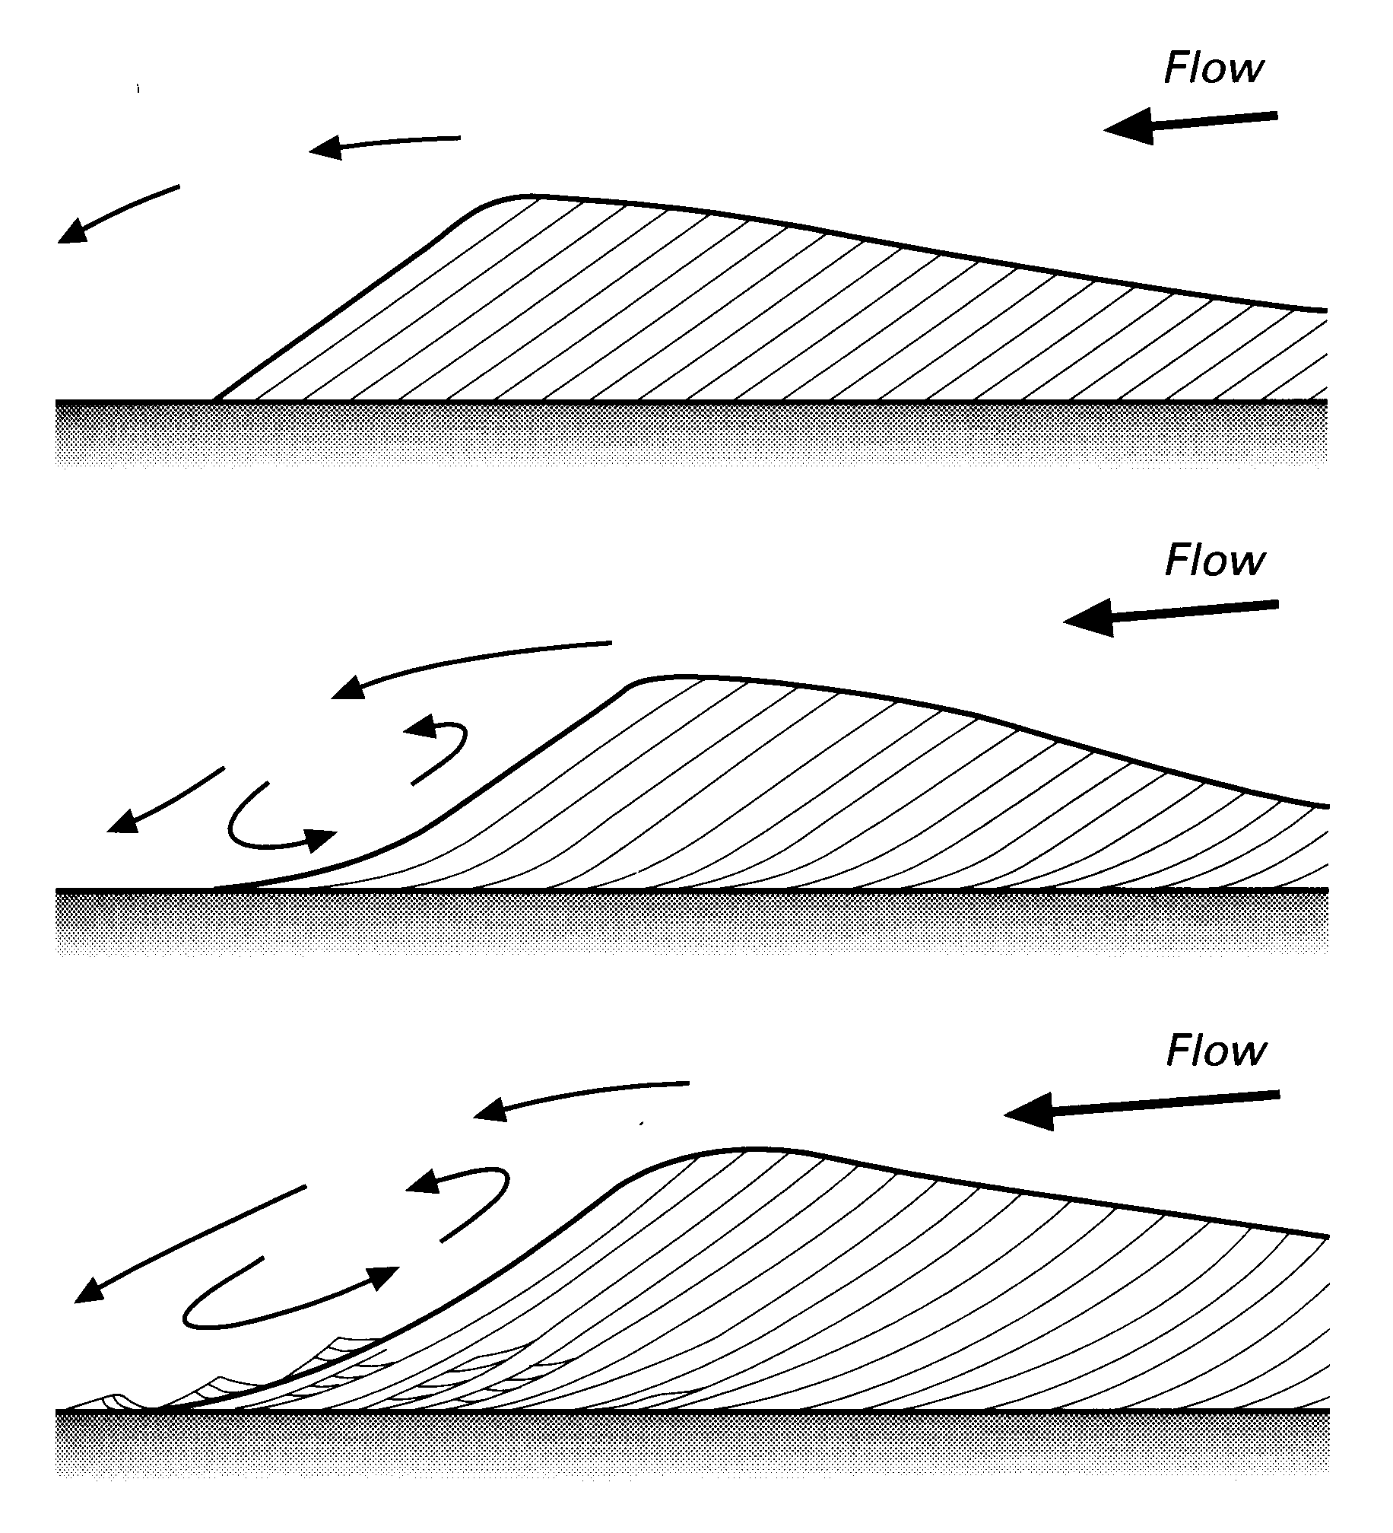
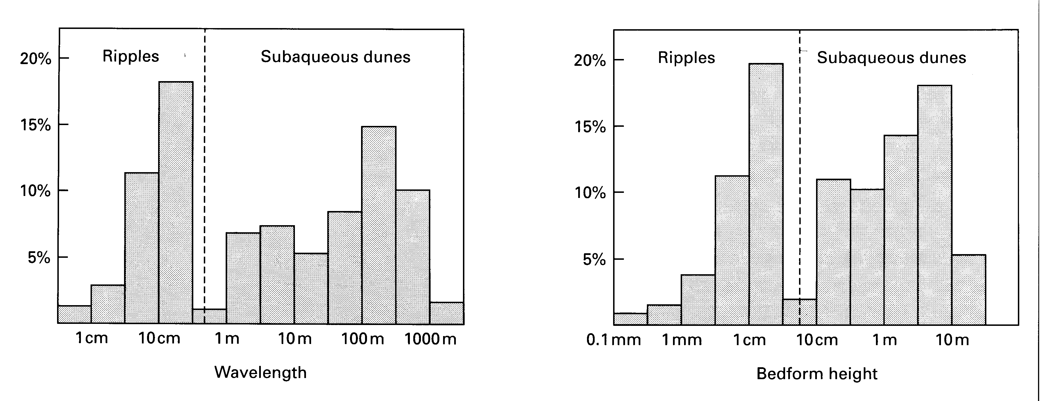
Dunes are distinctly larger than current ripples
Fig,7b)
Fig,7c)

Slide 17
D) Waves
Fig,9a)
Fig,9b)

Slide 18
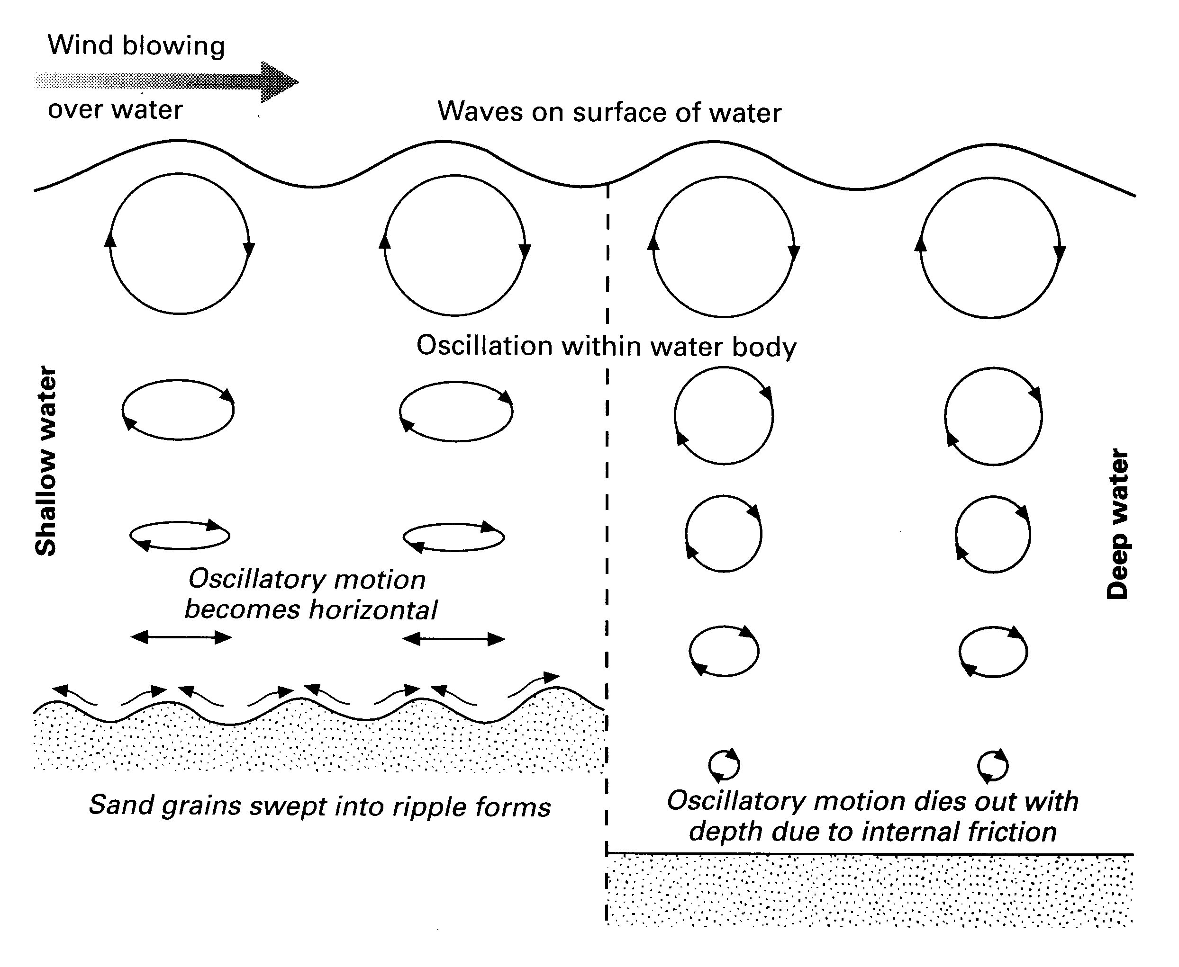
D) Waves
Fig,9c) difference of waves formed in shallow and deep water

