Slide 1
History of Diplomatic & Consular Relations
Module Instructor | Alla Rafiq
MA | Diplomacy
Dept| IRs and Diplomacy
2nd Year | 1st Semester
2020 - 2021

Slide 2
Lecture | 9
History of
Modern Diplomacy

Slide 3
Agenda of the lecture
Topic of the lecture : History of Modern Diplomacy

Slide 4
Key Words
Bilateral Relations | Secret & Open Diplomacy | Latin Language | Balance of Power | Nation State | INGOs | Vienna Congress | Westphalia Treaty | Summit Diplomacy |Precedence Rules and Diplomatic Ranks |

Slide 5
Main features of classical Diplomacy
A continuation Process between Main Modern state such as England, Italy, Spain, France, Austria.
Europe centric.
Organizing bilateral relations.
Undertaking in secrecy characterized by distinctive rules and procedure.
development of diplomatic protocol, immunities & privileges.

Slide 6
From Renaissance to Golden age
1500 - 1700
The thirty Years of War 1618 -1648
Main reason behind the lunch of 30 years war?
A fight for dominance among the new powers of France, England and the Hapsburg Empire (Austria and Spain).
The inability of the Catholic Church to carry out its own reform, created fertile ground for the protestant reformation. The first dent was made in papal power in 1534, when the English King Henry VIII established a separate Anglican Church, after the Catholic Church opposed his divorce from Catherine of Aragon.
Protestant and Catholic Conflict & disputes over power and diplomatic affairs.

Slide 7
Pre – Westphalia period
The Westphalia peace negotiations began after all sides in the war were exhausted by 30 years of fighting and destruction.
Ultimately, they reached a compromise which did not satisfy anyone (basis for a good compromise).
The peace deal was the result of very long negotiations, that lasted 5 years. The first 6 months were dedicated to agreeing on the question of precedence, which was highly controversial, due to the participation of 200 rulers, and more than 1000 diplomats.

Slide 8
Classical & Modern Diplomacy the Peace of Westphalia 1648
Resulted in; the End of 30 years of war between Protestant and Catholic states.
establishment of an international order based on sovereignty of states
Means; Nation states seen as independent political units.
Signed in Osnabruck & Munster in Westphalia Province.
Balance of Power.
Creation of Permanent Diplomatic Representation was the right of each sovereign state.

Slide 9
role of Diplomats during the Negotiation meetings
What was the role of Diplomats in the negotiation meetings of Westphalia treaty?
However, the Princes attended, but diplomats did most of the work in secret meetings, especially because by this time there was a corps of experienced diplomats who were mutually well acquainted. However, the task of the diplomats was complicated, because the problem of precedence was otherwise insoluble.

Slide 10
Westphalia Treaty & Issue of Precedence
Did the Treaty of Westphalia solve precedence disputes?
The Treaty of Westphalia did NOT solve precedence disputes, which reflected rivalry between states. The war between France and Spain, which continued from 1648 to 1659, was partly about this issue. Shortly thereafter, in 1661, there was a diplomatic dispute in London concerning whether the French ambassador’s carriage would precede that of his Spanish rival. War was narrowly averted, but questions of precedence continued to bedevil European diplomacy.

Slide 11
History of Modern diplomacy
The Golden Age
1815 - 1914
When started and why known as golden age?
It started in early 19th century. The period between the Congress of Vienna and World War I was often described as a golden age of diplomacy, which managed to secure one of the most peaceful periods in recent history.
Diplomatic Advancement.
Evaluation of technology and the Invention of telegraph

Slide 12
Modern diplomacy
19th Century | The Golden Age
1815 -1914
Technology Development | Invention of Telegraph
The key technological invention was the telegraph, which, for the first time in human history, effectively detached communication from transportation. Until the invention of the telegraph, the speed and reliability of communication depended on different means of transportation available at the time, for example, foot messenger, horseman, or ship, to name but a few.

Slide 13
Use and Role of technology in the diplomatic services
The telegraph was initially used in diplomacy for internal communication between diplomatic missions and headquarters. This also included communication on personal, ceremonial, and organizational matters.
It was only during the 1850s that the telegraph started to be used more
intensively in diplomatic services. During the Congress of Paris (1856), the British representative received instructions from Prime Minister Palmerstone through coded telegrams.

Slide 14
Modern diplomacy
19th Century | The Golden Age
1815 -1914
2. On the diplomatic side, the 1814-15 Congress of Vienna laid the foundation for modern diplomacy – including the introduction of diplomatic precedent and diplomatic ranks.

Slide 15
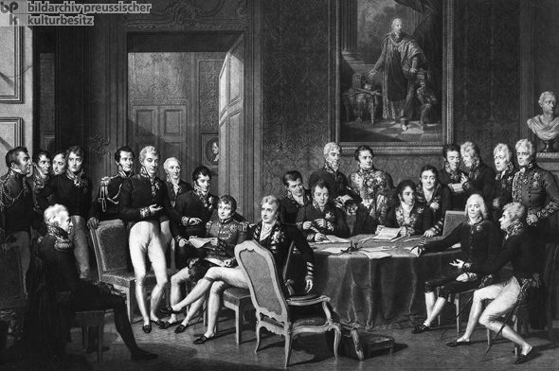
The Vienna Congress 1814-1815

Slide 16
Classical & Modern Diplomacy the congress of Vienna 1815
After the fall of Napoleon, the Congress of Vienna of 1815 established an international system of diplomatic ranks and Precedence issue.

Slide 17
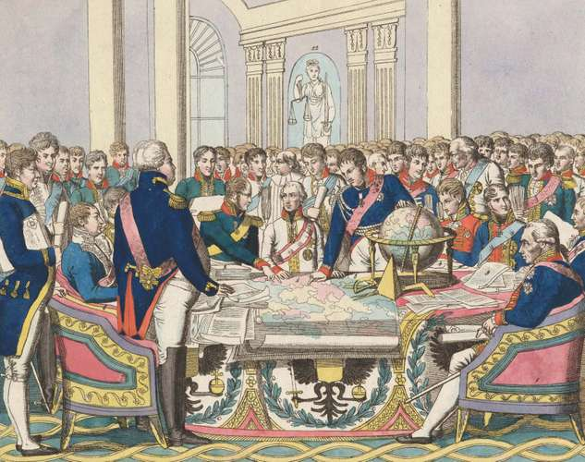

Slide 18
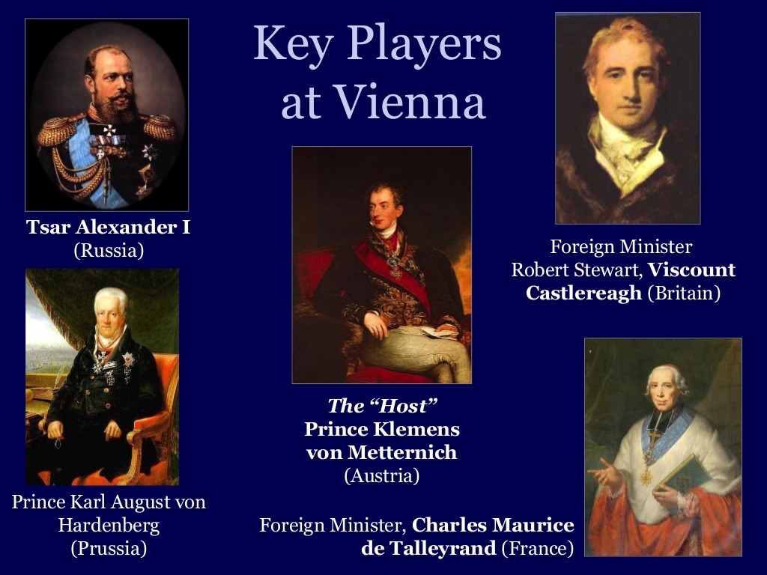

Slide 19
Vienna Congress & Establishment of Precedence System & Diplomatic Ranks & Classes
The Final Act of Vienna of 1815, as amended at the Congress of Aix-la-Chapelle in 1818. in which it established;
The Four Ranks & classes related to heads of diplomatic missions:
Ambassadors Extraordinary and Plenipotentiary.
Envoys Extraordinary.
Ministers Plenipotentiary.
chargés d’affaires accredited to ministers of foreign affairs. Is a deputy temporarily acting for an absent head of mission.

Slide 20
Classical & Modern Diplomacy the congress of Vienna 1815
How the issue of Precedence solved? through;
Alphabetical order ; 1st letter of the country’s Name.
Date of appointment or the announced arrival date of the ambassador to the receiving state. Or
Based on the date of presentation of credentials.
A system for signing treaties in French alphabetical order by country name.

Slide 21
Successes of Congress of Vienna
No major war between European powers for another century from 1815-1914.
Balance of power maintained.
Established diplomatic rules that is effective to this day.
Free use of international waterways.
abolition of the slave trade.

Slide 22
Features of Modern Diplomacy
Diplomacy was transformed from ad hoc meetings into an organized system consisting of diplomatic services, INGOS, and habitual international gatherings.
Main Actors : states & Non – State actors; INGOs
well establishment of Permanent Embassies abroad.
the advancement and invention of Telegraph.
Bilateral Relations; on a state to a state basis.
Multilateral Relations; group of States in INGO such as League of Nations and UN.

Slide 23
Reference:
Thierry Balzacq & Frédéric Charillon, Global Diplomacy ‘An Introduction to Theory and Practice, Translated: William Snow, Palgrave Macmillan, 2020.
Renaissance Diplomacy and the Reformation. Jan 1st, 2021.
https://www.diplomacy.edu/2013/evolution/may
Sally Marks Chas. W. Freeman, Diplomacy, Encyclopaedia Britannica, Inc. , 2019
http://www.ediplomat.com/nd/history.htm#:~:text=Modern%20diplomacy's%20origins%20are%20often,established%20in%20the%20thirteenth%20century.&text=It%20was%20in%20Italy%20that,to%20the%20head%20of%20state.
The Privileges of Ambassadors and Foreign Ministers, https://www.jstor.org/stable/pdf/1272906.pdf
The First Resident Embassies: Mediaeval Italian Origins of Modern Diplomacy
https://www.jstor.org/stable/2849298?seq=1#metadata_info_tab_contents

