Slide 1
University of salahaddin college of agriculture soil & water SCIENCES department
PLANT NUTRITION
Tutorial / Professor
Of Soil Fertility & Fertilizers
Dr. Alwand Tahir Rashed Dizayee
2021-2022

Slide 2
Plant Nutrition
vocabulary curriculum / Fourth Grade
Theory: -- 1. Introduction: - The definition and importance of plant nutrition. - The Mining of the Mineralization & Assimilation processes. - The process of transition elements from the soil and plants. - The effect of plant genetics. - History of the topic of nutrition and its relationship with other sciences. 2. The Cycle of the some elements in nature (carbon, phosphorus, nitrogen). Energy and the role of elements in plant growth and division & classification of elements

Slide 3
3. The definition of plant growth and expression, and factors influencing growth. - Inorganic chemical composition of the plant and the factors that depend on the chemical composition. - Factors that affect the availability of nutrients in the soil and absorbed by the plant roots .(S.F)
4- Nutrient medium of plant : ( FIRST EXAMINATION ) Definition - types - compared to solutions , solid and exchange materials - advantages and disadvantages. 5. The external and internal environment of plant: -- Membranes and its importance - the cell structure - permeability - ion exchange – root space - the importance of permeability and ion exchange in relation connection with soil and plants. 6. Difference between the active & passive absorption and the indication of active absorption . - The theories which related to (-,+) –ions absorb. ( SECOND EXAMINATION ) - Some of the concepts of special theory of absorption. - different types of nutrition for different crops (cereals, legumes, fruits) and to produced ( carbohydrate , portion and oil ) (THIRD EXAMINATION )

Slide 4
1-K. Mengel &Ea. Kirkby (1987 ). Principle of plant nutrition 4th- Edition. عواد كاظم مشحود - 1987 - التسميد و خصوبة التربة.-2 3-Tisdale & etal 1998. Soil fertility & fertilizer 7th- Edition. ابوضاحي يوسف محمد و اليونس مؤيد احمد - 1988– تأليف دليل تغذيةالنبات4- د. محمد عبدالعظيم -2002.اساسيات تغذية وتسميد النبات-5 أ.د . السيد عمران محمد- 2005 .خصوبة الأراضى و تغذية النبات.6
References

Slide 6
Soil science
A collection of information ,the organization data related to cover of earth , so called soil science and it is the nature science , in particular formed the (chemistry, physics , biological soils science ).
And divided according to old division:
Soil science
Pedophology
Edaphology

Slide 7
Pedology
Its Greek words, that branch of soil science that deals with the surrey , genesis & classification of soils for land use planning , the natural dynamic body has three dimension(length*width*depth) divided to:
Soil Genesis
Soil morphology
Soil survey & classification
Soil mineralogy

Slide 8
Edaphology
It’s a Greek words means soil or ground & it’s a branch of soil science which is deals with the study of the soil in relation to growth of plants , nutrition & yield of crops , crops production and divided in to :
1.Soil chemistry.
2.Soil microbiology.
3.Soil physics.
4.Soil fertility & plant nutrition.
5.Soil conservation.

Slide 9
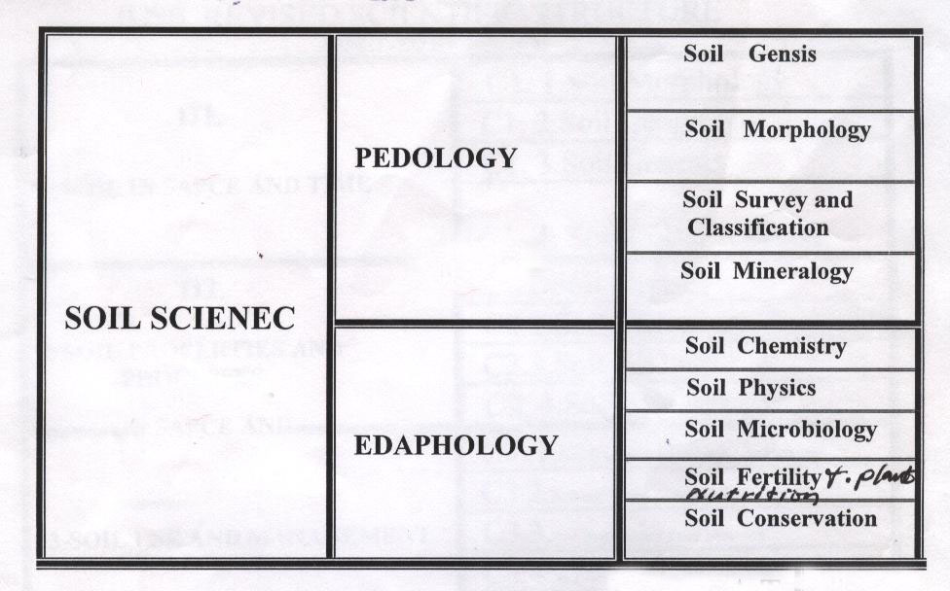

Slide 10
There are many other branches of soil science is within the jurisdiction and the most important in terms of agricultural management and maintenance of the soil (soil management) and (soil conservation) and soil important uses in terms of their use in science and engineering, construction, roads, airports, laboratories, factories ..... etc. ..... Parks, hotels, and soil mechanics of the most important terms of reference in the face of engineering.
There was a further endorsement by the World Conference in Soil Science, which was held in Bangkok in Thailand (18-21) April 2000
International Union of Soil Science( IUSS )
on 18-21 of April 2000 in Bangkok -Thailand

Slide 11
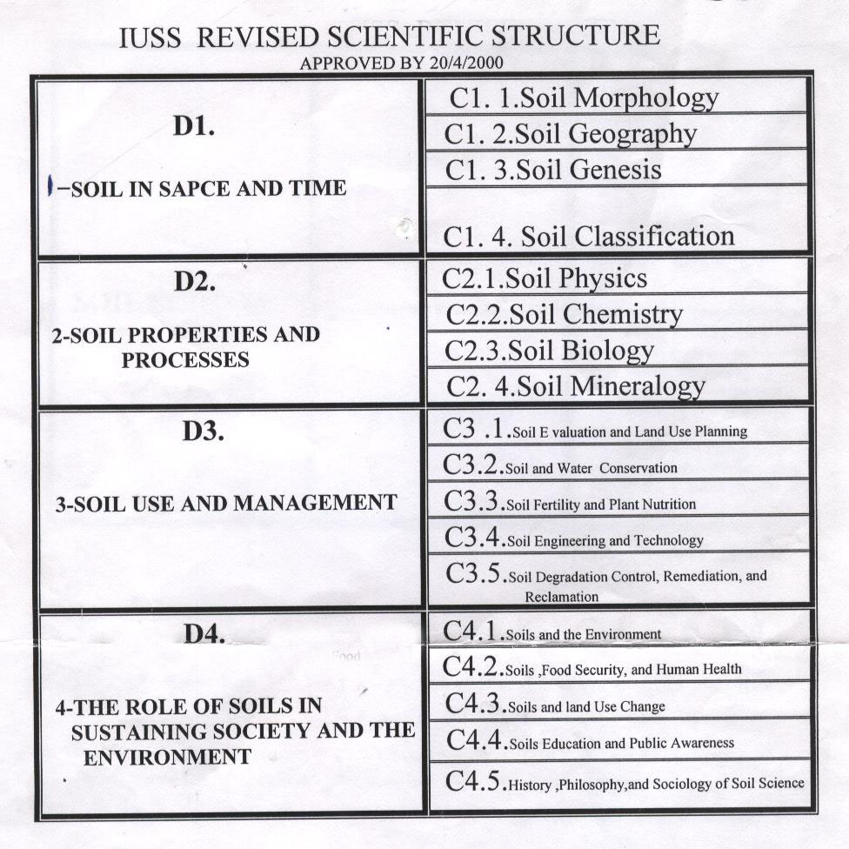
New division
$$∎$$

Slide 12
Principles of Plant Nutrition
Plant Nutrition science
Is a science studying all processes that have to do with how to get the plants requirements of the different nutrients and how to absorbed and follow the entry of the plant environment (soil solution nutrients and air) until it reaches the inside and cytoplasm Gap succulent Cell Space, as well as studied the arguments and hypotheses, and theories of absorbing the different factors affect their availability in the soil and absorbed by plant roots and diagnose symptoms of deficiency or toxicity and how to treat them as well as the study of toxic elements as rare as interested in nutrient science to study physiological functions of nutrients and their role in plant life and the role of nutrients in plant resistance to disease, insects, and improved methods of fertilizer industry and ways to add storage and the date added, quantity and how it is done

Slide 13
Important of Plant Nutrition
Necessary for stay the life Cycles on the surface of the Earth. Why?
2. All objects , metals …… dead and living things made up of atoms and elements of metal (alive – mineral (bio -matiales )- rock - oceans - sea - air - plants - forest ..... etc.) and in turn become the components of the nutrient element and is done by rotation & Cycle in nature
Such as: C P N S and micronutrients, and these are used, including plant and turn it into Organic matter necessary for growth and survival.
Micro Organisms
Anabolism
Assimilation
Mineralization
Degradation
Living or BIO systems
PROTIN or M O
Amino acid , metals

Slide 14
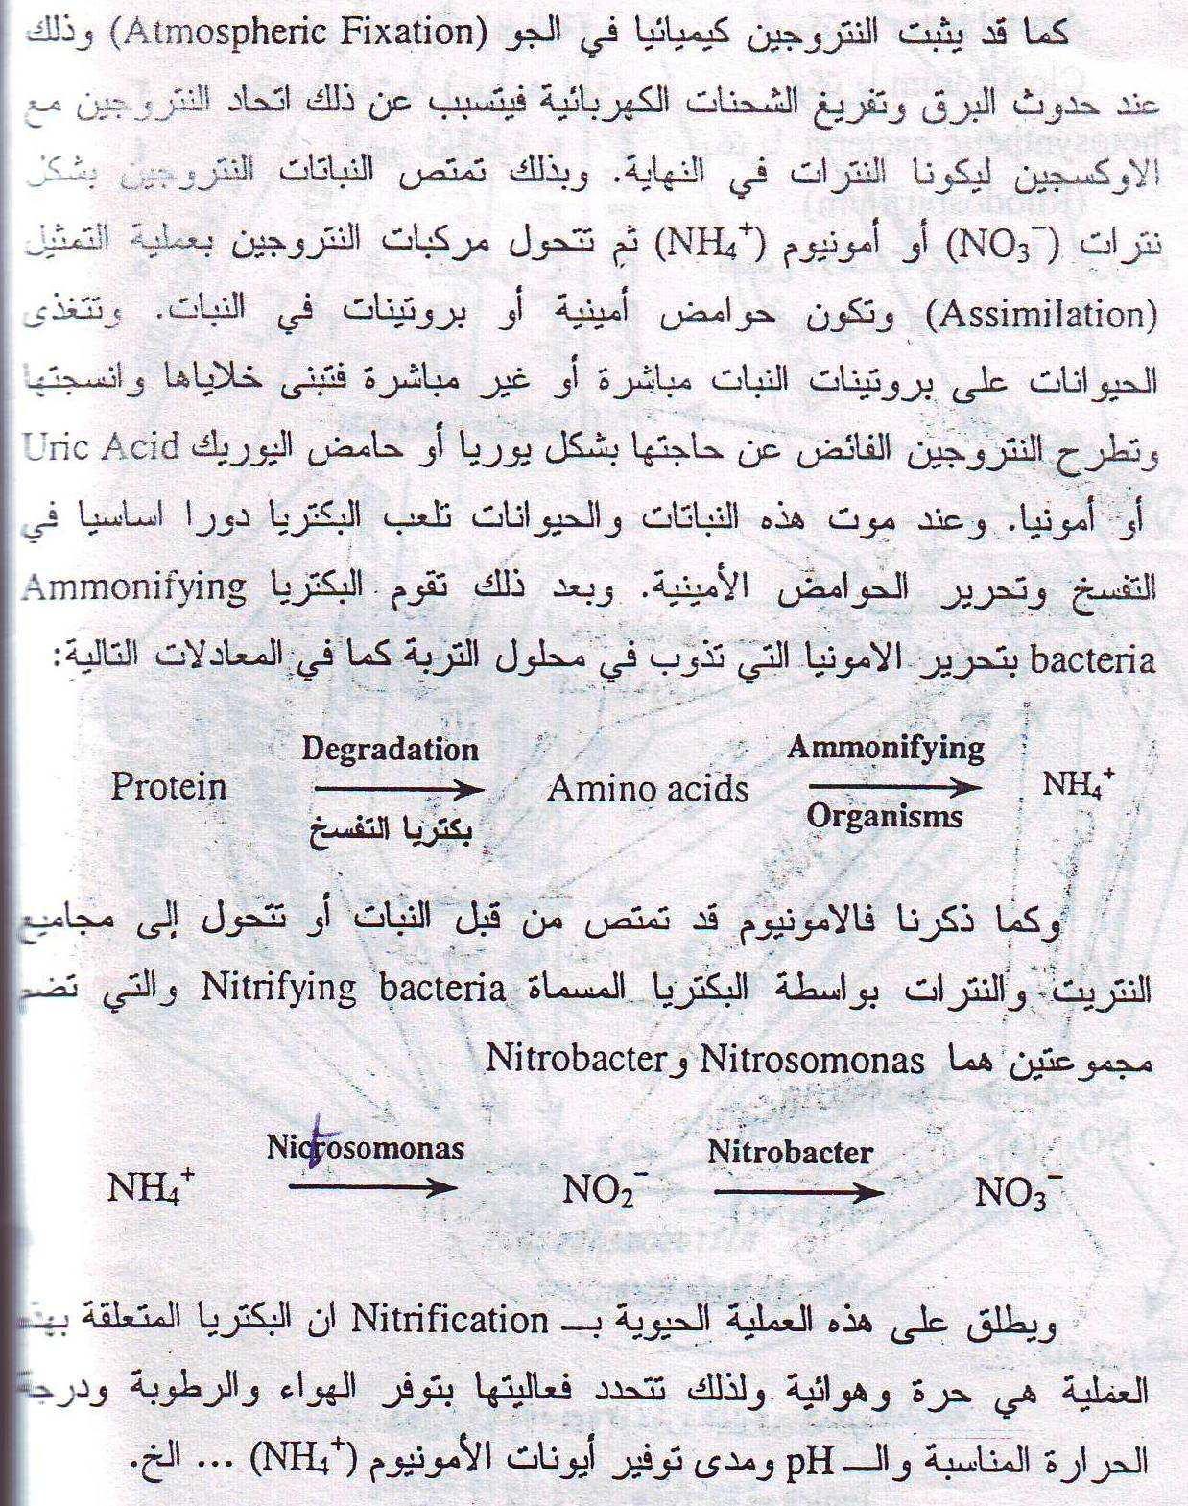

Slide 15
Goals of Science
Why study the science of plant nutrition
For the following reasons:
Account the plants nutrition requirements & fertilizers .
How to access the nutrients for the body of plants and absorbed.
Physiological functions of nutrients within the body of plants and lack of diagnostic elements and toxic it.
Create, the nutrient medium and nutrient cultures composition nutrient solution and to study ways to absorption by the plant of nutrients.
Factors that affect the availability of the elements and factors that affect the absorption by the plant roots .
The role of nutrient elements in disease-resistant insect.
Fertilizer industry , formed and methods to add it to plant as well as storage of fertilizer until to the plants need.

Slide 16
علاقة علم تغذية النبات بالعلوم الاخرى
Relation with other sciences
Product
الانتاج
Ecology
Metrology
أشعة شمس
علم البيئة
انواء جوية
إتزان غذائي
Plant Nutrition
تغذية النبات
هواء وسرعة رياح
SOIL MICROB.
SOIL CHEM.
تاثير الاحياء والانسان
مايكروبيولوجيا
SOIL PHYS.
فيزياء تربة
كيمياء تربة
Humane & Micro O.
activity
خصوبة التربة
SOIL FERTILITY

Slide 17
EPSTEIN 1972
ضوء وطاقة
C₆H₁₂O₆
Output
Photosynthesis
Co₂+H₂O+
كلوروفيل
Assimilation
أكلات اعشاب Herbivores
( Relation between plant and creatures)
سلاسل مستهلكات
أكلات لحومCarnivores
سطح التربة
Sequences of Consumers
N
P
K
Ca
Mn
Fe
Cu
Mo
Zn
كائنات محللةDecomposers
Input
Solid Mineral
Ion transport
Minerlization
C,H, O, N, P, K , S, Ca, Mn , Fe, Mo , Mg, Cu, Zn, Na, Cl ,………….

Slide 18
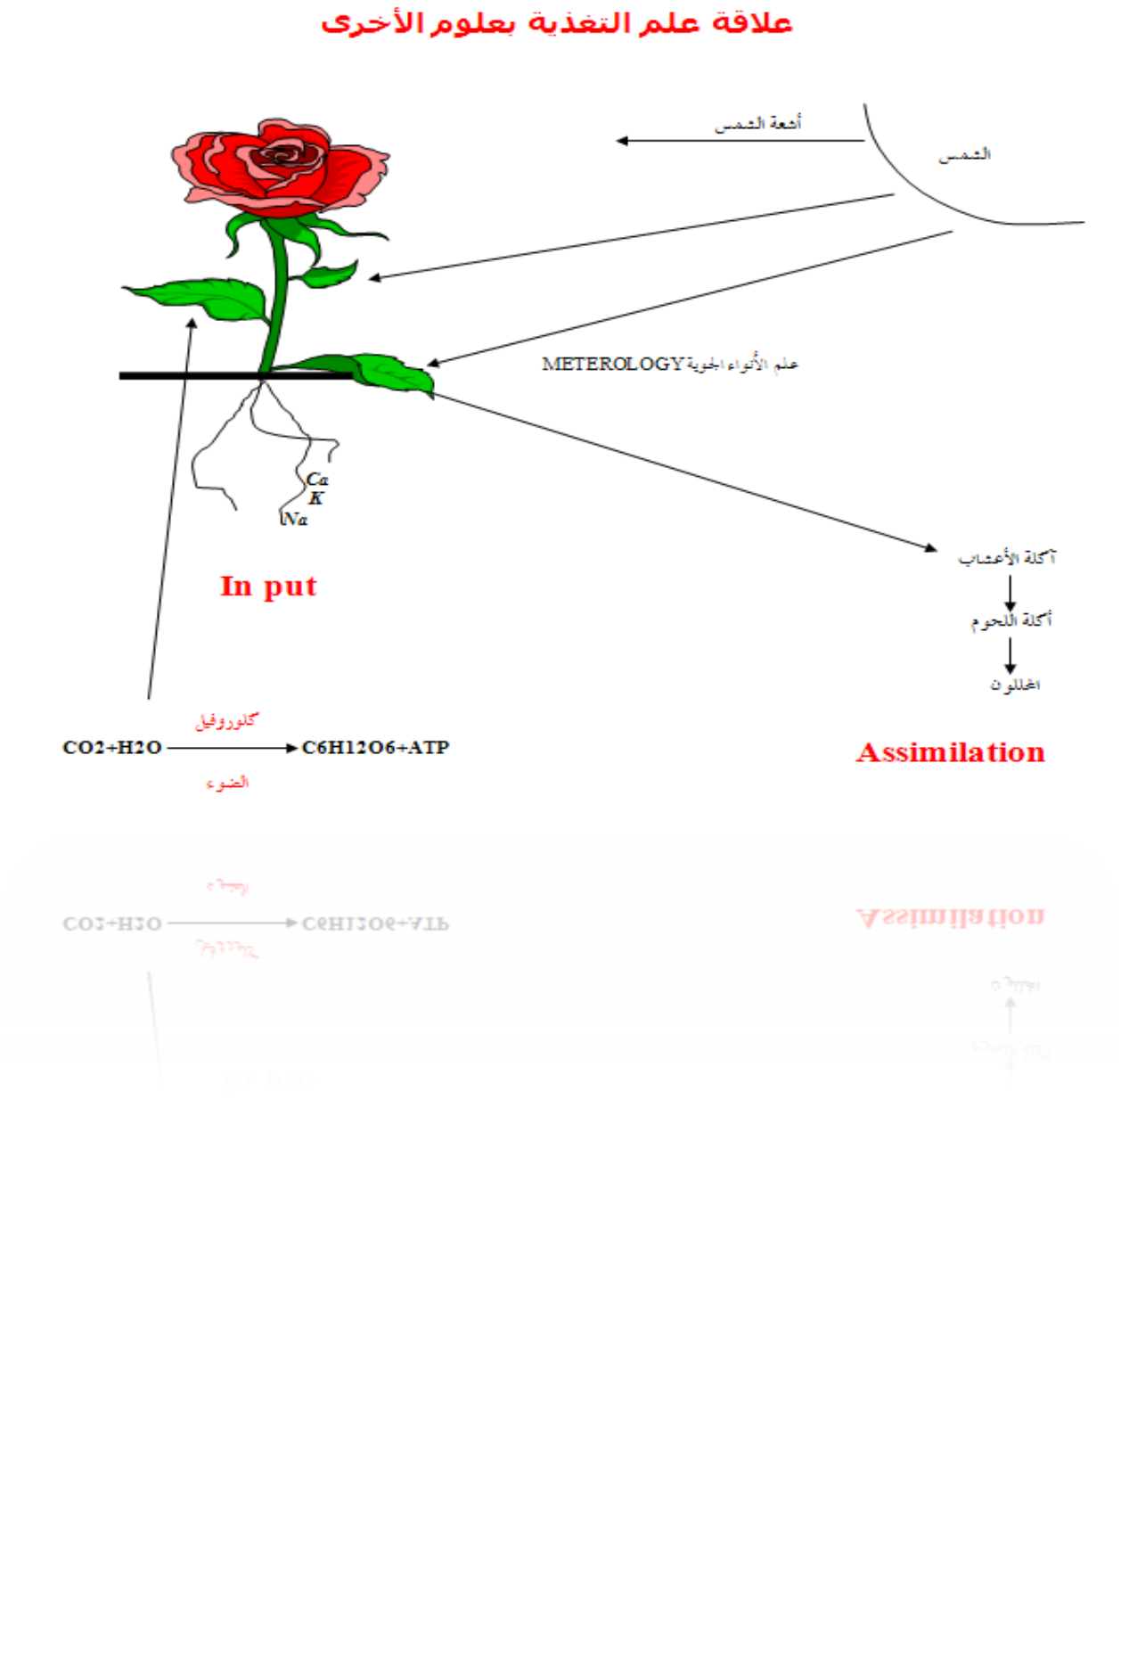
The relationship between plant nutrition science and other science
Sun light
Sun
HILL REACTION
CLIMOTOLOGY
Herbivores
Carnivores
Decomposers
chlorophyll
light

