Slide 1
Temperature:
There are three degrees or grade of temperature: -
Minimum temperature: And the growth of plant is generally be in less grade low thermal degrees . the bioprocesses be in minimize .
Optimum temperature: And the growth of most plants where the best and optimize this
Be different in different plants, and environments … .
Maximum temperature: And the growth of plant is generally be in less grade low thermal degrees . the bioprocesses be in minimize .
At 4 C^{о} degrees be germination .

Slide 2
The most important physiological processes are affected by heat
Which are:
Photosynthesis.
Breathing. Respiration
Transpiration.
Permeability of roots.
Absorbing elements.
Movement within the members and organs .
The effectiveness of the enzymes.
Anabolism ,assimilation of the elements and the formation of protein.
* The effectiveness of Biology amplified by the increasing temperature and increasing concentration of CO₂ in the soil air and leads to lower pH and increase the availability of the elements.

Slide 3
Structure Of Water
2.Water
Structure Of Water
H+
H+
O
⁼
105°

Slide 4
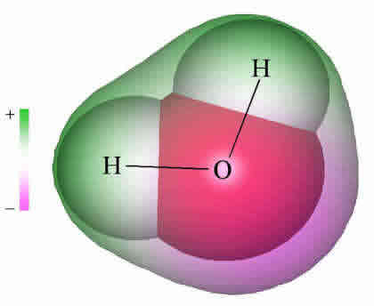
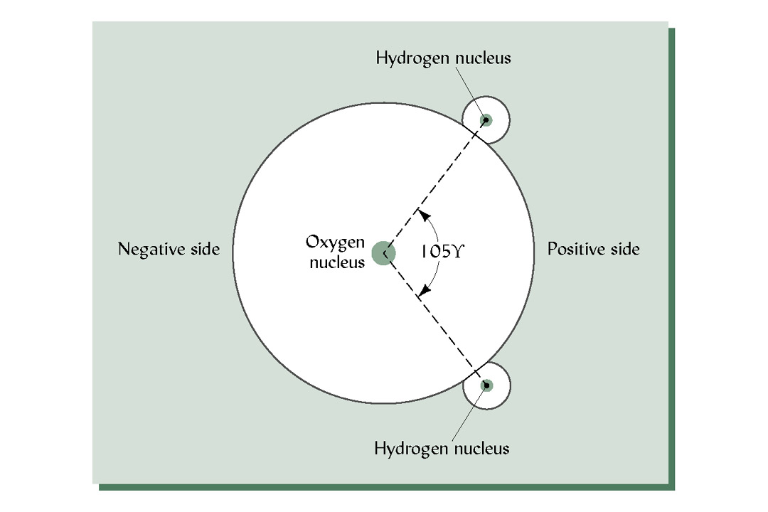
Polarity of Water

Slide 5
Hydrogen
Electro positive
Hydrogen
H-O : 0.97 A
H-H : 1.54 A
105⁰
Polarity
Oxygen
angstroms
Negative
Symmetrical

Slide 6
Hydrogen bond
H⁺
O⁻⁻
H₂O
= +
-
H⁺
Gives structural strength
Bond depends on temperature:
Higher is the temperature weaker is bond
Positive end attraction with -ve end of other water molecules

Slide 7
Polymer type of grouping
soil
H⁺
H⁺
O⁻
H- bond
Adhesion
Cohesion
Cations: Na⁺, K⁺, Ca²⁺ : become hydrated through their attraction to the Oxygen
Anions or negatively charged clay surfaces: attract water through hydrogen
Factor bonding water molecule : H- bond, cohesion & Adhesion, Surface tension

Slide 8
2. Water:
The essence of life is water. And characterized by the following: -
primary material with high strength reductionist in the process of photosynthesis.
Included in the composition of matter protoplasm 80%.
Transfer of nutrient element.
Dissolving all of the O₂, CO₂ in it.
Assist in the bulge cells.
few of water hampered the process of cell division.
Water is chemically from several chemical compounds called water vehicles. And divided in terms of their plants to the water to: --
Hydrophytes. Plant which need high quantity of water like ( rice ,reed, reed mace) .
Mesophytes. Plant which normal need to water ( wheat , barley ,tomato)
Xerophytes. Plant which need very less quantity of water arid zone ( Pine, Al hage ) .
Halophytes. Plant which normal need to water but live on salty soil ( Palme ,Su wad )

Slide 9
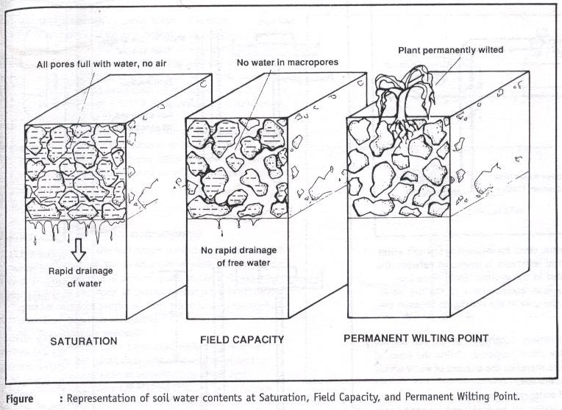
Notes:
9

Slide 10
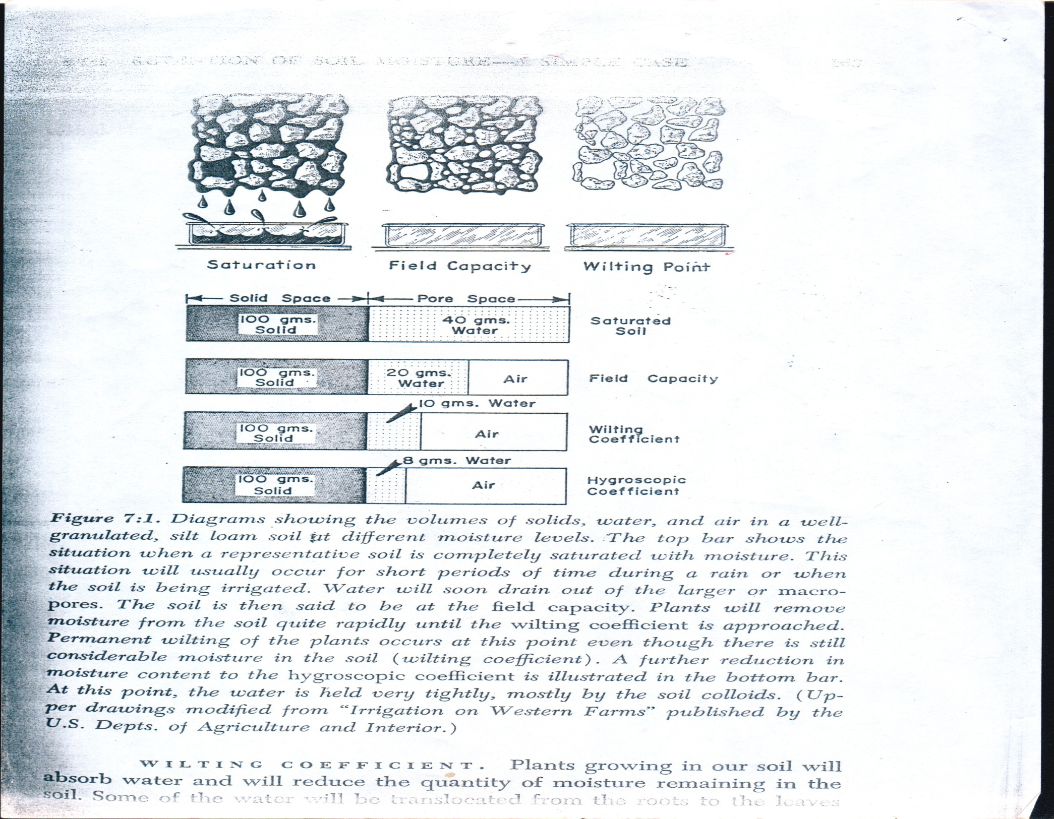
Notes:
10

Slide 11
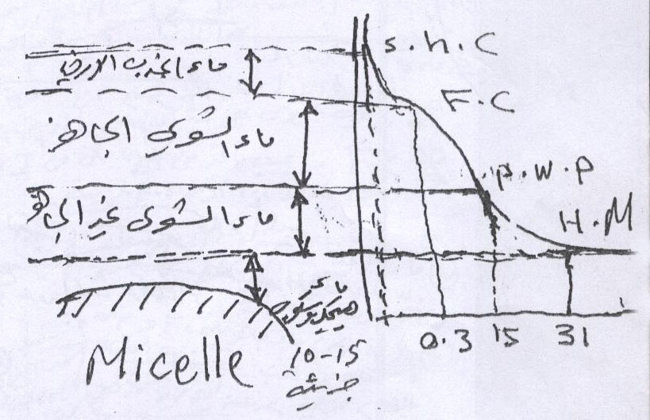
2. Water:
The essence of life is water. And characterized by the following: -
primary material with high strength reductionist in the process of photosynthesis.
Included in the composition of matter protoplasm.
Transfer of nutrient element.
Dissolving all of the O2, CO2 in it.
Assist in the bulge cells.
few of water hampered the process of cell division.
Water is chemically from several chemical compounds called water vehicles. And divided in terms of their plants to the water to: --
Hydrophytes.
Mesophytes.
Xerophytes.
Halophytes.

Slide 12
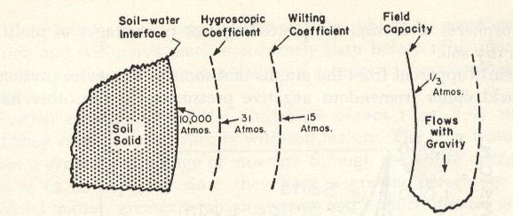
The soil physical & chemical properties affect from more water content in the soil such as infiltration rate & affect to availability of water in saturated.
0.001-0.00bars(Saturated soil) سعة تشبعية
0. 1-0. 3bars (Field capacity)سعة الحقلية
) 15 bars -Permanent wilting point نقطة ذبول الدائم(
( 31bars-Hygroscopic point)معامل هايكروسكوبي
(10000 bars- Oven dry soil) جافة تماما
The Soil Water Content Constant
Notes:
12

Slide 13
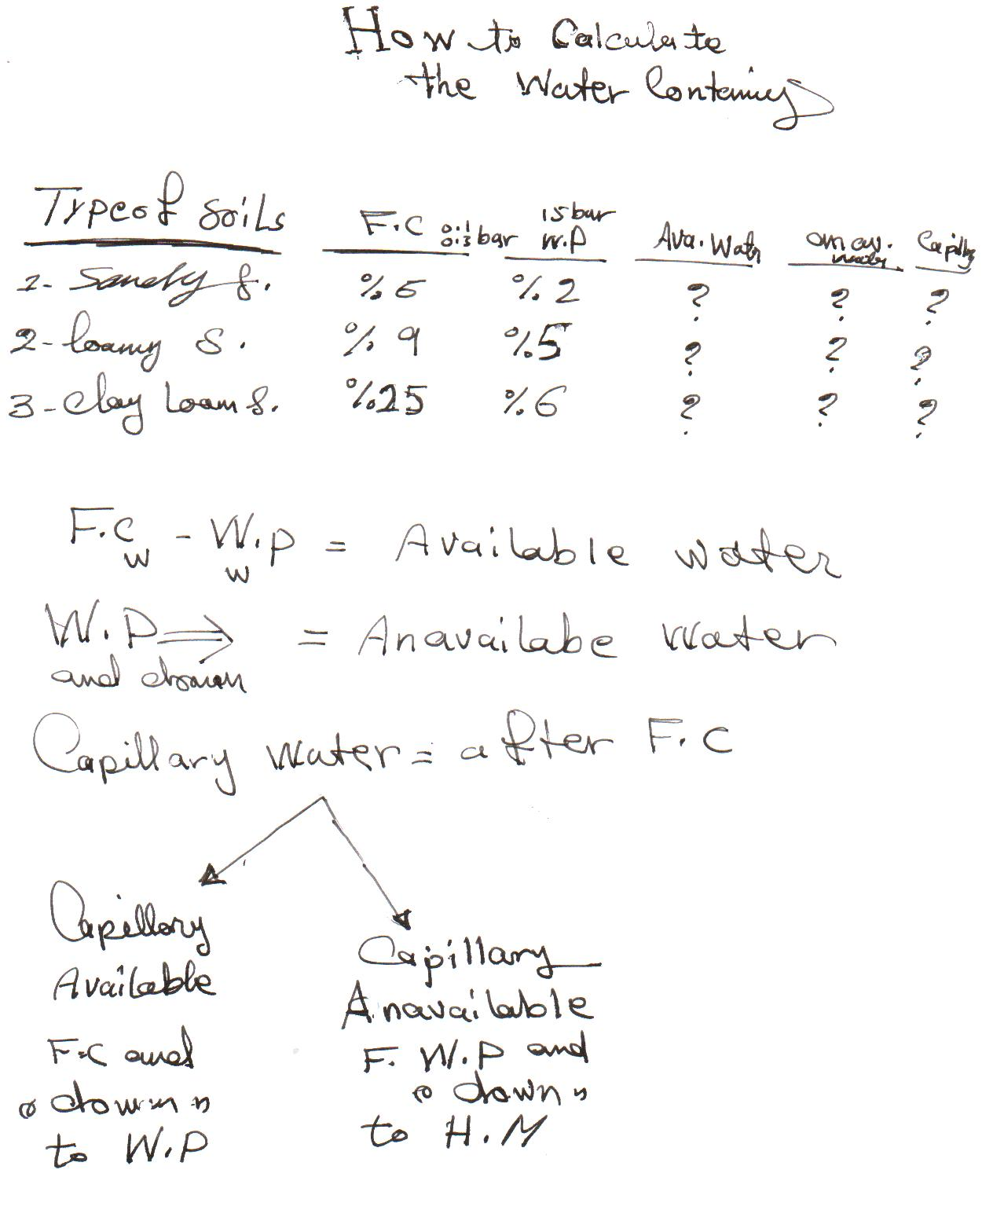

Slide 14
Why water is the dominant center on the rest of other liquids? Why water is v. importantS ?
For following reasons:-
1-Provided on the surface of the earth 10²⁴* 1.25 gm. 2.5 Km depth
2-Central dynamic for dissolving all gas and solid material .
3-Ability to regulate the temperature of the soil near plant roots.
Specific heat ( calorie =4.18 joule)
Boiling point 540 cal/g 100 Cº , melting point 80 cal/g
Maximum amount of cooling in evaporation and
Maximum amount of heating in condensation
4- High surface tension. High layer hydration
5-Water is the best solvent (polarized) , nutrients which plant need to growth . H-band . 90-95 % n. g is water , 15% d.m
6- Viscosity very few compared with other liquids, works to spread the water molecules carrying with him the various ions .

Slide 15
Critical periods of water in some plants
cauliflower : replication when need water .
lettuce : at the beginning of a head.
Onion : onions during the onion creation .
Soybean: during the creation of flowers. ear emergence
Wheat / barley / corn: during the filling grain, creation of milk .
(the formation of milk y stage ).
* Water affects the amount of plants to absorbed nutrients and increase water absorption increased water use efficiency the amount of dry matter produced in the use of a certain quantity of water or in other words is the amount of water required to produce one kilogram of dry material (dry matter).

Slide 16
3. Light:
the sun is a source of energy located at a distance from the earth 93 million miles
The multiple effects of light on plant growth and how to and the quality of nutrients, for example : light energy
Increase in nitrogen adsorption (K ⁺, NH₄ ⁺) in the light more than it is in darkness.
4. Components of the atmosphere:
The atmosphere contains 0.03% of the second carbon dioxide CO₂ and the gas is of great importance in the process of photosynthesis. As shown in the following equation:
REDACTION
chlorophyll
CO₂+H₂O C₆H₁₂O₆ + O₂
Sun light

