Slide 1
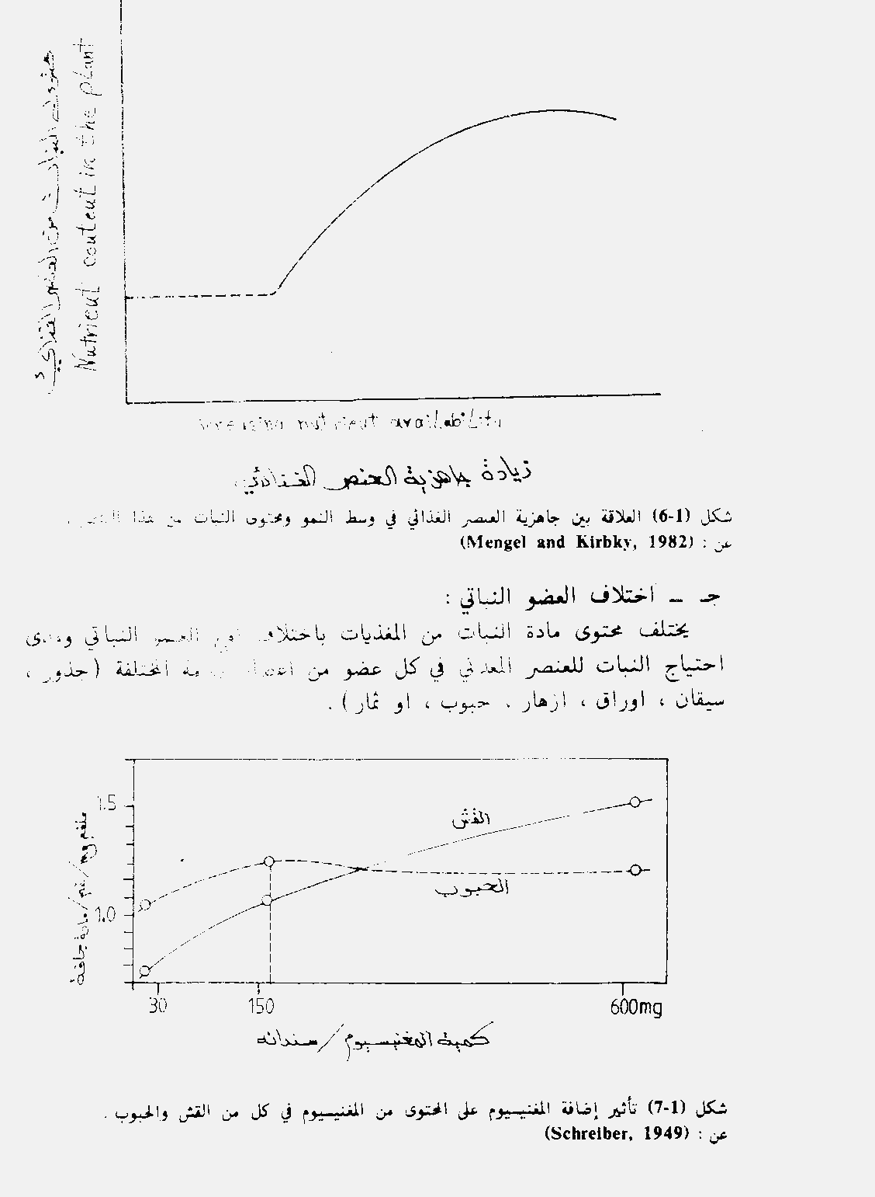
HAY
GRAIN

Slide 2
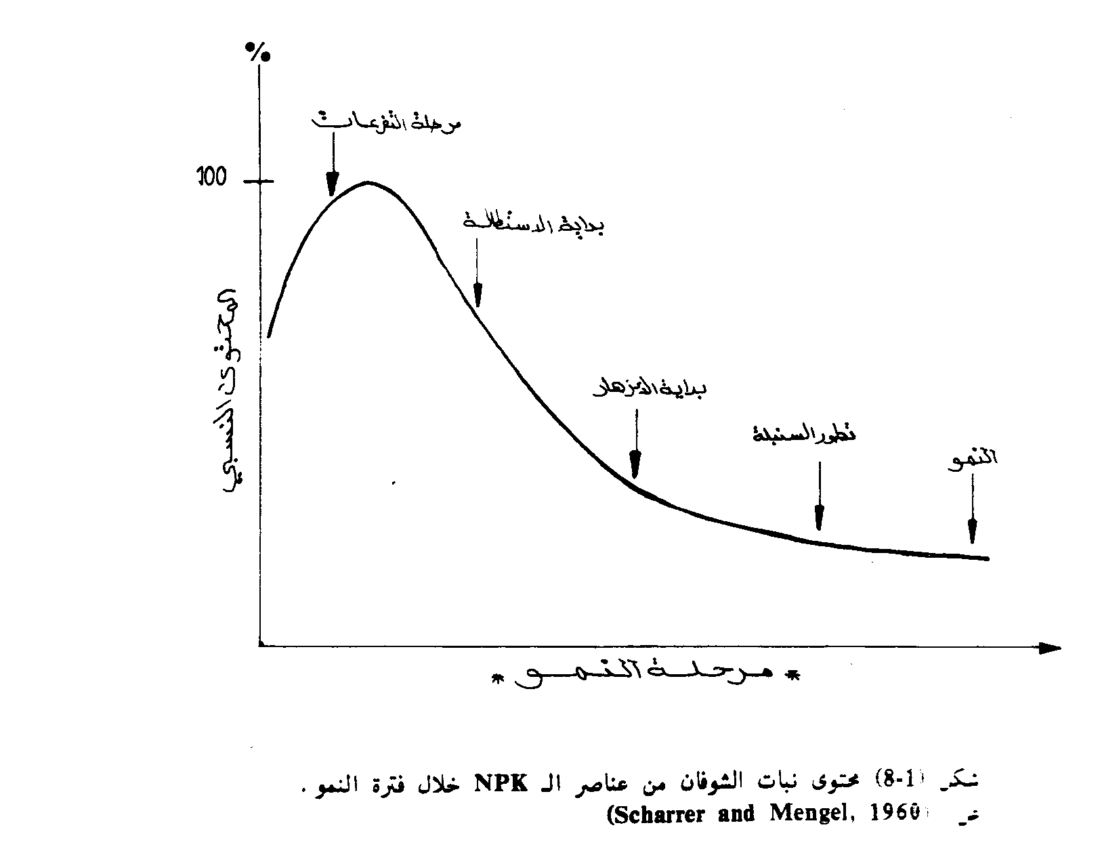
Divaricating
Elongation
lengthening
Bloom
Flowering
Ear
Spike

Slide 3
(smith -1962) noted :
1. Plants have high content in the elements (N, P, K) in modern age, less concentration over time.
2. Plants in the stage of maturity that the elements (Ca, Mn, Fe, B) more concentration than (N, P, K) nutrients .
3-Dilution factor ,this is the explanation of (N,P,K)in the initial stage of growth than be less with procession and adsorbed high amount of water .

Slide 4
How calculate the amount of nutrients
® the amount of elements in plants are either mg / g or % percentages.
® or be limited to PPM or mg / kg or mg / liter.

Slide 5
Culture media and growth of plants
IS THE SOLUTION CONTENED ALL NUTRIENT WHICH PLANT NEEDED TO GROWTH
Molarities: The concentration Molarities
As the number of molecular weights(g or , mg) dissolved in one liter of water.
1 Mole = 1000 m moles
The number of moles = weight of a substance(matter) / molecular weight
Molar = number of moles / liter ÷ volume / L
M= w/M.w * 1000/V ml
Equivalent weight = Weight of solute / number of valence
Normality = Number of equivalent weight (dissolved substance) / volume (liters)
Normality = weight of dissolved substance / Litter ÷ equivalent weight
Dissolve molecular weight in one liter becomes one mole it means dissolve mol /L in a certain volume and be complemented by the litter m mol / litter.
for example,
Ca (NO3)₂ 4H₂O

Slide 6
Factors that affect the availability of nutrients in the soil and absorbed by the plant roots
1 - pH . 2 - O.M . 3 - CaCO₃ . 4 - Type of soil . 5 - The microbiological activity and its kind to
changing availability of nutrients .
6 - The type of clay minerals prevailing . 7 - Sesqueoxides elements and its presence in the soil
8 – Type of Plants . 9 - other factors (temperature, erosion, weathering - chemical and physical and bio.) .

Slide 7
Factors affecting the absorbency
(absorbed by the roots of plants) are :
1 – Relative humidity and soil moisture. 2 –Relation between ions :- competition, encouragement and overlap
(Interaction ,antagonisms) synergism. 3 –Valence of charge . 4 –Temperature . 5 - light .

Slide 8
Macro 80-90% | CO₂ | C
 | H₂O | H
 | H₂O + AIR O₂ | O₂
Macro% | K⁺ | K
 | HPO²⁻،⁻H₂PO₄ | P
 | ⁻NO₃ ،⁺NH₄ | N
Micro ppm | Ca²⁺ | Ca
 | Mg²⁺ | Mg
 | SO₄²⁻ | S
 | MoO₄²⁻ | Mo
 | Fe²⁺ | Fe
 | Zn²⁺ | Zn
 | Cu²⁺ | Cu
 | Mn²⁺ | Mn
 | Na⁺ | Na
 | Cl⁻ | Cl
Air
Soil& Air
soil

Slide 9
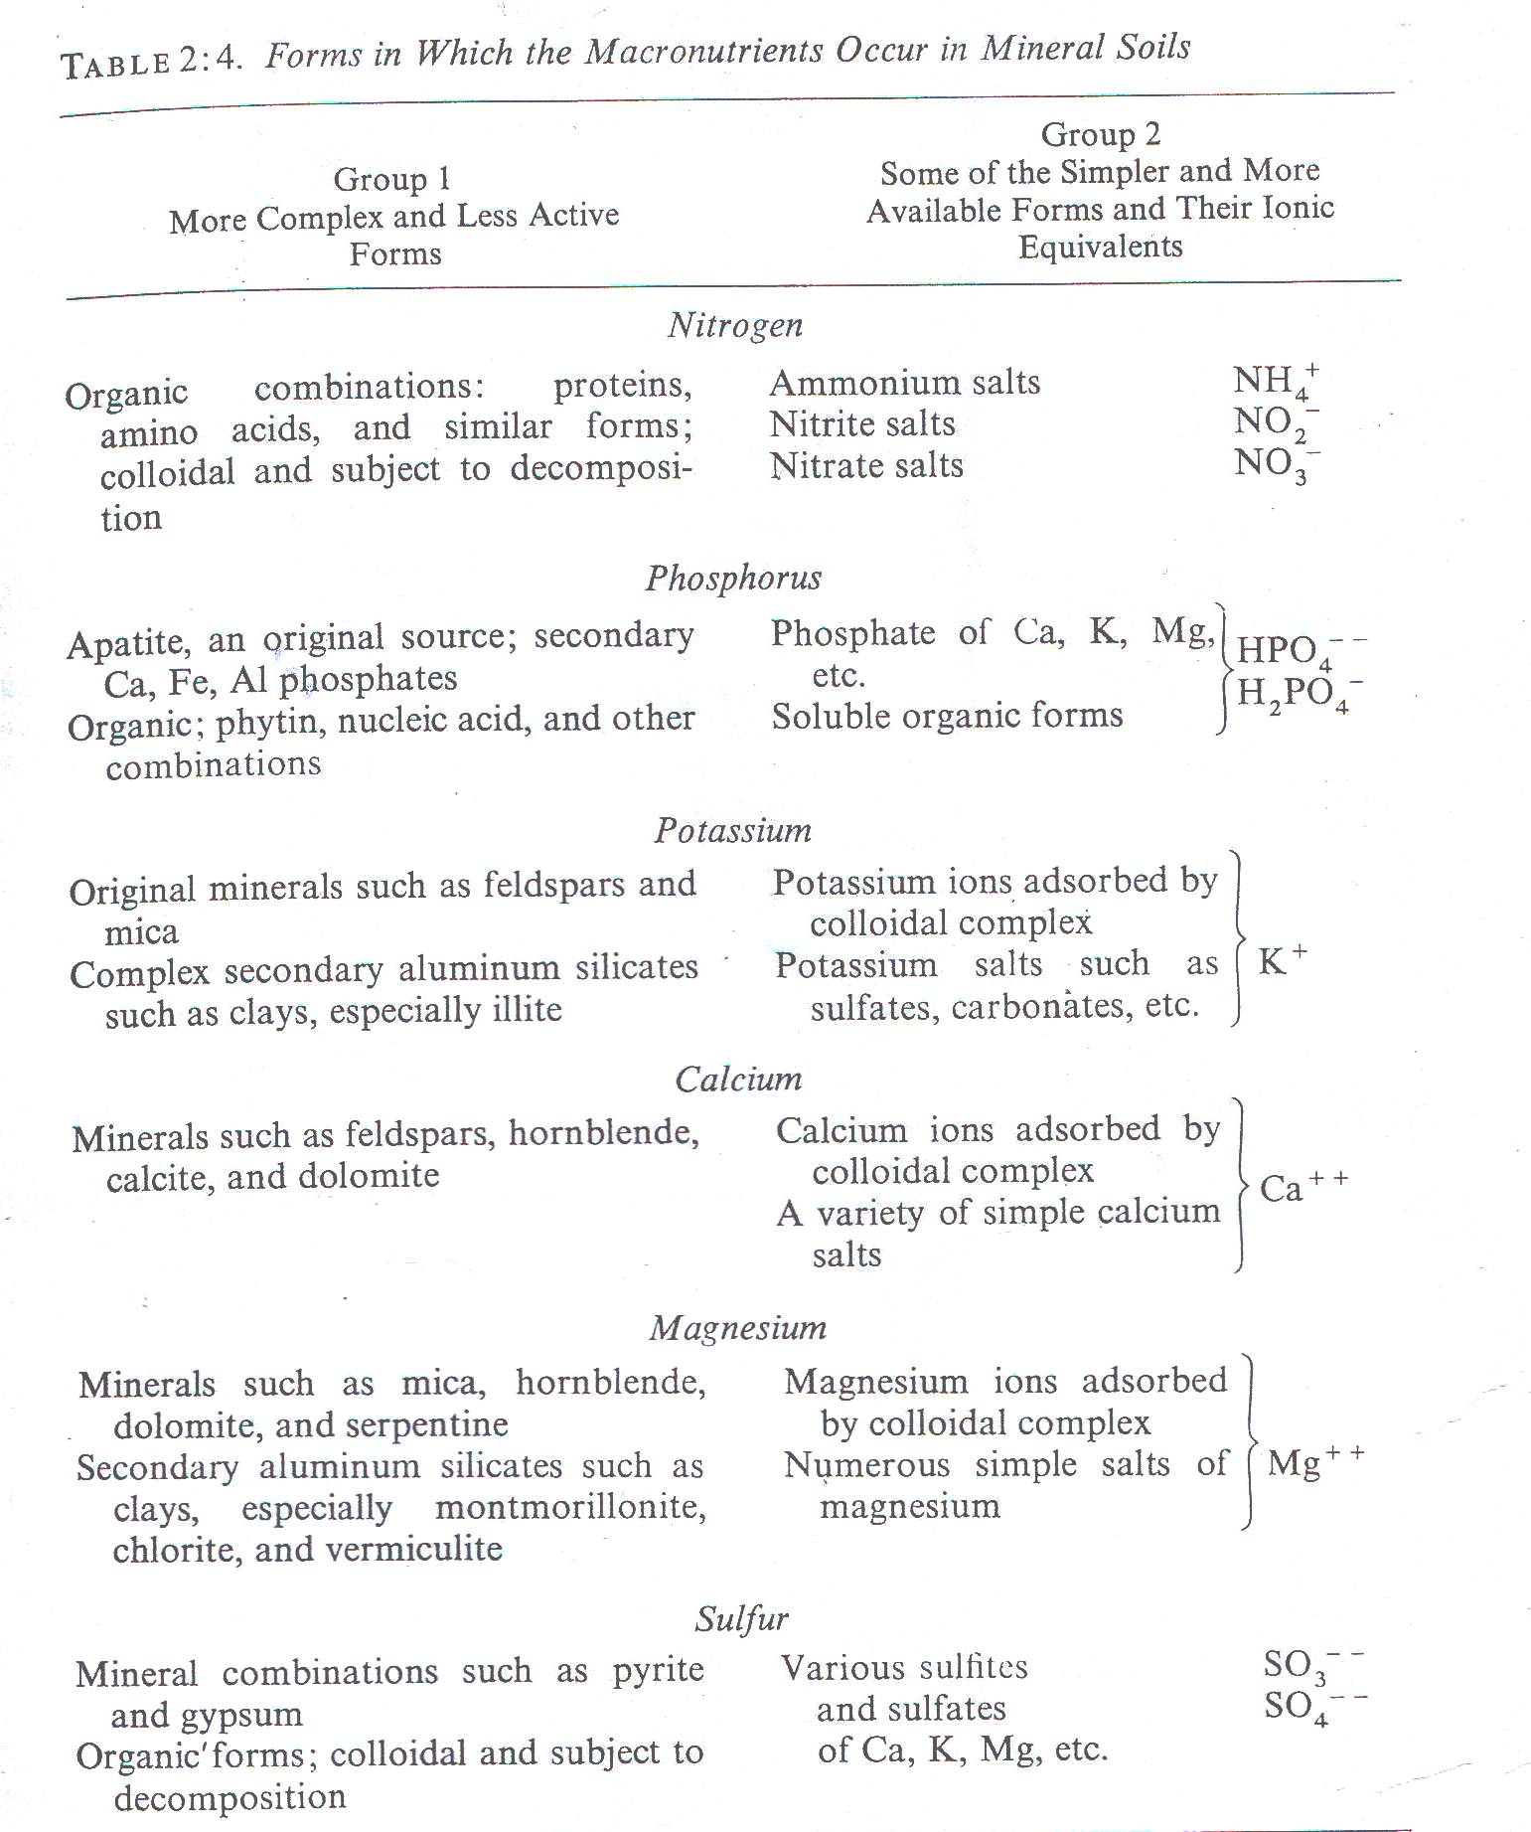

Slide 10
الاواسط الغذائية
The media of nutrition
المزارع المائية
Liquid Culture
مزارع الوسط الصلب الحبيبي
Aggregate Culture

Slide 11
The kind of liquid Cultures
Is the center where plants growth with out natural nutrients and soil , the solution
Industrial contenting all the requirements nutrition (Macro & Micro) of plants
1-Hydroponics Cultures.
2-Solution Cultures.
The center of growth is solution put on container ( Knops &Sachs 1865)
3-Water Cultures.
Hoagland & Arnon 1950 .
Eran & Nason 1953.
Johanson etal 1957.

Slide 12
Kind liquid culture
Hydroponics Culture or Solution Culture or Water Culture
The centre or the environment which containing the plants and the all solved essential nutrients to growth with out containing the soil these media formed and industrial ,don’t Natural the first time formed by (Knops & Sachs 1865).
Hoagland & Arnon 1950 .
Eran & Nason 1953.
Johanson etal 1957.

Slide 13
المزارع المائية انواع
محلول المغذى – وسط تنمو فيها نبات دون التربة الطبيعيةو تستمد النباتات غذائها من المحلول الذي يحتوي و على جميع العناصر الغذائية الكبرى والعناصر الضرورية لنمو النباتات وتطورها و نسب هذه العناصر تكون معلومة وصناعية من صنع الانسان .
باودر مذابHydroponics Culture
1
المحلول المائى Solution Culture
2
المزارع المائية Water Culture
3
وسط النمو - هو المحلول المغذي يوضع في اوعية او احواض خاصة – ابتكر الفيلسوف الالماني Knops & Sachs 1865 هذا النوع من المزارع ثم بعد ذلك جاء العلماء :
Hoagland & Arnon 1950 .
Eran & Nason 1953.
Johanson etal 1957.

Slide 14
liquid {Water}Cultures
Advantages :-
1- Precise control of the quantities and amounts of nutrients .
2-Conduct research on the roots accurately .
3-Easily transport the plants to another pot or place with out any effects to roots for broking or damaging .
4-In the develop counties uses double or twin purpose. on Japan ,Fish farming and floriculture Field crops .
Disadvantages :-
1- Economically costly and requires expertise .
2-May broken the shoots of plants when transport .
3- Must ventilations nutrient solution .
4-Must changing solution { 10 days to two weeks } with controlling to osmotic pressure and pH around (6.0) .
5- Potted be dark to prevents the entry of Light and prevent Algae growth.
6- The temper cure degree of containers must stable on the holes .
7- With nutrient NO₃⁻ have basic effect and precipitation the nutrients must be modification .

Slide 15
المزارع المائية Water Culture
المزايا :
تحكم دقيق بكميات العناصر الغذائية .
اجراء البحوث على الجذور بصورة دقيقة .
سهولة نقل النبات من اصيص لاخر دون تعرض الجذور لكسر او التلف .
ثنائي الغرض ( في البلدان المتقدمة يستخدم في تربية الاسماك وزراعة نباتات الزينة ) .
المساوىء :
مكلفة اقتصاديا ويحتاج الى خبرة .
قد تتكسر سيقان النباتات .
يجب تهوية المحلول المغذي .
تبديل المغذي من فترة لاخرى ( عشرة ايام الى اسبوعين ) مع ثبات ضغط ازموزي و pH لايكون اكثر من 6 .
اصيص تكون مظلم لمنع دخول الضوء ونمو الطحالب في منطقة اتصال الساق بالمغذي .
د . ح محلول يظل ثابتا في حوض و الفتحات الكبيرة .
في حالة اضافة NO₃- لها تاثير قاعدي ويؤدي الى ترسيب العناصر الصغرى لذا يجب تعديل ال pH.

Slide 16
The kind of {solid} Aggregate Culture
The Solid Materials empty of nutrients the granular &aggregate washed with acids added the nutrients in form of solutions or powder dissolved on water .
1-Sand Cultures. Pure Quartz Sand,
the diameter no more than 2mm.
2-Gravel Cultures. The diameter more than 2mm .
3-Exchange Materials. Divided to :
Characterized the Surface of granular naturally effective to exchangeable with { -,+ } and nutrients actively absorption and dissolving on soil solution the surface with interface solution is Equilibrium .
Natural clay Minerals closest type for nutrients culture and usually the clay minerals diameter not more than 0.2 micron . 1/200 mm
A- Synthetic resins
B-Natural clay Minerals

