Slide 1
The roots of plants has cation exchange capacity(e.g. wheat 23, beans 54 corn 29 , tomato 62 ) M Equivalents / 100 g of dry material of the roots and this depends on:
1- The quality , the type of the plant
(legume more cereal). 2- Plant Ages, old and stage of growth (plants more durable modern or old). 3-The pH difference because it affects the root.
® the diffusion of out side and in Donnan space does not represent the true absorption. ® entering of water and ions across the plasma and to the gap cytoplasm juicy absorption is vital active.

Slide 2
{ Vital transition& free} ,{active & passive Transport } Vital = Bio = Active There are two types of potential which effects on ion transport : 1. Chemical potential : chemical potential is the force
produced by
a change in concentration effort Typical Chemical. In
high con . To low con . 2. Electrical potential: a force resulting from the effort or Electrical concentration electric potential cuts. charges The movement of ions from high concentration to
concentration, and chatted about the positive or negative
about the negative result will be
positive voltage. Effort and finished products to the
movement of ions
in both cases is called the effort ( +,-)
electrochemical electrochemical potential gradient.

Slide 3
the cells be negative charge {active groups ,lactic acid ,phosphates ,phospholipids } comparison with the soil solution, enter to the space ion or ions is a result of these two or proliferation (plasma membrane and Tonoplast ) this movement happening to the state of balance between electric power and kinetic force resulting from the concentration chemical between inside and out side. Was described by the following equation: NERNST EQUATION
[ K⁺o]
ـــــــــ Ψi – Ψo = E = RT / ZF ln
[ K⁺i]
Ψi = the electric charge of inner or in (cytoplasm)
Ψo = The electric charge of external outer (nutrient solution) E = voltage electric R = gas constant and equal to 1.987 T = absolute temperature (degree Celsius in the center of growth +273) Z = equal ions F = Faraday constant (23000 cal / V) Ln = natural logarithm and that equals Ln = ( 2.3 Log 10 ?/ ? )

Slide 4
The previous equation can be as follows: [C l⁻ _{I} ] Ψi - Ψo = E = RT / ZF ln [C l⁻_{O}] = ( 2.3 Log Concentration. of Cl_{i} 100.000 / Con. of Cl_{o} 1
This depends on where in the shipment ions the positive charge such as potassium K+ Ko over the Ki be either in a negative charge such as chlorine, Cl⁻ ibe over Cl ⁻o. < 1
is meaning accumulation ion (K⁺) outer cell or in soil solution. more
[K_{o}⁺]
[K_{i}⁺]
[Cl⁻_{I}]
1 <
[Cl⁻_{o}]
Is meaning accumulation ion (Cl⁻ ) inner cell or in cell solution. more

Slide 5
Up hill ) active (Transport
Down hill ) passive ) Transport
Passive diffusion from high to low con .
Active on Against con.
To see if that absorption be vital or negative follow the following: - Voltage measured Em (micro electrodes).
- Voltage calculated Ecal. - Force-carrying ions Ed. Energy of drive force

Slide 6
Em = measured potential (micro electrode).
Ecal =calculat electrical potential. ( Nernst equation)
Ed = difference (driving force).
Ed = Em – Ecal
may be (Ed) is positive or negative. and the trance
( -,+)
Ion | Em | Ecal | Ed | Active & passive
Na⁺ | -138 | -67 | -71 | passive
K⁺ | -138 | -179 | ⁺41 | Active
Cl⁻ | -138 | -99 | -39 | Active

Slide 7
® in the case of (+), for example (Na⁺.K⁺.NH₄⁺). Ed = Em - Ecal IF E m < E cal if Ed=+ ^{+ active} _{– passive} active to (+) transport and non-vital (-). ® In the case of (-), for example (Cl⁻.NO₃⁻.SO₄⁼). Ed = Em - Ecal IF E m >E cal if Ed= - _{+ passive} active to (-) transport and non active for (+). the cells of living in conditions of normal pH
is always fraught with the shipment of the negative anions (-) be more prone to move the vital ( active ) concentration of anions and be more than inside the cell
than in solution outside the center so it would be a vital transition for each of the
(NO₃ ⁻, SO₄⁻² H₂PO₄⁻¹, HPO₄⁻², Cl⁻) most pass vital. Cl⁻calculated to be smaller than the Cl⁻size and this means that Ecal smaller than Em.
_{– active}

Slide 8
As for the cations such as (Na ⁺¹, Ca ⁺², Mg ⁺²) is absorbed in any free absorbed and there is a vital test to prove that potassium moves vital (against decline in concentration or against regression electrochemical) and there are differences in the absorption of light and darkness (120 Milvolt - 180 Milvolt ). The carrier theory for ( - ,+ )anions & cations where each ion to the carrier, the low concentrations of potassium below (0.5 mmol )of potassium, the move is active transport but in high concentrations is nonActive .is passive There are theories: for active transport - Have carrier for each of the anions and cat ions ( - ,+ ) . - As well as pumping ion H - pump. - Separating the Ionian. - Salt respiration (Breathe saline ). - Enzyme ATP ase.

Slide 9
Permeability, and optional in the absorption and uptake transfer of anions and cat ions The cell wall is porous and allows anions and cations it's not optional , permeable either cover cytoplasm allows (plasma lemma ) passage of any other of which is optional , not permeable for all ions permeability differentially permeable.
There are some qualities of absorption and transmission of ions
1-Absorption of single charges-Fastest than double charges . K⁺, Cl⁻ <Ca⁺², SO₄-² 2-That similar ions in the center of the absorption or lead to a slow or increase in the absorption.
3-Calcium ion plays an important role in the absorption
A- of:NH₄ is the situation of competition with K ⁺, Ca ⁺², Mg ⁺².
B- viet’s effect When there is calcium in the central absorption
increases absorption of potassium in creasing by roots of plants
( viet’s effect) don't be losing of Potassium.
C-Potassium reduces the absorption of sodium and vice versa.

Slide 10
There are a number of explanations for the behavior of calcium: 1- Motivate or Stimulate carriers when there is Calcium and increase from absorption. 2-Calcium removes Hydrogen - Barrier H - Barrier. 3-Calcium reduces the flow of potassium (efflux - K).and increase of the (enter influx -K) increase the rate of entry.
K + adsorption = influx - efflux *** Membranes, not whether the plasma membrane of the root (maize) high permeability of the chlorine ion ( Cl⁻ )in the membrane, while the membrane of tono plast very few permeability.
*** External carriers affecting the permeability of cell membrane content of
(Ca ⁺² ,H⁺) when pH is equal to the pH 4.5 or less (leak occurs efflux of potassium and less of the influx and increase from influx - K (H + ). *** The presence of calcium regulates the external solution where the pH, especially at low pH to the acidic, reducing the losing of potassium.

Slide 11
*** Calcium associated with the negative charge of cell wall and plasma while the other cations not associated the permeability of the overlap or because of their involvement and there is antagonism between the (H ⁺and Ca ⁺² ) ions. *** If remove the impact of calcium ion with Chelating substances or hydrogen ion, the permeability of the cell wall increases and gets prematurely of organic compounds with low molecular weights and reduce the calcium ion in the external medium and exuding lead to leakage and to loss . *** The affecting of antagonism , and so far not known exactly for the absorption of ( SO₄⁻² ,H₂PO₄-¹ ,Cl ⁻ ) stimulates the deficiency of presence of ( NO₃ – )and there is a contention between the (Cl⁻ and NO₃. ) ***The influence encouragement (synergism )increase uptake by the presence of another ion, NO₃ ⁻ nutrition to promote absorption cations and non-specialist to cause a private the hygroscopic groups (OH⁻) on the surface of the root and lead to the absorption of ( + ) cat ions.
Mitochondria - Outer cell wall is high permeable but inner is not permeable .

Slide 12
Synergism
® also found that phosphorus has a beneficial effect to increase the absorption of magnesium. ® absorbs cations anions and get some changes:
Perform Increased absorption
H₂PO₄
Mo
Perform increased absorption
Si
H₂PO₄
® and processes are competing and antagonism on the transfer of non-specialist. ® competition between the ions (K ⁺and Rb⁺⁾ and (Ca ²⁺and Sr ²⁺ ) ...... etc..

Slide 14
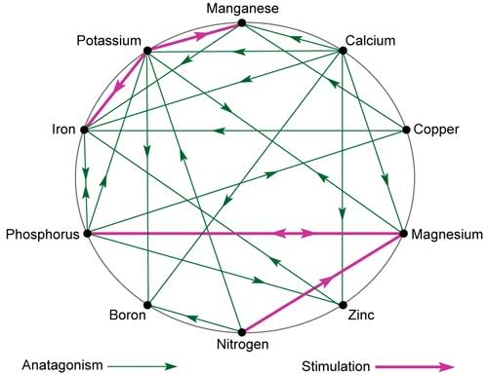

Slide 15
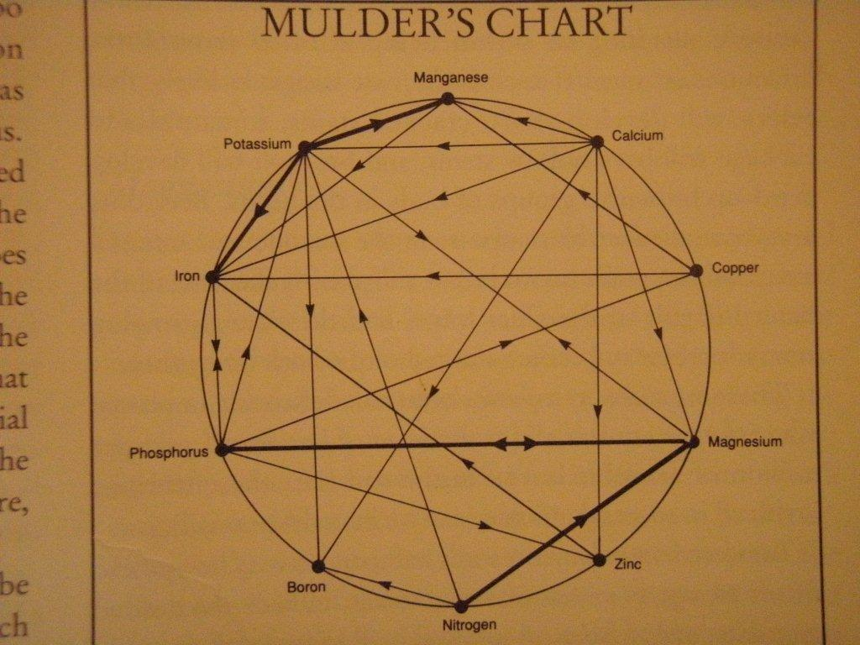

Slide 16
Theories related to the Passive Absorption 1. Diffusion theory diffusion theory: is the process of transition ions nutrients from high concentration to low concentration that is equal to the concentration of these ions in the soil solution and in free space. 2.Exchange absorption - Cross-absorption on the surface of the root & Soil solution OR clay partial as the surface of crossing and exchange . 3. Contact exchange: where there cations mutual exchange between the root surface with cations mutual soil colloids (clay and humus), some time without that soil solution to any role and is done when the fields overlap Oscillation (field oscillation) for soil particle with root When the ions of each of them located at the end of the field oscillation can occur for these ions exchange between soil and root. 4. carbon dioxide CO₂ ca tions absorption into the soil with the assistance of CO₂

