Slide 1
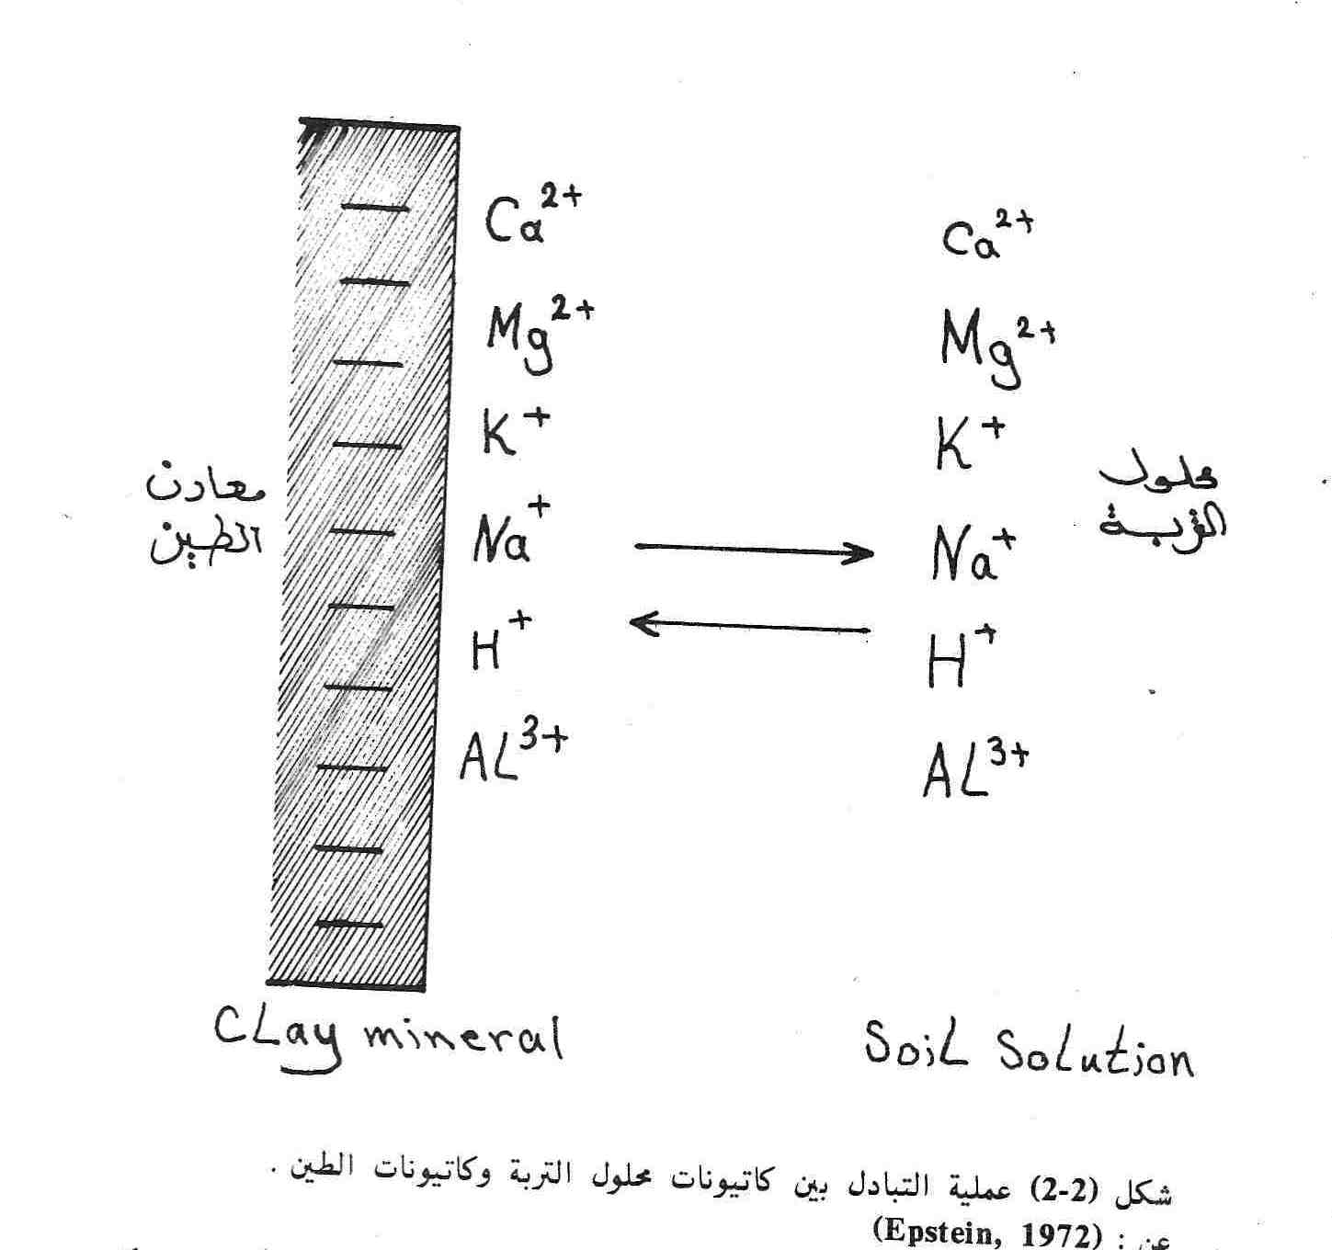

Slide 2
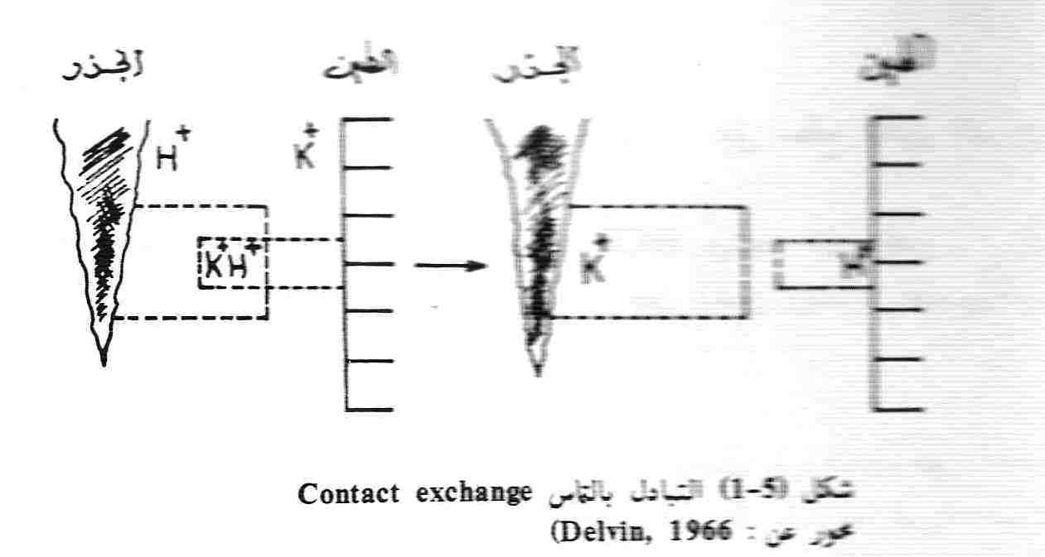
Field Oscillation

Slide 3
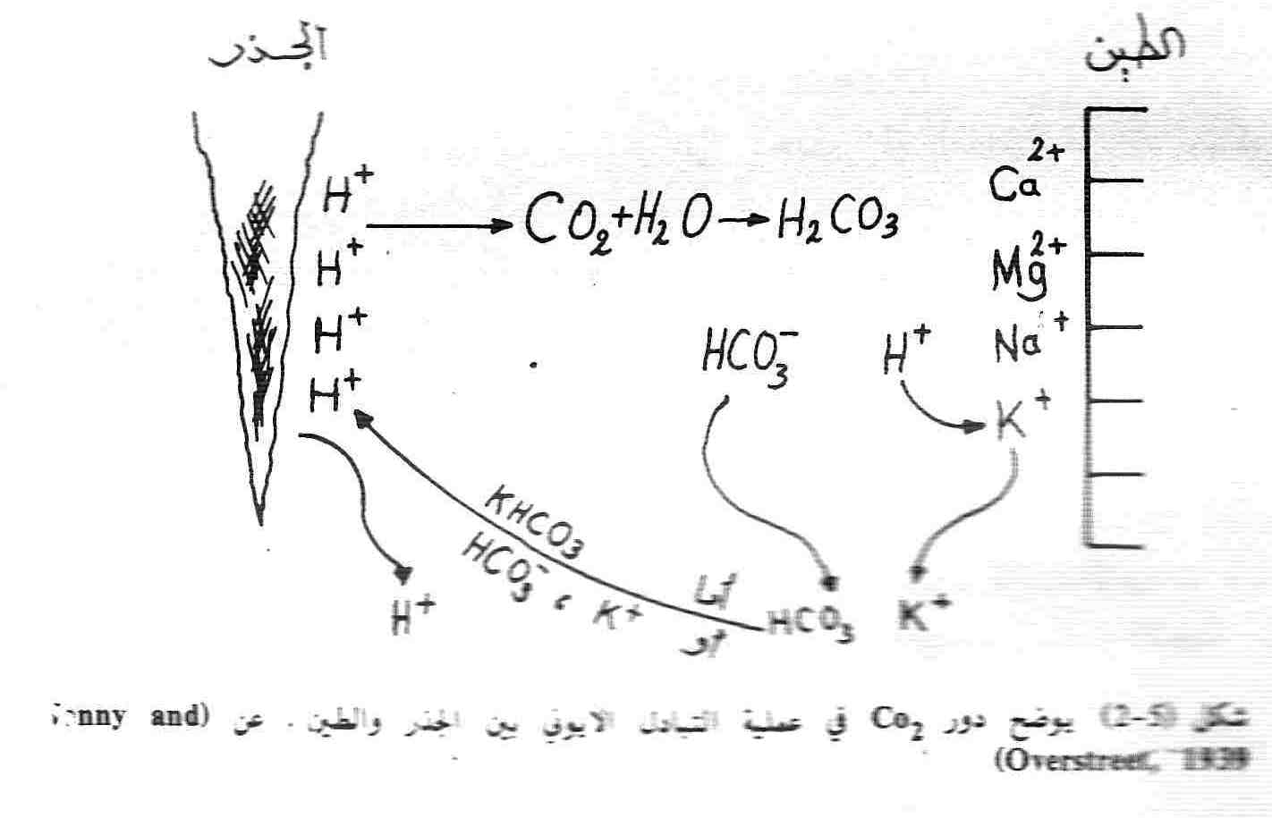

Slide 4
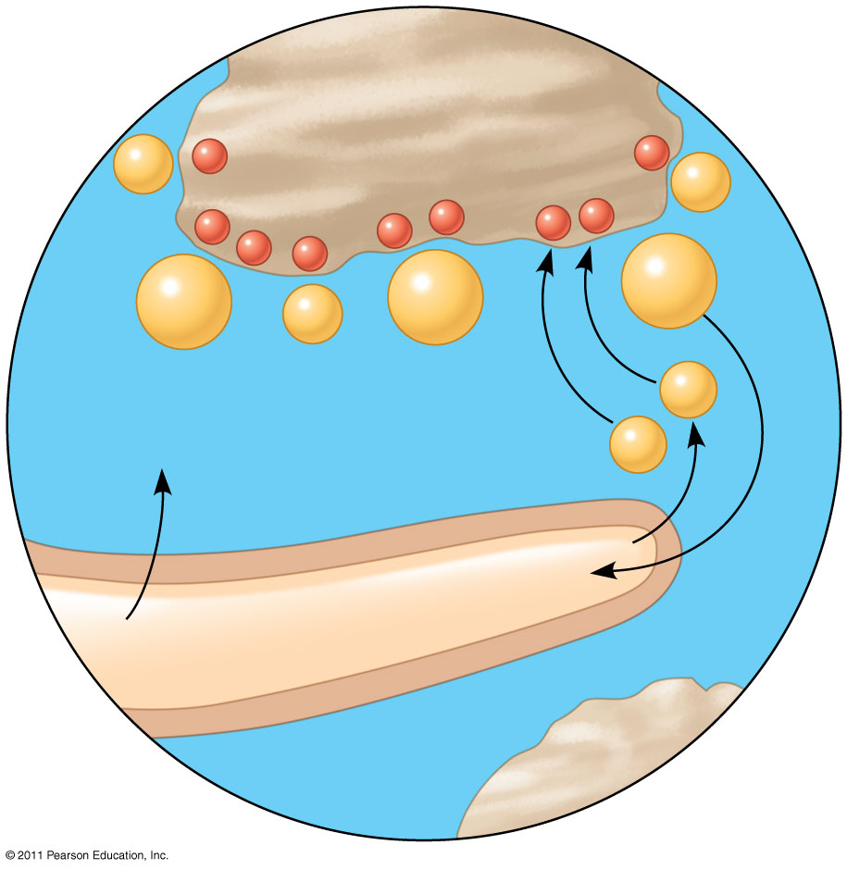
Figure 37.3
Soil particle
K⁺
−
−
K⁺
−
−
−
−
−
−
−
Ca²⁺
Mg²⁺
Ca²⁺
K⁺
H⁺
H₂O + CO₂
H₂CO₃
HCO₃⁻ +
H⁺
Root hair
Cell wall
Notes:
Figure 37.3 Cation exchange in soil.

Slide 5
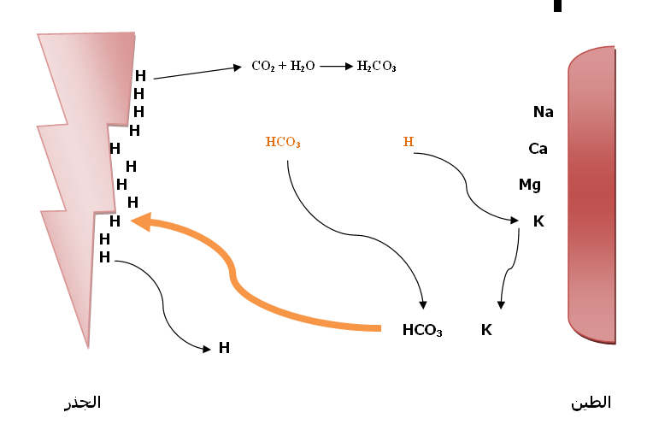

Slide 6
DONAN Equilibrium: To inter any anions into free space have caught and interred in to cytoplasm and don’t return again this run against with diffusion connotation or meaning . When the spread of equal numbers of anions and cations into the cell through the cell membrane which leads to unequal distributions of ions on both sides of the membrane. At the point of equilibrium the concentration of anions and cations equal on both sides of the membrane. DONAN NOTED when ions diffused with numeric valiant for both of ( - ,+ ) there are not same or equal distribution at both side of membrane . At the point of equilibrium . C + = I -

Slide 7
Where the C ⁺ is the total concentration of cations and I-is the total concentration of anions. Within the cell:
C ⁺ = I⁻+ F ⁻ Where the C + and I-are equivalent concentration to positive and negative ions the cell. At the point of balance and equilibrium must be multiplied by concentration cations the other side of the membrane, namely that:
(Co +) (Io-) = (Ci +) (Ii-) Inside the cell outside the cell

Slide 8
OUTER | CELL | INNER
+ ، - | ≠ | - ، +
(+،-) | = Diffusion & nun diffusion ions Equilibrium | ( + ، - )
C_{o}⁺ | = | I i⁻ ( Protein ,fates)
C_{O}⁺ = I_{O}⁻ |  | C_{i} ⁺= I_{i} ⁻⁻+ F⁻
 | يمتص + مجموع الايونات دون صرف الطاقة اى دائما يزداد (-) | (+( for equilibrium
, absorbed (-)
With out spend energy
The Aide of Donan for Equilibrium permanent increase
( - ) this terminology is (Against concentration gradient )
with out energy ………..

Slide 9
As a result, the total concentration of anions inside the cell more than a concentration outside the cell. In order to be electric balance must pass an additional positive ions through the membrane to equalize the anions and installed inside the cell and this leads to that is the concentration of cations in the cell than outside the contrary concentration anions.
It should be recalled that the idea of Donnan take into account the pool anions against the concentration decline (against concentration gradient) without the need to energy by plants.

Slide 10
Hypothesis Electrical Potential the cell wall with a negative charge as is the case in the clay fraction and solution of less concentration of hydrogen ions from the cloud 10⁻³ : g/ Ion / liter = 1 mg = 1ppm - Less than 1 mg. Ion / liter of hydrogen ion is the root of the plant with a negative ( - ) charge absorbs the positive charge. ( - ) - If equal to 1 mg. Ion / liter of hydrogen ion is the root of the plant is zero for any absorption of ions not taking place where the shipment is neutral.
( 0) - If it is higher than ppm 1 be the root of the plant ( + ) absorbs the negative charge. ( + ) The soil solution: Negative: if the concentration of hydrogen ions less than 1 mg. Ion / L is a negative root absorbs positive. Zero (neutral): If the concentration of hydrogen ions is equal to 1 mg. Ion / liter. Positive: if the concentration of hydrogen ions more than ppm 1 root be positive and absorbs negative.

Slide 11
® Why added the lime CaCO₃ for acid soil? In acidic soils of humid areas and that a high concentration (H⁺)ions resulting from the decomposition of organic matter in the soil increases the absorption of anions and lower absorption cations the contrary may occur secretion (DEPLETION) Any withdrawal of cations and presents originally on the surface of the root and edit this cations to a solution soil, due to heavy rains had washed and provider of large quantities of soil to depths beyond the reach of plant roots. As for the soils of Iraq and soils dry areas and semi-arid opposite is true where the difference voltage is negative and increasing cations absorption and lower absorption of anions. At decreasing of transudation decrease (Ca²⁺) and all absorption of (Ca²⁺) are done on transudation ,mass flow

Slide 12
Sign that maintain active Absorption Experiments carried out by ( lande gard 1948) and his aides have made to the alga Nitella in freshwater pond water and the valonia in sea water sea water have shown that:
Nitella / Pond water | Valonia / Sea water
1-concentrtion of (K , Cl) <<P.W | 1-concentrtion of (Na)>> S.W
2-Accumulatio OF (K,CL)in Nitella cell. | 2-don’t accumulation of (Na⁺)in Valonia cell .
3-this process don’t to happen with diffusion .
4-The process is Selectively don’t compulsory (the concentration of Na⁺ is thousands time more than K⁺ ) (against concentration gradient) .

Slide 13
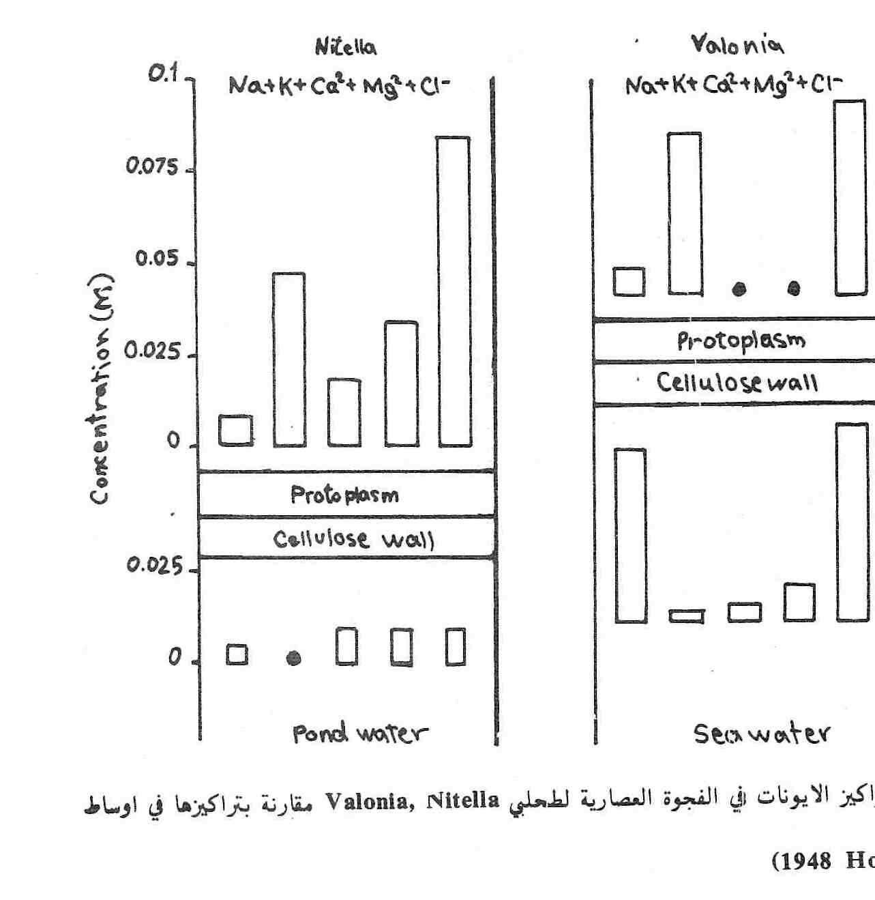

Slide 14
This experience led to the following facts:
Absorption need to divert energy from living plants in order to sustain her life. That the anions be present in the soil solution and root vegetable has a negative charge also get any aversions to the absorption needs to exchange energy. Other evidence confirming the absorption of active: 1-Temperature: When you increase the degree of temp. of the solution ,cells increased absorption. 2-Oxygen: increase the proportion of absorption by increasing the proportion of oxygen. 3-Carbohydrates: When there is an increase of carbohydrates in plant tissue increased absorption. 4-Breathing: Oxygen consumption, any increase in breathing and increase the CO₂.

Slide 15
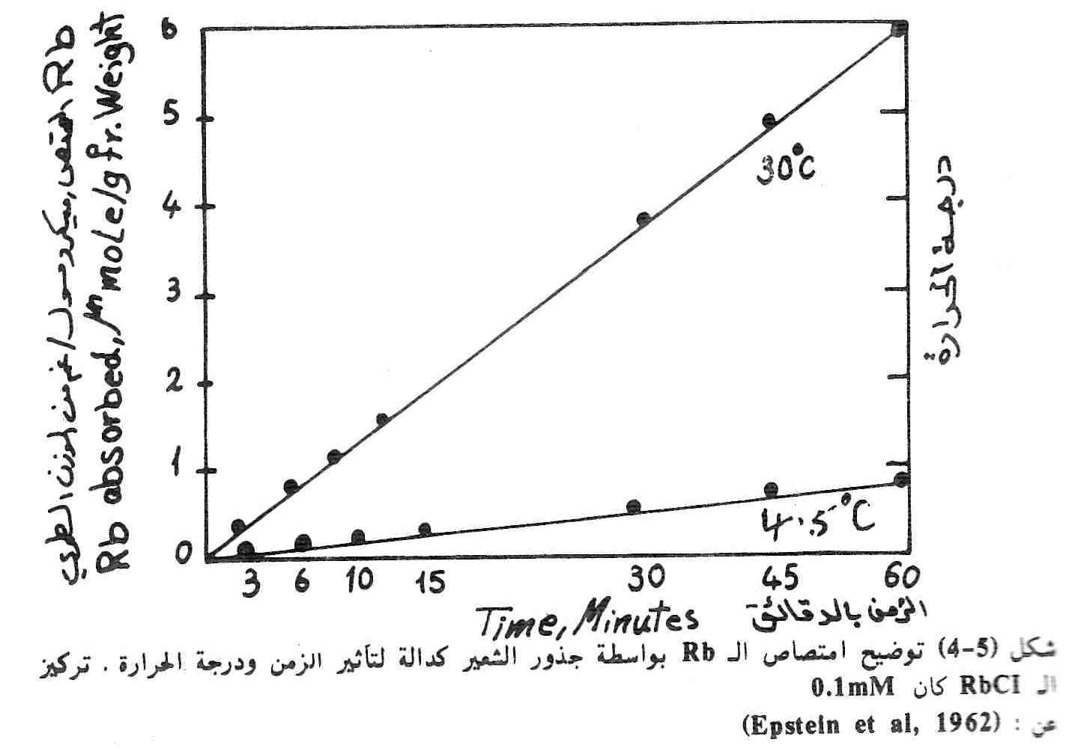

Slide 16
