Slide 1
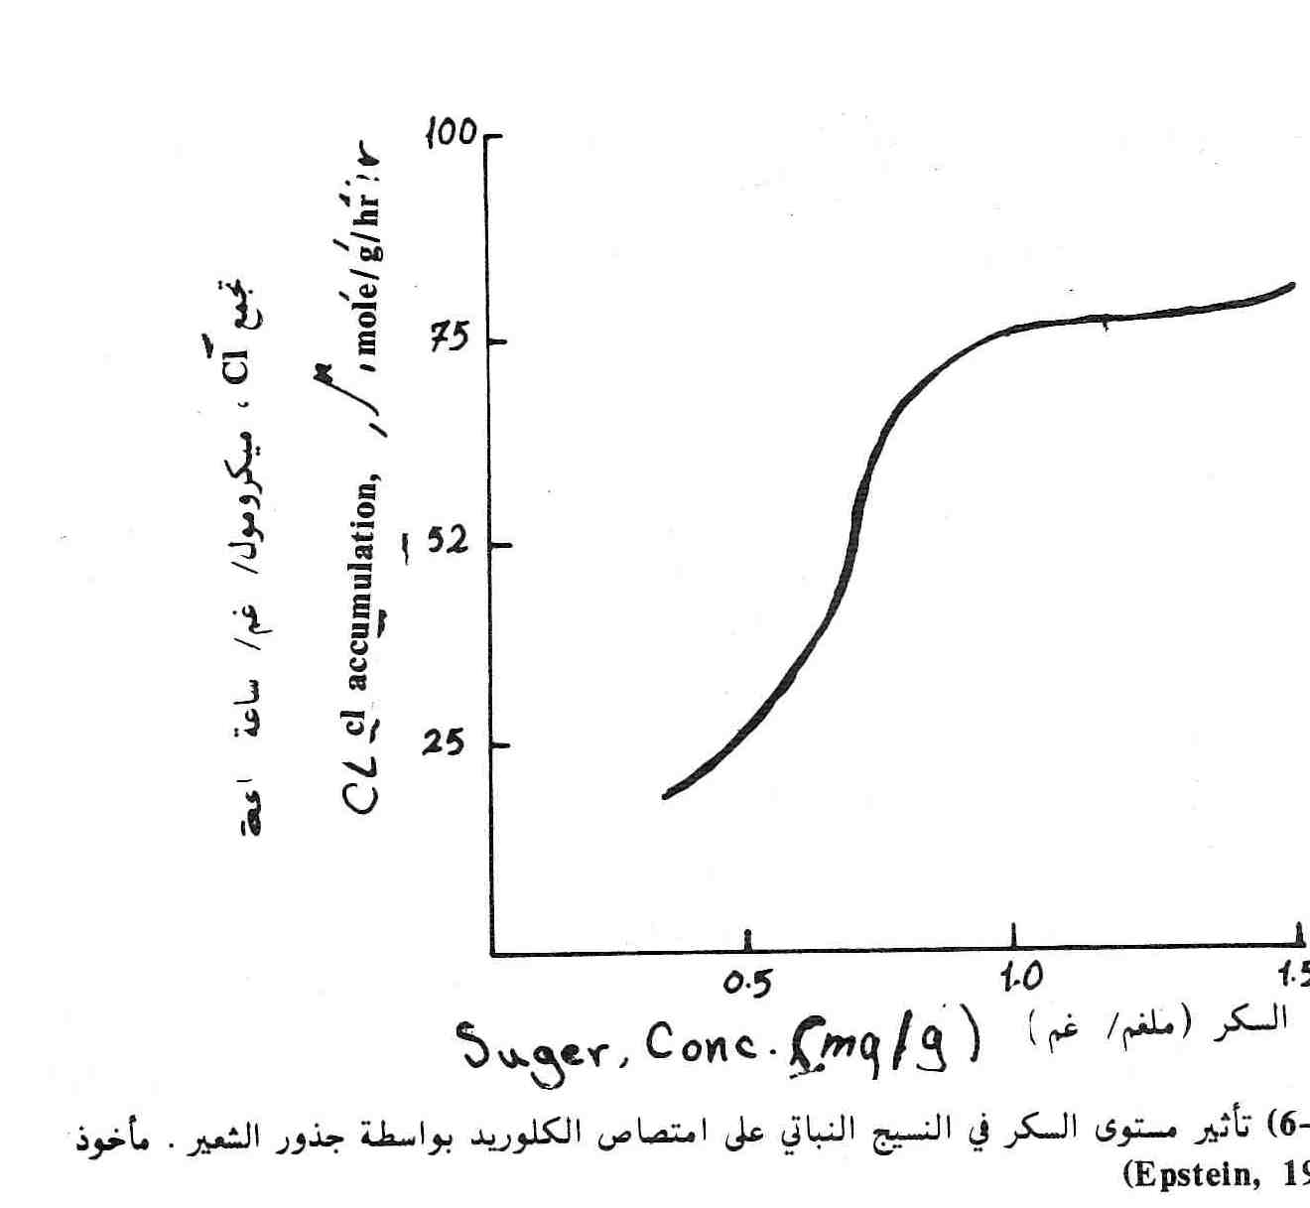

Slide 2
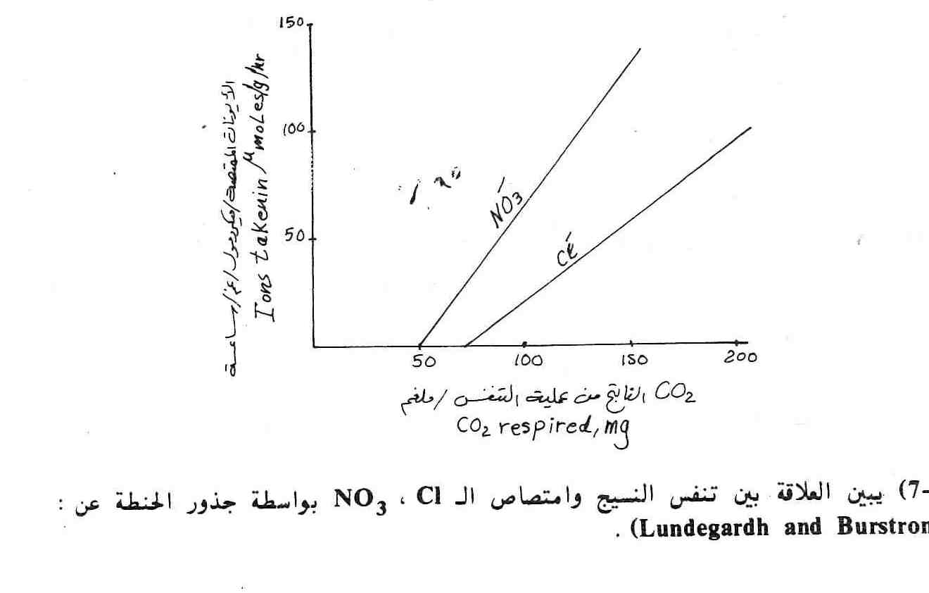

Slide 3
5-Inhibitors: retardant materials, toxic or reduces the absorption and evidence that this process was vital, (Di methyl )article was added to the nutrient solution of KCL decreased rate of potassium K⁺ absorption rate of 90% . and chlorine CL⁻ decreased rate 60% and Oxygen consumption decreased by 60%. 6-Light: found that ions increases with their light intensity and this is further proof to link the process of bio-energy absorption resulting from the process of photosynthesis as a function of the process of photosynthesis is to convert light energy to energy in the form of ATP's chemical and NADPH2 result of the interaction Hill reaction observed that plants in the light absorbing ions faster than plants grown in the shade.
ATP = Adenosine tri phosphate
NADPH₂ = Nicotine amide adenine nucleotide phosphate .

Slide 4
The amount of energy required for ions to absorbed : The concentration of ions within plants over hundreds or thousands of times the concentration in soil solution and nappy on this high concentration necessary for the plant to divert energy and this energy can be calculated roughly as follows: ΔG = RT ln C2/C1 ΔG = the change in free energy to pumped ions in the cell unit cal / mol R= gas constant and equal to 1.987 calories/mole/degree T= the absolute temperature (H.T +273) Ln = logarithm natural and that equals (2.3 Log10) C2 = concentration of ions within the plant m mole/cm³ C1= concentration of ions in the soil solution m mole/cm³ If we assume that the concentration of a 10000 times more potassium inside the cell than in the soil solution and at a temperature 20 C⁰ .the energy expended by the plant as follows: = (1.987) * (273 +20) * (2.3log10000 / 1) = 5356 cal / mole

Slide 5
Sources of energy in green plants 1)The process of photosynthesis 2) Respiration (breathing, ) First: the process of photosynthesis: where they are in the process converts light energy into chemical energy (HILL reaction ) in the form of ATP and NADPH2, that the change in free energy ΔG broken bond, when the rich and one of the estimated ATP (cal / mole 7000-10000).
ATP + H2O
ADP + H₃PO₄
ΔG = 10000-7000 cal/mole
The energy stored in the form of the NADPH2 about 52000 cal / mole and this energy both in the ATP or the NADPH2 used to transport ions and saved in the cell. The process of generating energy by a process called photosynthesis, the process of phosphorescence optical photo Phosphorylation. Second: breathing, a process for demolition of plant carbohydrate and energy necessary for him, whether under anaerobic conditions in the absence of any oxygen, the process of fermentation and gly colysis, which ends the composition of Pyruvic acid:
ATP = Adenosine triphpsphat
NADPH₂ = Nicotine amide adenine nucleotide phosphate .

Slide 6
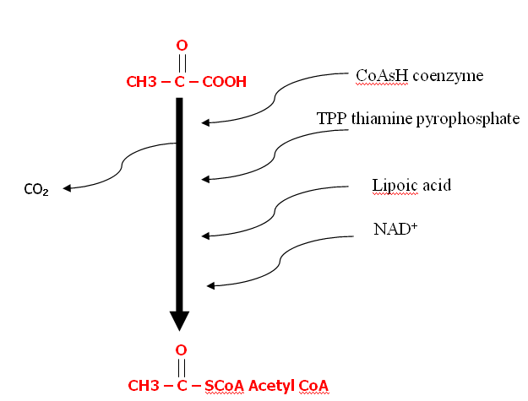
C6H12O6

Slide 7
Then Acetyl COA reacts with the acid to form oxaloacetic acid,…… citric acid, which is the first acid consists in the Krebs cycle as it is called a Tri carboxylic acid cycle and energy resulting from the process of respiration occur oxidative Phosphorylation and this process can be summarized as the following equation:
C₆H₁₂O₆ + 6O₂ + 38ADP + 38Pi 6CO₂ + 6H₂O + 38ATP
That 90% of the ATP formed in side of plant on mitochondria In other words, the process of oxidative Phosphorylation result of the process of respiration is responsible for producing 90% of the energy in the form of ATP inside the plant and that 10% only be the result of the process of photo Phosphorylation light as a result of photosynthesis . The rate of non-green plants, the production of most of the energy in the form of
ATP is through Phosphorylation result of breathing in the mitochondria

Slide 8
ATP Formation
ATP
%10 Photophosphorylation( Photosynthesis )
%90 Oxidative Phosphorylation ( Respirations )

Slide 9
Krebs cycle حامض الستريك ( اول حامض في دورةايضا يتم تسمية بدورة ثلاثى حامض كربوكس
(Tri carboxyic acid cycle )
و الطاقة الناتجة تحدث بعملية الفسفرة التأكسدية و مخطط يبين كيفية تكوين ATP
عملية التنفس يحدث بعملية الفسفرة التاكسدية
ATP
10% تحدث بواسطة 90% متكون يحدث من
الفسفرة الضوئية في عملية عملية الفسفرة التركيب الضوئى بواسطة عملية التنفس في
المايتوكوندريا

Slide 10
Absorption of nu. &it is mechanism
الاراء و الفرضيات و النظريات المتعلقة بالامتصاص النشط (الحيوى)
امتصاص العناصر و اسس ميكانيكية لها
Concepts , Hypothesis and Theories related with active absorption
تجمع Accumulation | تحول و انتقال Translation | امتصاص Absorption
ٌR⁺ + R⁻ = KNO₃ | K⁺R⁻ + R⁺ NO₃⁻ | الايونات K⁺, NO₃⁻ هناك نواقل (R⁺, R⁻)
Inner space | Carrier Anion& cation | Ione- carrier
اول من لاحظ هذه العملية هو العالم سويدى
(Landeigard 1948) على طحلبين
فرضية تنفس الملحى و أول من ربط عملية امتصاص في محلول التربة هو نفس العالم و سمي الفرضية التنفس الملحي أو الانيونى
Salt Respiration or Anion Respiration

Slide 11
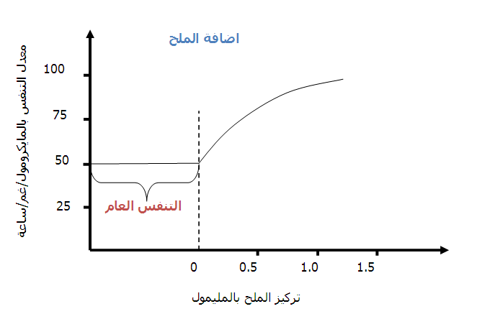
Salt Addition
General respiration Salt respiration
NO₃ ⁻¹ ,SO₄⁻² ,H₂PO₄⁻¹

Slide 12
Mechanical salt respiration Summarize the views of the lingard: Important part in the Cytochrom is ( Fe ) and changes its valency, that is the loss of oxidative stress and increased e- and reduction is to gain and a decrease of e-.
Ionized of ( H+) e- + Fe^{+3 redaction}
^{oxidation}
Fe⁺² - e-
The Cytochrom is the article carrier or carriers by parity change occurs and oxidation reduction of iron within the Cytochrome that can be carried and the transfer of anions across the plasma membrane and membrane the cytoplasm to the gap and then to the gap and be juicy like a series the cytoplasm arch bridge or a bridge and be the first of at the beginning of membrane endoblast inside ( membrane gap) adjacent to the gap juicy and the end of the outer membrane of the wall adjacent to the plasma membrane. The source of the negative electron is the output of ionized hydrogen or dissolution of organic acids near the membrane and the impact of the Tonoplast enzyme ( De- hydrolyses ). Lose hydrogen electron and the negative turn into a hydrogen ion. Successively hydrogen ion composition comprises a steady stream toward the gap juicy inside and out side and to the cell wall of the high concentration at inside to concentration Allowati out side.

Slide 13
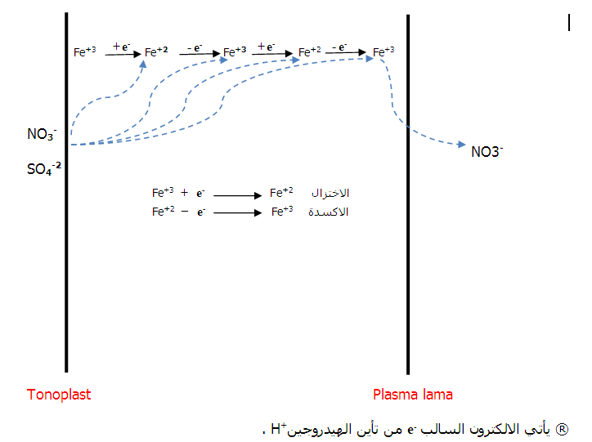
Plasma lama
Tono plast

Slide 14
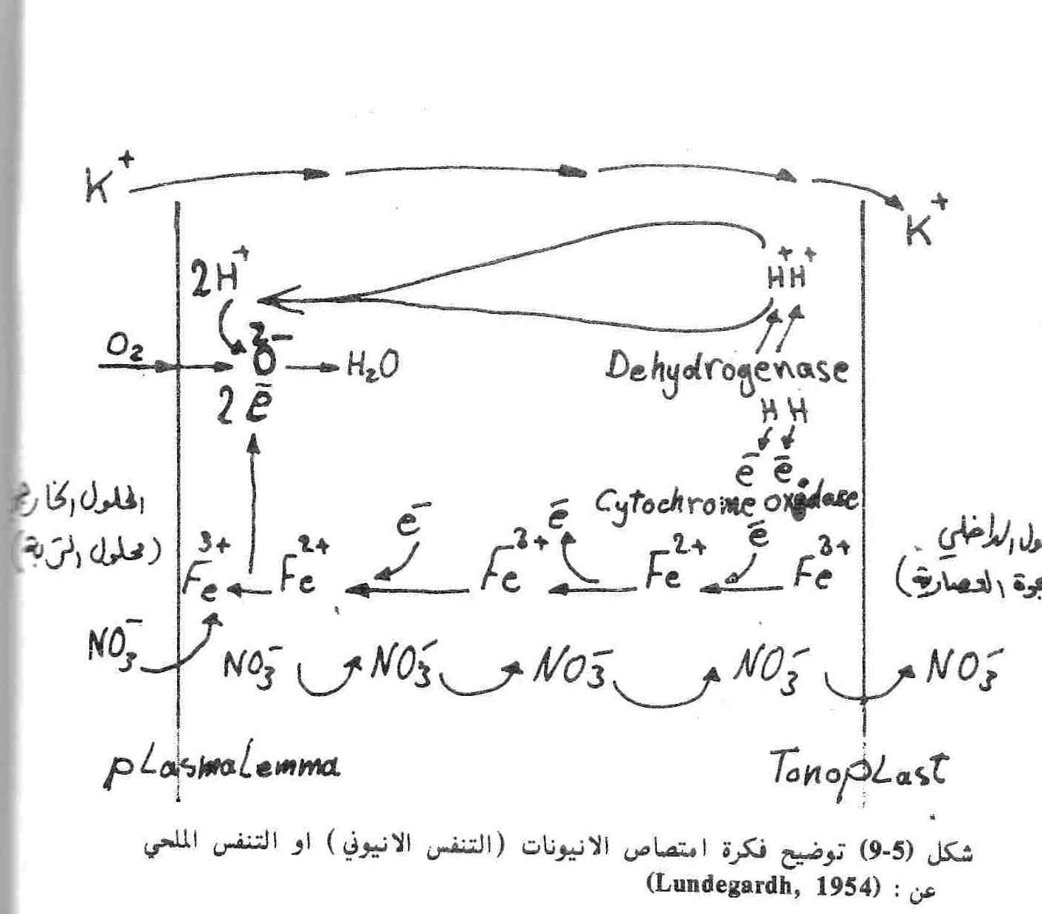

Slide 15
The source of the negative electron is the output of ionized hydrogen or dissolution of organic acids near the membrane and the impact of the Tonoplast enzyme (dehydrogenize).
Lose hydrogen electron and the negative turn into a hydrogen ion.
Successively hydrogen ion composition comprises a steady stream toward the gap juicy inside and out side and to the cell wall of the high concentration at inside to low concentration out side.
Arise with the current of hydrogen ion stream of negative electrons. Negative interference of electrons as they move to the respiratory enzyme system which Cytochrome oxide (Cytochrome oxidize).
Negative electrons moving out side with hydrogen ions and electrons in the same direction to the negative Cytochrome and near the gap juicy to iron.

Slide 16
And the iron in the Cytochrome as in the first step of the mechanical process of breathing and circulation are received negative electrons.
Moving negative electrons, which attacks the grains Cytochrome to oxygen inside the cell to the process of breathing and concomitant to that two electrons in order to become O₂ to O₂⁻², which combine with 2H⁺ to form water.
Address or unite iron Cytochrome and valence 3 Lannion NO₃⁻ and the direction of the plasma membrane to the gap juicy iron Fe⁺³ to Fe⁺² and finally after the entry of NO3-in the gap juicy returns from the iron Fe ⁺² to Fe ⁺³.
Thus arises a stream of anions from the direction of outside and inside. In order to enter the anions into the gap that must be juicy cation until it is equivalent to electric: The tie is by-ion by the decomposition of acid. Faces the potassium or where it is absorbed without a free exchange of energy.

