Slide 1
There are major trends to vital absorb
1-Transmission by hold carrier theory :-. 2- Ion pump :-. And scientists who supported the theories they are the following: landeigardh 1954 : Salt respiration and the Cytochrome. Ben net Clark 1956 : Phospholipids. Phosphate cycle And others such as (Mitchell 1966 - Hodges 1972 - Epstein 1957 - Hagen). Protein molecules or enzymes responsible for the transfer of ions: a vital membranes containing molecules, particularly those capable of keeping and transfer of ions with in membranes is not allowed to live influence ions (alone) of these so-called carrier either organic molecules (the phospholipids or proteins or enzymes) are allocated a specific ion specificity without other ions in the active sites and there are specialized working for (K ⁺ , Rb ⁺) and (Ca ⁺² , Sr ⁺²⁾ and (SeO₄⁻² ,SO₄-²). ® Note that the stability of the salt respiration when adding cyanide acid (HCN) is working to discourage or inhibition of process any stopping the Cytochrom oxidation and reduction in Fe ⁺³. Summary way:

Slide 2
® and this vital process involving enzymes. ® and can be hold is because the fat molecules can move through the molecule fat cell membranes. ®, as well as can antibiotics, such as Gramicielin and Valinomycin It will also use derivatives (anpicillin) be the holder of the mobile and ions and is optional, for example, when potassium Valinomycin commitment to be more absorbed about 300 times more than sodium. Ion pumping or ATP ase enzyme
Discovered (Mitchell 1966) and (Hodges 1970) energy molecule ATP present in animal membranes or blood where the concentration of various ions of sodium and chlorine and potassium external medium. Where the red blood cells containing high concentration of potassium and low concentration of sodium, while the opposite is what is in the blood plasma, where the high concentration of sodium and low concentration of potassium and this distribution is the enzyme activity caused by ATP ase. And the ATP- ase enzyme complex is a set of enzymes have the ability to analyze compounds ATP as in the equation:
Energy
® and use this energy in the process of ion transport in animal ,plant cells.

Slide 3
حاليا يوجد اتجاهين رئيسين لامتصاص الحيوى
انتقال بواسطة الحامل Carrier theory
الضخ الايونى Ion pump
و علماء الذين ايد النظريات كانوا بالشكل التالى :-
Landeigardh 1- لينديكارد
تنفس الملحى و سايتوكروم
2- بنيت كلارك Ben net Clark
فوسفولبيديس
3- باحثين اخرين منهم
Epistein & hagn 1957
Mitchell 1966
Hadges, etal 1972
جزيئات البروتين او الانزيمات مسئولة عن نقل الايونات

Slide 4
اغشية الحيوية يحتوى على جزيئات خاصة قادرة على مسك و نقل الايونات ظمن اغشية حية لا يسمع بالنفوذ الايونات ( وحدها) هذه يسمى (Carrier) أما جزيئات العضوية و الفوسفولبيد أو البروتينات أو الانزيمات هناك تخصص اي نقل ايون معين دون غيرها في الايونات يوجد مواقع فعالة و هناك عامل متخصص لل (Rb⁺ , K⁺) (Ca⁺², Sr⁺²) كذلك (SeO₄⁻² , SO₄⁻²)
1- الجزيئات 2- تخصص 3- اختيارى
انتقال الحامل الايونى عبر الغشاء:
و المنشط بالطاقة ATP حسب ارء كل من
(Mengel & Kirkby 1982)

Slide 5
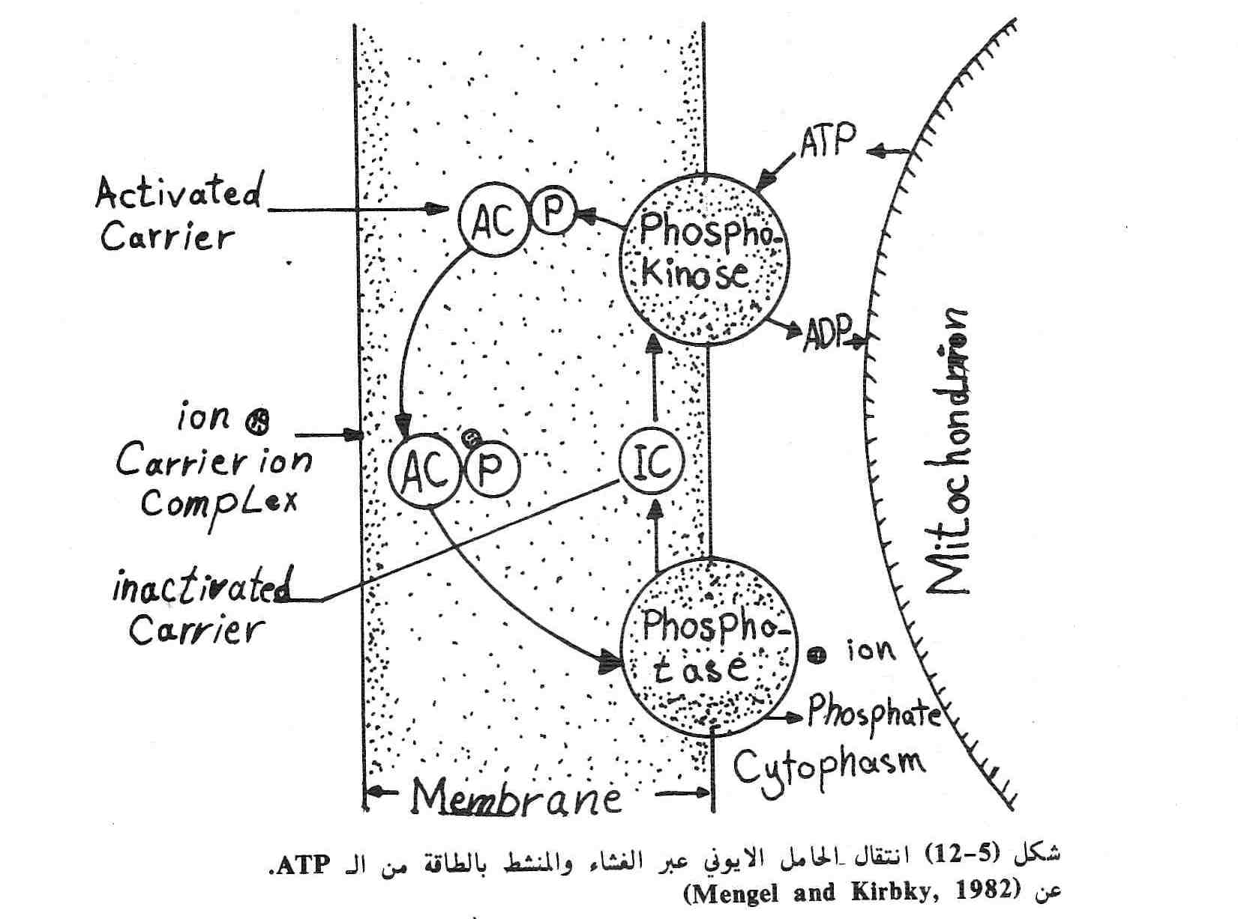

Slide 6
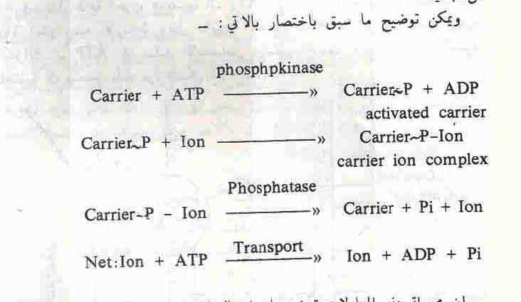

Slide 7
و يكون حسب المعادلات التالية
Phosphokinase
1- Carrier +ATP Carrier-P +ADP Activated carrier
2- Carrier –P + Ion Carrier-p-Ion ^{phosphats} carrier +Pi +Ion
phosphates
3- Carrier-p-Ion carrier +Pi +Ion
4- net : Ion +ATP Ion +ADP +Pi
Transport
و هذه العملية الحيوية يشترك فيها انزيمات
و يمكن ان يكون حامل هو جزيئات دهنية لان يمكن لجزيئة الدهن انتقال عبر الاغشية الحيوية .
و كذلك يمكن لمضادات الحيوية مثل ( Valinomycin ,Gramicidin) و يستعمل ايضا مشتقات (nonactin) يكون هو نقال و حامل الايونات و يكون اختيارى و على سبيل المثال K⁺ عند استخدام Valinomycin يكون اكثر امتصاصا بحوالى 300 مرة اكثر من Na⁺

Slide 8
ion pump: a process is the transfer of ions by a composition consisting of two companioned - ATP - ase enzyme and protein diabetes (glycoprotein( hydrolysis. Where hydrolysis of the ATP molecule by the enzyme ATP - ase and change the shape and a size of the protein is ready to transfer cat ions through the cell membrane. And ATP- ase of bacteria and fungi and higher plant differs from the ATP ase of Animals (change the shape of the protein), but in the other boroughs are in the above-mentioned plasma membrane is responsible for the negative charge of the cell and be a source of energy in the absorption of vital
namely, that
Source of negative charge
Source of energy on active transport
Enzyme that causes a change in pH through the membrane due to pump of hydrogen ions out of the cell and the cell becomes more and potential by the external base and the solution more acidic and positive.

Slide 9
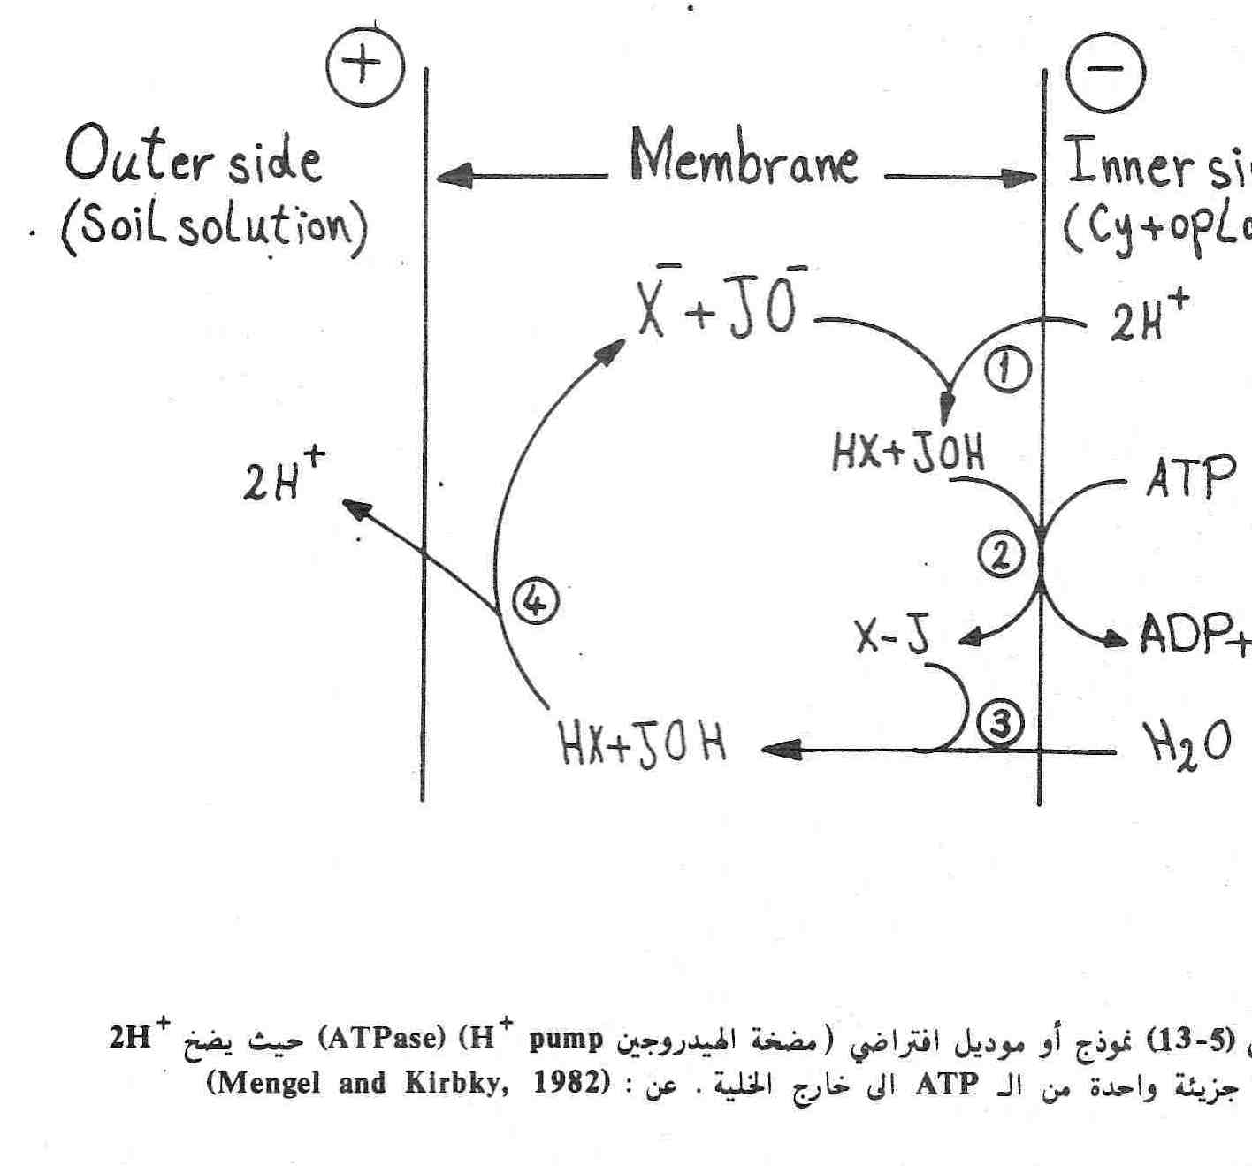

Slide 10
1- 2H⁺ X⁻ * JO⁻ XH*JOH
ياتى من سايتوبلازم On Cytoplasm
تزويد بالطاقة + Energy
2- XH*JHO ATP ADP+PI
3- X-J + H⁺ OH^{- Hydrolysis} تحلل المائى
4 - XH*JHO 2H TO OUTER out SIDE كل يفقد 2H+
Pmf = - pH Pmf = proton motive force . Force for proton movement across both sides of the membrane (- pH),
which indicates the difference between the concentration of hydrogen
ions on both sides of the membrane is responsible for the transfer
cat ion against declining

Slide 11
The change in an effort electrochemical potential has been interpreted by the world (pools 1978) the following equation:
Pmf = - pH Pmf = proton motive force . Force for proton movement across both sides of the membrane (- pH), which indicates the difference between the concentration of hydrogen ions on both sides of the membrane is responsible for the transfer cat ion against declining concentration.
Thus, the (outer side) is positive (inner side) and consists of a negative voltage for this process, the cytoplasm becomes more alkaline and more acidic external solution and the absorption of free cat ion occur only in rare cases, either absorb anions occurring active and occurs in specialized steps (specificity) .
Found to have both ( hodges 1972, fisher 1970) that there is a close link between the activity of the enzyme ATP ase and ion uptake, and ATP energy source and contains a plasma membrane ATP ase that has the capability of degradation of ATP as in the equation:

Slide 12
+
+
H
And free hydrogen ion out side, thus shifting the external solution to increase the acid-free hydrogen ion and potential by increasing the inside base as a result a large amount of free ADP, where degraded water generators of large amounts of OH and that what remains in the plant cell in effect, that there is a difference in voltage between the plant cell Live and external medium already 60 to 160 milie volt the cell that attracts negatively charged cation that exchange with hydrogen ions (Mitchell 1966).
As for the proposed anions ( hodges) OH group resulting in the degradation of ADP to bring hold ions thereby stimulating absorption ions moratorium on facilities with OH, analyzed by ADP, which absorbs the carrier ions absorb anionic optional and exchanged with OH. The figure of hydrogen ions H climbs by consumption of hydrogen ions and the formation of OH as a result of the process ( de carboxylation) that occur for anions.

Slide 13
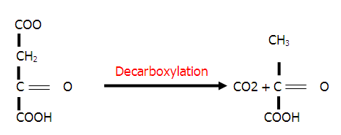
+H
And the plants are developing and UPS (N - NO3) and as a result of reduced within the plant resulting in OH and some plant absorbs anions By Others without interference enzyme ATP ase.
Proposed world ( hodges 1973) when there is a process of phosphorylation that the uptake cation affected more than secretion of anions as a result of more OH instead of H.

Slide 14
Dynamic mechanical transfer of ions
transmission speed of ions such as potassium and concentration found: concentration less than 0.2 Mil micron move increasing at the outset there is less then with the increase concentration to rise much from the beginning and then less concentration up to the maximum. If the concentration of many so up to 50 Mil micron increase the speed of the speed limit.
So that the refraction of the curve obtained between 0.2-0.5, the presence of more of the sites for high concentrations of the hold women have many active sites (active site). This guide has more than one mechanical transmission elements or ions, depending on the concentration.

Slide 15
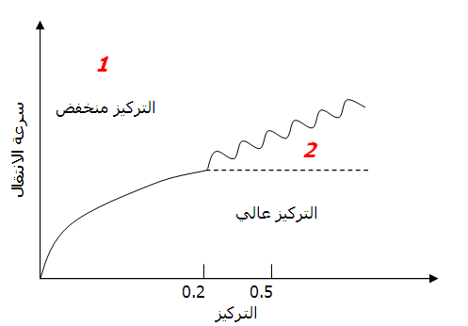
Lower Concentration
FIRST ORDER KINATIC EQUATION V _{max} = k ( S )
ZERO ORDER KINATIC EQUATION V _{max} = K
V _{max} = k ( S )
Higher Concentration

Slide 16
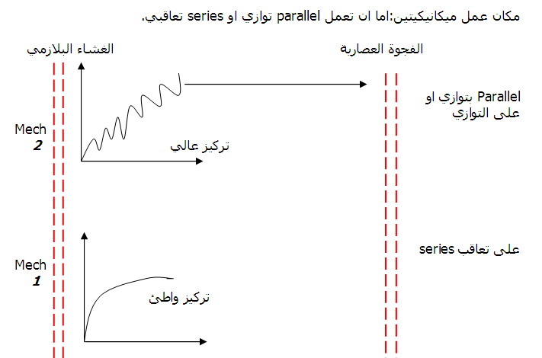
ZERO O. K. E.
V _{max} = K high concentration
FIST O. K. E.
V _{max} = k ( S ) low concentration

