Slide 1
After further research, either: 1. Occurs in parallel mechanical plasma membrane mechanical first concentration and low and high concentration in the membrane gap juicy in high concentration. 2. Mechanical sequence occurs in the series, one in the plasma membrane at low concentration of any mechanical first and second place in the film and the gap in the succession of high concentration of second mechanical.
Move mineral nutrients copies upward and back downward A group of scientists suggested that: 1. Gets the movement of nutrients in the bottom to the top by copying the rising influence occurs transpiration from leaves and to the bottom. 2. Back downward into the water and going sideways. 3. Of water and to timber and to other higher and this case with really move (N, P, K) and Ca caused by the wood to the top and the bottom is not due to the movement or transfer of elements within the plant body can learn from the following formula Is it a mobile or sedentary, or quick movement

Slide 2
® Calcium ion to move a few copies of the cortex only moving to upper and staying it doesn’t come done . The feeding of nutrients used by plants in the following forms: 1-Domestic needs internal requirement. 2-The needs of foreign external requirement. 3-Jobing requirements functional requirement. ® said the plants feed on itself any feed itself, when it means a deficiency of nutrition and the plant does not uptake it is requirements on environment ,and the nutrient moving component within the body to efficiency the elements.

Slide 4
Movement of the nutrition component =
concentration of nutrient in the old leaves / concentration of nutrient in the young leaves :
If more than 1 it is immobile. If equal to 1 is almost not mobile. If they are smaller than 1 it mobile. .
® mobile Phosphorus a day or over several times a day within the body of the plant (photosynthesis) to build and analyze the protein composition of sugars and fats and nucleic acids and organic. ® Sulfur also mobile, but less than the movement of phosphorus and sulfur from the roots to the leaves to the very old to the young leaves for photosynthesis.

Slide 5
There are a relationships between : (-) As well as Nitrogen and composition of carbohydrates. (-) The composition of the oil and protein. (-) The composition of carbohydrates and oil.
There are a relationships between : (+) Protein formation and the addition of Nitrogen. (+) Formation oil and the addition of Potassium and Phosphorus. (+) Composition of carbohydrates, Potassium and Phosphorus.

Slide 6
Different crops needs different nut.
1.Cereal Crops .
2.Root & Tuber Crops.
3.Oil Crops.
4.Vegetable &Fruit trees Fruitful.
5.Fodder Crops .
Nutrients { N,P & K } Macro Nu. production.
{ All Micro } test Nu.

Slide 7
Mineral nutrition and quality of crops, the purpose of use :
All the best characters and the quality varies according to the plant :-(taste , relish, hardness , solidity ,softens , freshness)
hardness of digestion
for example: Barley:
- Feed: increase the proportion of protein. - Beer: not more than 7% of protein at the expense of carbohydrates. Malt Linen: Flax - Fibers: the seeds are don’t important but to increase the fiber and its ramifications. - Oil: the seeds are important . Potato: - Starch. - Human feeding .
Notes:
,,,;;

Slide 8
Cereal crops:
During the formation of pods the Potassium deficiency irregularity of seeds and the yield reduces the number of spikes and reduces the number of grains per spike in wheat and oats, the environment and climate affect the filling grain. Provided with a sufficient amount of Nitrogen & Cu processing of appropriate and leaves and sheets The still be younger and chlorophylls ,don’t demolition ,an impact on photosynthesis and grain filling, or to affect photosynthesis to fill the grain and grain fill
(70-80%) material that was found be supplied on photosynthesis process after the expulsion of spikes fill the grain was also found that Potassium has similar effect and to increase the CO₂ metabolism .
Initially needed for the plant (N, P, K) for the expulsion of spikes and full ears and grain protein composition, either in the last needs (N, K) .

Slide 9
Root and tuber crops : - The appropriate level of Potassium stimulates the metabolism of CO₂ also stimulates the movement of carbohydrates from leaves to Potato tubers, and this explains the high content of starch in the Potato tubers are well equipped with Potassium, and this also depends on the type of fertilizer and that the user (KCL) gives a low content of starch, compared with ( K₂SO₄) and this may be due to the negative impact of chlorine ion in the transition of carbohydrates from leaves to the tubers in a long experience for (TERMAN 1950) where, in addition to 800 kg K₂O ha of fertilizer
( Potassium chloride ,sulfate) did not observe substantial differences on yield, but differences were observed in the proportion of starch in the percentages tubers, as in the table:
carbohydrate % | Yield ton/ hectar | Treatment
13.3 | 2.81 | KCL
14.6 | 2.82 | K2SO4
13.8 | 2.86 | K2SO4 1/2 + KCL

Slide 10
The quality of Potato tubers don t depending only the proportion of starch in the tubers that are used to produce starch and must contain a high percentage of ester- groups with Phosphate and
a group (OH⁻)carbohydrate ,notice the high correlation between the membrane with a high degree of ester-g and high viscosity and pure white color of it.
It was observed by (GORLIT 1966) and (EFFMENT 1967) that the content of Phosphorus not only increasing the concentration of starch but effecting the quality of starch . The appearance of the color (BLAKING) in tubers used for human nutrition under the addition of Potassium it be less (MULDER 1955) as the sensitivity of Potato tubers less mechanical harvesting by adding Phosphate fertilizer application. ® quality beets depending on sugar and solubility of amino compounds and elements of (Potassium and Sodium) to be blocked the polymerization process of the sugars through the process of refining and purification of sugars and sugar production .

Slide 11
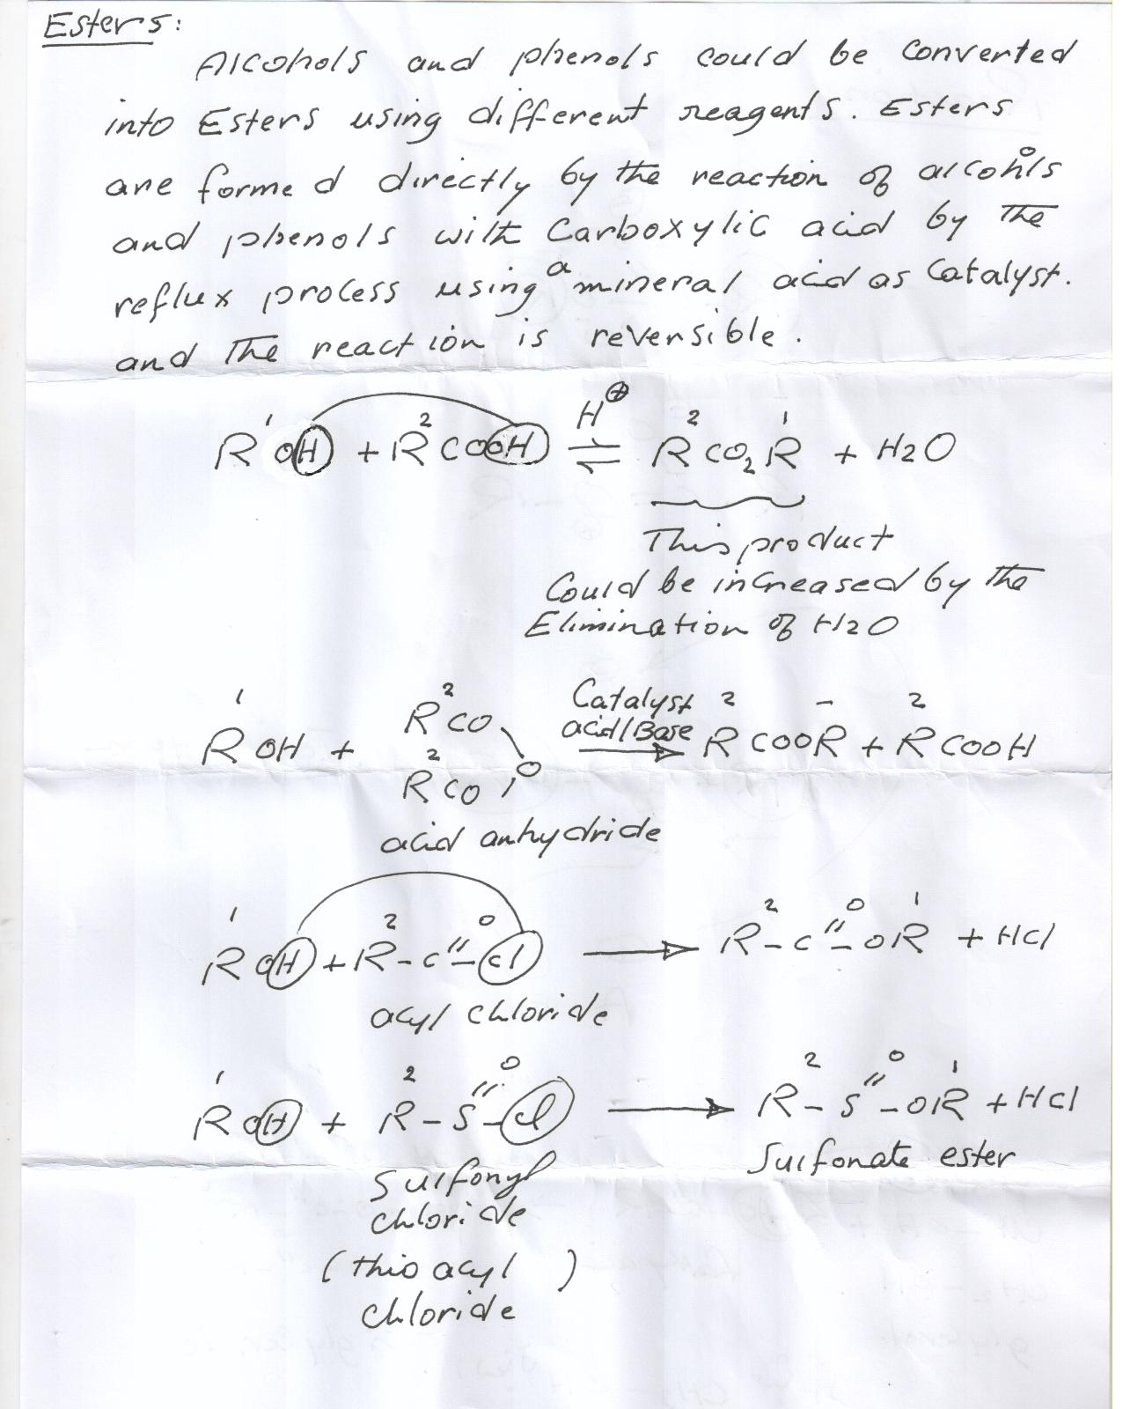

Slide 14
Increasing of k+ adsorption and Increasing of root contents of k+ that has Negative effects for concentration and proportion of Sugar
( Von Boguslawski &Schhildbach ,1969).
Nutrition with Nitrogen for quality and quantity and the time of application have important role of yield and protection of Sugar , carbohydrate and starch
® to get the good growth and good yield but more excessive growth in the final stages, this is have negative effect for filling of the tubers, roots fill both noted (winner 1968) and (bronner 1974)
as well as a boost to the final application of Nitrogen led to a reducing in the yield of sugar beet and led to an increase concentration of amio component and mineral , which resulted because of the tissue remains in the early stages immaturity (juvenile stage) ( forster 1970).

Slide 15
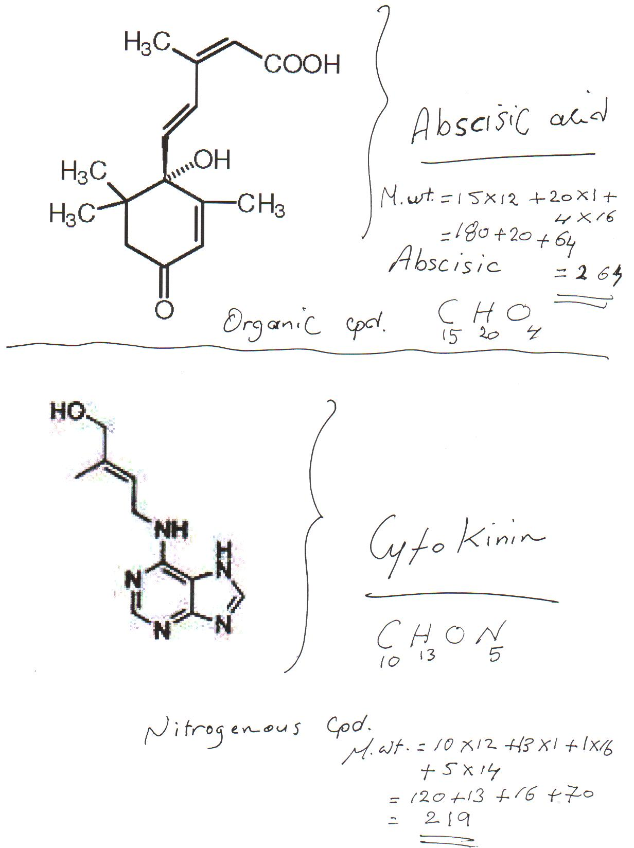

Slide 16
® beet that does not depend only on nutrition and climatic factors, but also: - Light intensity: In the last weeks of growth. - Water.
® in beet salts lead to the quality of bad reduce sugar and a large proportion of soluble amino compounds, and also to the elements, thus making it impossible less of polymerization process of sugar and low sugar extraction . ® Boron: { H3Bo3, H2 Bo3 , HBO3,BO3}The deficiency of B in potato cover of tubers and to sugar Beet root (crown rot and brown heart disease) moldiness of root of beet
Tuber crops, and roots: Potassium compounds and elements dissolved amino Kcl polymerization of sugars. Nitrogen is important in the early stages of carbohydrate ,starch and sugars final stages of the risk in terms of reducing sugars in the sugar beet.

