Slide 1
The omission of beneficial compounds and minerals in commercial production could mean that plants are not being grown to their optimum genetic potential but are merely produced at a subsistence level. This is one of the major blunders associated with the industrial commercial agricultural revolution that accompanied the Industrial Revolution in the late 1800's. By assuming plants only need a finite number of materials to grow, farmers neglected the benefits of myriad other compounds and biological materials towards plant growth in soil. They essentially brought hydroponic fertilization (salt or synthetic based) into the soil zone effectively locking out beneficial biological systems. This miscalculation is prevalent in our farming today and is just now being augmented by organic farming in the mainstream

Slide 2
Function and Sign of Deficiency of the Essential Elements It should be noted that this spec analysis is only a start and that a plant can only respond to stress and deficiency in a handful of ways. For example, having an HID light too close to your plants can cause leaf curling, overwatering can cause yellowing, etc. If growing indoors, before you try and correct what you think is a mineral deficiency troubleshoot your environmental conditions. However, deficiency can still be experienced using complete fertilizers so listen to your plants.

Slide 3
Potassium Deficiency

Slide 4
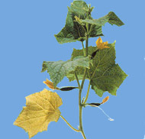
Phosphorus Deficiency

Slide 5
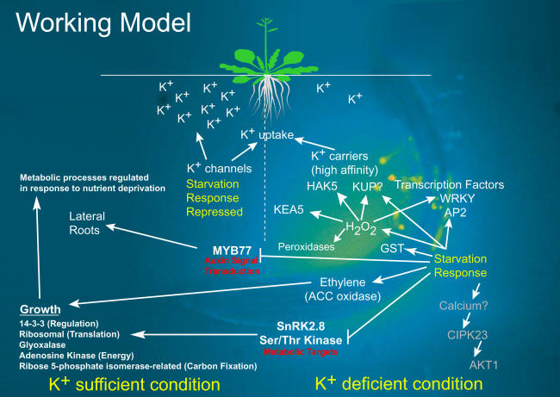

Slide 6
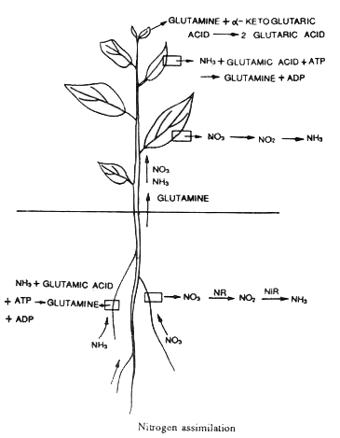

Slide 7
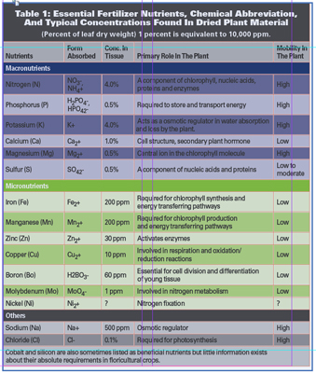

Slide 8
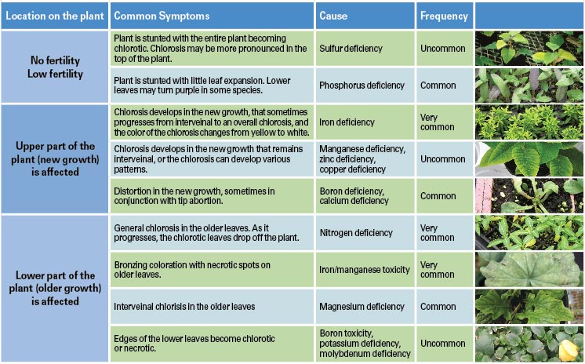

Slide 9
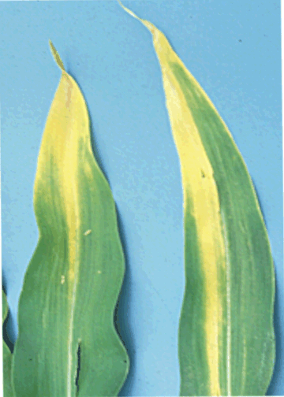

Slide 10
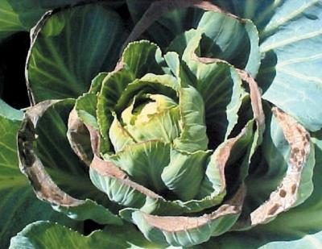
calcium deficiency

Slide 11
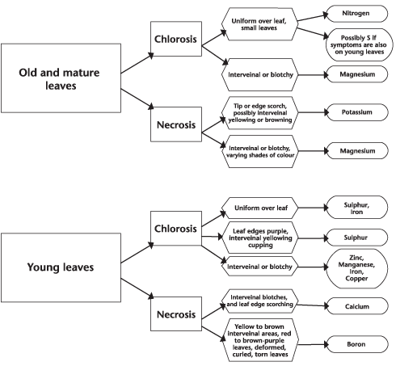

Slide 12
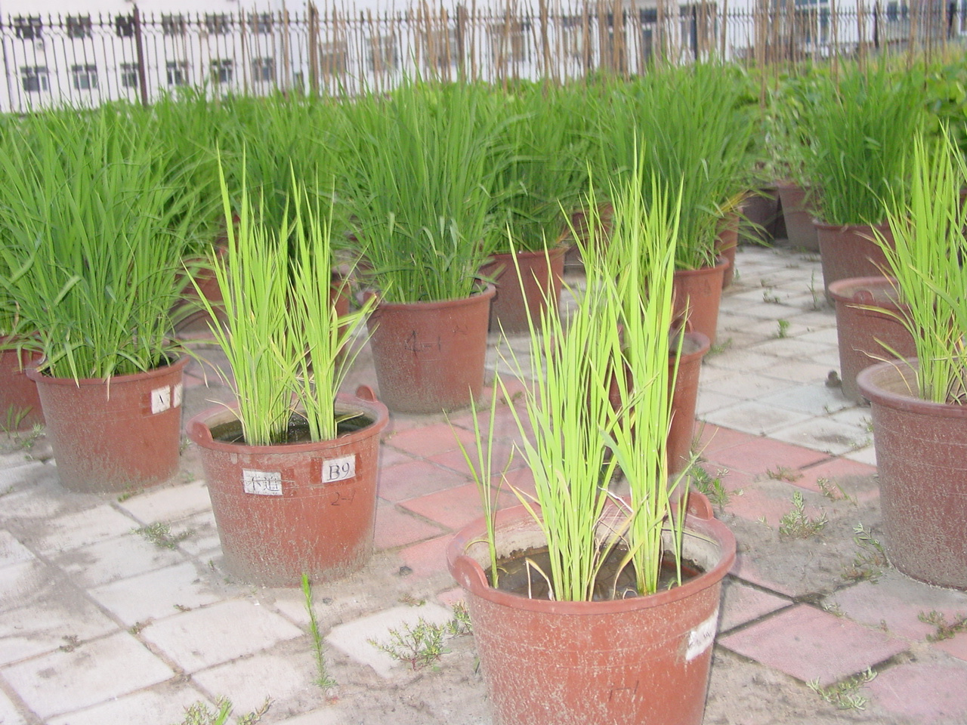

Slide 14
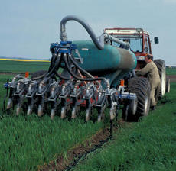

Slide 16
