Slide 1
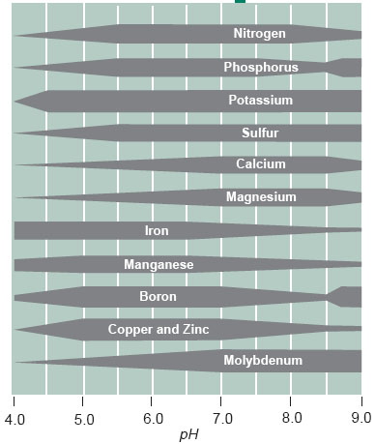

Slide 2
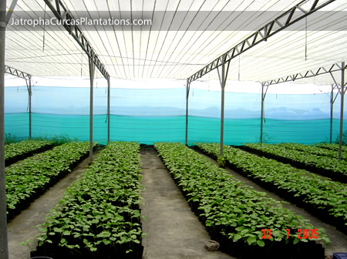

Slide 3
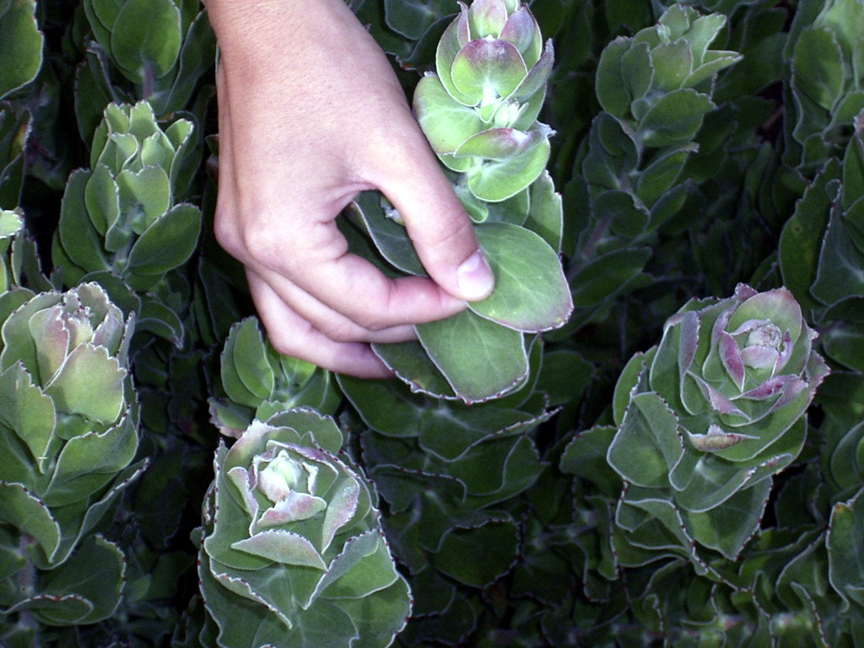

Slide 4
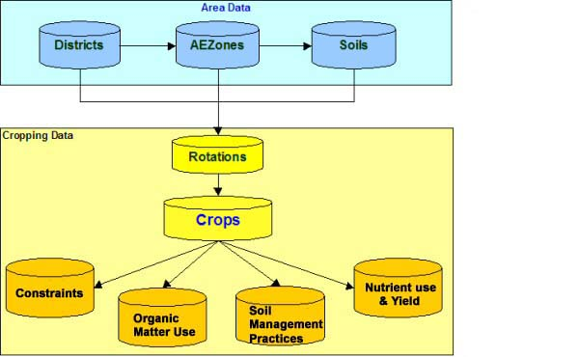

Slide 5
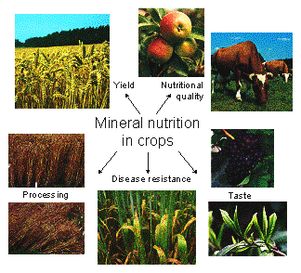

Slide 6
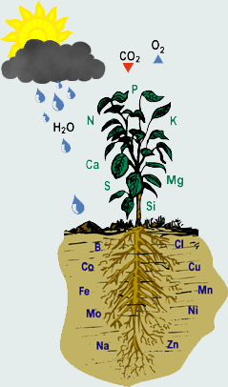

Slide 7
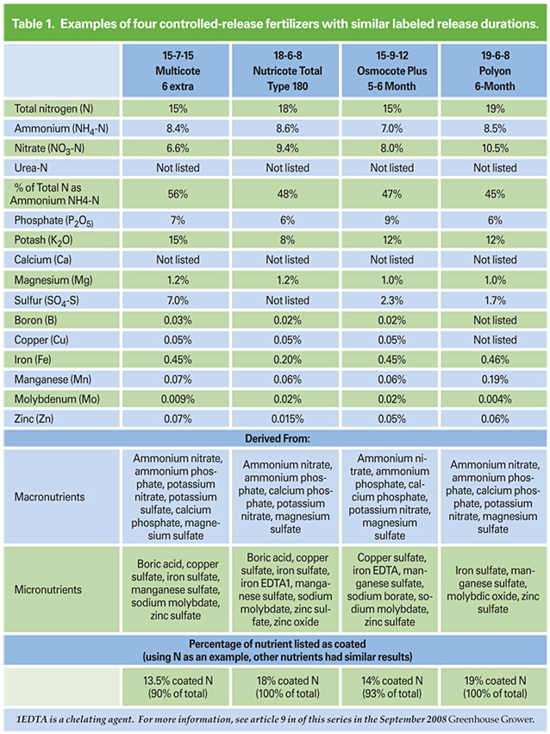

Slide 8
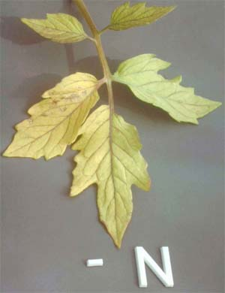
1. Nitrogen (N): Part of a large number of necessary organic compounds, including amino acids, proteins, coenzymes, nucleic acids, and chlorophyll. Deficiency: Plants are short, leaves tend to be pale green-yellow in color, especially on the older foliage. The young leaves at the top of the plant maintain a green but paler color and tend to become smaller in size. Branching is reduced in nitrogen deficient plants resulting in short, spindly plants. The yellowing in nitrogen deficiency is uniform over the entire leaf including the veins. However in some instances, an interveinal necrosis replaces the chlorosis commonly found in many plants. In some plants the underside of the leaves and/or the petioles and midribs develop traces of a reddish or purple color. In some plants this coloration can be quite bright. As the deficiency progresses, the older leaves also show more of a tendency to wilt under mild water stress and become senescent much earlier than usual. Recovery of deficient plants to applied nitrogen is immediate (days) and spectacular.

Slide 9
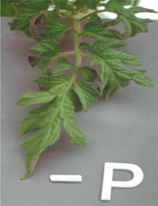
2. Phosphorous (P): Part of many important organic compounds including sugar phosphates, ATP, nucleic acids, phospholipids, and certain coenzymes. Deficiency: Symptoms occur on the older leaves first and plant maturity is often delayed. Phosphorous deficiency in some plant species can be due to conditions being too cold for uptake of this element, rather than as lack of phosphorous in the nutrient solution. A major visual symptom is that the plants are dwarfed or stunted. Phosphorus deficient plants develop very slowly in relation to other plants growing under similar environmental conditions but without phosphorus deficiency. Phosphorus deficient plants are often mistaken for unstressed but much younger plants. Some species such as tomato, lettuce, corn and the brassicas develop a distinct purpling of the stem, petiole and the under sides of the leaves. Under severe deficiency conditions there is also a tendency for leaves to develop a blue-gray luster. In older leaves under very severe deficiency conditions a brown netted veining of the leaves may develop.

Slide 10
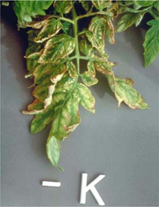
3. Potassium (K): Acts as a coenzyme or activator for many enzymes (e.g., pyruvate kinase). Protein synthesis requires high potassium levels. Plays a vital role in the regulation of stomata regarding gas exchange via osmosis. Potassium does not form a stable structural part of any molecules inside plant cells. Deficiency: The onset of potassium deficiency is generally characterized by a marginal chlorosis progressing into a dry leathery tan scorch on recently matured leaves. This is followed by increasing interveinal scorching and/or necrosis progressing from the leaf edge to the midrib as the stress increases. As the deficiency progresses, most of the interveinal area becomes necrotic, the veins remain green and the leaves tend to curl and crinkle. In contrast to nitrogen deficiency, chlorosis is irreversible in potassium deficiency, even if potassium is given to the plants. Because potassium is very mobile within the plant, symptoms only develop on young leaves in the case of extreme deficiency

Slide 11
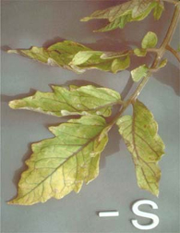
4. Sulfur (S): Incorporated into several organic compounds including amino acids (cystine, cysteine, glutathione and methionine) and corresponding proteins. Coenzyme A and the vitamins thiamine and biotin also contain sulfur. Sulfur is present in glycosides, which give the characteristic odors and flavors to mustard, onion and garlic plants. Deficiency: The visual symptoms of sulfur deficiency are very similar to the chlorosis found in nitrogen deficiency. However, in sulfur deficiency the yellowing is much more uniform over the entire plant including young leaves. The reddish color often found on the underside of the leaves and the petioles has a more pinkish tone and is much less vivid than that found in nitrogen deficiency. With advanced sulfur deficiency brown lesions and/or necrotic spots often develop along the petiole, and the leaves tend to become more erect and often twisted and brittle.

Slide 12
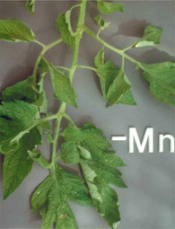
5. Magnesium (M): An essential part of the chlorophyll molecule and required for activation of many enzymes including steps involving ATP bond breakage. Essential to maintain ribosome structure. Deficiency: In its advanced form, magnesium deficiency may superficially resemble potassium deficiency. In the case of magnesium deficiency the symptoms generally start with mottled chlorotic
Chlorosis : A condition in plants resulting from the failure of chlorophyll to develop caused by a deficiency of an essential nutrient. Leaves of chlorotic plants range from light green through yellow to almost white. Chlorosis may be a symptom of a number of different plant ailments, including mineral deficiencies (commonly, iron) and some diseases. It occurs as a result of reduced chlorophyll production, turning newer (usually) growth yellow. In established leaves, areas between the veins yellow first. areas developing in the interveinal tissue. The interveinal laminae tissue tends to expand proportionately more than the other leaf tissues, producing a raised puckered surface, with the top of the puckers progressively going from chlorotic to necrotic
Necrotic : From Greek nekrosis; localized death of living tissue. tissue. Deficiency is common on tomato crops with the older leaves developing yellowed areas between the veins, which stay green.
5. Magnesium (M): An essential part of the chlorophyll molecule and required for activation of many enzymes including steps involving ATP bond breakage. Essential to maintain ribosome structure. Deficiency: In its advanced form, magnesium deficiency may superficially resemble potassium deficiency. In the case of magnesium deficiency the symptoms generally start with mottled chlorotic areas developing in the interveinal tissue. The interveinal laminae tissue tends to expand proportionately more than the other leaf tissues,producing a raised puckered surface,with the top of the puckers progressively going from chlorotic to necrotic tissue. Deficiency is common on tomato crops with the older leaves developing yellowed areas between the veins, which stay green.

Slide 13
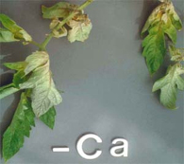
6. Calcium (Ca): Often precipitates as crystals of calcium oxalate in vacuoles. Found in cell walls as calcium pectate, which cements together primary walls of adjacent cells. Required to maintain membrane integrity and is part of the enzyme amylase. Sometimes interferes with the ability of magnesium to activate enzymes. Deficiency: The very low mobility of calcium is a major factor determining the expression of calcium deficiency symptoms in plants. Classic symptoms of calcium deficiency include blossom-end rot of tomato (burning of the end part of tomato fruits), tip burn of lettuce, blackheart of celery and death of the growing regions in many plants. All these symptoms show soft dead necrotic tissue at rapidly growing areas, which is generally related to poor translocation of calcium to the tissue rather than a low external supply of calcium. Very slow growing plants with a deficient supply of calcium may re-translocate sufficient calcium from older leaves to maintain growth with only a marginal chlorosis of the leaves. This ultimately results in the margins of the leaves growing more slowly than the rest of the leaf, causing the leaf to cup downward. This symptom often progresses to the point where the petioles develop but the leaves do not, leaving only a dark bit of necrotic tissue at the top of each petiole. Plants under chronic calcium deficiency have a much greater tendency to wilt than non-stressed plants.

Slide 14
From the air and water 7. Carbon (C): Constituent of all organic compounds found in plants. Sole source of C is CO2. Deficiency: Deficiency comes from lack of airflow. Without a reliable way to bring fresh air into a grow room (generator, CO2 tank, exhaust fan, etc.) Co2 will become a deficiency and photosynthesis will stop.
8. Hydrogen (H): Constituent of all organic compounds of which carbon is a constituent. Important in cation exchange in plant-nutrient relations.
9. Oxygen (O): Constituent of many organic compounds in plants. Only a few organic compounds, such as carotene, do not contain oxygen. Also involved in anion exchange between roots and the external medium. It is terminal acceptor of H+ in aerobic respiration.

Slide 15
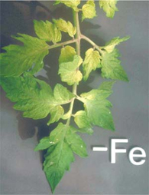
 | 10. Iron (Fe): Required for chlorophyll synthesis and is an essential part of the cytochromes, which act as electron carriers in photosynthesis and respiration. Is an essential part of ferredoxin and possibly nitrate reductase. Activates certain other enzymes. Deficiency: The most common symptom for iron deficiency starts out as an interveinal chlorosis of the youngest leaves, evolves into an overall chlorosis, and ends as a totally bleached leaf. The bleached areas often develop necrotic spots. Up until the time the leaves become almost completely white they will recover upon application of iron. In the recovery phase the veins are the first to recover as indicated by their bright green color. This distinct venial re-greening observed during iron recovery is probably the most recognizable symptom in all of classical plant nutrition. Because iron has a low mobility, iron deficiency symptoms appear first on the youngest leaves. Deficiency shows as a distinct yellowing between the leaf veins, which stay green, on the new growth and younger leaves (this distinguishes it from magnesium deficiency which shows first on the older leaves). On crops such as tomatoes, iron deficiency may show when conditions are to cold for uptake, rather than be caused by an actual deficiency in solution.

Slide 16
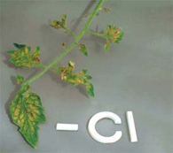
11. Chlorine (Cl): Required for photosynthesis where it acts as an enzyme activator during the production of oxygen from water. Additional functions are suggested by effects of deficiency on roots. Deficiency: Plants require relatively high chlorine concentration in their tissues. Chlorine is very abundant in soils, and reaches high concentrations in saline areas, but it can be deficient in highly leached inland areas. The most common symptoms of chlorine deficiency are chlorosis and wilting of the young leaves. The chlorosis occurs on smooth flat depressions in the interveinal area of the leaf blade. In more advanced cases there often appears a characteristic bronzing on the upper side of the mature leaves. Plants are generally tolerant of chloride, but some species such as avocados, stone fruits, and grapevines are sensitive to chlorine and can show toxicity even at low chloride concentrations in the soil. Roots become stunted and thickened near tips

Slide 17
12. Manganese (Mn): Activates one or more enzymes in fatty-acid synthesis, the enzymes responsible for DNA and RNA formation, and the enzyme isocitrate dehydrogenase in the Krebs cycle. Participates directly in the photosynthetic production of oxygen from water and may be involved in chlorophyll formation.
Deficiency: The early stages of the chlorosis induced by manganese deficiency are somewhat similar to iron deficiency. They begin with a light chlorosis of the young leaves and netted veins of the mature leaves especially when they are viewed through transmitted light. As the stress increases, the leaves take on a gray metallic sheen and develop dark freckled and necrotic areas along the veins. A purplish luster may also develop on the upper surface of the leaves.

Slide 18
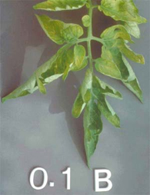
13. Boron (B): Role in plants not well understood. May be required for carbohydrate transport in phloem. Deficiency: The early stages of the chlorosis induced by manganese deficiency are somewhat similar to iron deficiency. They begin with a light chlorosis of the young leaves and netted veins of the mature leaves especially when they are viewed through transmitted light. As the stress increases, the leaves take on a gray metallic sheen and develop dark freckled and necrotic areas along the veins. A purplish luster may also develop on the upper surface of the leaves. In plants with poor boron mobility, boron deficiency results in necrosis of meristematic tissues in the growing region, leading to loss of apical dominance and the development of a rosette condition. These deficiency symptoms are similar to those caused by calcium deficiency. In plants in which boron is readily transported in the phloem, the deficiency symptoms localize in the mature tissues, similar to those of nitrogen and potassium. Both the pith and the epidermis of stems may be affected, often resulting in hollow or roughened stems along with necrotic spots on the fruit. The leaf blades develop a pronounced crinkling and there is a darkening and crackling of the petioles often with exudation of syrupy material from the leaf blade. The leaves are unusually brittle and tend to break easily. Also, there is often a wilting of the younger leaves even under an adequate water supply, pointing to a disruption of water transport caused by boron deficiency.

Slide 19
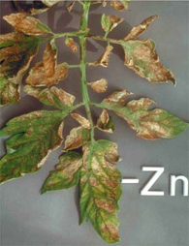
14. Zinc (Zn): Required for the formation of the hormone indoleacetic acid. Activates the enzymes alcohol dehydrogenase, lactic acid dehydrogenase, glutamic acid dehydrogenase and carboxypeptidase. Deficiency: In the early stages of zinc deficiency the younger leaves become yellow and pitting develops in the interveinal upper surfaces of the mature leaves. As the deficiency progress these symptoms develop into an intense interveinal necrosis but the main veins remain green, as in the symptoms of recovering iron deficiency. In many plants, especially trees, the leaves become very small and the internodes shorten, producing a rosette like appearance.

Slide 20
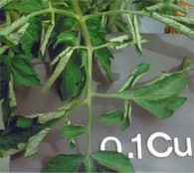
15. Copper (Cu): Acts as an electron carrier and as part of certain enzymes. Part of plastocyanin which is involved in photosynthesis, and also of polyphenol oxidase and possible nitrate reductase. May be involoved in nitrogen fixing. Deficiency: Copper deficiency may be expressed as a light overall chlorosis along with the permanent loss of turgor in the young leaves. Recently matured leaves show netted, green veining with areas bleaching to a whitish gray. Deficiency is rare, but young leaves may become dark green and twisted or misshapen, often with brown dry spots.

Slide 21
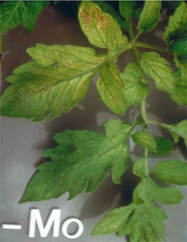
16. Molybdenum (Mo): Acts as an electron carrier in conversion of nitrate to ammonium and is also essential for nitrogen fixation. Deficiency: An early symptom for molybdenum deficiency is a general overall chlorosis, similar to the symptom for nitrogen deficiency but generally without the reddish coloration on the undersides of the leaves. This results from the requirement for molybdenum in the reduction of nitrate, which needs to be reduced prior to its assimilation by the plant. Thus, the initial symptoms of molybdenum deficiency are in fact those of nitrogen deficiency. However, molybdenum has other metabolic functions within the plant, and hence there are deficiency symptoms even when reduced nitrogen is available. In many plants there is an upward cupping of the leaves and mottled spots developing into large interveinal chlorotic areas under severe deficiency. At high concentrations, molybdenum has a very distinctive toxicity symptom in that the leaves turn a very brilliant orange.

Slide 22
Others Although most higher plants require those 16 essential elements, certain species may need others. They may, at least, accumulate these other elements even if they are not essential to their normal growth.
17. Cobalt : One of eight micronutrients essential to plant health. Cobalt is thought to be an important catalyst in nitrogen fixation. It may need to be added to some soils before seeding legumes
18. Silicon (Si): Silicon is believed to be used for support. It adds strength to tissues, giving resistence to fungal infection.
19. Nickel (Ni): Nickel is believed by some to be an essential element. It is used in production of the urease enzyme.
20. Sodium (Na): Sodium stimulates the growth of certain plants such as beets and turnips under some conditions. However, it is not considered essential since plants can complete their growth cycle in its absence.s

Slide 23
What is Plant Nutrition? Plants use inorganic minerals for nutrition. Complex interactions involving decomposition of rocks, organic matter, animals and microbes take place to form inorganic nutrient ions in soil water. Roots absorb these mineral ions if they are readily available. They can be tied up by other elements or by alkaline or acidic soils. Soil microbes also assist in ion uptake.
Why Doesn't My Soil Have What it Takes? Even in the most well kept garden or greenhouse these conditions for uptake of ions may not exist. Soils do not have all the minerals required for optimum plant growth year after year. Potting mixes contain few essential minerals for plants. They are sterilized and so may lack microbes to break down organic matter. Within months plants have used the available supply. Because of plant uptake, mineral nutrients must be replaced in the field or container.

Slide 24
The ABCs or NPKs of The Nutrition Solution® Dyna-Gro is more than a fertilizer. Dyna-Gro is a complete nutrient solution - The Nutrition Solution®- the only formulas containing all the mineral elements required for optimum plant growth in one, easy to use, liquid concentrate. Ordinary fertilizers are incomplete. Many simply contain N-P-K! Some contain additional elements but are not complete. This requires the purchase of multiple incomplete products in an attempt to provide plants with complete nutrition. Only Dyna-Gro formulas contain all of the minerals essential for plant growth in one, easy to use, liquid concentrate.
The Elements of Complete Plant Nutrition Complete nutrition results in superior plant growth. Why choose anything less for your plants? There are 20 elements necessary for optimum plant growth. Air and water supply carbon, hydrogen and oxygen. Macronutrients are required by plants in large amounts. Micronutrients are required in smaller amounts. Eliminate any of these elements,and plants will display abnormal growth, deficiencies or may not reproduce. The following is a brief guide to the role played by each of these essential nutrient elements.

Slide 25
N)-Nitrogen: Component of proteins, hormones, chlorophyll, vitamins and enzymes.
Promotes stem and leaf growth. The ammoniacal and nitrate forms are used directly by plants
for stem and leaf growth. The urea form of nitrogen must be broken down by soil borne
microorganisms or urease before it can be utilized by the plant. Urea can cause leaf tip and root burn
. Deficiency (Def.): reduced yields, yellowing of leaves, stunted growth. Excess nitrogen can delay fruiting and flowering.
(P)-Phosphorus:Seed germination, photosynthesis, protein formation, overall growth and metabolism,
flower and fruit formation. Def.: purple stems and leaves, retarded growth and maturity, poor flowering
and fruiting.
Large amounts without zinc cause zinc deficiency. Low pH (<4) ties up phosphates in organic soils.
(K)-Potassium: Formation of sugars, carbohydrates, proteins, cell division. Adjusts water balance;
improves stem rigidity and cold hardiness; enhances flavor, color and oil content of fruits; important for leafy crops.
Def.: spotted, curled or burned look to leaves; lower yields.

Slide 26
(Ca)-Calcium: Activates enzymes; structural part of cell walls; influences water movement, cell growth and division Required for uptake of nitrogen and other minerals. Leached from soil by watering. Immobile-requires a constant supply for growth. Def.: stunting of new growth in stems, flowers, roots; black spots on leaves and fruit; yellow leaf margins.
(Mg)-Magnesium: Critical component of chlorophyll; needed for functioning of enzymes for carbohydrates, sugars and fats; fruit and nut formation; germination of seeds. Def.: yellowing between veins of older leaves; chlorosis; leaf droop. Leached by watering. Foliar spray to correct deficiencies.
(S)-Sulfur: Component of amino acids, proteins, vitamins, enzymes. Essential for chlorophyll. Imparts flavor to many vegetables. Def.: light green leaves. Water supply may contain sulfur. Leached by watering.

Slide 27
Fe)-Iron: Enzyme functions; catalyst for synthesis of chlorophyll; essential for new growth. Def.: pale leaves, yellowing of leaves and veins. Leached by water and held in lower parts of soil. High pH soils may have iron present but unavailable to plants.
(Mn)-Manganese: Enzyme activity for photosynthesis, respiration and nitrogen metabolism. Def.: young leaves are pale with green veins similar to iron deficiency; advanced stages-leaves are white and drop; brown, black or gray spots may appear next to veins. Plants in neutral or alkaline soils often show def. Acid soils may increase uptake causing toxicity.

Slide 28
(Mo)-Molybdenum: Structural part of enzymes that reduce nitrates to ammonia for amino acid development essential to protein formation; required by nitrogen fixing bacteria. Def.: pale leaves with rolled, cupped margins. Seeds may not form. Nitrogen deficiency may occur if plants are lacking Mo.
(Ni)-Nickel: Recently recognized as essential. Required for the urease enzyme to break down urea into usable nitrogen and for iron uptake. Seeds require nickel to germinate.
(Na)-Sodium: Improves nitrogen metabolism in many plants, involved in osmotic (water movement) and ionic balance in plants. Def.: yellowing of leaves and leaf tip burn; may inhibit flower formation.
(Si)-Silicon: Component of cell walls; enhances resistance to sucking insects and fungi.Foliar sprays reduce populations of aphids on some plants. Enhances leaf presentation; improves heat, drought and cold tolerance; improves photosynthesis; extends bloom life. Def.: wilting, poor fruit and flower set, increased susceptibility to insects and disease. Disease resistance is enhanced by regular foliar feeding.
(Zn)-Zinc: Functional part of enzymes including auxin (growth hormone) synthesis, carbohydrate metabolism, protein synthesis, stem growth. Def.: mottled leaves, irregular yellow areas. Zinc deficiency leads to iron deficiency. Occurs in eroded soils; least available at pH of 5.5-7.0. Lower pH can cause availability to the point of toxicity.

