Slide 1
Lasers and their applications - Table of Contents
1. Introduction - Laser Radiation and its properties.
1.1 Electromagnetic radiation - in vacuum and in matter.
1.2 Properties of laser radiation - Monochromaticity, Directionality, Coherence.
2. Laser Mechanism.
2.1 Bohr model of an atom.
2.2 Photons and Energy levels diagrams.
2.3 Absorption of electromagnetic radiation.
2.4 Spontaneous emission of electromagnetic radiation.
2.5 Thermodynamic equilibrium.
2.6 Population inversion.
2.7 Stimulated emission.
2.8 Rate equations.
2.9 Stimulated transitions.
2.10 Amplification.
2.11 3 level laser.
2.12 4 level laser.
3. Laser system.
3.1 Active medium.
3.2 Excitation mechanism.
3.3 Feedback mechanism.
3.4 Output coupler.
3.5 Interactive Demonstration.

Slide 2
4. Optical cavity and oscillation modes.
4.1 Standing waves.
4.2 Longitudinal modes in a laser.
4.3 Transverse modes in a laser.
4.4 Optical Cavity.
5. Amplification in a laser - Laser Gain.
5.1 Fluorescence line shape.
5.2 Amplification in a closed loop path between the mirrors of the optical cavity.
6. Laser types and their characteristics.
Laser types introduction
6.1 Gas lasers:
Atom Gas:
6.1.1 Helium-Neon Laser (He-Ne).
Ion Gas:
6.1.2 Argon Ion Laser (Ar⁺).
Molecular Gas:
6.1.3 Carbon Dioxide Laser (CO₂).
6.2 Solid State lasers:
6.2.1 Ruby Laser.
6.2.2 Neodimium YAG and Nd Glass Laser.
6.3 Diode Laser (Semiconductor Laser, Injection Laser).
6.4 Dye Laser (Liquid).
6.5 Special Lasers:
6.5.1 X Ray Laser.

Slide 3
7. Characteristics of Laser Radiation.
7.0 Radiometry and measurement of Electromagnetic Radiation.
7.1 Spatial Energy Distribution at the Laser Output.
7.2 Laser Beam Divergence and Focusing Capability.
7.3 Special Mechanisms for creating Pulses ("Q" switch).
8. Laser Applications.
8.1 Industrial applications.
8.1.1 Material working (cutting, welding, hardening, melting, evaporating,).
8.2 Medical applications.
8.2.1 Laser surgery.
8.2.2 Laser in diagnostic medicine, and in combination with drugs.
8.2.3 Soft lasers (Wound healing, pain relief, cosmetic applications).
8.3 Military applications.
8.3.1 Laser range-finder.
8.3.2 Target designation.
8.3.3 Laser weapons ("Star War").

Slide 4
8.4 Daily applications
8.4.1 Bar code scanner.
8.4.2 Optical storage of information.
8.4.3 Optical computer.
8.4.4 Holograms against forgery (on credit cards).
8.4.5 Fibre optic communications.
8.4.6 Free space communications.
8.4.7 Holograms in exhibits and museums.
8.5 Scientific research applications.
8.5.1 Spectroscopy.
8.5.2 Laser (inertial) fusion.
8.5.3 Very short pulses (10⁻¹⁵ femtosec).
8.5.4 Laser cooling of atoms.
8.6 Special applications.
8.6.1 Energy transport in space.
8.6.2 Laser gyroscope.
8.6.3 Fibre laser.

Slide 5
References:
1/ lasers and their application by M.J. Beesely London (1979).
2/ principles of lasers, by O. Svelto plenum press New York (1982).
3/ laser physics by L.V. Tarasov MIR publishers, Moscow (1983).
4/ Lasers principles and application, by J. Wilson London (1987).
5/ The laser guide book, second edition by Jeff Hecht (1992).
And any other lasers textbook published in 21st century.

Slide 6
Chapter 1: Laser Radiation and its properties
Laser technology is one of the most rapidly developing areas in modern technology.
When the laser was invented, in 1960, it was classified as a solution in search of a problem, and today laser technology is applied in many different areas such as: medicine, communication, daily use, military, and industry.
To explain how the laser can be applied in such diverse areas, we need to understand the basic physical principles of the operation of a laser.
In principle, the laser is a device which transforms energy from other forms into electromagnetic radiation. This is a very general definition, but it helps to understand the basic physics of the laser.

Slide 7
The energy put into the laser can be in any form such as:
electromagnetic radiation, electrical energy, chemical energy, etc. Energy is always emitted from the laser as electromagnetic radiation (which includes light beams).
From this light output, the laser got part of its name: LASER = Light Amplification by Stimulated Emission of Radiation. The terms used in this definition will be explained later in this course.
We will try to obtain a qualitative picture of the quantum nature of the laser, based on some basic principles which came from the advanced mathematical tools.

Slide 8
Things you need to know:
Before studying about lasers, you must be familiar with basic terms used to describe electromagnetic waves:
Wavelength
Frequency (n)
Period (T)
Velocity of light ( c )
Index of refraction (n)
We will briefly review these terms (in chapters 1&2), but it is much better if the reader will be familiar with:
Some terms from geometric optics such as:
refraction, reflection, thin lenses etc.
Some terms from "Modern Physics" such as photons, Models of atoms, etc.

Slide 9
1.1 Electromagnetic Radiation
The electromagnetic radiation out of the laser can be in any part of the spectrum, including the visible spectrum, the Ultra-Violet (UV) spectrum, the Infra-Red (IR) spectrum, and beyond In the following pages the properties of Electromagnetic radiation is briefly described: 1.1.1 Electromagnetic Radiation in vacuum. 1.1.2 Electromagnetic Radiation in Matter.

Slide 10
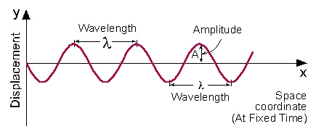
1.1.1 Electromagnetic Radiation in vacuum
Electromagnetic Radiation is a transverse wave, advancing in vacuum at a constant speed which is called: velocity of light. All electromagnetic waves have the same velocity in vacuum, and its value is approximately:
C = 3*10⁸ [m/sec] One of the most important parameters of a wave is its
wavelength.

Slide 11
Wavelength (λ) is the distance between two adjacent points on the wave, which have the same phase. As an example (see figure 1.1 ) the distance between two adjacent peaks of the wave.
In a parallel way it is possible to define a wave by its frequency.
Frequency (ν) is defined by the number of times that the wave oscillates per second (The number of periods of oscillations per second).
Between these two parameters the relation is:
C = λ * ν
From the physics point of view, all electromagnetic waves are equal (have the same properties) except for their wavelength (or frequency). As an example: the speed of light is the same for visible light, radio waves, or x-rays.

Slide 12
Wave Description A wave can be described in two standard forms:
Displacement as a function of space when time is held constant.
Displacement as a function of time at a specific place in space.
1- Displacement as a function of space, when time is "frozen" (held constant), as described in figure 1.1. In this description, the minimum distance between two adjacent points with the same phase is wavelength (λ). Note that the horizontal (x) axis is space coordinate !
Fig 1.1: Displacement as a function of space coordinate (at fixed time)
A = Amplitude = Maximum displacement from equilibrium.

Slide 13
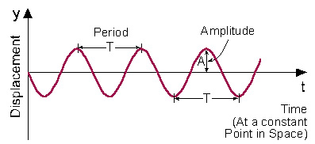
2-Displacement as a function of time
in a specific place in space, as described in figure 1.2. In this description, the minimum distance between two adjacent points with the same phase is period (T). Note that the horizontal (x) axis is time coordinate !
Figure 1.2: Displacement as a function of time (at a fixed point in space)

Slide 14
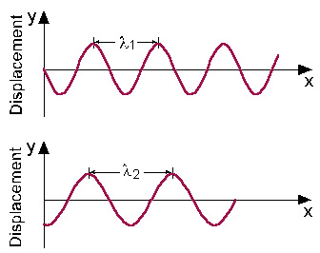
Wavelengths Comparison
Figure 1.3 describes how two different waves (with different wavelengths) look at a specific moment in time. Each of these waves can be uniquely described by its wavelength.
For electromagnetic waves, this wavelength is related to the type of radiation of the wave.
Figure 1.3: Short wavelength (λ₁ ) compared to longer wavelength (λ₂ )

Slide 15
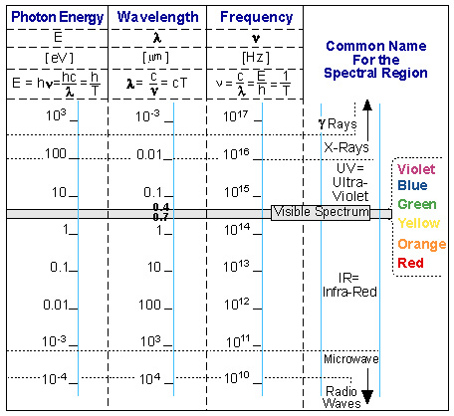
The electromagnetic spectrum
Figure 1.4 describes the electromagnetic spectrum.
Each part of the spectrum has a common name, and its range of wavelengths, frequencies and energies. The borders between the ranges are not sharp and clear, but are defined according to the applications of radiation in that portion of the spectrum.
Figure1.4:The Electromagnetic Spectrum

Slide 16
The most important ideas summarized in figure 1.4 are:
Electromagnetic waves span over many orders of magnitude in wavelength (or frequency).
The frequency of the electromagnetic radiation is inversely proportional to the wavelength.
The visible spectrum is a very small part of the electromagnetic spectrum.
Photon energy increases as the wavelength decreases. The shorter the wavelength, the more energetic are its photons.

Slide 17
Examples for electromagnetic waves are:
Radio-waves which have wavelength of the order of meters, so they need big antennas (The dimensions of an antenna are of the same order of magnitude as the wave).
Microwaves which have wavelength of the order of centimetres. As an example: in a microwave oven, these wavelengths can not be transmitted through the protecting metal grid in the door, while the visible spectrum which have much shorter wavelength allow us to see what is cooking inside the microwave oven through the protecting grid.
x-Rays which are used in medicine for taking pictures of the bone structure inside the body.
Gamma Rays which are so energetic, that they cause ionization, and are classified as ionizing radiation.
The discrete aspects of electromagnetic radiation is the result of Einstein's work at the beginning of the 20th century.

Slide 18
1.1.2 Electromagnetic Radiation in Matter
(We shall use the words "electromagnetic radiation" and "light" as synonyms)
Light Velocity in Matter When electromagnetic radiation passes through matter with index of refraction n, its velocity (v) is less than the velocity of light in vacuum (c), and given by the equation:
v = c / n
This equation is used as a definition of the index of refraction (n):
n = (speed of light in vacuum)/(speed of light in matter)
= c/v
Gases, including air, are usually considered as having index of refraction equal to vacuum n₀=1. The values of the index of refraction of most materials transparent in the visible spectrum is between 1.4-1.8, while those of materials transparent in the Infra-Red (IR) spectrum are higher, and are 2- 4 .

Slide 19
Wavelength in Matter:
We saw that the velocity of light in matter is slower than in vacuum. This slower velocity is associated with reduced wavelength: λ = λ₀/n , while the frequency remains the same (see figure 1.5).
Figure 1.5: Change of wavelength in matter

Slide 20
Refraction of Light Beam - Snell Law:
Reducing the velocity of light in matter, and reducing its wavelength, causes refraction of the beam of light. While crossing the border between two different materials, the light changes its direction of propagation according to the Snell Equation:

Slide 21
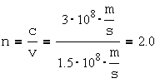
Example 1.1:The velocity of Red light (λ₀= 0.6mm) in a certain medium is 1.5*10⁸ [m/s]. What is the wavelength of this light in this material?
Solution to example 1.1:
First find the index of refraction:
Using n, calculate the wavelength in the material:
Conclusion: The wavelength of Red light in a material with an index of refraction of 2.0, is 0.3 [mm]

Slide 22
1.2 Properties of Laser Radiation
"Ordinary light" (from the sun or lamps) is composed of many different wavelengths, radiating in all directions, and there is no phase relation between the different waves out of the source.
Laser radiation is characterized by certain properties which are not present in other electromagnetic radiation:
1.2.1 Monochromaticity. 1.2.2 Directionality. 1.2.3 Coherence.

Slide 23
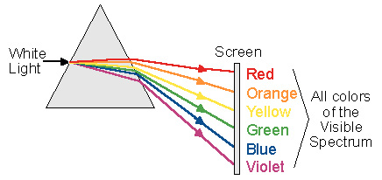
1.2.1 Monochromaticity
Monochromaticity means "One colour". To understand this term, examine "white light" which is the colour interpreted in the mind when we see all colours together. When "white light" is transmitted through a prism, it is divided into the different colours which are in it, as seen in figure 1.6.
Figure 1.6: White light passing through a prism

Slide 24
The Meaning of "One Colour"
In the theoretical sense "One Colour", which is called "spectral line", means one wavelength (λ₀). A graph of light intensity versus wavelength for ideal "one colour" is shown on the right side of figure 1.7. The right side of figure 1.7shows an artistic description of realistic "one colour". It has a peak of its value of "the colour“,but include a spread around the central peak. In reality, every spectral line has a finite spectral width (Δλ) around its central wavelength (λ₀), as can be seen in the left side of figure 1.7.
Figure 1.7: Bandwidth of laser radiation in Theory and in Reality

Slide 25
1.2.2. Directionality
Radiation comes out of the laser in a certain direction, and spreads at a defined divergence angle (θ) (see fig. 1.8, and example 1.2). This angular spreading of a laser beam is very small compared to other sources of electromagnetic radiation, and described by a small divergence angle (of the order of milli-radians).
In chapter 7, laser radiation characteristics are discussed in more detail, and different methods for measuring beam divergence are described. In figure 1.8, a comparison is made between the radiation out of a laser, and the radiation out of a standard lamp.
Fig.1.8: comparison between the light out of a laser, and the light out of an incandescent lamp

Slide 26
Divergence Angle
Divergence Angle is the full angle of opening of the beam. (Some books use half of this angle as divergence angle). The relation between radians and degrees is given by:
360⁰ = 2π Radians 1 Radian = 57.3⁰ 1 milli-Radian = 1 m.rad = 0.057⁰
Using the relation between minutes and degrees: 1⁰=60’,
we get:
1 m.rad = 0.057*60’= 3.5’ Sec.
Since laser radiation divergence is of the order of m.radians, the beam is almost parallel, and laser radiation can be send over long distances. We shall see in chapter 8, how a laser beam was sent to the moon, and returned to Earth to measure the distance between Earth and the moon with accuracy of tens of centimetres.

Slide 27
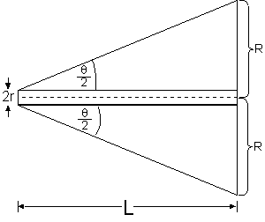
Spot Size Measurement:
R = Radius of the illuminated spot at a distance L from the laser (see figure below).
If the spot size measurement is done near the laser (where
the spot is small), then the size of the beam at the output of
the laser needs to be taken into account:
Because the laser radiation has a very small divergence, the small angle approximation can be used. Thus, we have set the tangent of the angle equal to the angle.

Slide 28
Spot Size Measurement:
On a screen, the laser produce a spot. The diameter of this spot (2R) determines the spot size.
When the measurement is done very far from the laser, the spot size (2R) is big compared to the beam size at the laser output (2r), and it is accurate enough to measure the spot diameter and divide it by the distance, to find the beam divergence.

Slide 29
Example: A laser with beam divergence of 1 m. radian creates a spot of about 10 [mm] at a distance of 10 [m]. The laser power measured over a defined unit surface area is called Power Density. Looking at figure 1.8, it is clear that from a laser it is possible to achieve higher power density than from conventional sources (see example 1.2).
This is the reason why a 5 [m.W] laser radiation is considered dangerous, and the light out of a 100 W incandescent lamp is not !!!

Slide 30
Example 1.2: Numerical Calculation of Power Density Calculate the power density of radiation per unit area at a distance of 2 meters, from an incandescent lamp rated 100 [W], compared to a Helium-Neon laser of 1 [mW]. The laser beam diameter at the laser output is 2 [mm], and its divergence is 1 [m.rad].
Solution:
Light from incandescent lamp is radiated to all directions, so it is distributed on a surface of a sphere with a radius of 2 [m]. The surface area is: 4π R², so the power density at a distance of 2 m is:
4.
Compared to the incandescent lamp, the laser beam diameter at a distance of 2 [m] increased to 4 [mm] (see drawing below):

Slide 31
R = 2.1 [mm] = 0.2 [cm]
The power density of the laser radiation is:
!!! When calculating radiation power in the visible spectrum (used for illumination), the low efficiency of the incandescent lamp must be considered (A 100 [W] lamp emits only 1-3 [W] of visible radiation, and all the rest is in the infrared spectrum).
At a distance of 2 [m] from the radiation source, the power density of the laser radiation is 40 times higher than from the lamp, although the power from the lamp is many times greater than original power of the laser.

Slide 32
1.2.3 Coherence
Since electromagnetic radiation is a wave phenomena, every electromagnetic wave can be described as a sum (superposition) of sine waves as a function of time. From wave theory we know that every wave is described by a wave function:
y = Acos(ωt+φ)
A = Amplitude. ω = 2πν = Angular Frequency. φ = Initial Phase of the wave (Describe the starting
point in time of the oscillation). (ωt+φ) = Phase of the wave.

Slide 33
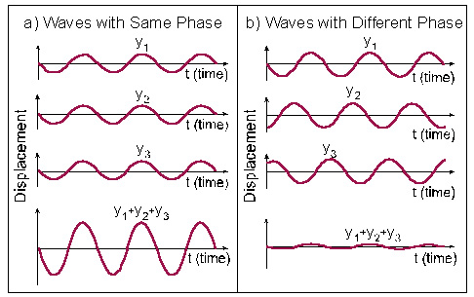
Superposition of Waves
Coherent waves are waves that maintain the relative phase between them. Figure 1.9 describes, using the same time base, 3 waves marked y₁, y₂, y₃, and their superposition. In figure 1.9a, the waves are coherent, like the waves out of a laser. In figure 1.9b, the waves have the same wavelength, but are not coherent with each other.
Light from an incandescent lamp is composed of waves at many wavelengths, and each wave appears randomly with no systematic relation between its phase and that of the other wave.
Laser radiation is composed of waves at the same wavelength, which start at the same time and keep their relative phase as they advance. By adding (superposition) the wave amplitudes of the different waves, higher peaks are measured for laser radiation.

Slide 34
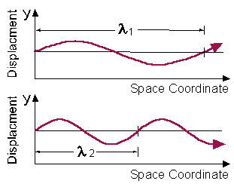
Example 1.3: Can waves with different wavelength be coherent?
Solution to example 1.3: Waves with different wavelengths can have the same phase in one point in space (or even in some points), but they can not keep this phase difference as can be seen in figure 1.10.
As can be seen from this example, coherence depends on monochromaticity. Coherence is important for applications like interference and diffraction, and the entire process of holography.
Figure 1-10: Waves with different wavelengths

Slide 35
Summary: Laser Radiation Properties
Very small divergence of the beam. The beam is almost a parallel beam and move in one direction in space - Directionality.
High degree of monochromaticity. The radiation is almost one wavelength, as can be measured by the very narrow spectral width.
Coherence.
The combination of these properties gives the laser radiation many advantages, like achieving very high power densities, not available from other sources.

