Slide 1
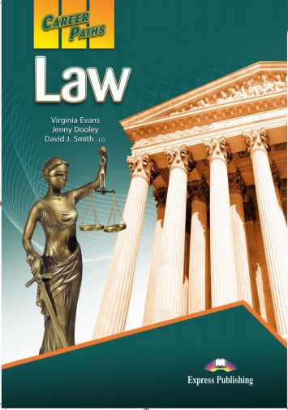
Salahaddin University-Erbil College of Law Academic English Part1 By: Amanj Ali Email:amanj.qadir@su.edu.krd 2024

Slide 2
