Slide 1
Architecture Through Out Various Ages In Pre-Historical Times (2)
Ancient History of Architecture
2nd Stage/ Spring Semester
M.Sc., Lecturer: Ansam Saleh
Tuesday- 21/02/2023

Slide 2
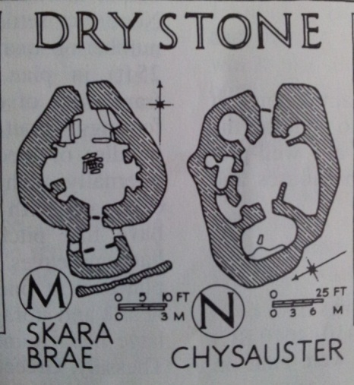
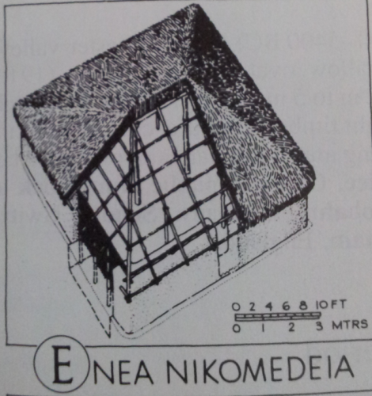
Architecture of the New Stone Age (Neolithic period):-
Architecture developed when early Stone Age man became settled, when he settled he learned to build permanent structures.
Early dwellings were round beehive huts.
Mud was popular material, though construction system varied by location & availability of construction materials.
Round huts changed to rectangular form about (9000-7000) BC.
Early villages were simple with no palaces, rich houses or non-residential buildings.
Once Neolithic man settled wanted to satisfy his spiritual needs,
this led to the construction of monuments.

Slide 3
Examples (New Stage Age Architecture):-
1- Neolithic Dwelling & Settlement;
(Catal Huyuk),(Çatalhöyük).
2-Megalithic Monuments;
Dolmen Tomb, Carnac.
Stone Alignment, Carnac.
Stonehenge in England.

Slide 4
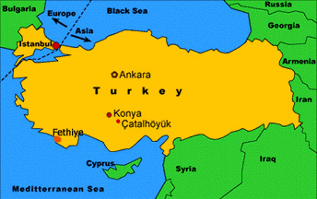
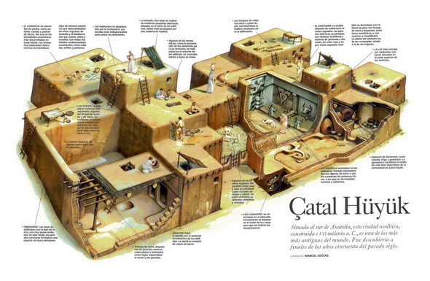
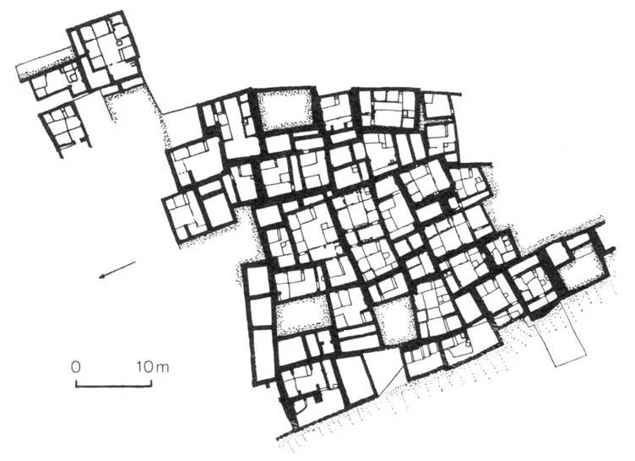
1-Neolithic Dwelling & Settlement (Catal Huyuk):-
One of the best preserved Neolithic towns indicates the beginning of using Straight walls with windows.
covering 32 acres(129,499) m2 in southern Turkey.
Houses were rectangular with windows & no doors, they attach each other like cells in a honeycomb.
The entrance to each one through the roof.
Occupied between (6300-5400) BC.

Slide 5
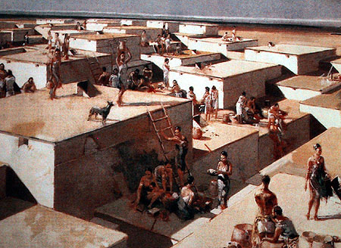
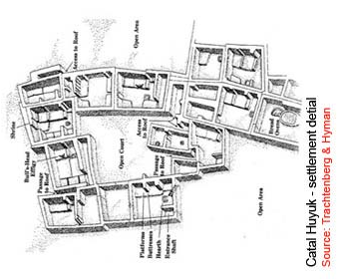
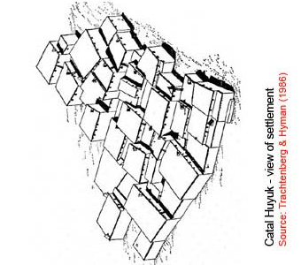
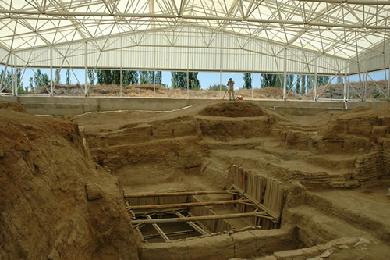
Support a population of up to (6000) people, it was the largest city of its time.
The city was a trading center.
Physically Catal Huyuk was highly organized with elegant architectural features, houses were in one continuous block punctuated by courtyards.
Houses were of one story mud construction.
No streets in settlement & access to houses was through the roof.
Movement from house to house through the roof.

Slide 6
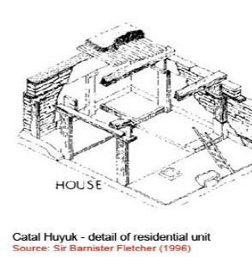
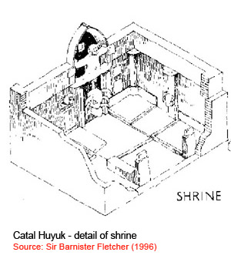
Houses had main rooms with built-in clay furniture, fire places & stair to the roof.
Many houses have cult rooms decorated with bull heads ,Some houses appear to be shrines for worship
Bull:ثور
cult :عبادة
Shrines:اضرحه

Slide 7
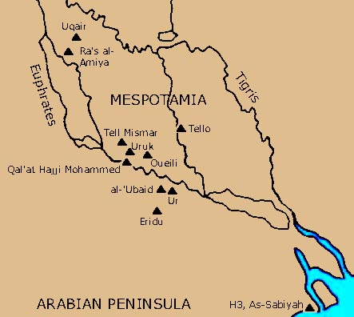
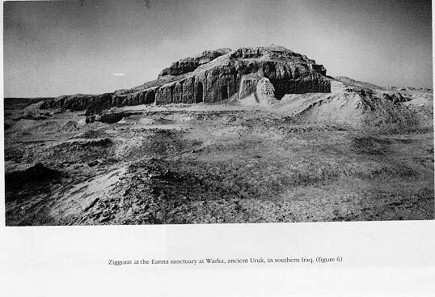
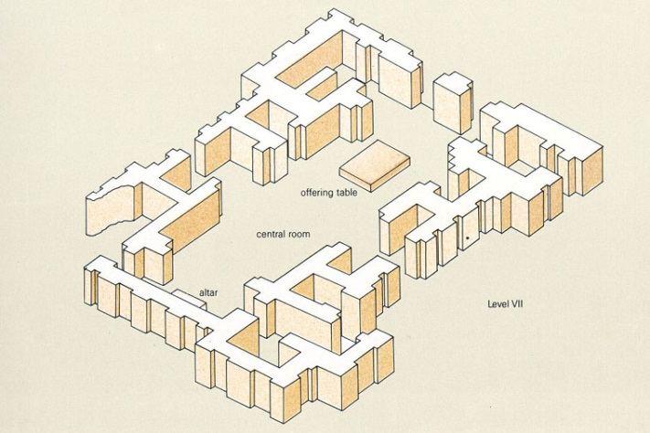
From that we found four main characteristics for the Neolithic period:-
1-The improvement in construction & planning that resulted in multi-roomed with mud-brick wall.
2- The emergence of non- residential building; work ,storage , ritual purposes & monumental temples as in the (Ubaid period in Mesopotamia).
3- More open form of villages layout including streets.
4- More common construction of walls for many purposes like defense.
Ritual:شعائر دينيه

Slide 8
2-Megalithic Monuments:-
Monumental construction by Neolithic man mainly in Europe took the form of megalithic monument.
Megalithic means large stone.
Megalithic construction involves setting up large stone blocks alone or leaning against each other.
Sometimes post & lintel construction is used.
Method of Megalithic Construction:-
Very similar to the Egyptian pyramids.
Stone is cut from rocks, transported by rollers pulled by people.
Lever is used to lift & place stone in position.
Lever:رافعة
leaning :sloping

Slide 9
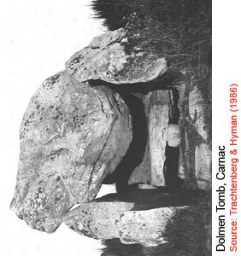
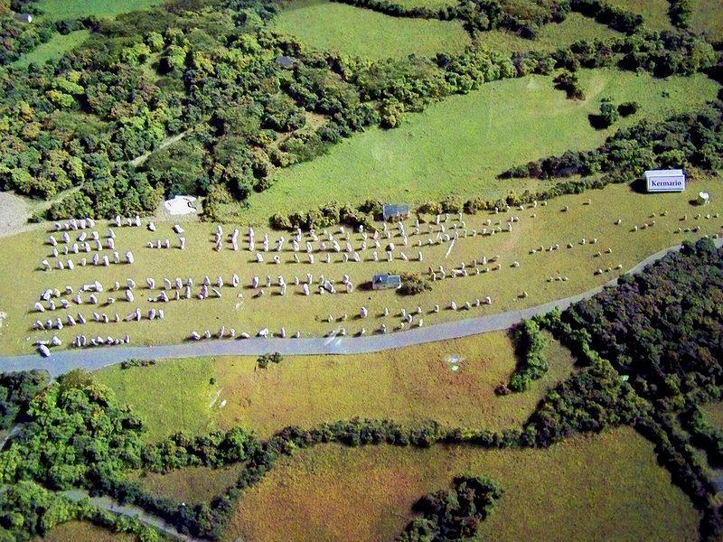
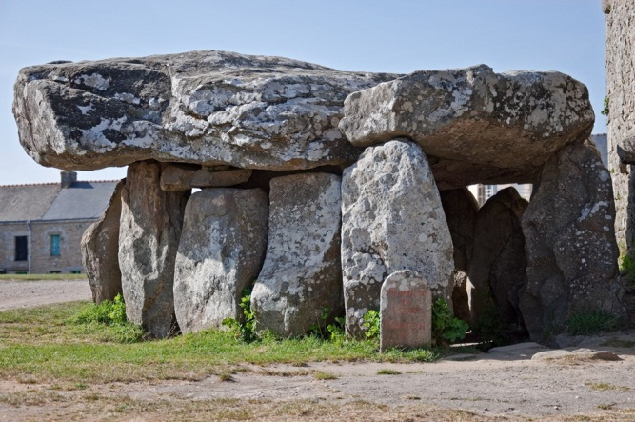
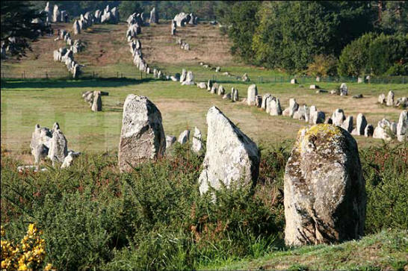
Classification of Megalithic Monuments:-
1-Tombs also called Dolmen.
2-Non funereal structures;
Single stones,(Stone Alignment).
Stones composed in groups,(Stonehenge in England).
Dolmen Tomb, Carnac France
Stone Alignment, Carnac France
Funereal:جنازه

