Slide 1
Akkadian LANGUAGE Level 4 dr. ardalan khwshnaw archaeology department

Slide 2
Lecture 1
Notes:
1

Slide 3
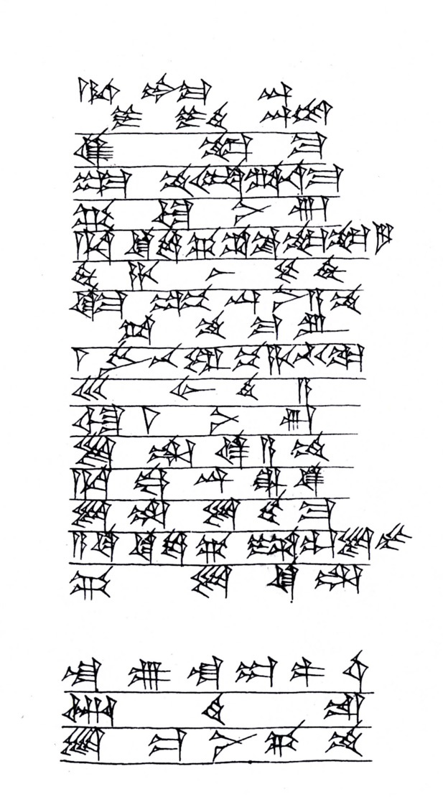
A Old Babylonian Letter of Ammi-ditana
Notes:
2

Slide 4
Obv
Transliteration
a-na šum-ma-dingir dumu i-din-^{d}marduk
qí-bí-ma
um-ma am-mi-di-ta-na-ma
GÁ ù Ì-nun
a-na ki-sì-ga ša ^{iti}ne-ne-gar
ih-ha-aš-še-eh
ki-ma dup-pí an-ni-a-am
ta-am-ma-ru
1 LÚ be-el pí-ha-ti-ka
30 ÁB.HI.A
ù 0.1.0 Ì-nun
li-il-qé-a-am
a-na ká.dingir.ra^{ki}
Translation
to Summa-ilum, son of Iddin-Marduk
Speak
Thus says Ammi-ditana
Milk and ghee
for the funerary offering of the month of Abu
are needed
As soon as, this letter
you have read
one of your officials
take 30 cows
And 60 quarts of ghee
Let take
come to Babylon
Notes:
3

