Slide 1
Modern Physics
Chapter Four : Einstein's theory of general relativity
EXPERIMENTAL EVIDENCE FOR GENERAL RELATIVITY
Prof. Dr. Asaad Hamid Ismail
Asaad.ismail@su.edu.krd
2022-2023
Notes:
11

Slide 2
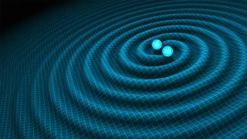
How to understate general relativity theory ?
General relativity is physicist Albert Einstein's understanding of how gravity affects the fabric of space-time.
The theory, which Einstein published in 1915, expanded the theory of special relativity that he had published 10 years earlier. Special relativity argued that space and time are inextricably connected, but that theory didn't acknowledge the existence of gravity.
Einstein spent the decade between the two publications determining that particularly massive objects warp the fabric of space-time, a distortion that manifests as gravity, according to NASA.
- One manifestation of general relativity is gravitational waves, depicted here as created by two colliding black holes. the fabric of space-time (see figure).

Slide 3
HOW DOES GENERAL RELATIVITY WOK?
To understand general relativity, first, let's start with gravity, the force of attraction that two objects exert on one another. Sir Isaac Newton quantified gravity in the same text in which he formulated his three laws of motion, the "Principia."
The gravitational force between two bodies depends on how massive each one is and how far apart the two lie. Even as the center of the Earth is pulling you toward it (keeping you firmly lodged on the ground), your center of mass is pulling back at the Earth. But the more massive body barely feels the tug from you, while with your much smaller mass you find yourself firmly rooted thanks to that same force. Yet Newton's laws assume that gravity is an innate force of an object that can act over a distance.
Albert Einstein, in his theory of special relativity, determined that the laws of physics are the same for all non-accelerating observers, and he showed that the speed of light within a vacuum is the same no matter the speed at which an observer travels, according to Wired.
As a result, he found that space and time were interwoven into a single continuum known as space-time. And events that occur at the same time for one observer could occur at different times for another.
As he worked out the equations for his general theory of relativity, Einstein realized that massive objects caused a distortion in space-time. Imagine setting a large object in the center of a trampoline. The object would press down into the fabric, causing it to dimple. If you then attempt to roll a marble around the edge of the trampoline, the marble would spiral inward toward the body, pulled in much the same way that the gravity of a planet pulls at rocks in space.

Slide 4
EXPERIMENTAL EVIDENCE FOR GENERAL RELATIVITY
In the decades since Einstein published his theories, scientists have observed countless of phenomena matching the predictions of relativity.
The first three tests, proposed by Albert Einstein in 1915, concerned the
1) Anomalous“ precession of the perihelion of Mercury ,
2) Bending of light in gravitational fields, and
3) The gravitational redshift .
GRAVITATIONAL LENSING
What Is Gravitational Lensing? ... A gravitational lens can occur when a huge amount of matter, like a cluster of galaxies, creates a gravitational field that distorts and magnifies the light from distant galaxies that are behind it but in the same line of sight. The effect is like looking through a giant magnifying glass. It allows researchers to study the details of early galaxies too far away to be seen with current technology and telescopes.
Light bends (curved) around a massive object, such as a black hole, causing it to act as a lens for the things that lie behind it. Astronomers routinely use this method to study stars and galaxies behind massive objects.
The Einstein Cross, a quasar in the Pegasus constellation, according to the European Space Agency (ESA), and is an excellent example of gravitational lensing. The quasar is seen as it was about 11 billion years ago; the galaxy that it sits behind is about 10 times closer to Earth. Because the two objects align so precisely, four images of the quasar appear around the galaxy because the intense gravity of the galaxy bends the light coming from the quasar.

Slide 5
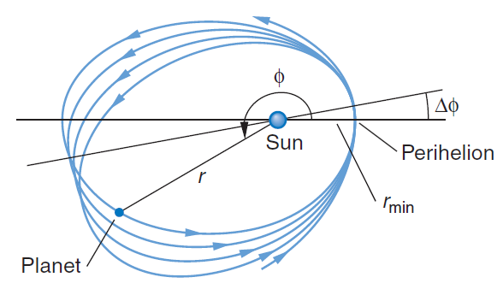
CHANGES IN MERCURY'S ORBIT (precession of the perihelion of Mercury)
A third prediction from Einstein’s theory of general relativity is the excess precession of the perihelion of the orbit of Mercury of about 0.01° per century. The orbit of Mercury is shifting very gradually over time due to the curvature of space-time around the massive sun.
It is a remarkable feature of Newton’s law of gravity that it accounts for the orbits of the planets in detail, predicting that they should each be closed ellipses with the Sun located at one focus and the major axes always pointing in the same direction in space. In fact, however, the mutual gravitational interactions of the planets add a small time-varying force to the primary force of the Sun. The result is that the orbital motions are not quite closed ellipses but rotate slowly in the plane of the orbit; that is, the major axis of the ellipse slowly rotates about the Sun, as shown in the figure. In the absence of the mutual interactions of the planets, Newton’s gravitational theory predicts the orbit to be a perfect ellipse, the distance r of the planet from the Sun being given by
where r min distance to the point of closest approach of the planet to the Sun, called the perihelion, and eccentricity of the orbit, meaning that the maximum and minimum distances from the Sun are more or less, respectively, than the mean distance. ( 0 for a circle.)
FIGURE The elliptical planetary orbits have the Sun at one focus. The smaller gravitational forces due to the other planets cause the major axis to slowly rotate about the Sun, shifting the line from the Sun to the perihelion through
an angle each orbit. This shift is referred to as the precession of the perihelion. For Mercury, 9.55 arc minutes per century.

Slide 6
GRAVITATIONAL REDSHIFT
The electromagnetic radiation of an object is stretched out slightly inside a gravitational field. Think of the sound waves that emanate from a siren on an emergency vehicle; as the vehicle moves toward an observer, sound waves are compressed, but as it moves away, they are stretched out, or redshifted. Known as the Doppler Effect, the same phenomena occurs with waves of light at all frequencies.
In the 1960s, according to the American Physical Society, physicists Robert Pound and Glen Rebka shot gamma-rays first down, then up the side of a tower at Harvard University. Pound and Rebka found that the gamma-rays slightly changed frequency due to distortions caused by gravity.
GRAVITATIONAL WAVES
Einstein predicted that violent events, such as the collision of two black holes, create ripples in space-time known as gravitational waves. And in 2016, the Laser Interferometer Gravitational Wave Observatory (LIGO) announced that it had detected such a signal for the first time.
That detection came on Sept, 2015 LIGO, made up of twin facilities in Louisiana and Washington, had recently been upgraded, and were in the process of being calibrated before they went online. The first detection was so large that, according to then-LIGO spokesperson Gabriela Gonzalez, it took the team several months of analysis to convince themselves that it was a real signal and not a glitch.

Slide 7
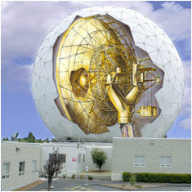
The Shapiro Experiment (Shapiro time delay)
The Shapiro time delay effect, or gravitational time delay effect, is one of the four classic solar-system tests of general relativity. Radar signals passing near a massive object take slightly longer to travel to a target and longer to return than they would if the mass of the object were not present. The time delay is caused by spacetime dilation, which increases the time it takes light to travel a given distance from the perspective of an outside observer.
In 1962 Irwin Shapiro suggested that this delay be measured by sending some strong radio signals to Venus, when it is in opposition to the Earth, and then measuring the time it takes for the (extremely weak) reflected signals to arrive.
When in 1964 the 120 foot Haystack antenna in Westford, US was left by the military to MIT, Shapiro and his team began plans to carry out the experiment. The experiment first took place from November 1966 until August 1967. "It would have been nice to prove Einstein wrong," said Shapiro later. That has not been granted him since all experiments up till 2006 have confirmed the GTR within the specified accuracy.
Shapiro lowered the imprecision of his initial measurements from over 3% to less than 1% in subsequent years. Newer versions of this experiment work with transponders on space probes. These receive the signal from the earth and after a precisely known delay send it with increased intensity back to earth. Thus with the Viking Mars probe of 1979 the predictions of the GTR for this delay in the gravitational field of the sun could be confirmed to an accuracy of 0.1%. In 2003, with the space probe Cassini an accuracy of 0.0012% was achieved!
The 120 foot radio antenna at MIT in Westford / USA with which Shapiro in 1966/67 carried out his first experiment.

Slide 8
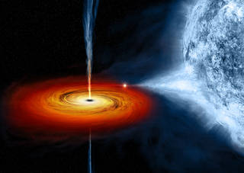
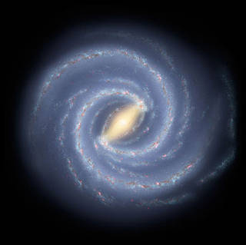
The Black holes (What Is a Black Hole?)
A black hole is a place in space where gravity pulls so much that even light can not get out. The gravity is so strong because matter has been squeezed into a tiny space. This can happen when a star is dying.
Because no light can get out, people can't see black holes. They are invisible. Space telescopes with special tools can help find black holes. The special tools can see how stars that are very close to black holes act differently than other stars.
How Big Are Black Holes?
Black holes can be big or small. Scientists think the smallest black holes are as small as just one atom. These black holes are very tiny but have the mass of a large mountain. Mass is the amount of matter, or "stuff," in an object.
Another kind of black hole is called "stellar." Its mass can be up to 20 times more than the mass of the sun. There may be many, many stellar mass black holes in Earth's galaxy. Earth's galaxy is called the Milky Way.
The largest black holes are called "supermassive." These black holes have masses that are more than 1 million suns together. Scientists have found proof that every large galaxy contains a supermassive black hole at its center. The supermassive black hole at the center of the Milky Way galaxy is called Sagittarius A. It has a mass equal to about 4 million suns and would fit inside a very large ball that could hold a few million Earths.
An artist's drawing a black hole named Cygnus X-1. It formed when a large star caved in. This black hole pulls matter from blue star beside it
An artist's drawing shows the current view of the Milky Way galaxy. Scientific evidence shows that in the middle of the Milky Way is a supermassive black hole.

Slide 9
How Do Black Holes Form? Scientists think the smallest black holes formed when the universe began.
Stellar black holes are made when the center of a very big star falls in upon itself, or collapses. When this happens, it causes a supernova. A supernova is an exploding star that blasts part of the star into space.
Scientists think supermassive black holes were made at the same time as the galaxy they are in.
If Black Holes Are "Black," How Do Scientists Know They Are There?
A black hole can not be seen because strong gravity pulls all of the light into the middle of the black hole. But scientists can see how the strong gravity affects the stars and gas around the black hole. Scientists can study stars to find out if they are flying around, or orbiting, a black hole.
When a black hole and a star are close together, high-energy light is made. This kind of light can not be seen with human eyes. Scientists use satellites and telescopes in space to see the high-energy light.
Could a Black Hole Destroy Earth?
Black holes do not go around in space eating stars, moons and planets. Earth will not fall into a black hole because no black hole is close enough to the solar system for Earth to do that.
Even if a black hole the same mass as the sun were to take the place of the sun, Earth still would not fall in. The black hole would have the same gravity as the sun. Earth and the other planets would orbit the black hole as they orbit the sun now.
The sun will never turn into a black hole. The sun is not a big enough star to make a black hole.
How Is NASA Studying Black Holes? NASA is using satellites and telescopes that are traveling in space to learn more about black holes. These spacecraft help scientists answer questions about the universe.

