Slide 1
Modern Physics Post-1900 Physics Why 1900?
Prof. Dr. Asaad Hamid Ismail
Asaad.ismail@su.edu.krd
2022-2023
Notes:
11

Slide 2
Post-1900 Physics
Why 1900?
Two radical developments: Relativity & Quantum Mechanics
Both changed the way we think as much as did Galileo and Newton.
The Physics Revolution of the Early 1900s (Relativity, Quantum)
By about 1900, it seemed as though most fundamental physics problems had been solved. There were questions of chemistry, in that it not clear what matter was made of (whether there were atoms and whether atoms were made of anything else, but we had Newton's equations for particles, and Maxwell’s equations for light. Presumably(may be) these equations applied to whatever it is that matter is made of. It was very difficult to rationally account for Fraunhofer lines though, and, by 1911, there was a big problem with the “planetary” model of an atom of charged particles. But that was not all.
Two kinds of experiments in the late 1890s involving the light–matter interaction had yet to be clarified. These involved explaining the intensity of thermally emitted short-wavelength light (the ultraviolet catastrophe (big problem)) and the energies of electrons ejected from metals by light (the photoelectric effect). The new theories that would be proposed to explain these effects would bend the mind and yet explain atomic spectra and the chemical bond.

Slide 3
Chapter One Theory of relativity
Outline
The principle of relativity
Special Relativity
Galilean Transformations
Names & Reference Frames
The Ether River
Michelson-Morley Experiments
Einstein Postulates
Lorentz Transformations
Position
Velocity
Space-Time Diagrams
Relativistic Forces & Momentum
Relativistic Mass
Relativistic Energy

Slide 4
The principle of relativity
The theory of relativity usually includes two interrelated theories by Albert Einstein: special relativity and general relativity, proposed and published in 1905 and 1915, respectively. Special relativity applies to all physical phenomena in the absence of gravity. General relativity explains the law of gravitation and its relation to other forces of nature. It applies to the cosmological and astrophysical realm, including astronomy. (Cosmology is a sub-field of Astrophysics, while Astrophysics is the branch of astronomy that deals with the physics of the universe)
Explanation:
Astronomy is a natural science that deals with the study of celestial objects, such as stars, planets, comets, nebulae, star clusters and galaxies.
Astrophysics is the branch of astronomy that deals with the physics of the universe, including the physical properties of celestial objects, as well as their interactions and behavior. Among the objects studied are galaxies, stars, planets, exoplanets, the interstellar medium and the cosmic microwave background.
Cosmology studies universe as a whole and its phenomena at largest scales. The difference between Astrophysics and Cosmology is that Cosmology studies universe as a whole and its phenomena at largest scales

Slide 5
The theory transformed theoretical physics and astronomy during the 20th century, superseding a 200-year-old theory of mechanics created primarily by Isaac Newton
The Relativity introduced concepts including spacetime as a unified entity of space and time, relativity of simultaneity, kinematic and gravitational, time dilation, and length contraction. In the field of physics, relativity improved the science of elementary particles and their fundamental interactions, along with ushering in the nuclear age. With relativity, cosmology and astrophysics predicted extraordinary astronomical phenomena such as neutron stars, black holes, and gravitational waves.

Slide 6
Two-dimensional projection of a three-dimensional analogy of spacetime curvature described in general relativity
Albert Einstein published the theory of special relativity in 1905, building on many theoretical results and empirical findings obtained by Albert A. Michelson, Hendrik Lorentz, Henri Poincaré and others. Max Planck, Hermann Minkowski and others did subsequent work.
Einstein developed general relativity between 1907 and 1915, with contributions by many others after 1915. The final form of general relativity was published in 1916.

Slide 7
Special relativity
Special relativity is a theory of the structure of spacetime. Special relativity is based on two postulates which are contradictory in classical mechanics:
1) The laws of physics are the same for all observers in any inertial frame of reference relative to one another ( principle of relativity).
2) The sped of light ( c=3×10⁸m/sec²) in a vacuum is the same for all observers, regardless of their relative motion or of the motion of the light source.
For example, postulate 2 explains the results of the Michelson – Morly experiment. The theory has many surprising , and some of these are:
Relativity of simultaneity: Two events, simultaneous for one observer, may not be simultaneous for another observer if the observers are in relative motion.
Time dilation: Moving clocks are measured to tick more slowly than an observer's "stationary" clock.
Length contraction: Objects are measured to be shortened in the direction that they are moving with respect to the observer.
Maximum speed is finite: No physical object, message or field line can travel faster than the speed of light in a vacuum.
Mass–energy equivalence: E = mc², energy and mass are equivalent and transmutable.

Slide 8
Classical Reference Frames
Inertial Reference Frame
Non-accelerating
Newton’s Laws apply at face-value
Non-Inertial Reference Frame
Examples:
Rocket during acceleration phase
Rotating merry-go-round
Rotating Earth

Slide 9
According to the principle of Newtonian relativity, the laws of mechanics must be the same in all inertial frames of reference. For example, if you perform an experiment while at rest in a laboratory, and an observer in a passing truck (car) moving with constant velocity performs the same experiment, Newton’s laws may be applied to both sets of observations. Specifically, in the laboratory or in the truck a ball thrown up rises and returns to the thrower’s hand. Moreover, both events are measured to take the same time in the truck or in the laboratory, and Newton’s second law may be used in both frames to compute this time. Although these experiments look different to different observers (Fig.1) , and the observers measure different values of position and velocity for the ball at the same times, both observers agree on the validity (principle) of Newton’s laws and principles such as conservation of energy and conservation of momentum. This mean that no experiment involving mechanics can detect any essential difference between the two inertial frames. The only thing that can be detected is the relative motion of one frame with respect to the other. That is, the notion of absolute motion through space is meaningless, as is the notion of a single, preferred reference frame

Slide 10
In order to show the underlying equivalence of measurements made in different reference frames and hence the equivalence of different frames for doing physics, we need a mathematical formula that systematically relates measurements made in one reference frame to those in another. Such a relation is called a transformation, and the one satisfying Newtonian relativity is the so-called Galilean transformation, which owes its origin to Galileo.
An example of a non-inertial frame is an accelerated frame, and one is shown in

Slide 11
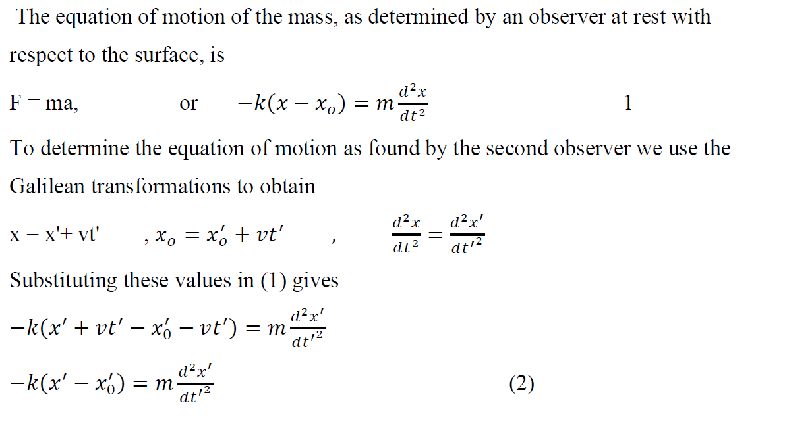
Problem: A sample of radioactive material, at rest in the laboratory, ejects two electrons in opposite directions. One of the electrons has a speed of 0.6c and the other has a speed of 0. 7 c, as measured by a laboratory observer. According to classical velocity transformations, what will be the speed of one electron as measured from the other Ex.3: A mass attached to a spring and moving on a horizontal, frictionless surface. Show, from the classical transformation laws, that the equations of motion of the mass are the same as determined by an observer at rest with respect to the surface and by a second observer moving with constant velocity along the direction of the spring. Ans.:
Because (1 and 2) have the same form, the equation of motion is invariant under the Galilean transformations

Slide 12
Something is very wrong either with the equations of electromagnetism or with the Galilean transformations, and hence, a new transformation law was required.
A further difficulty associated with the electromagnetic waves of Maxwell was the medium in which these waves propagated. The more rigid the medium the higher the velocity of the wave. The ether, being a medium for propagation of an electromagnetic wave, should also be quite rigid in order to support the enormous speed of 3 x10⁸ m/s. Yet the earth moves through this rigid medium at an orbital speed of 3x 10⁴ m/s and its motion is not impeded one iota by this rigid medium.

Slide 13
The ETHER river History of ETHER MICHELSON-MORLEY EXPTS

Slide 14
The Ether River
Time t₁ from A to C and back:
down river
Time t₂ from A to D and back:
So that the difference in trip times is:

Slide 15
Michelson-Morley experiment
It is an attempt to detect the velocity of Earth with respect to the hypothetical luminiferous ether, a medium in space proposed to carry light waves. First performed in Germany in 1880–81 by the physicist A.A. Michelson, the test was later refined in 1887 by Michelson and Edward W. Morley in the United States.
The procedure depended on a Michelson interferometer, a sensitive optical device that compares the optical path lengths for light moving in two mutually perpendicular directions. Michelson reasoned that, if the speed of light were constant with respect to the proposed ether through which Earth was moving, that motion could be detected by comparing the speed of light in the direction of Earth’s motion and the speed of light at right angles to Earth’s motion. No difference was found. This null result seriously discredited the ether theories and ultimately led to the proposal by Albert Einstein in 1905 that the speed of light is a universal constant.

Slide 16
Ether River - Revisited
Orientation 1
down river
Orientation 2
down river
Difference in Orientations

Slide 17
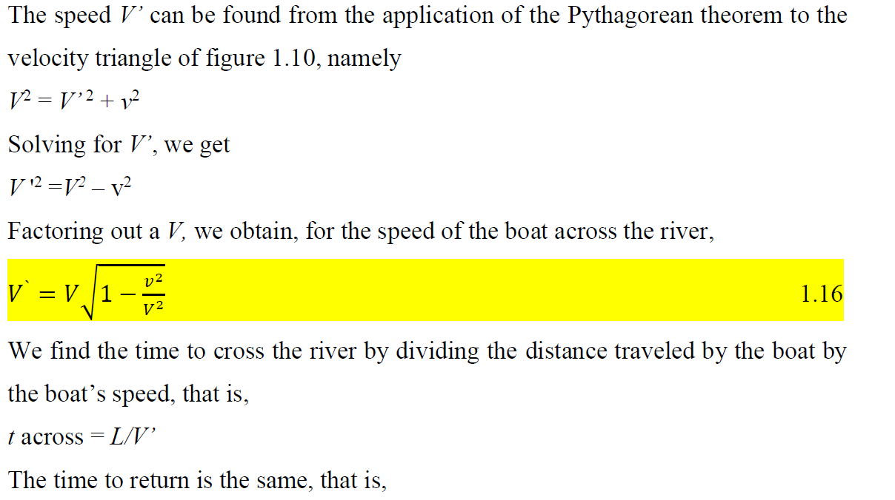

Slide 21
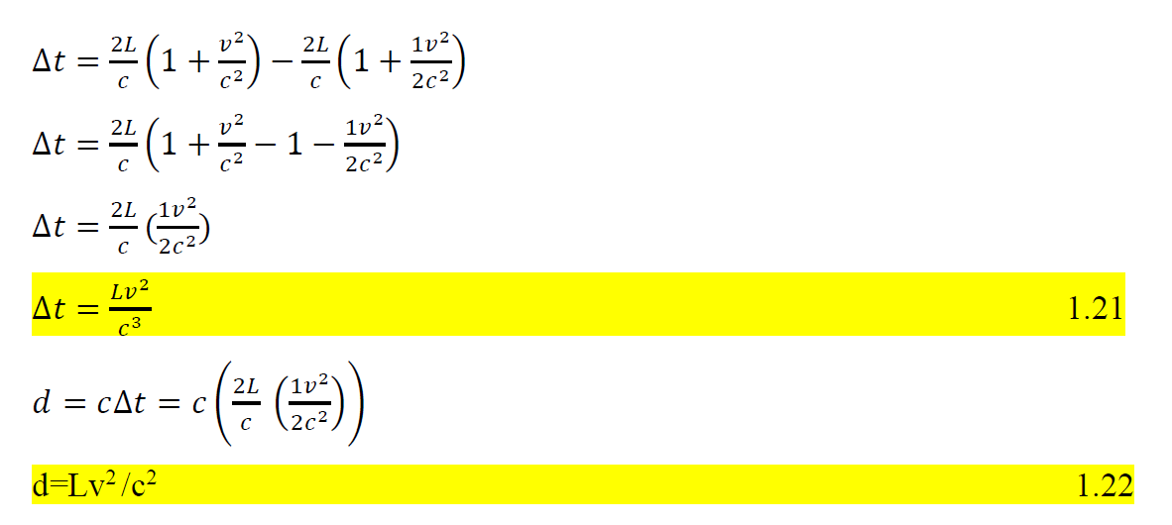

Slide 23
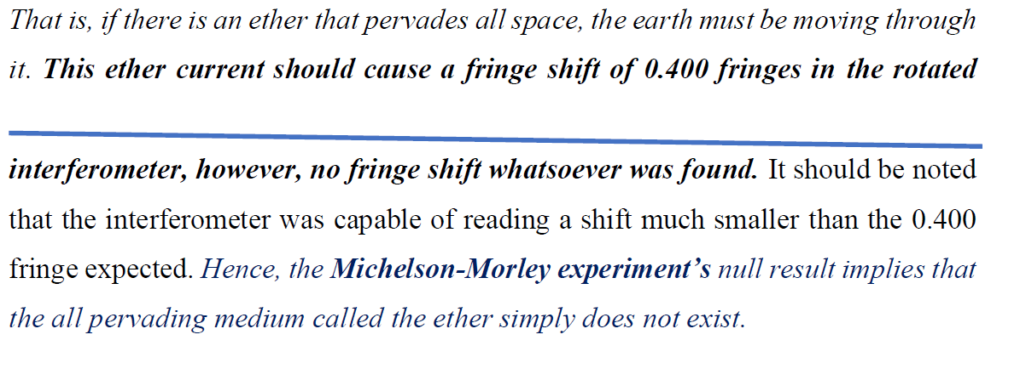

Slide 24
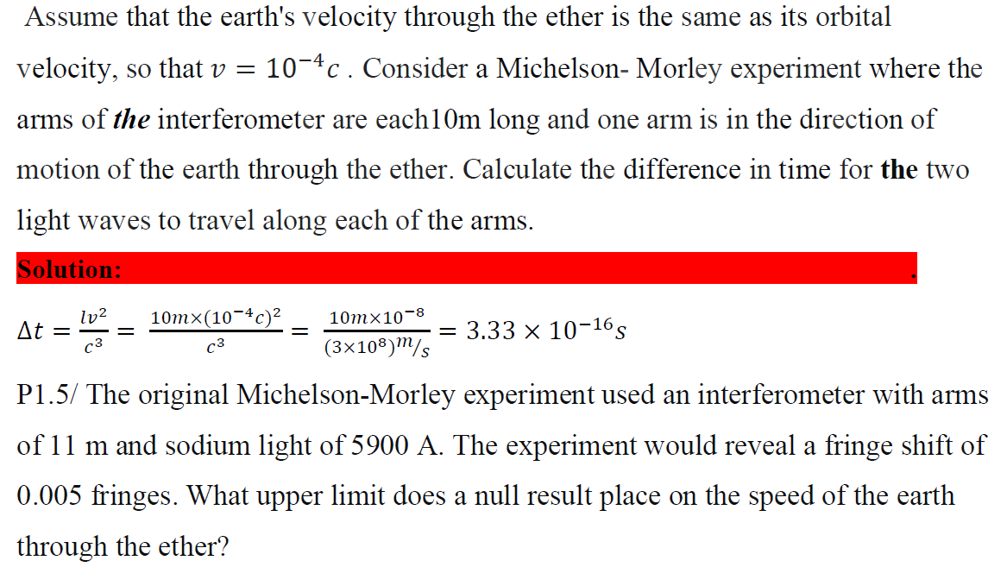

Slide 25
Now, is just the time the light would take if there were no aether wind at all, say, a few millionths of a second. second. If we take the aether wind speed to be equal to the earth’s speed in orbit, for example, about is about1/1/10,000, so is about 1/100,000,000.
This is means the time delay between the pulses reflected from the different mirrors reaching the telescope is about aboutone-hundred-millionth of a few millionths of a second.
It seems completely hopeless that such a short time delay could be detected. However, this turns out not not be to be the the case, and Michelson was the first to figure out how to do it. The trick is to use the interference of properties of the of the light waves. Instead of sending pulses of light, as we discussed above, Michelson sent in a steady beam of light light of a single color.
Einstein’s Answer
The results of the various aether detection experiments discussed above seem to leave us really stuck. also Apparently light is not as sound, with a definite speed relative to some underlying medium. However, it is also not we not like bullets, with a definite speed relative to the source of the light. Yet when we measure its speed we always show always get the same result. How can all these facts be interpreted in a simple consistent way?

Slide 26
Crises (problems) with Reference Frame X formations
Can’t find the Ether
Maxwell’s Equations not Galilean Invariant
Speed of Light fixed by EM constants

Slide 27
Fitzgerald-Lorentz Hypothesis 1889 (1895) {only a partial explanation}
POSTULATE: the null (empty) results are due to changes in length in the direction of travel.

Slide 28
LORENTZ POSITION-TIME TRANSFORMATIONS

Slide 29
Lorentz Transformations
K
K’
v
K’← K
x
P
x’
x’-axis
x-axis
Thus, according to the results of the first postulate of relativity, the time t’ in the moving coordinate system is not equal to the time t in the stationary coordinate system.

Slide 30
Lorentz Transformations
K
K’
v
K← K’
x
P
x’
x’-axis
x-axis

Slide 31
Substituting this value of k into equation of x’ gives the first of the new transformation equations, namely

Slide 32
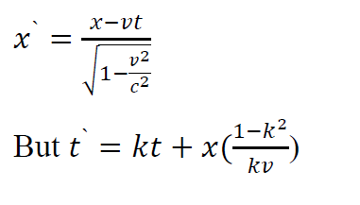
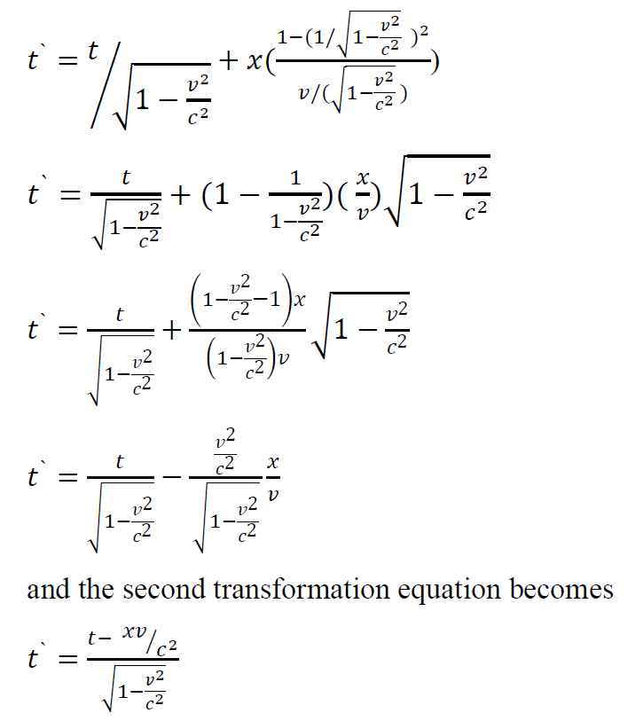
These new transformation equations are called the Lorentz transformations.
The Lorentz transformation equations are summarized as

Slide 33
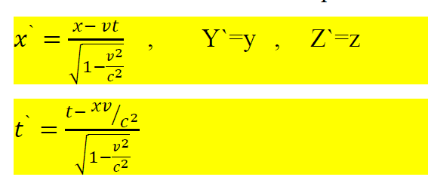

Slide 34
Thus, the Lorentz transformation equations reduce to the classical Galilean transformation equations when the relative speed between the observers is small as
compared to the speed of light. This reduction of a new theory to an old theory is called the correspondence principle and was first enunciated as a principle by Niels
Bohr in 1923. It states that any new theory in physics must reduce to the well established corresponding classical theory when the new theory is applied to the special situation in which the less general theory is known to be valid.

Slide 36
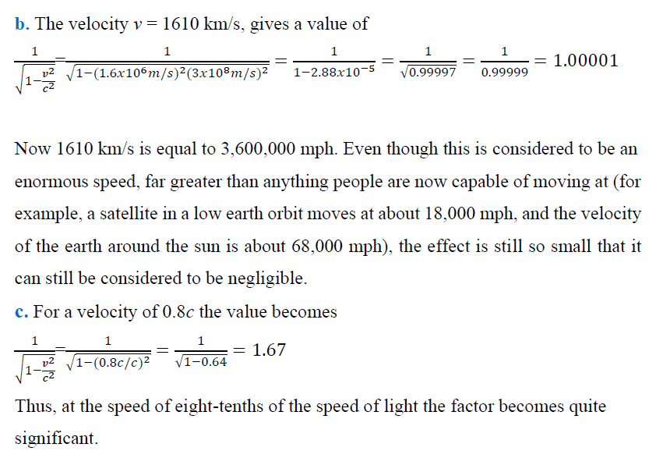

Slide 37
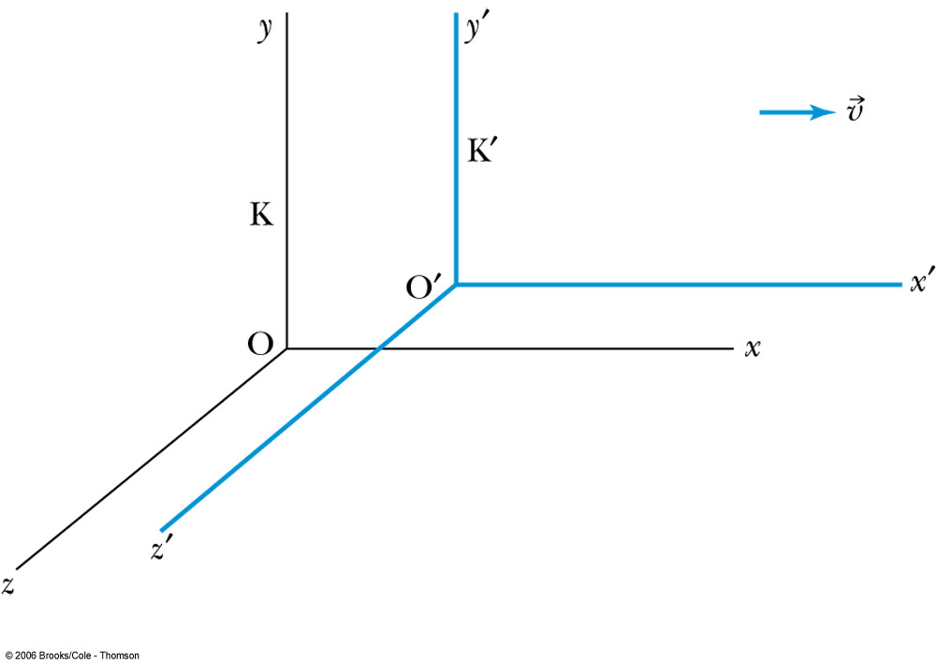
Example
K: 3km, 5us
K’: 2.6km, -1.25us
As observed from a large asteroid, an explosion occurs at
x=3000, y=500, z=-500 and t=5 us.
v
P
A spaceship approaches at a high speed v=0.6c .
The reference frames coincided at t=0, t’=0
At what position does the spaceship observe the explosion to occur?

Slide 38
Length Contraction (Lorentz-Fitzgerald)
A meter stick, lying parallel to the x-axis, is moving with speed v
v
Moving
objects
appear
shorter
How long does the stick appear to be to a stationary observer
who makes the observation of the length at t=0?
x_{left} & t_{left}=0
x_{right} & t_{right}=0

