Slide 1
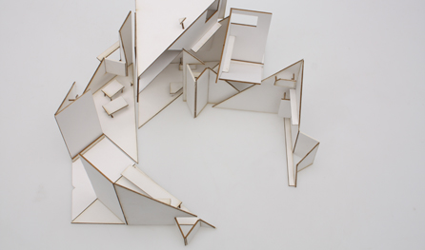
Salahaddin University
Architecture Department
The Architectural Design Concept
Prepared By:
Ausama Magid Akrayi
2021

Slide 2
CONCEPT
FUNCTION:
SPACES
AREA
RELATION
SITE: SHAPE
TOPOGRAPHY
ROADS
VIEW
CLIMATE:
SUN
WIND
HUMIDITY
TEMRETURE
SITE
PROGRAMM
USERS:
GENDER
SOCIAL
CULTURE
BUILDING
HEIGHT
SHAPE
COLOUR
EXTERIOR FORM
&INTERIOR SPACE
CLIENTS
VISION
BUDGET
SCHEDULE
ELEMENTS
TEXTURE
COLOR
SCALE
SIZE
VOLUMES
SHAPES
CONCEPT
IDEA
ANALOGY
METAPHOR
PRINCIPLES
VARIETY
BALANCE , SYMMETRY , ASYMMETRY
PROPORTION, UNITY, RHYTHM
SOLUT ION
SKETCHES
DRAWINGS
DETAILS

