Slide 1
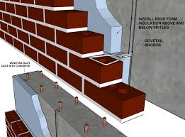
Salahaddin University
Architecture Department
1st Stage
^{10d}-April-2021
Building Construction
Subject:
Masonry System
Brick Work
Prepared By:
Ausama Magid Omer
2021

Slide 2
The Main aims of Lecturer(Objectives):
Brick Work
Type
Shape
Size
Bonds

