Slide 1
Building material
University of Salahaddin-Erbil
Department of Architecture
1st Stage
^{27th}-Feb-2021
Building material in general and types
Lecture 2
BY:
AUSAMA MAGID

Slide 2
From Previous Lecture:
History of Building Material
Primitive Material
Basic Material in Mesopotamian
Architecture
Basic Material in Nile
Architecture
Notes:
Computer is an advanced electronic device that takes raw data as input from the user and processes these data under the control of set of instructions (called program) and gives the result (output) and saves output for the future use. It can process both numerical and non- numerical (arithmetic and logical) calculations.

Slide 3
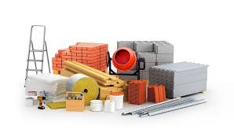
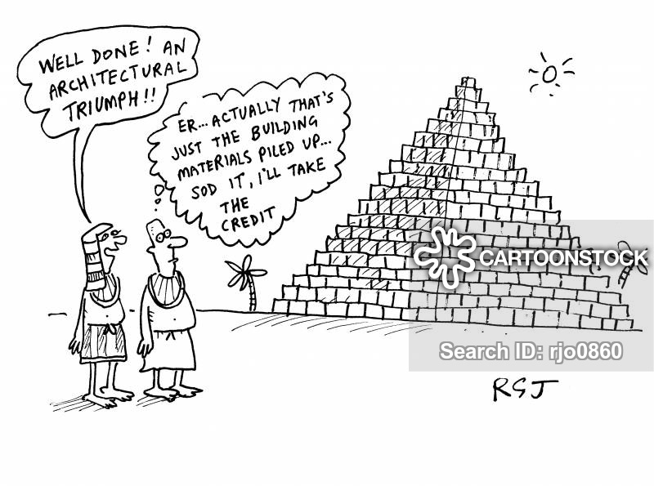
The Contents of This Class Lecture
Introduction of Building Material
Architecture Material
Construction Material
Types of Material

