Slide 1
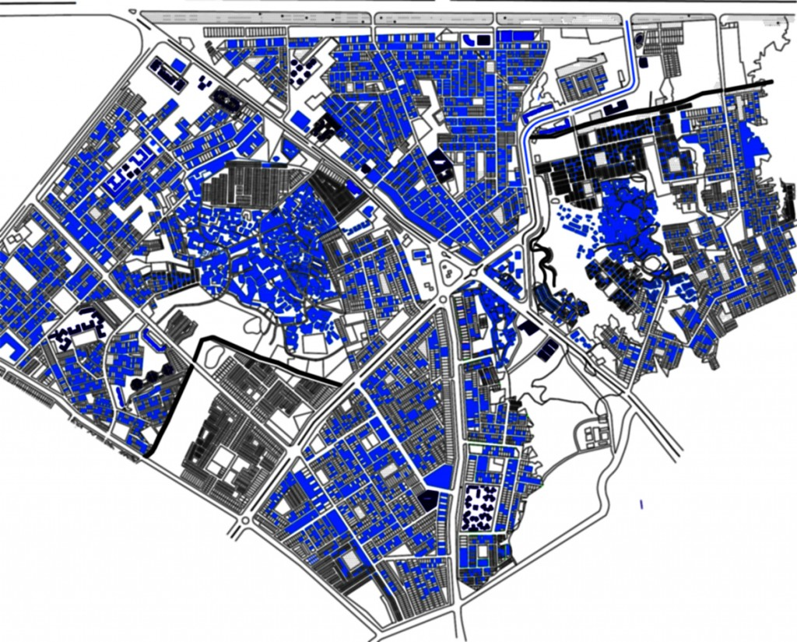
Salahaddin University
Architecture Department
Third Stage
24th -February-2021
City Planning
Subject:
Urban Pattern & Form
Prepared By:
Ausama Magid Omer
2021

Slide 2
The Main aims of Lecturer(Objectives):
What is Urban Morphology.
Urban Form.
Urban Pattern.

