Slide 1
Classism vs. Romanticism in Arts and Literature
Asst. Lect. Avan Taha Saleh

Slide 7
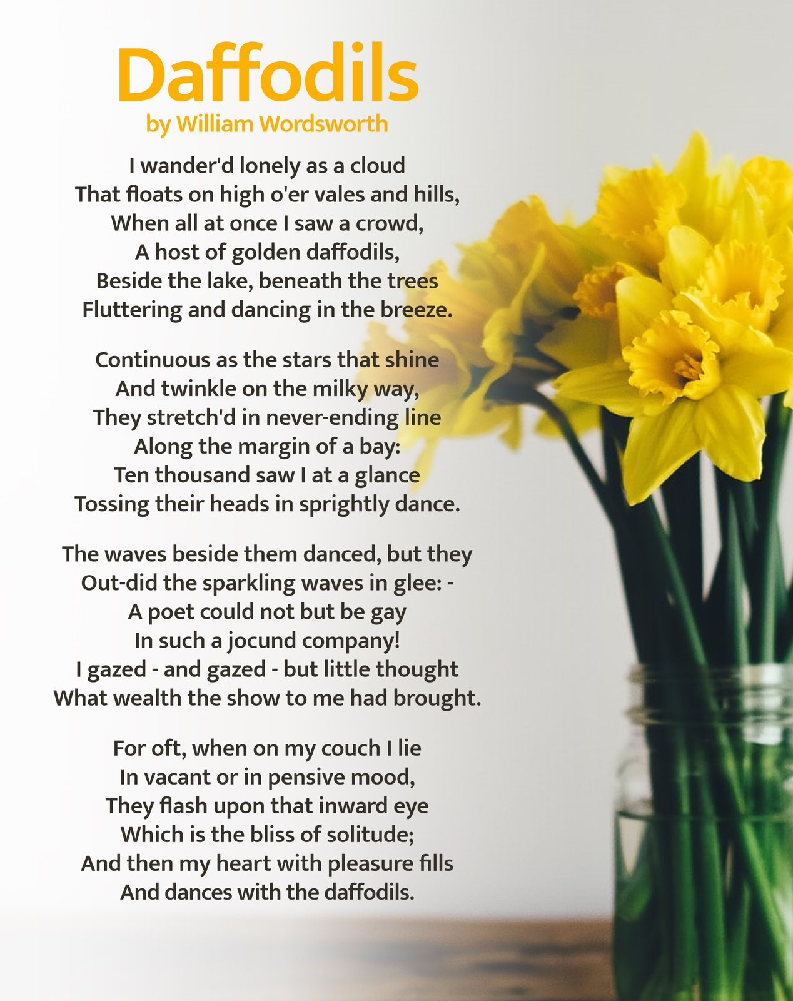

Slide 8
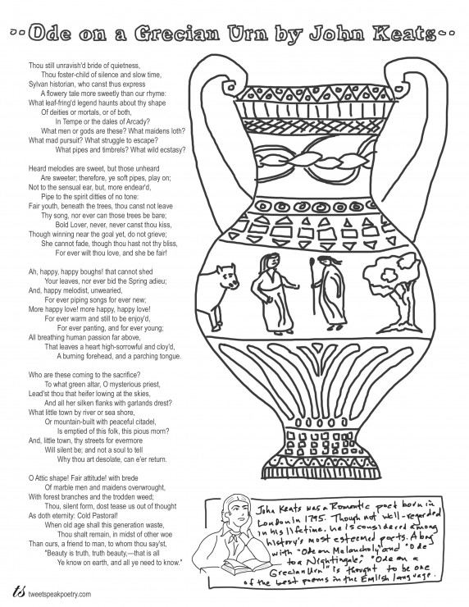

Slide 9
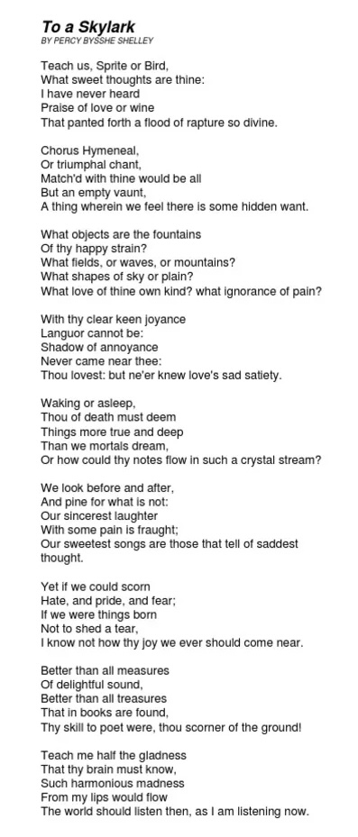
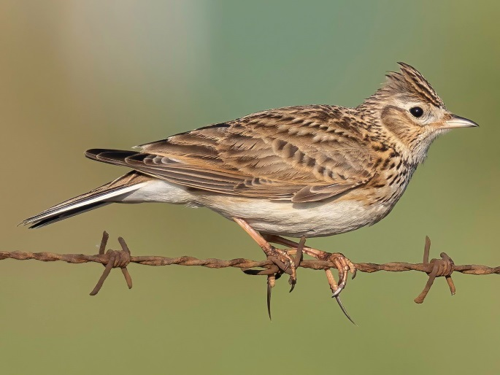

Slide 10
