Slide 1
CREDIT AND COLLECTION
Chapter One
Credit And Types Of Credit
Finance And Banking Dept.
2nd Stage
2nd Semester
2023-2024
Ass. Lecture Aveen A. Majed

Slide 2
Chapter Outlines
What is Credit?
The cost of credit?
Elements of Credit Who uses credit?
Advantages and disadvantages of Credit
Types of Credit

Slide 3
WHAT IS CREDIT?
Credit is issued to people who want to obtain something now, but who can’t or don’t want to necessarily pay for it now, based on that person’s ability to pay for it later. Credit can be used to purchase new property or to take out a loan, and a person’s creditworthiness is represented in different ways.
Credit is the measure of trust one party has in another party’s ability to receive some kind of resource now and pay for it at a designated point in the future. In most cases, that means a person in relation to her/his bank.
Generally “Credit” means; an agreement to get money, goods, services now in exchange for a promise to pay in the future.
But the term of “Bank Credit” refers to; the amount of credit available to a business or individual from a banking institution in the form of loans. Bank credit, therefore, is the total amount of money a person or business can borrow from a bank. A borrower's bank credit depends on their ability to repay any loans and the total amount of credit available to lend by the banking institution.
Notes:
Creditworthiness الجدارة الائتمانية؛ الحالة الائتمانية؛, ثقة ائتمانية

Slide 4
THE COST OF CREDIT
To cover the risk and costs associated with extending credit, a lender will charge the borrower interest or service charges depending on the agreement. These extra charges - the cost of credit - consist of any amount that exceeds the amount borrowed (the principal).
The amount of interest you are charged by a lender is determined by several factors. These include the Credit Score, Credit History, Employment Type and Income, Loan Size, Length of Term, collateral..etc.
Of primary concern to a lender however, is your "creditworthiness" or ability to repay the loan. Before extending any kind of credit, a lender will carefully consider your income, the amount of debt you already have and your repayment history.

Slide 5
ELEMENTS OF CREDIT
One who lends money/provides credit – creditor
One who borrows money/uses credit - debtor
Creditors charge a fee for using their money – interest
“Credit is your financial trustworthiness”

Slide 6
Who Uses Credit?
Consumer credit – credit used by people for personal reasons
Commercial credit – credit used by businesses
Federal, state and local governments also uses credit to fund programs and projects.

Slide 7
ADVANTAGES OF CREDIT:
Convenience; Don’t have to carry cash & worry about it getting lost or stolen.
Don’t have to save for expensive items
Useful for emergencies
Pay for things over the phone/internet
Allows you to establish a credit rating – measure of person’s ability and willingness to pay debts on time
Helps you keep track of your spending
Contributes to the growth of our economy

Slide 8
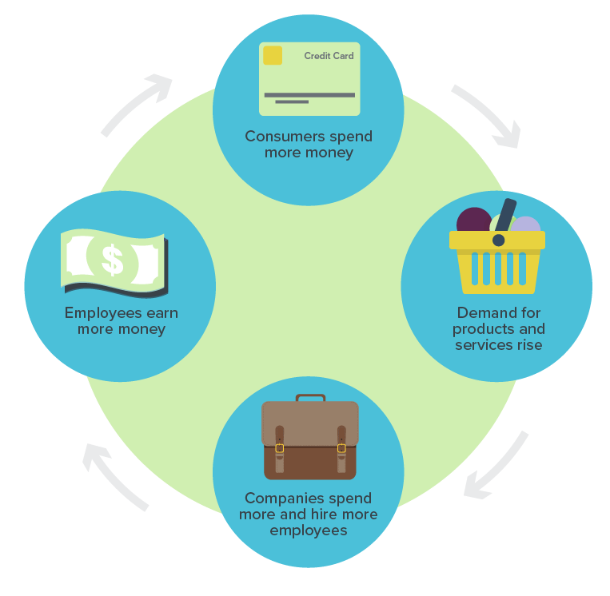
ADVANTAGES OF CREDIT:
Contributes to the growth of our economy;

Slide 9
DISADVANTAGES OF CREDIT:
Easy to misuse
Tempting to buy things you can’t afford
Items cost more on credit because of interest
Credit limits
Late/missed payments lower credit rating
“Credit is money you owe, not own!”

Slide 10
Good Credit & Bad Credit
Good credit means that your history of payments, employment and salary make you a good candidate for a loan, and creditors (those who lend money or services) will be more willing to work with you.
Bad credit, however, can be a big problem. It usually results from making payments late or borrowing too much money, and it means that you might have trouble getting a car loan, a credit card, a place to live and, sometimes, a job.
Credit is more than just a plastic card used to buy things. It’s your financial trustworthiness.

Slide 11
TYPES OF BANK CREDITS
Bank credit can be classified into many sections on the various basis;
1- By Purpose of the Credit;
Ruse and Hudgins have divided loans into seven broad categories, delineated by their purposes:
Real estate loans are secured by real property – land, buildings, and other structures – and include short-term loans for construction and land development and longer-term loans to finance the purchase of farmland, homes, apartments, commercial structures, and foreign properties.
Financial institution loans include credit to banks, insurance companies, finance companies, and other financial institutions.
Agricultural loans are extended to farms and ranches to assist in planting and harvesting crops and supporting the feeding and care of livestock.
Commercial and industrial loans are granted to businesses to cover purchasing inventories, paying taxes, and meeting payrolls.
Loans to individuals include credit to finance the purchase of automobiles, mobile homes, appliances, and other retail goods, to repair and modernize homes, and to cover the cost of medical care and other personal expenses, and are either extended directly to individuals or indirectly through retail dealers.
Lease financing receivables, where the lender buys equipment or vehicles and leases them to its customers.

Slide 12
TYPES OF BANK CREDITS
2- By Duration of the Credit
Depending on the duration for which loans are given loans can be classified into three categories:
Short-term credits are scheduled to be repaid within one year. Businesses take short-term loans to meet working capital needs. Short-term loans are usually given against inventory and accounts receivable. These loans can also be unsecured, such as a line of credit, revolving credit.
Mid-term credits are repaid over a period ranging from one year to five years. Banks customarily grant such loans against immovable properties. Interest rates on mid-term loans are higher than on short-term loans.
Long-term credits are the loans whose repayment period extends beyond five years. Long-term loans are used for constructing plants and factories, construction of a house, purchase of land, equipment, and machinery. Immovable properties are used as securities for such loans.
Notes:
1- Why businesses take short-term loans? to meet working capital needs (to finance their business activities)
2- The interest rate on the short term credit is higher than mid-term and long-term credits.
3-Why short term loans known as unsecured credit? Because short term loans usually given against inventory and account receivable.

Slide 13
TYPES OF BANK CREDITS
3- By Nature of the Credit
Funded credits or non-documentary credits are given out of the bank’s funds to individuals and organizations through current accounts or loan accounts. Financed credits include loan, cash credit, and bank overdraft.
Non-funded credits or documentary credits are given through issuing various documents, this form of credit banks provide the loan by not extending cash but by lending their reputation and good names, Examples of non-funded credit include a letter of credit (LC), bank guarantee, etc.
Notes:
1- Letter of Credit is a type of non-documentary credit. True or False

Slide 14
FOUR COMMON FORMS OF CREDIT
1. Revolving Accounts ; This form of credit allows you to borrow money up to a certain amount. The lending institution sets a credit limit, or the most you can borrow. In revolving credit, the borrower revolves the balance by rolling from month to month until it is paid in full. Interest charges typically occur for any revolving balance. As the money is paid back, the difference between the maximum credit limit and the current balance is available to be borrowed. This is the most common form of credit issued by credit cards, such as Visa, MasterCard, and store and gas cards. Credit cards are considered unsecure credit because there is no collateral securing the amount borrowed.
2. Charge Cards; A charge card, different than a credit card, cannot carry a balance. This means it must be paid in full each month. If the balance is not paid on time and in full, penalty fees are often added. American Express is a company that mainly offers charge-cards (although they do offer credit cards now as well).
Notes:
Revolving credit = الائتمان المتجدد

Slide 15
FOUR COMMON FORMS OF CREDIT
3. Installment Credit
Installment credit involves a set amount borrowed, a set monthly payment and a set timeframe of repayment. Interest charges are pre-determined and calculated into the set monthly payments. Common forms of installment credit agreements are home mortgages and auto loans.
Installment credit is also typically secure. Secure credit requires security for the lender. The borrower must provide collateral, something of value pledge in order to guarantee loan repayment. If the borrower fails to repay, or defaults on the loan, the lender may confiscate the collateral. A home is an example of collateral on a mortgage, and a vehicle on an auto loan. If the borrower were to default, the home or vehicle would be repossessed.
4. Non-Installment or Service Credit
This form of credit allows the borrower to pay for a service, membership, etc. at a later date. Generally, payment is due the month following the service, and unpaid balances will incur a fee, interest, and/or penalty charges. Continued non-payment will result in service cancellation and can be reported to the credit bureau, affecting your credit score. Service or non-installment agreements are very common in our everyday life. Cell phone, gas and electricity, water and garbage are all examples of service credit.

Slide 16
Secured vs. Unsecured Credit
It’s important to distinguish between two different types of credit: secured and unsecured.1- Secured credit describes an exchange where a loan is attached to some type of asset or collateral, such as a home or an automobile.
2-Unsecured credit, on the other hand, is not attached to collateral. This type of credit includes credit cards and charge cards.

Slide 17
Classification of Credit Cards
Based on mode of Credit recovery
Based on status of Credit Card
Based on Geographical validity
Based on franchise /Tie-up
Based on issuer Category
Charge Card
Revolving Credit Card
Individual Cards
Corporate Cards
Domestic Card
International Card
Standard Card
Business Card
Gold Card
Domestic Tie-up Card
Proprietary Card
Master Card
Visa Card

Slide 18
Creditors have better memories than debtors.
—Benjamin Franklin

