Slide 1


Money and Central Bank
UNVERSITY OF SALAHADDIN
COLLEGE OF ADMINISTRATION & ECONOMIC
BANKING & FINANCE DEPARTMENT
Ass. L. Aveen A. majed
Second Stage
First Semester
2023-2024

Slide 2
Characteristics of Money
Acceptability
Homogeneity
Divisibility
Portability
Durability
Scarcity
Storability
Stability
Recognizability
Economically Issued

Slide 3
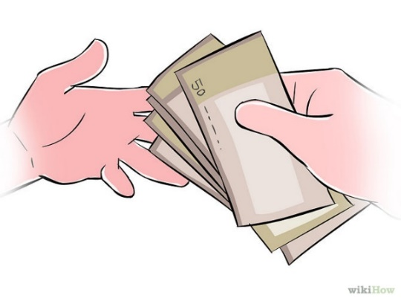
Acceptability
money must be generally acceptable by all in the society or country as a means of exchange.

Slide 4
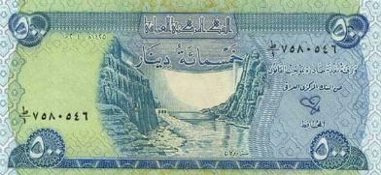
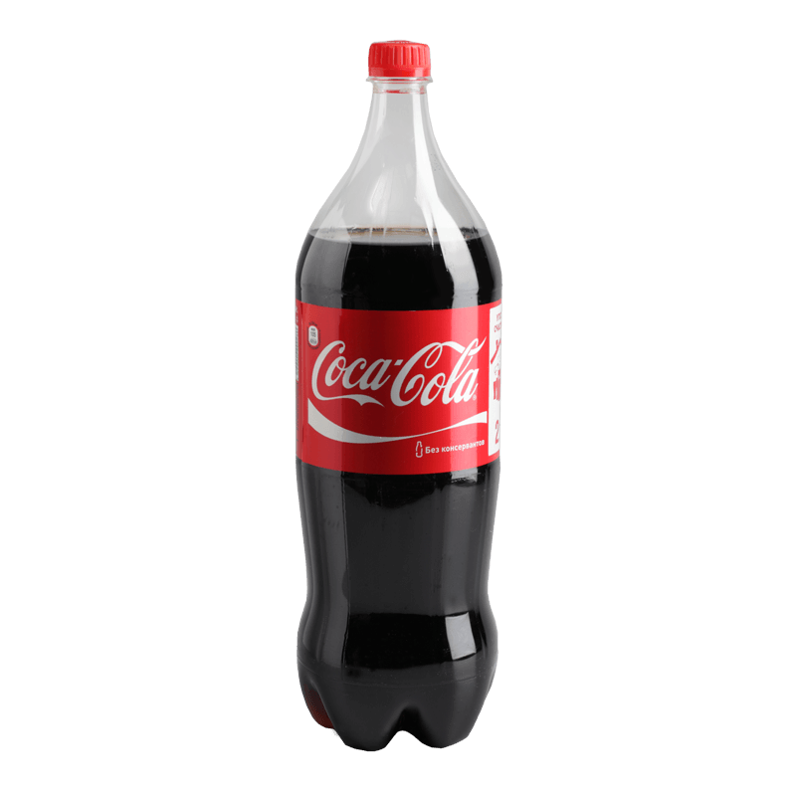
Homogeneity
Each unit of money must be same in:
Size
Colour
Quality
Purchasing power

Slide 5
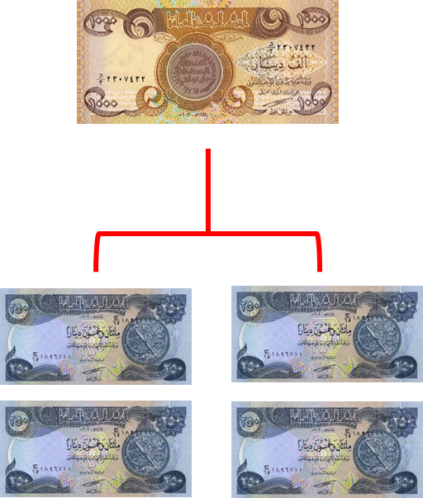
Divisibility
Money must be capable of being divided into smaller units, to enable it to purchase both high and low priced commodities.

Slide 6
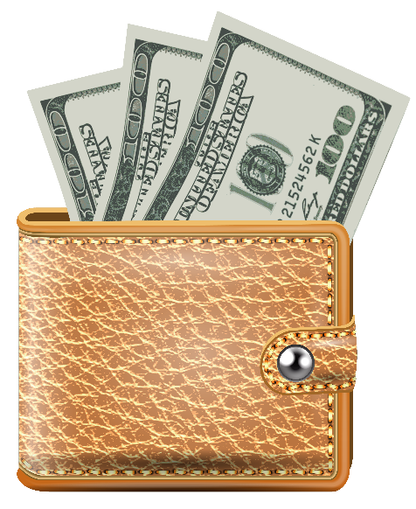
Portability
Money should be easy to carry with varying amounts and should be easily transferred from one place to another.

Slide 7
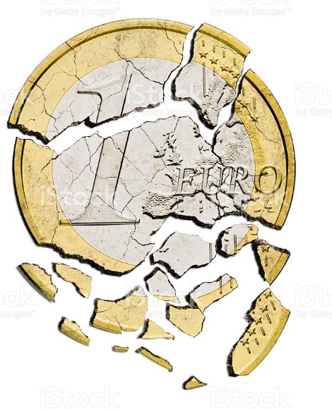
Durability
The object that will serve as money must be durable and does not depreciate over time so that it can be used as a store of value.

Slide 8
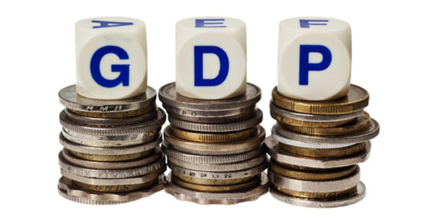
Scarcity
Money must be relatively scarce, that is, it must not be too many so as not to lose its value.

Slide 9

Storability
Money should be stored without any fall in its value.
This quality of money will encourage savings and investment.

Slide 10
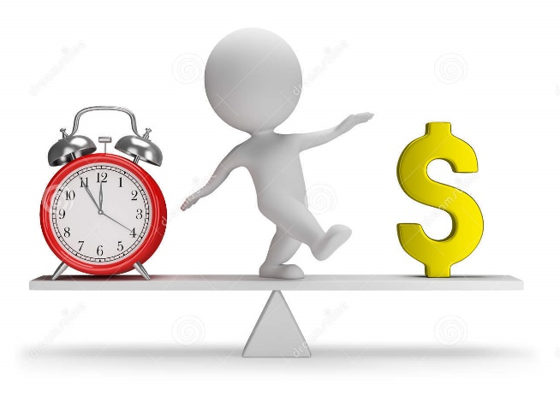
Stability
The value of money must be stable. The stability of its value will help the business to be predictable and encourage lending and borrowing of money.

Slide 11
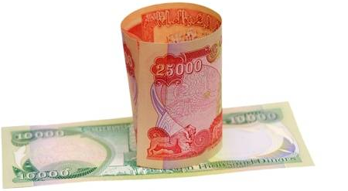
Recognizability
Money must be easily recognized and identified by the totality of the people in the society.

Slide 12
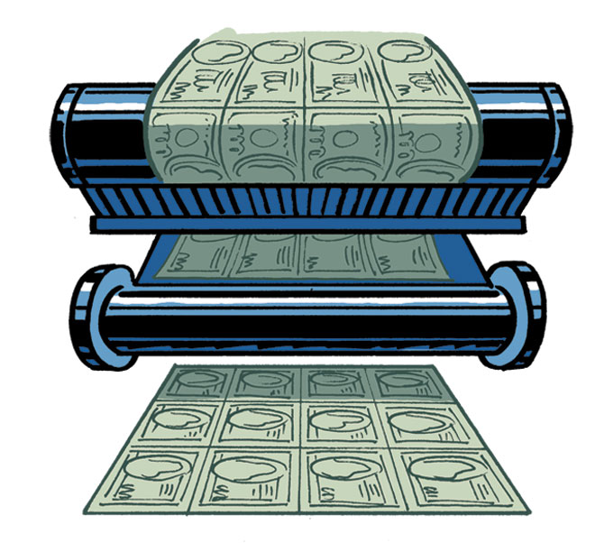
Economically issued
The issuance of notes and minting of coins must be characterized by lower costs and the best materials.

Slide 13
Types of Money
(Commodity Money)

Slide 14
Types of Money
Commodity Money
Bank Money
Currency
Coin
Money
Common Commodity
Metallic Money
Paper
Money
Near
Money
Electronic Money
Plastic
Card
Electronic Wallet
Electronic Check

Slide 15
Commodity Money
For the first time after the collapse of the barter system, a particular commodity such as (cattle, wheat, metal, etc.) was used to play the role of the money in market exchange.

Slide 16
Common Commodity
A common commodity such as (cattle, tobacco, wheat, knife, etc.) was used to play an intermediate role in the exchange of goods and services.

Slide 17
Defects of Common Commodity Money
Commodities were not uniform.
The difficulty of store commodities.
The supply of commodities were uncertain.
The difficulty of transfer commodities.
Lack of divisibility for some commodities.

Slide 18
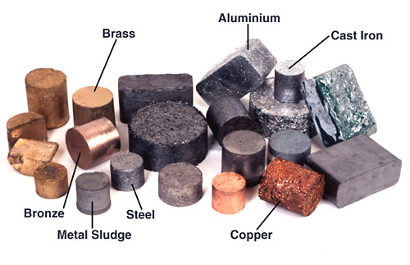
Metallic Money
People used metals as money through the following three forms:
Weighted Money
Accounted Money
Minted Money

Slide 19
Defects of Metallic Money
Its supply was limited.
It was impossible to carry and transport large sums of money.
It was unsafe to carry precious metals.
Metallic money was very expensive.

Slide 20
Thank You
to be continue…

