Slide 1
Experiment - 3 Uv - Spectrophotometric Determination of Aspirin

Slide 2
Aspirin (A.S.A) acetylsalicylic acid hydrolyzes to salicylic acid( S.A )when treated with alkaline solution.
Colorless
Some colorless compounds contain functional groups absorb radiation wave length in the UV region

Slide 3
Electronic excitation

Slide 4
Apparatus
Quartz Cell ( uv –region)

Slide 5
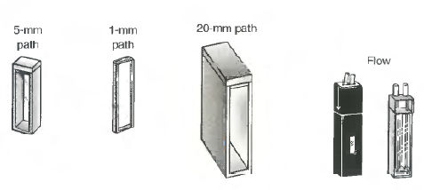

Slide 6
The salicylate ions will absorb UV light. The wavelength of light which is most strongly absorbed ( λ_{max} = 297 nm).
Series of salicylate standards is measured at this wavelength and a calibration plot of absorbance vs. concentration is prepared
The absorbance of the unknown sample is measured and the calibration curve is used to calculate the concentration of aspirin present in the tablet.

Slide 7
Reagents
5 M NaOH ( ? g in 250 ml D.W.)
1 M NaOH (prepared by dilution to 25mL)
0.02M NaOH (prepared by dilution to 500mL)
Unknown : Weigh an aspirin tablet on an analytical balance. Place it in a clean 100 mL beaker and add 10 mL of 5.0 M NaOH. Heat the mixture to boiling. Boil for five minutes and avoid splattering, washing down the sides of the flask with distilled water as needed. Cool and quantitatively transfer this solution to a 500-mL volumetric flask, and dilute to the mark with water.

Slide 8
Stock salicylate solution. Weigh 0.4 g of salicylic acid and place it into a 125-mL Erlenmeyer flask. Add 10 mL of 1 M NaOH and heat the mixture until it dissolve. Cool and quantitatively transfer this solution to a 500-mL volumetric flask, and dilute to the mark with water.
Working solution ( 1x10⁻³M) in 25ml volumetric flask, and dilute to the mark with 0.02 M NaOH

Slide 9
Procedure
Prepare series standard solutions of salcylate from the stock solution as show below: ( 0.2 , 0.4 , 0.6 , 0.8 , 1.0 , 1.2 ) x 10⁻⁴ M
( dilute to the mark with 0.02 M NaOH )
use 0.02 M NaOH as the blank solution.
Measure the absorbance of each standard solution at ( λ_{max} = 297nm)
Dilute the unknown solution 1 to 25 with 0.02 M NaOH and measure the absorbance of the solution

Slide 10
Calculations
Prepare a Beer’s law plot ( Graph).
From Least Squares regression, Y = a + b X determine the concentration of aspirin in the final diluted unknown .
Calculate the weight ( mg ) of acetylsalicylic acid (ASA) in the aspirin tablet considering the dilutions involved.

