Slide 1
ESP English for Specific purposes
Avin N. Qadir

Slide 2
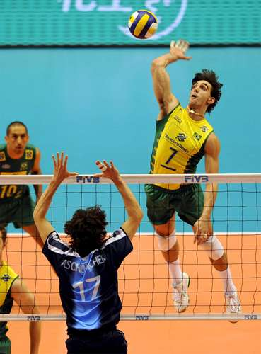
Volleyball
Volleyball is a team sport in which two teams of six players are separated by a net. Each team tries to score points by grounding a ball on the other team's court under organized rules.

Slide 3
Objective
The objective of the game is for each team to send the ball over the net to ground it on the opponent's court, and to prevent the ball from being grounded on its own court.
The ball is put into play by the serving player. The player serves by hitting the ball, with one hand or arm, over the net to the opponent's court.

Slide 4
Duration
A volleyball match typically lasts between 60 and 90 minutes (about 20 minutes per game).
The clock is not a factor; play continues until one team has won three games.

Slide 5
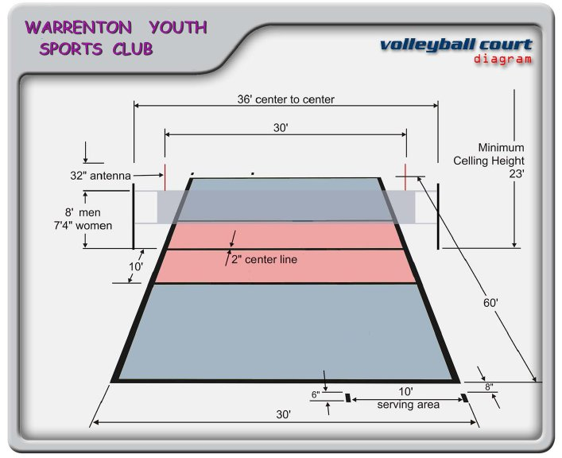
Court Dimensions the game is played on a volleyball court 18 meters (59 feet) long and 9 meters (29.5 feet) wide, divided into two 9 m × 9 m halves by a one-meter (40-inch) wide net placed so that the top of the net is 2.43 meters (7 feet 11 5/8 inches) above the center of the court for men's competition, and 2.24 meters (7 feet 4 1/8 inches) for women's competition (these heights are varied for veterans and junior competitions).

Slide 6
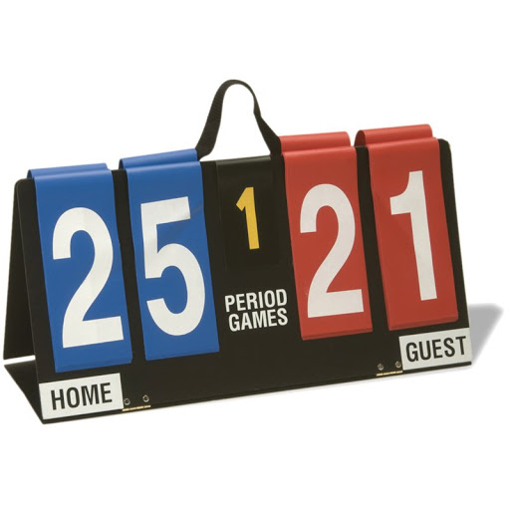
scoring
Here are two scoring methods used for volleyball.
The first is known as Sideout scoring, which basically means the only team that can score is the team that is serving. If the non-serving team hits the ball in the opponents' court or their opponents make an error, they earn the right to serve only.
Rally Scoring
With rally scoring, teams score a point when the other team fails to return the ball over the net, hits the ball out of bounds, commits an infraction or makes a service error.

Slide 7
Rules
An official volleyball court is 18 m × 9 m.
To start a point, the server can serve from anywhere behind the end line, either overarm or underarm, into the opposing team's side of the court.
The opposing team is allowed a maximum of three touches on their side of the court before sending the ball back over the net.
A player is not allowed to touch the ball twice in a row.
The ball must be hit - not caught.
Whichever team wins the point then goes on to serve.
Every time a team wins the serve from the other team, the players rotate their position on court clockwise so that everyone gets a chance to serve.

Slide 11
vocabulary
Net
Grounding
Prevent
serving player
Typically
Lasts
Competition
Veterans
Infraction
clockwise

