Slide 1
General English for University Students second year Students

Slide 2
▪ Key references: - Phillips, T. et al. (2013) General English for University Students, Workbook. Garnet Publishing Ltd. ▪ Useful references: - www.uefap.com - Google website and YouTube channel for researching new information - English-English dictionaries for looking up some vocabulary regarding meaning and pronunciation. Some useful English dictionaries are Macmillan dictionary (online), Oxford advanced learners dictionary, Longman dictionary, Cambridge dictionary.

Slide 9
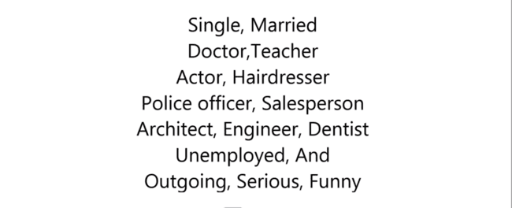
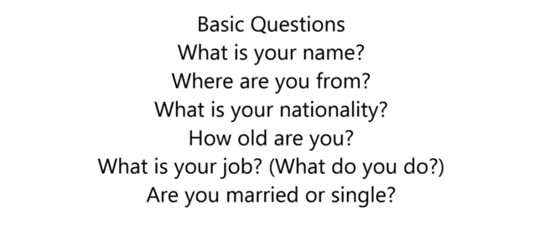

Slide 10
Present Simple

Slide 12
GRAMMAR FOR LISTENING-PAGE 79. make negative:
1-negative sentences:
Main verbs:
AUXILIRAY and modal
A.MAIN VERBS: verbs like = PLAY, CLEAN, STUDY, GO, EAT, READ, BUY..ETC.
1- PRESENT SIMPLE: S+V(S) + COMPLEMENT
EG. HE LOVES ME
SHE FEELS GOOD
WE PLAY EVERY DAY
NEGATIVE : SUBJECT+DOESN’T + VERB+ COMPLEMENT
HE DOSEN’T LOVE ME
SHE DOSEN’T FEEL GOOD
I DON’T EAT TEA

Slide 13
PAST SIMPLE:
SINGULAR SUBJECT OR PLURAL SUBJECT+ V(ED) + C
HE LOVED ME
THEY CLEANED THE HOUSE
NEGATIVE: S+DID’T+ VERB BASE+ C
HE DIDN’T LOVE ME
THEY DIDN’T CLEANE THE HOUSE.
AUXILIRAY : IS, AM, ARE, WAS, WERE
Negative: isn’t, am not, in english we don’t have amn’t, aren’t, wasn’t, weren’t
She is clever= she isn’t clever
Modals: can=can’t, would=wouldn’t, will=won’t, must=mustn’t
She will visit her aunt
She won’t visit her aunt

Slide 14
Reasons: page79
Speakers often follow an obligation sentence with a reason sentence. We can link the obligation sentence and reason sentence in several ways:
1-obligatory sentence is always have must +because + reason sentence
Managers mustn’t behave rudely because it makes people angry.
2-obligatory sentence.+ why? Because, + reason sentence
Managers mustn’t behave rudely.why? Because, it makes people angry.
3- obligatory sentence+ pause….+or just one .+ reason sentence
Managers mustn’t behave rudely....it makes people angry.
Managers mustn’t behave rudely.it makes people angry.

Slide 15
But be careful sometimes the next sentence is a new point and always confused with number three:
obligation+pause…+reason. So only through the meaning, you can realize whether the second sentence is a reason or a new point Consider:
Obligation sentence+ pause…+new point
Managers mustn’t behave rudely.(pause)they mustn’t get angry new point
Closed questions: page85
Is a type of question which is answered by YES or NO
Is she smart? NO, she isn’t
1 2 2 1

Slide 16
Exam: answer the following Closed questions
1. Are they outside?
Yes, they are. No, they are not(aren’t)
2. Was she nervous?
Yes, she was No, she was not(wasn’t)
3. Were they brilliant?
Yes, they were No, were not(wasn’t)
4. Can she stop talking?
Yes, she can No, she can’t
5. Do, they believe in God?
Yes, they do No they don’t
6. Did she write the letter?
Yes she did No she didn’t
Note: if the subject of the question is YOU, so the answer will be I FOR EXAMPLE:
Are you a student?
Yes,I am No, I am not

Slide 17
Are you a student?
Yes, I am No, I am not ( are is changing into am)
were you late for class today?
Yes, I was No, I wasn’t ( were is changing into was)
Sometimes closed questions offer a choice, so you can’t answer by YES or NO, consider:
Would you like to have tea or coffee?
Tea, please
But not:
Yes, I would or I wouldn’t

Slide 18
3.14 Grammar for reading: basic sentence patterns
Page 91-
Types of words
There are three main kinds of words:
Nouns: MAN, CAREER, IDEA
Verbs: GO, BE, CAN, DO, LOVE, TEST,
Adjectives: GOOD, INTELLIGENT, THREE, GREEN, RED
MINOR WORD TYPES ARE: pronouns: he, she, they, we
Prepositions in: on, by, at
Adverbial TIME- Sunday, at 5 OCLOCK
Adverbial Place-: In school, at home, all over the world
MANNER- ADJECTIVE+LY= QUICKLY, SLOWLY

Slide 19
THE FOLLOWING ARE THE BASIC ENGLISH PATTERN:
SUBJECT+ VERB (SV) =THE WOMEN LISTENING
SUBJECT+ VERB(main verb: has, need)+OBJECT(SVO)= THE COMPANY HAS TWO hundred EMPLOYEES/ HAS IS MAIN VERB
SUBJECT+ VERB (to be=am,is,are) +COMPLEMENT (SVC) = THE JOB IS INTERESTING THEY ARE JOURNALISTS
Subject + verb+ adverbials( SVA)
some journalist work from home place
We travel all over the world place
In the exam: B1. write the sentences pattern of the following sentence:
it means what is the pattern sentences: we have 4

Slide 20
SV/ SVO/ SVC/SVA
YOU HAVE TO MAKE SLASH IN THE EXAM : B PAGE 91
Employment / is declining . SV
Unemployment/ is rising. SV
many young people/ are/ out of work SVC
Most employers/ want/ skilled workers. SVO
They/ work/ now and then. SVA( ADVERBIAL OF TIME)
They/ don’t earn/ every week. SVA

Slide 21
A-ARTICLES. PAGE 111
B- INTRODUCTION PHRASES
A-ARTICLES; A, AN, THE, AND SOME
We often use articles before noun. There are some rules;
we use a and an before a singular countable nouns. e.g a book a car an elephant
We use the before specific singular countable noun e.g the sun the boy the girl
We use the before specific plural countable noun e.g the girls, the boys, the students
We use some before plural noun for a group of item e.g some girls, some peoples
5. We don’t use an article with uncountable nouns to talk about things in general
6. We don’t use an article with plural nouns to talk about things in general/

Slide 22
A- understanding article usage page111- (a1,b6,c5, d2, e4, f3)
A hypothesis/ singular countable noun
Plants/ plural, countable; things/ plural, countable NO ARTICLE in general
Sunlight, water/ uncountable NO ARTICLE IN GENERAL
The hypothesis/ specific singular countable
Some plants/ plural, countable, group of items
The plants/ plural, countable pot A/ singular, uncountable

Slide 23
4.4 Grammar for listening; A- Articles;
B-introduction phrases
introduction phrases like: I know(that)…., I think (that)…, I believe (that)…, the results mean (that)…., the experiment proves (that)….,etc. Introduction phrases are put before SVO,SVC.. SENTENCE they are not sentences they are phrases
subject + verb + object = plants need water put introductory phrases:
introduction phrases + subject +verb + object
I know that plants need water.

Slide 24
How to change active to present simple passive
delete the subject of the active sentence.
Bring the object to the beginning
Write the verb and the object is singular =is +p.p or plural= are+ p.p
It is optional, you can write by+ subject at the end of passive or not to write it
(Make active to passive or passive to active)
Action +because + reason.
Reason + so + action

Slide 25
3.19 grammar for writing: page 99
B complete each sentence with something logical:
Because they don’t like putting bad things in writing.
Because they must understand their needs
Because people rely on you
SO some journalists work shifts.
SO they must be outgoing.
SO a small number is selected.
Page 100 A:
WRITE? A job description/ person description
Design? An advertisment

Slide 26
Send? An application form
Complete and return? An application form
Make? A short list
Take up? Reference
Telephone? A referee
Conduct? An interview
Interview? A candidate
Select? The best candidate

Slide 27
4.14 GRAMMAR FOR READING: COMPARATIVES
PAGE-123
1- In the comparative structure:
We add –er to the end of adjectives if:
the adjective has ONE-syllable( has one vowel) example:
cold=colder than
warm= warmer than
NOTE: A- if the one-syllable adjective end with 1 consonant an preceded
by 1 vowel, so we double the last consonant then we add –er, example: big=bigger than/ hot= hotter than

Slide 28
B- If the one-syllable adjective ends with –y, we change the –y to I then add –er and –est, example:
Heavy= Heavier than
Pretty= prettier than
4.14 GRAMMAR FOR READING: COMPARATIVES
PAGE-123
2- We add more+ adjective and most+ adjective with two-syllable or more syllables adjectives( having more than two vowels) ending in
ed, ing, ful, less example:
Worried= more worried than Careful=more Careful than
Boring= more boring than

Slide 29
4.14 grammar for reading: comparatives
page-123
A- The structure of the a comparative sentence is:
FIRST THING + OMAPARIVE + SECOND THING
Erbile is hotter than Duhok
leyla is more beautiful than sarah
1-underline the comparative forms in the following text
2- circle( blue color) the two things involved in each case
Imagine two cities on the same continent. City A is closer to the Equator than city B. so is city B warmer in winter than city A ? No, it is colder , because it is Inland, whereas city b is on the coast. Why are coastal cities usually warmer than in the winter than places inland? It is because the sea in the winter is warmer than the land. In the fact, the climate in coastal cities is more pleasant all year round. In the summer, the sea is cooler than the land, so coastal cities are cooler in summer than inland cities on the same latitude.

