Slide 1
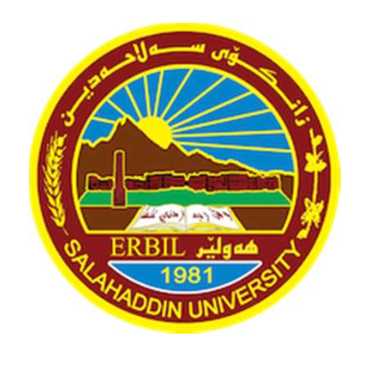
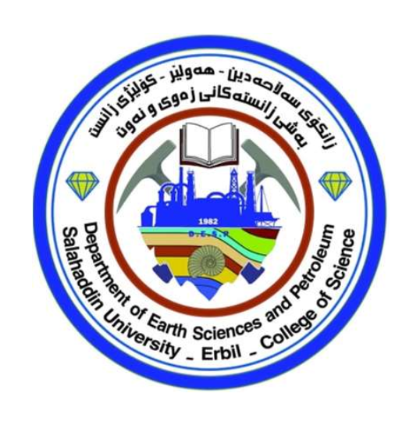
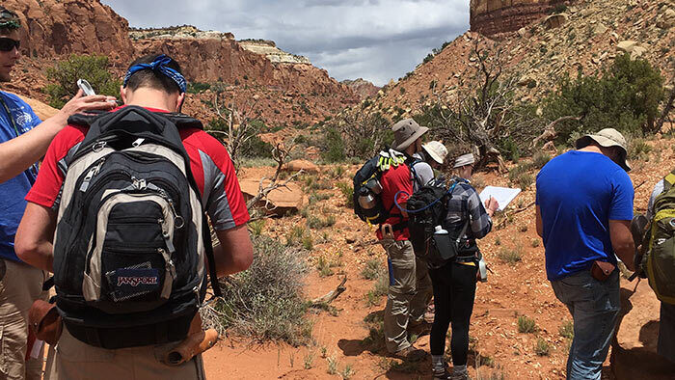
Field geology

Slide 2
An introduction on field geology Lecture 1

Slide 3
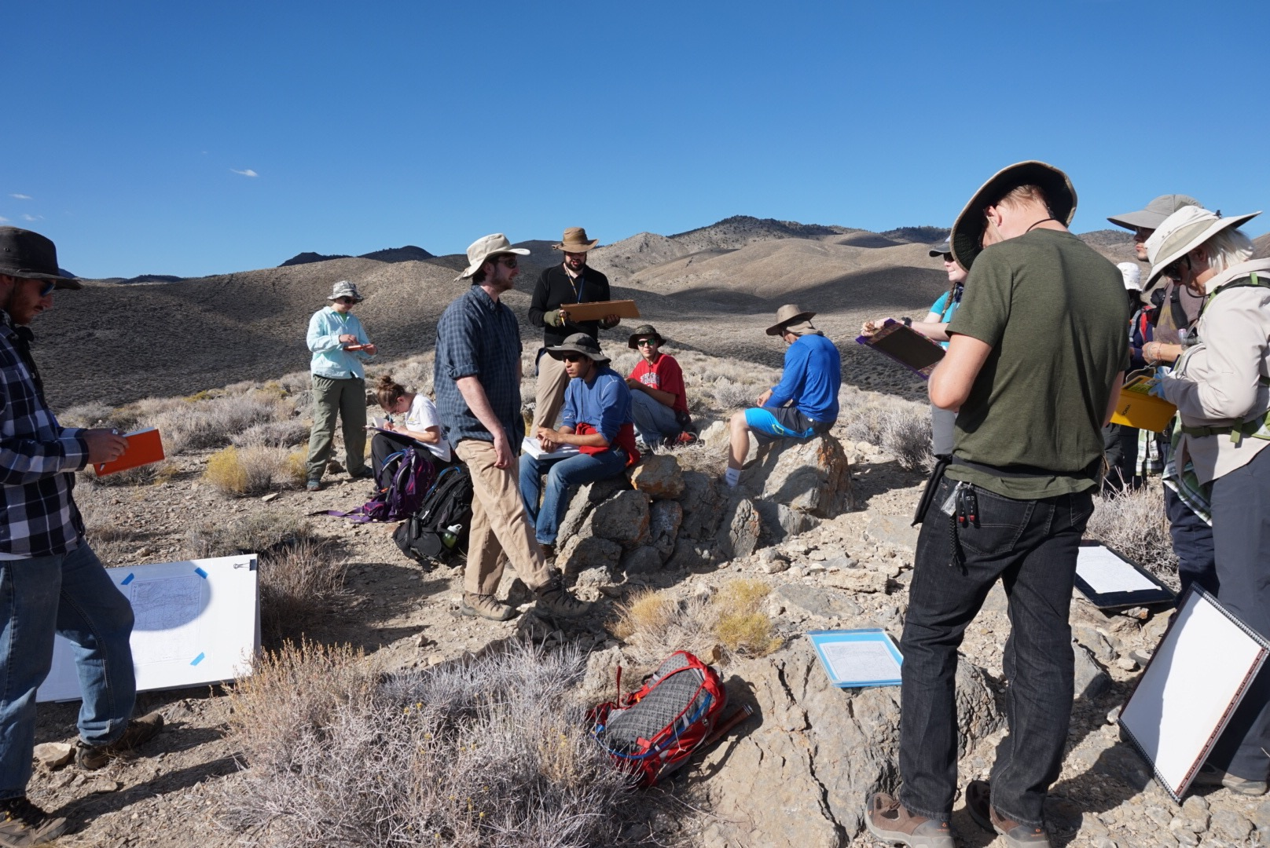
Introduction
The main aim of field geology is to observe and collect data from rocks and/or unconsolidated deposits, which will further our understanding of the physical, chemical and biological processes that have occurred over geological time. Many of the basic observational principles used in field geology have not changed for hundreds of years, although the interpretation of the data, the scale of resolution and some of the equipment has advanced greatly.

Slide 4
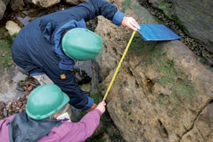
Fieldwork involves making careful observations and measurements in the field (Figure 1. a) and the collection and precise recording of the position of samples for laboratory analysis (Figure 1. b). The very act of collecting field data often raises questions about processes on Earth, which had perhaps not previously been envisaged.
Furthermore, during fieldwork it is usual to initiate, or to build on, constructing and testing different hypotheses and interpretations based on the observations; this iterative process will help to determine the essential data and samples to collect.
Figure 1. a

Slide 5
What are the main benefits of field work?
There are plenty benefits of field work including:
1- Applying what you’ve been studying in class to hands-on, real-life situations.
Field studies and field trips will give students and those participating in continuing education the opportunity to learn how to use some tools which are necessary in the field to collect some reliable data. Example of some of these tools are;
Compass clinometers (like a Brunton Compass) to measure the dip and strike of exposed beds.
Magnifying lenses for examining fine details of rock and soil features,
Different cell phone apps for measuring distances between two targets or features,
GPS trackers for pinpointing locations,
Several editing image apps like CorelDraw and Illustrator

Slide 6
What are the main benefits of field work?
2- Getting to travel and see the our region.
Many of us have been to many parts of our region but we do field trips to many areas where would be new to you and you will look around yourself with different eyes from now and on!
3- Bonding with fellow students and colleagues. Most field work involves teamwork. It fosters great connections and having a collection of hands and minds working together towards a common goal leads to better, more accurate results than solo work.

Slide 7
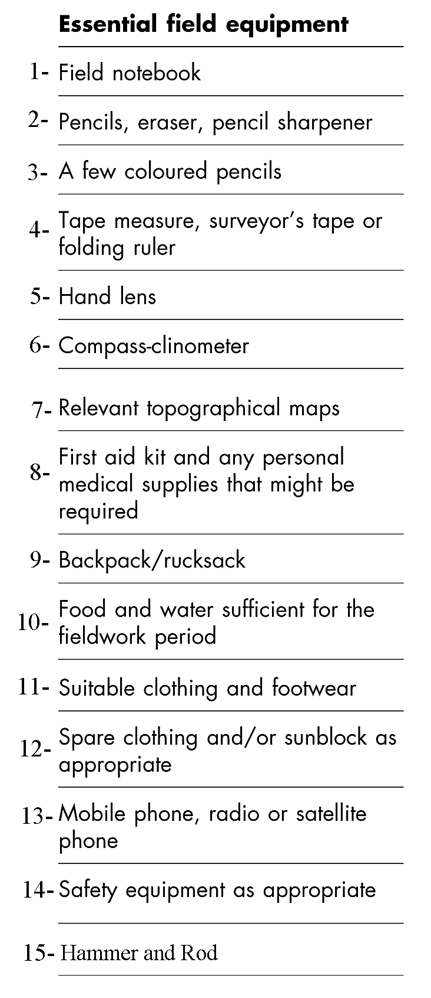
What are the common field trip equipments used by geologists .

