Slide 1
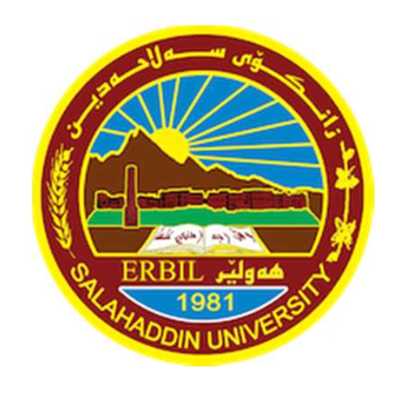
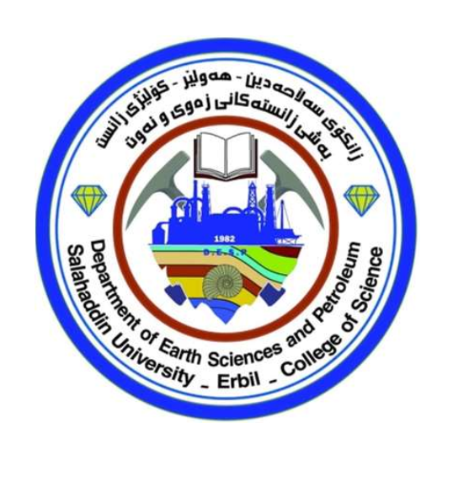
Geotectonics

Slide 2
Tectonic tools to determine and evaluate rates of erosion and exhumation over geologic time scale, and role of tectonics, and climate in controlling rates of long-term landscape change.

Slide 3
Objective of this lecture
﻿Most of the large scale topography of our planet is due to plate tectonics. Tectonically active regions are usually characterized by high topography (e.g. see the Zagros Suture Zone). This is particularly true in areas where collisional tectonics has been taking place and continental margins have been compressed together, causing crustal thickening and high topography. ﻿As soon as topography is created by convergent, divergent or any geological large-scale events, it is modified, degraded and ultimately removed by surface processes (e.g. weathering ﻿and erosion). So, by the end of this lesson
1- You would be able to explain and discuss how surface process and tectonic process increase rate of erosion and thus moving up rocks to the surface.
2- You would learn about the most recent and commonly used tectonic techniques used by geologists to observe how quickly rocks are coming up to the surface which help us to understand long term landscape development.
3- You would better learn the relationship between tectonic uplift, climate and erosion.

Slide 4
﻿ Answer/ If the precipitation (when it is extra) drives faster erosion rates it can actually cause unloading of underlying faults which can then slip, thus tectonic uplift with in certain parts of orogenic wedge may occur! How might we actually test this question!
Think, are rocks coming to the surface faster beneath the peak of precipitation?
We need a way to understand and determine how quickly rocks are coming to the surface over time!
Thermochronology does just that! ☺

Slide 5
Outline
﻿ The concepts of low-temperature thermochronology
﻿ The applications of low-temperature thermochronology

Slide 6
What is Low-temperature thermochronology (LTT)
Low-temperature thermochronology is a geochronological method based on the temperature-sensitive retention of a radiogenically produced daughter product in mineral crystals. It is widely used to quantify long-term rates of tectonic and erosional processes in mountainous regions, but can also be applied to study erosional processes in ancient settings.
In coming slides we talk about how this technique works in detail! DON’T WORY IF YOU DON’T UNDERSTAND what this definition says!

