Slide 1


Slide 2
General English
* This course prepares students to study wholly or partly in English medium at university level, or to join the world of academic English, on the Internet and in print.

Slide 3
Course book aims
What are the aims of the CB?

Slide 4
Course book aims
In GEFUS students learn to understand the main types of academic spoken language, lectures and tutorials, and the main types of written language, journal articles and encyclopedia entries. They also learn to produce the main kinds of student academic language, oral presentation, contributions to a tutorial and written assignment.

Slide 5
Formal English vs General English
Formal English
for academic, technical, research
General English
analytical
objective
intellectual
serious
impersonal
formal
impressionistic
subjective
emotional
conversational
personal
colloquial
Clanchy and Ballard,1992,
cited in Jordan, 1997, p.244

Slide 6
General English
* The course is EAP (not TENOR)
EAP: English for Academic Purpose
TENOR: Teaching English Not for Obvious Reason

Slide 7
What is EAP?
English for academic purposes (EAP) entails training students, usually in a higher education setting, to use language appropriately for study. It is one of the most common forms of English for specific purposes (ESP).

Slide 8
General English
EAP aspect:
90% Simple aspect
7% Perfect aspect
3% Progressive aspect
In EAP we do not focus on Passive
0.5% Perfect Progressive aspect

Slide 9
Themes
This course comprises five themes, covering a wide range of areas of human knowledge.
Theme 1: Education
Theme 2: Psychology and sociology
Theme 3: Work and business
Theme 4: Science and nature
Theme 5: The physical world

Slide 10


Slide 11
Theme 1: Education
Theme 2: Psychology and sociology
Theme 3: Work and business
Theme 4: Science and nature
Theme 5: The physical world
Theme 6: Culture & Civilization
Theme 7: Technology
Theme 8: Arts & Media
Theme 9: Sports and Leisure
Theme 10: Nutrition and Health

Slide 12
The sections
Within each theme there are four main sections, each dealing with a separate skill: listening, speaking, reading and writing.
Listening: to lectures
Speaking: seminars, tutorials
Reading: for research
Writing: essays, assignments

Slide 13
The sections
A number of related topics are explored within each theme. For example, in Theme 1 the following areas are explored:
Listening: welcome talks for students starting at an English-medium
university
Speaking: systems of education and qualities of good teachers
Reading: living and working at university
Writing: completing an application form and
writing a Personal Statement

Slide 14
The Lessons
Each Skill [Listening, Speaking, Reading and Writing]
What is 5 – 4 – 5?

Slide 15
Skills Structure
Lesson 1 develops theme-related vocabulary and develops knowledge.
Lesson 2 activates knowledge, and tests real-time skill application.
Lesson 3 identifies and teaches new skills.
Lesson 4 introduces useful, skill-based, syntactic grammar.
Lesson 5 asks students to undertake a parallel activity to the first two lessons, applying the learning the section.

Slide 16
The Lessons
General English for University Students is an extremely flexible course. There are logical routes through the Course Book, from 25 to 120 hrs.

Slide 17
The lessons
Each skill section contains five lessons (A,B,C,D and E), and each lesson has a clear focus and purpose, as shown in the following table.
A : Core Lesson
B: Can be set for self study
C: Can be omitted
D: Can be set for self study
E: Can be omitted

Slide 18
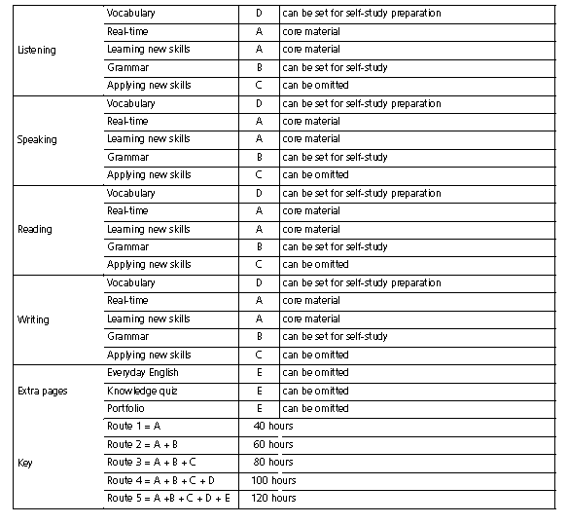

Slide 19
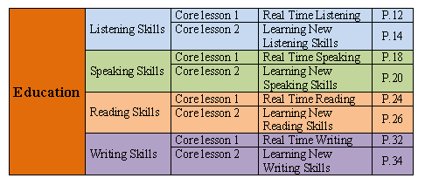
Theme 1

Slide 20
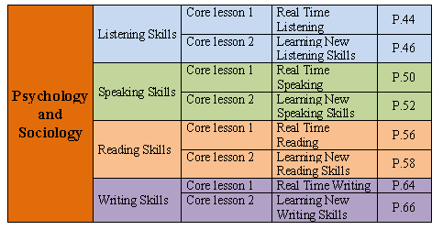
Theme 2

Slide 21
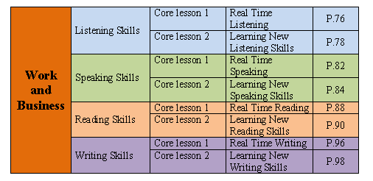
Theme 3

Slide 22
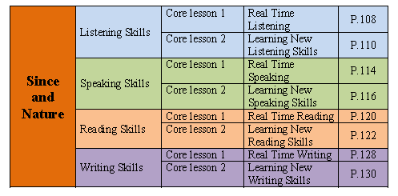
Theme 4

Slide 23
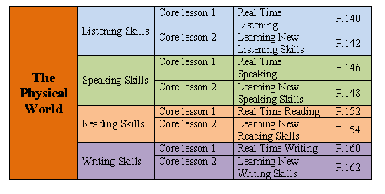
Theme 5

Slide 24
Traditional Lecturing
When everybody is sleeping
and one person is speaking
then that is what the teacher calls teaching.
“Tell me and I forget,
teach me and I may remember,
involve me and I learn.”

Slide 25
What is the role of a teacher?
Remember I S A!
Involve
(5-10 minutes)
Study
(5-10 minutes)
Activate
(25-35 minutes)
arouse interest, get attention
focus on a language area
get students to use it
What % of lesson time should we spend on each element?

Slide 26
What is a lesson plan?
A framework with a beginning, a middle and an end.
A journey?
A meal?
A football match?
A song?
you plan a route to a specific destination
there are separate sections; each part has its own purpose
the teacher is the manager; he or she must get the players to take their roles successfully
it must have a topic, it must have a rhythm, and it must stay in tune

Slide 27
Lesson Plan
A lesson plan is an extremely useful tool that reflects our teaching philosophy, and most importantly our goals for our students.
A lesson plan is essential for novice teachers and convenient for experienced teachers.

Slide 28
Why we plan?
Deciding what to teach, in what order, and for how much time are the basic components of planning.
It serves as a map that guide us in knowing what we want to do next.

Slide 29
Lesson Plan
Lesson plan usually begins with warm-up and/or review activities.
Once warmed up, the class is then ready for the presentation and practice stages of the lesson.

Slide 30
Lesson Plan 1.1
Objective:
By the end of the lesson, students should
be able to:
• demonstrate understanding of target
vocabulary in context;
• demonstrate understanding of
connections between words.

Slide 31
Lesson Plan 1.1
Write the name of the lesson on the board:
Fresher’s week

Slide 32
Activating knowledge
Check students understand the task, and go
over the example with them using CD 1.1.
Practice the responses (in speech bubbles)with the class. Elicit other possible responses,
I’m not sure I agree / I totally (dis)agree with
that, etc.
Play the rest of the statements in 1.1,
pausing after each one.
In pairs, students say if they agree or disagree with each statement.

Slide 33
CD Transcripts
Students:
1. At school, English is more useful than Mathematics.
2. There is no point in studying Art at school.
3. Writing is the most difficult skill in English.
4. A teacher should explain everything to the students.
5. At both university and school, you have lessons and
homework.
6. A university education is not right for everyone

