Slide 1
1- All organic compounds contain carbon atoms and most contain hydrogen atoms. Carbon always forms four covalent bonds, and hydrogen forms one covalent bond.
2- Carbon forms single, double, and triple bonds to other carbon atoms.

Slide 3
IUPAC naming
Undecane, dodecane, eicosane, henicosane, docosane, triacontane,hentriacontane, hectane

Slide 4
Alkynes
Alkynes are hydrocarbons that contain a carbon–carbon triple bond with general molecular formula CnH2n-2, for an acyclic (noncyclic) alkyne, and that for a cyclic alkyne is CnH2n-4. Acetylene (HC≡CH), the common name for the smallest alkyne, may be a familiar word because of the oxyacetylene torch used in welding. Acetylene is supplied to the torch from one high-pressure gas tank, and oxygen is supplied from another. Burning acetylene produces a high-temperature flame capable of melting and vaporizing iron and steel. Each carbon of -C≡C- is sp hybridized, so each has two sp orbitals and two p orbitals. Because the sp orbitals are oriented as far from each other as possible to minimize electron repulsion, ethyne is a linear molecule with bond angles of 180°.

Slide 5
A carbon–carbon triple bond is shorter and stronger than a carbon–carbon double bond, which in turn, is shorter and stronger than a carbon–carbon single bond. We have also seen that a carbon–carbon π-bond is weaker than a carbon–carbon σ- bond.
The relatively weak π- bonds allow alkynes to react easily. Like alkenes, alkynes are stabilized by electron-donating alkyl groups. Internal alkynes, therefore, are more stable than terminal alkynes, so alkyl groups stabilize alkenes, alkynes, carbocation's, and alkyl radicals.

Slide 7
Compound A is a terminal alkyne with molecular formula C6H10. Draw all four possible constitutional isomers that are possible structures for compound A, and provide a systematic name for each

Slide 8
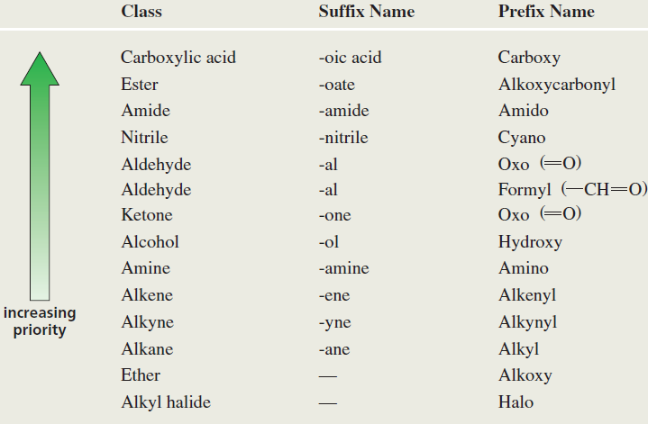

Slide 9
Physical Properties
All hydrocarbons have similar physical properties. In other words, alkenes and alkynes have physical properties similar to those of alkanes. All are insoluble in water and all are soluble in solvents with low polarity such as benzene and ether. They are less dense than water and, like other homologous series, have boiling points that increase with increasing molecular weight. Alkynes are more linear than alkenes, and a triple bond is more polarizable than a double bond.
These two features cause alkynes to have stronger Vander Waals interactions. As a result, an alkyne has a higher boiling point than an alkene containing the same number of carbon atoms.

Slide 10
Internal alkenes have higher boiling points than terminal alkenes. Similarly, internal alkynes have higher boiling points than terminal alkynes. Notice that the boiling point of cis-2-butene is slightly higher than that of trans-2-butene because the cis isomer has a small dipole moment, whereas the dipole moment of the trans isomer is zero.
Boiling points of Hydrocarbons:

Slide 11
Reaction of alkynes
Alkynes, like alkenes, undergo electrophilic addition reactions. The same electrophilic reagents that add to alkenes also add to alkynes and that again like alkenes electrophilic addition to a terminal alkyne is regioselective: When an electrophile adds to a terminal alkyne, it adds to the sp carbon that is bonded to the hydrogen. The addition reactions of alkynes, however, have a feature that alkenes do not have: Because the product of the addition of an electrophilic reagent to an alkyne is an alkene, a second electrophilic addition reaction can occur.

Slide 12
Terminal alkynes are less reactive than internal alkynes toward the addition of water. Terminal alkynes will add water if mercuric ion is added to the acidic mixture. The mercuric ion acts as a catalyst to increase the rate of the addition reaction.

Slide 13
