Slide 1
Compounds containing a single bond to heteroatom:
Several types of functional groups contain a carbon atom singly bonded to a heteroatom. Common examples include alkyl halides (RX, X: F, Cl, Br, I), alcohols (ROH), ethers (ROR), and amines (RNH2, R2NH, R3N, R4N+).
Nomenclature of Alkyl Substituents
An alkyl group name followed by the name of the class of the compound (alcohol, amine, etc.) yields the common name of the compound. The following examples show how alkyl group names are used to build common names:

Slide 2
Like the carbons, the hydrogens in a molecule are also referred to as primary, secondary, and tertiary. Primary hydrogens are attached to primary carbons, secondary hydrogens to secondary carbons, and tertiary hydrogens to tertiary carbons.

Slide 3
Because a chemical name must specify only one compound, the only time you will see the prefix “sec” is in sec-butyl. The name “sec-pentyl” cannot be used because pentane has two different secondary carbon atoms. Therefore, there are two different alkyl groups that result from removing a hydrogen from a secondary carbon of pentane. Because the name would specify two different compounds, it is not a correct name.

Slide 4
Nomenclature of Ethers
Ethers are compounds in which an oxygen is bonded to two alkyl substituents. If the alkyl substituents are identical, the ether is a symmetrical ether. If the substituents are different, the ether is an unsymmetrical ether.
The common name of an ether consists of the names of the two alkyl substituents (in alphabetical order), followed by the word “ether.” The smallest ethers are almost always named by their common names.

Slide 5
The IUPAC system names ether as an alkane with an RO substituent. The substituents are named by replacing the “yl” ending in the name of the alkyl substituent with “oxy.”

Slide 6
Nomenclature of Alcohols
Alcohols are compounds in which a hydrogen of an alkane has been replaced by an OH group. Alcohols are classified as primary, secondary, or tertiary, depending on whether the OH group is bonded to a primary, secondary, or tertiary carbon—the same way alkyl halides are classified.
The common name of an alcohol consists of the name of the alkyl group to which the OH group is attached, followed by the word “alcohol.”

Slide 7
Physical Properties of Alkyl Halides, Alcohols, Ethers, and Amines
The boiling points of the compounds in any homologous series increase as their molecular weights increase because of the increase in van der Waals forces.
The boiling points of these compounds, however, are also affected by the polar character of the bond (where Z denotes N, O, F, Cl, or Br) because nitrogen, oxygen, and the halogens are more electronegative than the carbon to which they are attached..

Slide 8
As the table shows, alcohols have much higher boiling points than amines, alkanes and ethers of comparable molecular weight because, in addition to van der Waals forces and the dipole - dipole interactions of the C-O bond, alcohols can form hydrogen bonds.
Nitrogen is not as electronegative as oxygen, however, which means that the hydrogen bonds between amine molecules are weaker than the hydrogen bonds between alcohol molecules.

Slide 9
Both van der Waals forces and dipole–dipole interactions must be overcome in order for an alkyl halide to boil. As the halogen atom increases in size, the size of its electron cloud increases
Comparative Boiling Points of Alkanes and Alkyl Halides (°C)

Slide 10
Solubility
The general rule that explains solubility on the basis of the polarity of molecules is that “like dissolves like.” In other words, polar compounds dissolve in polar solvents, and nonpolar compounds dissolve in nonpolar solvents.
The interaction between a solvent and a molecule or an ion dissolved in that solvent is called solvation.
Alcohols with fewer than four carbons are soluble in water, but alcohols with more than four carbons are insoluble in water.
Similarly, the oxygen atom of an ether can drag only about three carbons into solution in water. Diethyl ether an ether with four carbons is not soluble in water.

Slide 11
Low-molecular-weight amines are soluble in water because amines can form hydrogen bonds with water.
Alkyl halides have some polar character, but only the alkyl fluorides have an atom that can form a hydrogen bond with water. This means that alkyl fluorides are the most water soluble of the alkyl halides. The other alkyl halides are less soluble in water than ethers or alcohols with the same number of carbons.

Slide 12
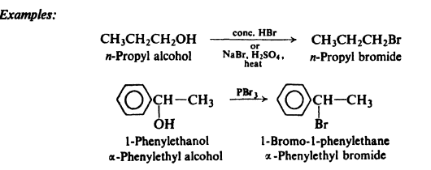
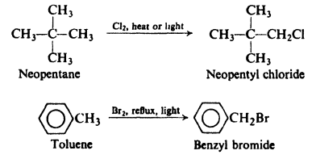
Preparations
In the laboratory alkyl halides are most often prepared by the methods outlined below.
1: From alcohols:
2: Halogenation of hydrocarbons:

Slide 13
3: Addition of hydrogen halides to alkenes.
X: Halogens
4: Addition of halogens to alkenes and alkynes

Slide 14
Preparation of Alcohols:
1. Substitution reaction
Alcohols can be prepared by substitution reactions in which a leaving group is replaced by a hydroxyl group. A primary substrate will require SN2 conditions (a strong nucleophile), while a tertiary substrate will require SN1 conditions (a weak nucleophile).
2. Reduction
1. Reduction using H2 /catalyst

Slide 15
2- Sodium borohydride (NaBH4) is another common reducing agent that can be used to reduce ketones or aldehydes.

Slide 16
3. Grignard Reagents
A Grignard reagent is formed by the reaction between an alkyl halide and magnesium.

Slide 17
Oxidation
The outcome of an oxidation process depends on whether the starting alcohol is primary, secondary, or tertiary. Let’s first consider the oxidation of a primary alcohol.
Notice that a primary alcohol has two protons at the α position (the carbon atom bearing the Hydroxyl group). As a result, primary alcohols can be oxidized twice. The first oxidation produces an aldehyde, and then oxidation of the aldehyde produces a carboxylic acid.
Secondary alcohols only have one proton at the α position so they can only be oxidized once, forming a ketone.

Slide 18
Tertiary alcohols do not have any protons at the α position, and as a result, they generally do not undergo oxidation:
A large number of reagents are available for oxidizing primary and secondary alcohols. The most common oxidizing reagent is chromic acid (H2CrO4), which can be formed either from chromium trioxide (CrO3) or from sodium dichromate (Na2Cr2O7) in aqueous acidic solution.

Slide 19
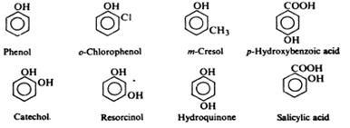
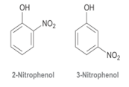
Phenols
Structure and nomenclature
Phenols are compounds of the general formula ArOH, where Ar is phenyl, substituted phenyl, or one of the other aryl groups. Phenols differ from alcohols in having the OH group attached directly to an aromatic ring. Phenols are generally named as derivatives of the simplest member of the family, phenol. The methyl phenols are given the special name of cresols. Occasionally phenols are named as hydroxyl compounds.

Slide 20
Physical properties
The simplest phenols are liquids or low-melting solids; because of hydrogen bonding, they have quite high boiling points. Phenol itself is somewhat soluble in water (9 g per 100 g of water), presumably because of hydrogen bonding with the water; most other phenols are essentially insoluble in water. From a comparison of the physical properties of the isomeric nitro phenols we notice that o-nitro phenol is the only one of the three that is readily steam-distillable, it is melting point is(45º) has a much lower melting point and much lower solubility in water (0.2gm/100ml) than its isomers (m- nitro phenol: m.p:96º), Solubility:(1.4gm/100ml) and (p-nitro phenol: m.p:114º) ,Solubility: (1.7gm/100ml); How can these differences be accounted for?

Slide 21
Acidity of Alcohols and Phenols
Acidity of the Hydroxyl Functional Group:
The acidity of a compound can be qualitatively evaluated by analyzing the stability of its conjugate base: The conjugate base of an alcohol is called an alkoxide ion, and it exhibits a negative charge on an oxygen atom. A negative charge on an oxygen atom is more stable than a negative charge on a carbon or nitrogen atom but less stable than a negative charge on a halogen, X

Slide 22
Factors Affecting the Acidity of Alcohols and Phenols
There are three factors for comparing the acidity:
1: resonance : Compare the pKa values of cyclohexanol and phenol:
As a result, phenol does not need to be deprotonated with a very strong base like sodium hydride. Instead, it can be deprotonated by hydroxide.

