Slide 1
Method of Estimation
-Maximum Likelihood Estimation Method(m.l.e.)
m.Awaz Shahab

Slide 2
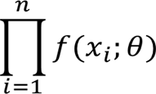
2)-maximum likelihood Estimation method.
$$the \text{likelihood} \text{function} \text{is} \text{the} \text{joint} \text{distyibution} \text{function} j.p.d.fof n observations,$$
$$L\left(θ\right)=f\left(x_{1},x_{2},x_{3},…,x_{n};θ\right)=$$

Slide 3
The maximum likelihood estimator (m.l.e.) is the value of $\hat{θ}$ that maximize the likelihood function, or is the solution of:-
$\frac{dlnL(θ)}{dθ}$=0 , such that $\frac{d^{2}lnL(θ)}{dθ^{2}}<0$
${\hat{θ}}_{m.l.e}$

Slide 4
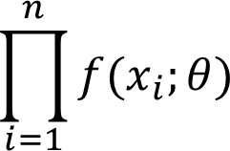

Example1// let $x_{1},x_{2},x_{3},…,x_{n}$be a r.s. from poisson($θ),estimate θ by using \left(m.l.e.\right)$
Solution//
$$f\left(x;θ\right)=\frac{e^{−θ}θ^{x}}{x!}$$
$$l\left(θ\right)=f\left(x_{1},x_{2},x_{3},…,x_{n};θ\right)=$$
= $\frac{e^{−θ}θ^{x_{1}}}{x_{1}!}$* $\frac{e^{−θ}θ^{x_{2}}}{x_{2}!}$* $\frac{e^{−θ}θ^{x_{3}}}{x_{3}!}$*…* $\frac{e^{−θ}θ^{x_{n}}}{x_{n}!}$
= $\frac{e^{−nθ}θ^{\sum{x_{i}}}}{\prod{xi!}}$

Slide 5

$$lnL\left(θ\right)=−nθ+\sum{x_{i}}lnθ−ln\prod{x!}$$
$\frac{dlnL(θ)}{dθ}$=$−n+\frac{\sum{x_{i}}}{θ}−zero$
$\frac{dlnL(θ)}{dθ}$=0
$−nθ+\frac{\sum{x_{i}}}{θ}$=0
$\frac{−nθ+\sum{x_{i}}}{θ}$=0
$−nθ+\sum{x_{i}}$=0 $→ \sum{x_{i}}$= $nθ$
$$θ=\frac{\sum{x_{i}}}{n}$$
$\hat{θ}$=$\overline{x}$ is m.l.e. for $θ$

Slide 6

Example2// let $x_{1},x_{2},x_{3},…,x_{n}$be a r.s. from Ber($θ),estimate θ by using \left(m.l.e.\right)$
$f\left(x;θ\right)$=$θ^{x}(1−θ)^{1−x}$
$$l\left(θ\right)=f\left(x_{1},x_{2},x_{3},…,x_{n};θ\right)=$$
$$\prod_{i=1}^{n}{θ^{x_{i}}(1−θ)^{1−x_{i}}}$$
= $θ^{\sum{x_{i}}}(1−θ)^{n−\sum{x_{i}}}$
$lnL\left(θ\right)=$ $\sum{x_{i}}lnθ+(n−$ $\sum{x_{i}}$)$\ln\left(1−θ\right)$
$\frac{dlnL\left(θ\right)}{dθ}$ = $\frac{\sum{x_{i}}}{θ} − \frac{n− \sum{x_{i}}}{\left(1−θ\right)}$

Slide 7
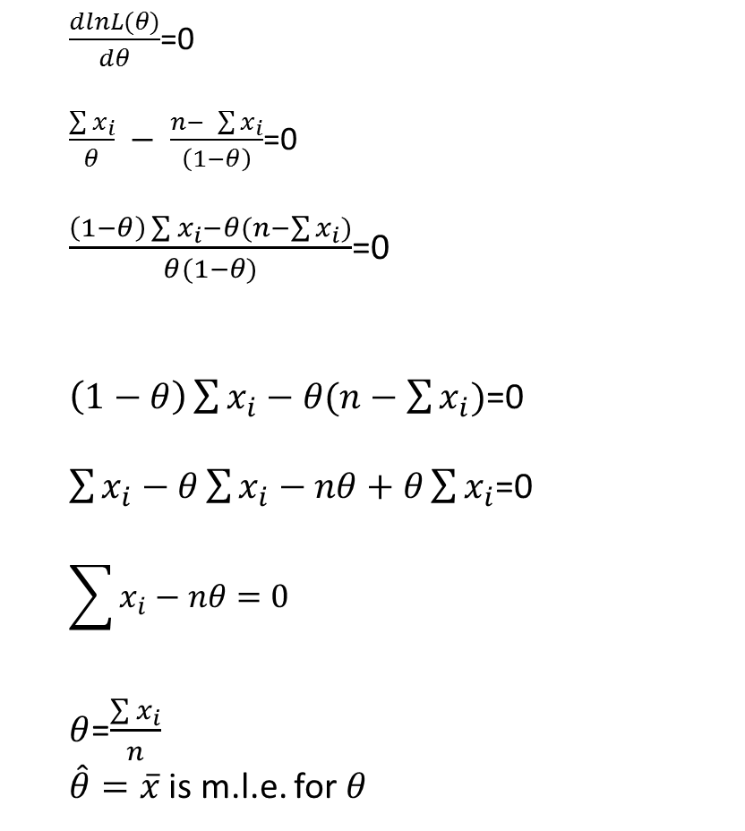
$\frac{dlnL(θ)}{dθ}$=0
$\frac{\sum{x_{i}}}{θ} − \frac{n− \sum{x_{i}}}{\left(1−θ\right)}$=0
$\frac{\left(1−θ\right)\sum{x_{i}−θ(n−\sum{x_{i}})}}{θ(1−θ)}$=0
$\left(1−θ\right)\sum{x_{i}−θ(n−\sum{x_{i}})}$=0
$\sum{x_{i}−θ}\sum{x_{i}}−nθ+θ\sum{x_{i}}$=0
$$\sum{x_{i}}−nθ=0$$
$θ$=$\frac{\sum{x_{i}}}{n}$
$\hat{θ}=\overline{x}$ is m.l.e. for $θ$

Slide 8

$$\frac{d^{2}lnL\left(θ\right)}{dθ^{2}}=\frac{−\sum{x_{i}}}{θ^{2}}<0$$
$θ$=$\frac{\sum{x_{i}}}{n}$
$\hat{θ}=\overline{x}$ is m.l.e. for $θ$

Slide 9
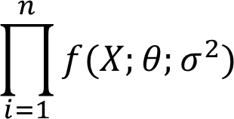
Example3// let $x_{1},x_{2},x_{3},…,x_{n}$be a r.s. from N($θ,σ^{2}),estimate θ,σ^{2}by using \left(m.l.e.\right)$
SOL//
$f(X;θ;σ^{2}$)=$\frac{1}{\sqrt{2πσ^{2}}}e^{− \frac{(x_{i}−θ)^{2}}{2σ^{2}}}$
$$l\left(θ,σ^{2}\right)=$$
= ${\left(2πσ^{2}\right) }^{\frac{−n}{2}}e^{− \frac{\sum{(x_{i}−θ)^{2}}}{2σ^{2}}}$
ln$l\left(θ,σ^{2}\right)$= $\frac{−n}{2}ln\left(2πσ^{2}\right)$ $− \frac{\sum{(x_{i}−θ)^{2}}}{2σ^{2}}$

Slide 10

1-$for θ$
$\frac{dlnL(θ)}{dθ}$=zero $− \frac{2\sum{(x_{i}−θ)}}{2σ^{2}}∗$(-1)
$\frac{dlnL(θ)}{dθ}$=0
$\frac{\sum{(x_{i}−θ)}}{σ^{2}}$=0 $→$ $\sum{(x_{i}−θ)}$=0
$$\sum{x_{i}}−nθ=0$$
$θ$=$\frac{\sum{x_{i}}}{n}$

Slide 11

$$\hat{θ}=\overline{x}$$
$\frac{d^{2}lnL\left(θ\right)}{dθ^{2}}$=-$\frac{1}{σ^{2}} <0$
$\hat{θ}=\overline{x}$ is m.l.e. for $θ$
2-$for{ σ}^{2}$
$\frac{dlnL({ σ}^{2})}{d{ σ}^{2}}$= $\frac{−n}{2}$ *$\frac{2π}{2π{ σ}^{2}}$ + $\frac{\sum{(x_{i}−θ)^{2}}}{2σ^{4}}$
= $\frac{−n}{2{ σ}^{2}}$ + $\frac{\sum{(x_{i}−θ)^{2}}}{2σ^{4}}$

Slide 12
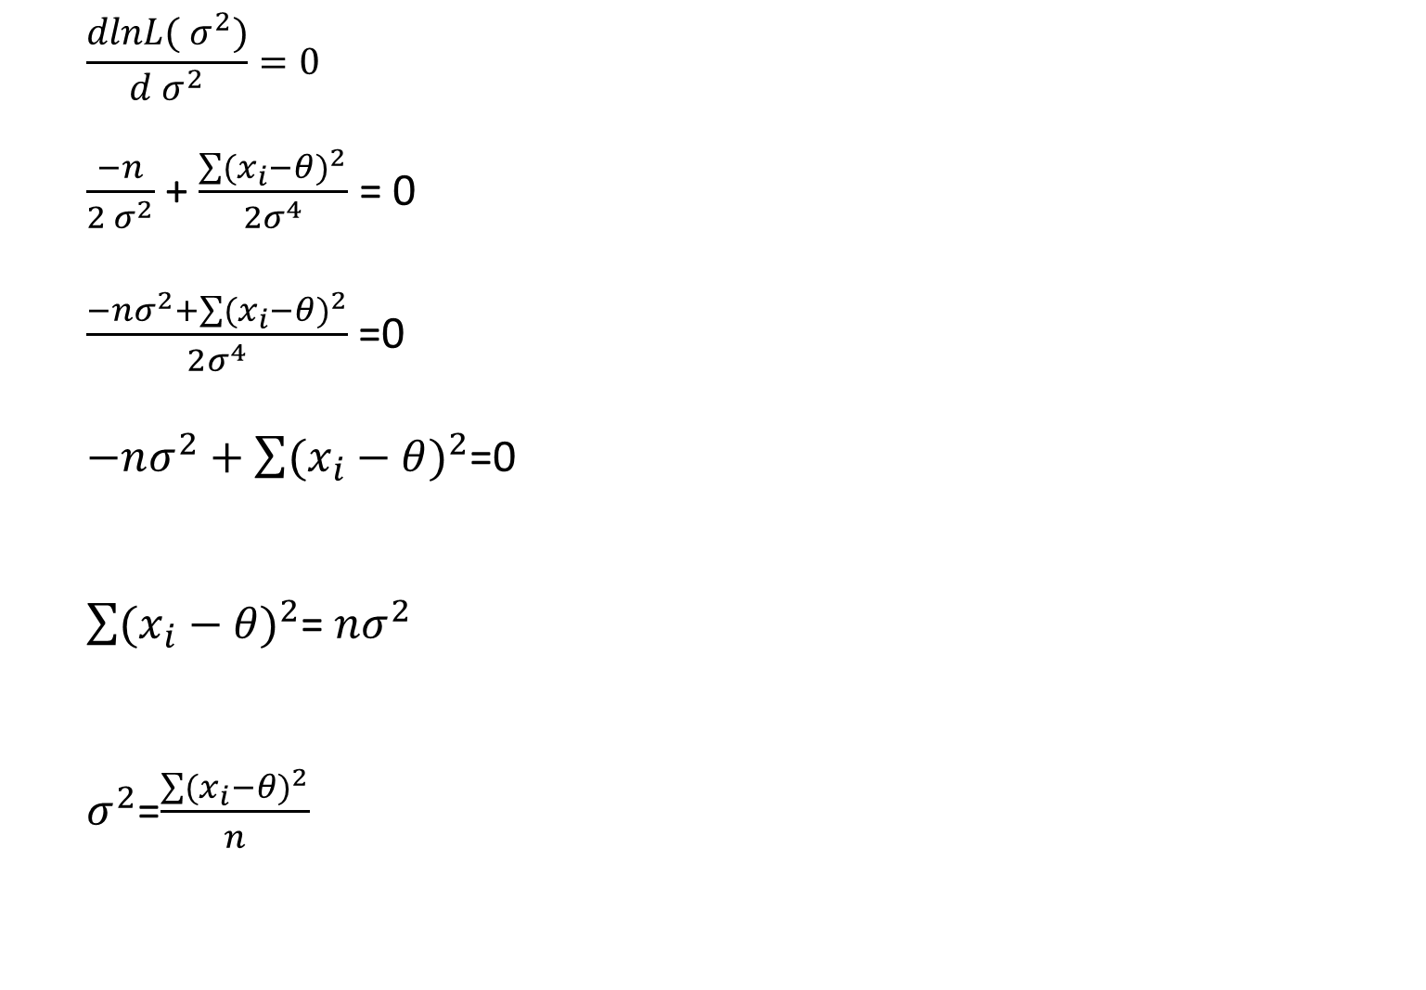
$$\frac{dlnL({ σ}^{2})}{d{ σ}^{2}}=0$$
$\frac{−n}{2{ σ}^{2}}$ + $\frac{\sum{(x_{i}−θ)^{2}}}{2σ^{4}}$ = 0
$\frac{−nσ^{2}+\sum{(x_{i}−θ)^{2}}}{2σ^{4}}$=0
$−nσ^{2}+\sum{(x_{i}−θ)^{2}}$=0
$\sum{(x_{i}−θ)^{2}}$= $nσ^{2}$
$σ^{2}$=$\frac{\sum{(x_{i}−θ)^{2}}}{n}$

Slide 13

$$\hat{σ^{2}}=s^{2}$$
$\frac{d^{2}lnL({ σ}^{2})}{d^{2}{ σ}^{2}}$= $\frac{n}{2{ σ}^{2}}$ - $\frac{\sum{(x_{i}−θ)^{2}}}{σ^{4}}$ <0
$\hat{σ^{2}}=s^{2}$ is m.l.e. for ${ σ}^{2}$

Slide 14
H.W// $f\left(x;θ\right)=(θ+1)x^{θ}$ 0<x<1 find m.l.e. for $θ$

