Slide 1
Minimum Variance Method

Slide 2
3-Minimum Variance Method (Least Variance Method) (m.v.u.e.)
In this method the unbiased estimate $\hat{θ}$, which has the minimum (or least)variance should satisfy the following relation
$\frac{dlnL(θ)}{dθ}$=$\frac{\hat{θ}−θ}{v(\hat{θ})}$

Slide 3
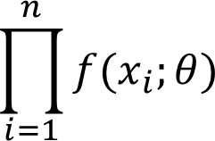
Example1// In a r.s.s.n from
1- Ber($θ)$
2-poi($θ)$ ,Find m.v.u.e. for $θ$
Solution//
$f\left(x;θ\right)$=$θ^{x}(1−θ)^{1−x}$
$$l\left(θ\right)=f\left(x_{1},x_{2},x_{3},…,x_{n};θ\right)=$$
$$\prod_{i=1}^{n}{θ^{x_{i}}(1−θ)^{1−x_{i}}}$$

Slide 4
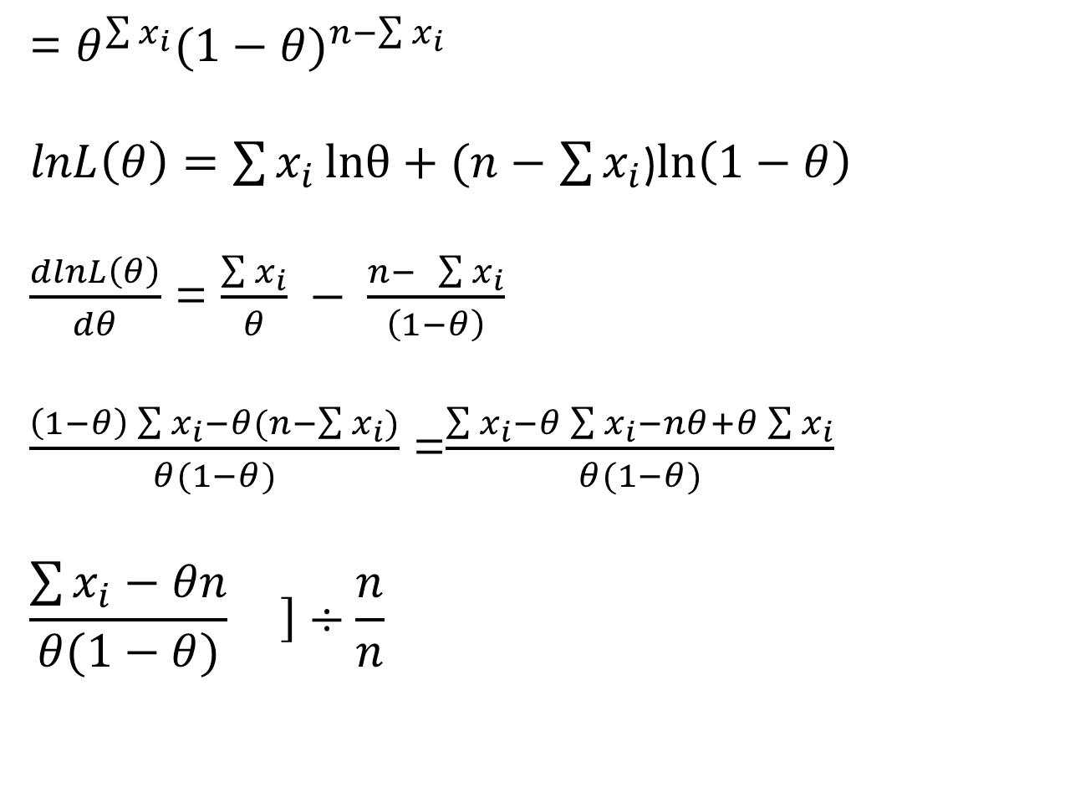
= $θ^{\sum{x_{i}}}(1−θ)^{n−\sum{x_{i}}}$
$lnL\left(θ\right)=$ $\sum{x_{i}}lnθ+(n−$ $\sum{x_{i}}$)$\ln\left(1−θ\right)$
$\frac{dlnL\left(θ\right)}{dθ}$ = $\frac{\sum{x_{i}}}{θ} − \frac{n− \sum{x_{i}}}{\left(1−θ\right)}$
$\frac{\left(1−θ\right)\sum{x_{i}−θ(n−\sum{x_{i}})}}{θ(1−θ)}$ =$\frac{\sum{x_{i}−θ}\sum{x_{i}}−nθ+θ\sum{x_{i}}}{θ(1−θ)}$
$$\frac{\sum{x_{i}−θn}}{θ(1−θ)}\left.\right]÷\frac{n}{n}$$

Slide 5
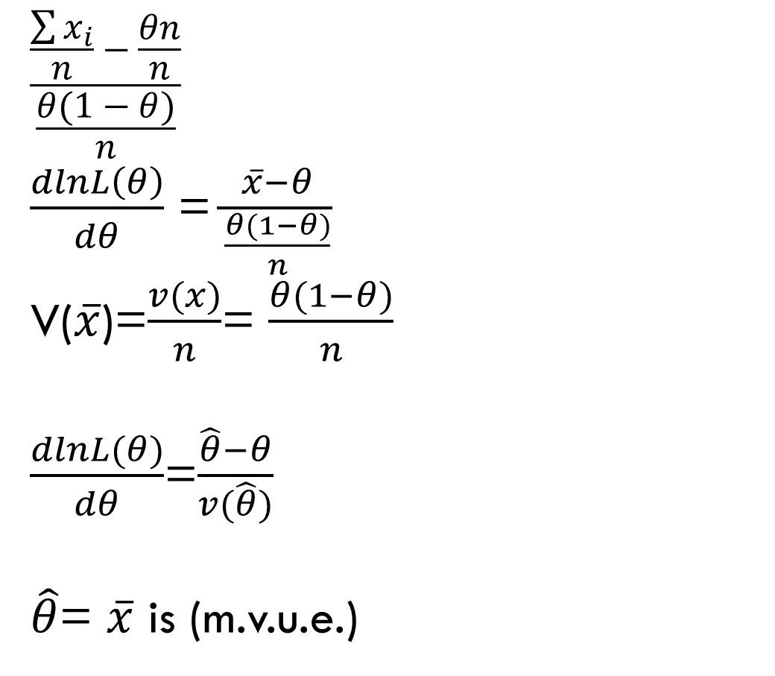
$$\frac{\frac{\sum{x_{i}}}{n}−\frac{θn}{n}}{\frac{θ(1−θ)}{n}}$$
$\frac{dlnL\left(θ\right)}{dθ}$ =$\frac{\overline{x}−θ}{\frac{θ(1−θ)}{n}}$
V($\overline{x}$)=$\frac{v(x)}{n}$= $\frac{θ(1−θ)}{n}$
$\frac{dlnL(θ)}{dθ}$=$\frac{\hat{θ}−θ}{v(\hat{θ})}$
$\hat{θ}$= $\overline{x}$ is (m.v.u.e.)

Slide 6
$2−$pois $\left(θ\right)$
$$f\left(x;θ\right)=\frac{e^{−θ}θ^{x}}{x!}$$
$$l\left(θ\right)=f\left(x_{1},x_{2},x_{3},…,x_{n};θ\right)=$$
= $\frac{e^{−θ}θ^{x_{1}}}{x_{1}!}$* $\frac{e^{−θ}θ^{x_{2}}}{x_{2}!}$* $\frac{e^{−θ}θ^{x_{3}}}{x_{3}!}$*…* $\frac{e^{−θ}θ^{x_{n}}}{x_{n}!}$
= $\frac{e^{−nθ}θ^{\sum{x_{i}}}}{\prod{x_{i}!}}$

Slide 7

$$lnL\left(θ\right)=−nθ+\sum{x_{i}}lnθ−ln\prod{xi!}$$
$\frac{dlnL(θ)}{dθ}$=$−n+\frac{\sum{x_{i}}}{θ}−zero$
$$−n+\frac{\sum{x_{i}}}{θ}$$
$\frac{−nθ+\sum{x_{i}}}{θ}$ $\left.\right]÷\frac{n}{n}$

Slide 8
$\frac{\frac{\sum{x_{i}}}{n}−θ}{\frac{θ}{n}}$ = $\frac{\overline{x}−θ}{v(\overline{x})}$
$\hat{θ}$= $\overline{x}$ is m.v.u.e.

Slide 9

Exampl/2//Give x$\sim Exp(θ)$with p.d.f. as $f\left(x;θ\right)$= $\frac{1}{θ}$ $e^{−\frac{x}{θ}}$ Is $\overline{x}$ a m.v.u.e. for $θ$
Sol//
$f\left(x;θ\right)$= $\frac{1}{θ}$ $e^{−\frac{x}{θ}}$ , EX=$θ$ , V(X)=$θ^{2}$
$$l\left(θ\right)=$$
=$\frac{1}{θ^{n}}e^{−}\frac{\sum{x_{i}}}{θ}$=$θ^{−n}$ $e^{−}\frac{\sum{x_{i}}}{θ}$
$lnL\left(θ\right)=−nlnθ −$ $\frac{\sum{x_{i}}}{θ}$
$\frac{dlnL(θ)}{dθ}$=$\frac{−n}{θ}+$ $\frac{\sum{x_{i}}}{θ^{2}}$

Slide 10

=$\frac{−nθ+\sum{x_{i}}}{θ^{2}}$ $÷\frac{n}{n}$
$\frac{\frac{\sum{x_{i}}}{n}−θ}{\frac{θ^{2}}{n}}$ = $\frac{\overline{x}−θ}{v(\overline{x})}$ , $\text{V}\text{(}\overline{x}\text{)=}\frac{v(x)}{n}$=
$$∴\overline{x} is m.v.u.e. for θ$$
$$\frac{θ^{2}}{n}$$

Slide 11
H.W// find m.v.u.e. for $θ and σ^{2}$of N($θ$, $σ^{2}$)
H.W// What is the difference between m.l.e. & m.v.u.e.

