Slide 1
Methods of Estimation
The following are familiar methods of estimation:-
1)- moments method.
2)-maximum likelihood method.
3)-Least(or minimum) variance method.
4)-Bayesian method.

Slide 2
1)-moments method
In this method we equate population moments and sample moments about the origin. This means that we solve:
$M_{j}^{′}=m_{j}^{′}$ $, j=1,2,3,…,k$
Where $k$ is the number of parameters to be estimated ,and
$M_{j}^{′}$=$E\left(X^{j}\right)→population moment about the origin$
$m_{j}^{′}$=$\frac{1}{n}\sum_{i=1}^{n}{x_{i}^{j}}$→sample 𝑚𝑜𝑚𝑒𝑛𝑡 𝑎𝑏𝑜𝑢𝑡 𝑡ℎ𝑒 𝑜𝑟𝑖𝑔𝑖𝑛

Slide 3
Example//let $x_{1},x_{2},x_{3},…,x_{n}$be a r.s.s.n use moment method to an estimate for parameters of the following distribution:-
1-Ber($θ$) 2- unif($θ$) 3-Geomtric($θ$) 4-poisson(𝜃)

Slide 4
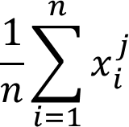
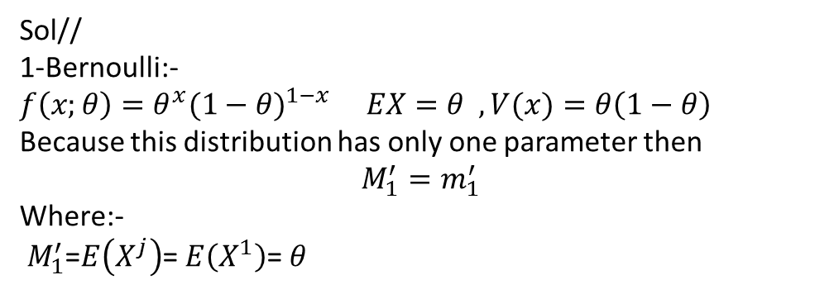
Sol//
1-Bernoulli:-
$f\left(x;θ\right)=θ^{x}(1−θ)^{1−x}$ $EX=θ ,V(x)=θ\left(1−θ\right)$
Because this distribution has only one parameter then
$$M_{1}^{′}=m_{1}^{′}$$
Where:-
$M_{1}^{′}$=$E\left(X^{j}\right)$= $E\left(X^{1}\right)$= $θ$
$m_{j}^{′}$= where $j=1$
$m_{1}^{′}$= $\frac{1}{n}\sum_{i=1}^{n}{x_{i}^{1 }}$=$\overline{x}$
$\hat{θ}$=$\overline{x}$ moment estimate for $θ.$

Slide 5
2- uniform
$$f\left(x;θ\right)=\frac{1}{θ} , EX=\frac{θ}{2} , V\left(θ\right)=\frac{θ^{2}}{12}$$
Because this distribution has only one parameter then
$$M_{1}^{′}=m_{1}^{′}$$
Where:-
$M_{1}^{′}$=$E\left(X^{j}\right)$= $E\left(X^{1}\right)$=$\frac{θ}{2}$
$m_{1}^{′}$=$\frac{1}{n}\sum_{i=1}^{n}{x_{i}^{1 }}$=$\overline{x}$
Now we solve $M_{1}^{′}$= $m_{1}^{′}→$ $\frac{θ}{2}$= $\overline{x}$
$→\hat{θ}=2\overline{x}$ moment est. for $θ .$

Slide 6

3-Geomtric
$f\left(x;θ\right)=θ^{}(1−θ)^{x}$ $EX=\frac{1−θ}{θ} ,V(x)=\frac{1−θ}{θ^{2}}$
where $j=1$
$$M_{1}^{′}=m_{1}^{′}$$
$M_{1}^{′}$=$E\left(X^{j}\right)$= $E\left(X^{1}\right)$= $\frac{1−θ}{θ}$
$m_{1}^{′}$=$\frac{1}{n}\sum_{i=1}^{n}{x_{i}^{1 }}$=$\overline{x}$
$→$ $\frac{1−θ}{θ}$= $\overline{x}$
$$\overline{x}θ=1−θ$$
$\overline{x}θ$+ $θ$=1
$$θ\left(\overline{x}+1\right)=1$$
$$→ \hat{θ}=\frac{1}{\left(\overline{x}+1\right)}$$

Slide 7
4-poisson(𝜃)
$f\left(x;θ\right)=\frac{e^{−θ}θ^{x}}{x!}$ , $EX=θ ,V(x)=θ$
Because this distribution has only one parameter then
$$M_{1}^{′}=m_{1}^{′}$$
$M_{1}^{′}$=$E\left(X^{j}\right)$= $E\left(X^{1}\right)$= $θ$
$m_{j}^{′}$=$\frac{1}{n}\sum_{i=1}^{n}{x_{i}^{j}}$ where $j=1$
$m_{1}^{′}$=$\frac{1}{n}\sum_{i=1}^{n}{x_{i}^{1}}$=$\overline{x}$
$\hat{θ}$=$\overline{x}$ moment estimate for $θ$

Slide 8
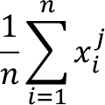
Example//let $x_{1},x_{2},x_{3},…,x_{n}$be a r.s.s.n from N($θ,σ^{2}$ ) estimate the parameter by using moments method
Solution :-
From normail dist. $Ex=θ$
$M_{1}^{′}=m_{1}^{′}$
$M_{1}^{′}$=$E\left(X^{j}\right)$= $E\left(X^{1}\right)$= $θ$
$m_{j}^{′}$= where $j=1$
$m_{1}^{′}$= $\frac{1}{n}\sum_{i=1}^{n}{x^{1}}$ =$\overline{x}$
$\hat{θ}$=$\overline{x}$ moment estimate for $θ$
$$M_{2}^{′}=m_{2}^{′}$$
$M_{2}^{′}$=$E\left(X^{j}\right)$= $E\left(X^{2}\right)$
$$v\left(x\right)=EX^{2}−(EX)^{2}$$
$σ^{2}=$ $EX^{2}−θ^{2}$
$EX^{2}$= $σ^{2}$+ $θ^{2}$

Slide 9
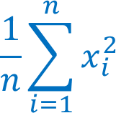

$m_{j}^{′}$=$\frac{1}{n}\sum_{i=1}^{n}{x_{i}^{j}}$
$m_{2}^{′}$=
$$M_{2}^{′}=m_{2}^{′}$$
$σ^{2}$+ $θ^{2}=$
$$\hat{σ^{2}}= −θ^{2}$$
$\hat{σ^{2}}$=$s^{2}$

Slide 10
Example// H.W//let $x_{1},x_{2},x_{3},…,x_{n}$be a r.s.s.n from Gam($α,β$ ) estimate the parameter by using moments method

