Slide 1
Chapter 5 Alloys and slowly cooled alloys
5-1 : Pure metal and alloys composition
It has been already established that many useful engineering materials consist of only one phase . The examples of such materials are pure metals like, copper, zinc , aluminium etc . However a greater number of useful engineering materials are the mixture of phases. The example of such materials are , steel, Portland cement, grinding wheels , paints, glass reinforced plastics etc . In order to understand the microstructure of multiphase materials, the concepts of solid solution and phase diagrams play an important role.

Slide 2
Alloys
Alloys are the combination of two or more metals into one material. The combinations may be mixtures of two kinds of crystalline structures.
The mechanical and physical properties of an alloy may be appreciably different from these of any one the constituent pure elements.
Table 1 . Indicates some of the important effects of alloying.

Slide 4
Definitions and concept related to alloying
Solid solution
Solvent and solute two components
When two solids A and B are mixed together in varing properties, the two components ( A+B) , may be completely or partially soluible in each other.
In solid solution, solid solute metal is present in minor amount, and solvent metal is present in major amount.
complete solid solution occur when the two metallic, components are similar in atomic size and in electronic structure, and in crystal structures.
Face centred cubic
Zinc , Copper
Zn-Cu , Cu = 0.1278 nm
Zn = 0.139 nm Homogeneous solution

Slide 6
Types of solid
Ø Substitutional
Solute atoms replace solvent atoms.
It can be formed with limited solubility e.g. Bronze (Sn in Cu)
or unlimited solubility e.g. Brass (Zn in Cu), in this case both atoms
have nearly the same size.
Ø Interstitial solid solutions
small atoms located at the interstices between larger atoms. E.g. C in Fe
Ø Ordered solid soltion
The two types of atoms arranged in a specific order.
Heating always destroys the ordering in the solution.

Slide 8
The most important kinds of metallic solid solution
Interstitial solid solution Substitutional solid solution
What is the condition must be satisfied to interstitial solid solution?

Slide 12
What is the condition must be satisfied to substitutional solid solution?

Slide 15
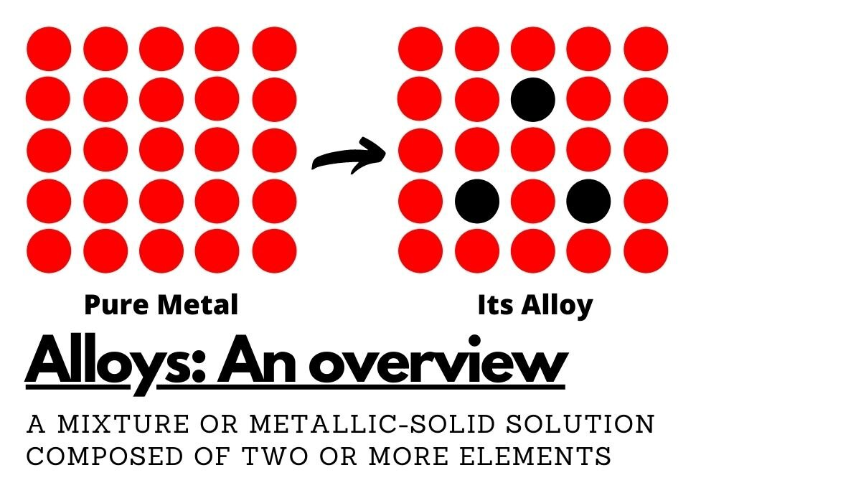

Slide 16
Solid Solution
Some times impurities are desirable, example, sterling silver, 7.5% Cu and 92.5% Ag.
The copper make silver stronger and harder.
Zn added to Cu in brass, which is stronger, harder and more ductile than copper .
Both alloys are solid solutions in which the original structures of the metals are changed.
Solid solutions consist of a solute and solvent.
Solute = small amount , solvent = large excess

Slide 17
System
A system any body of mater under consideration disregarding its sourounding.
It may relate to the series of possible alloys consisting of the ions , atoms component. Ni – copper , Cu – ZN system
Refers to all possible combinations of specific metals without regard to any specific composition.
Phase
A homogeneous region of a system that have uniform physical and chemical properties. Water in glass single phase two phase in one system
(Salt + solution)
Components of the system:-
Compound or compound
When I doing solid solution it may be element or compound
Al2O3-Cr2O3 system
Equlibrium
In regard to alloys, a system is said to be in equilibrium when there is no change net change between amounts and compositions of the phases present ( i.e a system it its free energy is at minimum)

Slide 18
Equilibrium phase diagram (EPD):-
Phase diagram
A phase diagram is a map that gives the relationship between the phases in equilibrium as a function of temperature, pressure and composition. The study of phase relationships plays an important role in understanding the internal structure and mechanical propertieses of materials. Phase diagrams powerful tools in the hands of scientists and engineers who design materials for specific applications as well as for others who anticipate the stability of specific materials, when designing products for service environments.

Slide 21
Phase Rule:-
The phase rule establishes a definite relationship in an alloy between the number of degree of freedom, the number components and the number of phases, it is given by the relation:
F= C-P+ 2 ………(i)
F= Number of degrees of freedom
P= Number of phase that exist in equilibrium,
C= Number of components in system,
2= Number of external variables
i.e temperature and pressure.

Slide 22
To applay this rule the single component (i.e. C=1)
when p=1 F=2
Two degrees of freedom in a single component system means that
temperature and pressure may be varied independently.
If two phase coexist (i.e p=2) then F=1
One degree of freedom means that either temperature or pressure can be varied indenpendly , but not both, similarly , if three phase coexist (i.e p=3) then
F=0
Zero degree of freedom means that temperature and pressure are fixed.

Slide 23
F=c-p+1 Take p=1,2 and 3
(C-1) = number of variables required to specify completely the
composition variable
P(C-1) =The total no. composition variable
P(C-1) +2 = The total no. of variable including the external variable.
Example
What are the decrease of freedom of a system of two components when the number of the phases is one, two, three, …. Etc ?

Slide 24
No . Of phases P | No components | Total variable P(C-1)+2 | Degree of Freedom F=C-P+2
1 2 3 4 | 2 | = 1(2-1)+2= 3 4 5 6 | = 2-1+2=3 2 1 0

Slide 35
1. What is alloy? Why alloy? Examples of alloy Properties of alloys Pure Metal and Alloy
• Pure Metal • Alloy
2.What Is Alloy?
Alloy is a mixture of two or more elements with a certain fixed composition inwhich the major
component is metal.
3.The Aim in Making Alloy
To increase the hardness and strength of a metal • To prevent corrosion or rusting • To improve the
appearance of the metal surface.
4.Examples of Alloy • Bronze • Brass • Steel • Stainless steel • Duralumin • Pewter
5. Properties of Alloys Alloy Composition Properties Uses • To build statues and • Hard and strong
•90% copper monuments. Bronze • Doesn’t corrode easily • 10% tin • In the making of medals, • Has shiny surface
swords and artistic materials. • 70% copper • In the making of musical Brass • Harder than copper • 30% zinc
instruments and kitchenware. • In the construction of • 99% iron building and bridges. Steel • Hard and strong
• 1% carbon • In the building of the body of cars and railway tracks. • 74% iron • Shiny Stainless • To make cutlery and • 8% carbon • Strong
steel surgical instruments. • 18% chromium • Doesn’t rust • 93% aluminum • To make the body of • 3% copper • Light Duralumin
aeroplanes and bullet trains. • 3% magnesium • Strong • 1% manganese • 96% tin • Luster Pewter • 3% copper • Shiny • In the making of
• 1% antimony • Strong
6. Pure Metal and Alloys Pure Metal The arrangement of atoms in pure metals Force Force Pure metals are ductile and malleable
Alloy Pure Metal A Pure Metal B Alloy

