Slide 1
Kurdistan Regional Government - Iraq Ministry of Higher Education & Scientific Research Salahaddin University - Erbil
Histological Preparation for
Light Microscopy
(Paraffin Method)
2nd Lab of Microtechnique
2nd Semester
2022-2023
Azheen S. Abdulrahman
M.Sc. in Histology
College of Science-Biology Department
azheen.abdulrahman@su.edu.krd
ORCID: https://orcid.org/0000-0001-8584-2458

Slide 2
Laboratory Rules
Before we start any of the microtechnique methods we must apply some rules in order to achieve successful work:
Correct sample selection and collection
Planning
Records and labeling
Awareness of hazard materials

Slide 3
Paraffin method
Used in preparing a tissue (plant or animal) for histological and pathologic examination.
Principle
Obtaining fresh tissue preserving cutting it into thin sections mounting it on slides staining the sections

Slide 4
The main steps of paraffin method
Fixation
Dehydration
Clearing
Infiltration
Mounting
Staining
Embedding
Sectioning
Trimming

Slide 5
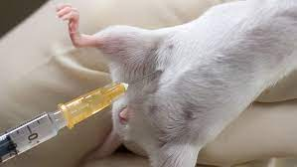
Dissection of the Animal

Slide 6
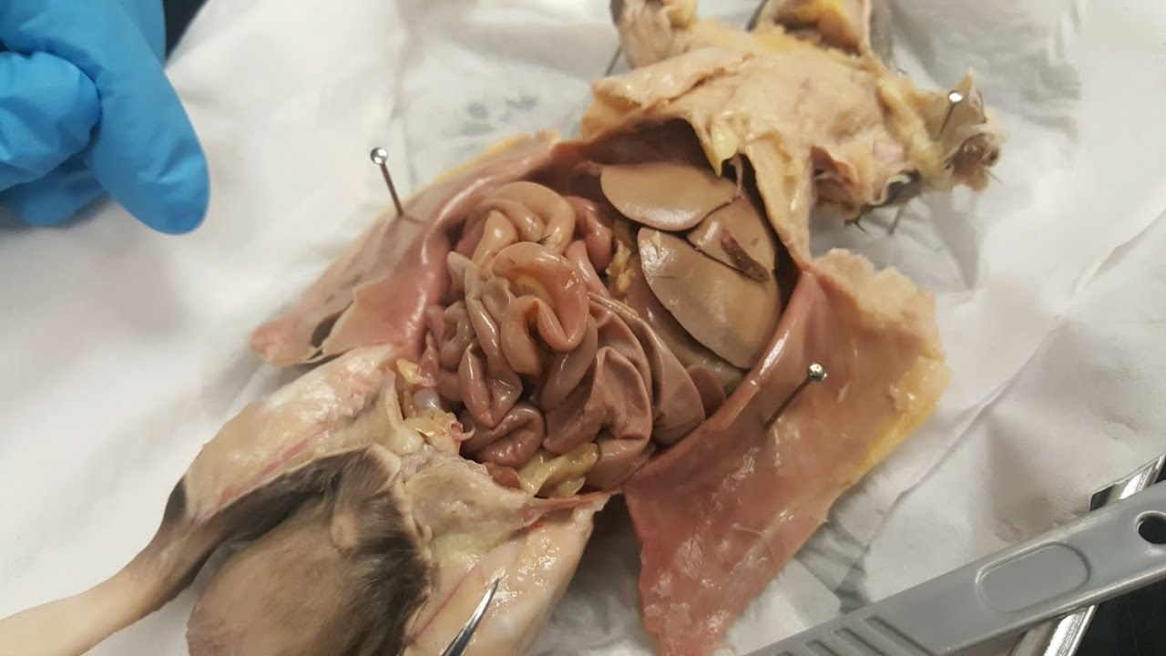

Slide 7
1. Fixation
Is the process of preserving a sample as close to its natural state as possible. It is important to maintain cells in as life-like a state as possible and to prevent post-mortem changes as a result of putrefaction and autolysis.

Slide 8
Importance of fixation
To prevent against intrinsic factor (enzymes)
To prevent bacterial attack (extrinsic factors)
To fix the tissues (volume and shape)

Slide 9
Types of Fixation
Chemical
Perfusion
Immersion
Physical
Heating

Slide 10
Properties of perfect fixative
High ability to preservation.
High ability to penetration.
Easy available.
Low cost.
Not toxic to worker.
Without effect on tissues.

Slide 11
Next Lab
Dehydration
Clearing
Infiltration

