Slide 1
Information Technology Basic Concepts of Computer

Slide 2
What is a Computer
A Computer is an electronic device which takes input through input devices, processes it and gives the output through output devices.
Computer works with 0’s and 1’s (Binary).

Slide 3
Block diagram of a Computer
CPU
ALU
Input Unit
Output Unit
Control Unit
Memory

Slide 4
The components of a computer system
Hardware:
is the physical aspect of the computer that can be seen and touch. like Screen, Cables, Keyboard, Printer. The hardware cannot do anything without software.
Software :
Software is a program which consists of step by step instructions that tell the computer how to do its work.
In general, we have
Operating Systems (ex: Windows)
Application Software (ex: Ms Word)
.

Slide 5
Hardware components
Central Processing Unit (CPU)
Memory (main memory)
Storage Devices (disks, CDs, tapes)
Input and Output Devices (monitors, keyboards, mice, printers)
Communication Devices (modems and network
interface cards (NICs))

Slide 6
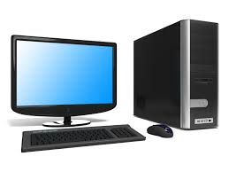
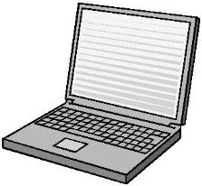
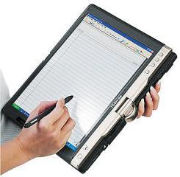
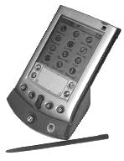
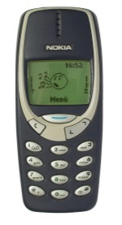
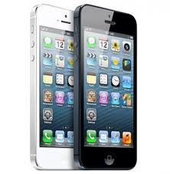
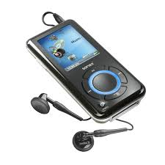
Types of Computers There are different types of personal computers: 1.Desktop/computers… 2.Laptop (or notebook) computers………… 3.Tablet PCs……… 4.Personal digital assistants (PDAs) ……. 5.Mobile Phones……. 6.Smartphones ………………………………….. 7.Multimedia players…….

Slide 7
Input / Output Ports
Typically all computers will have
these ports:
USB port
Serial port
Parallel port
Network port
FireWire port

Slide 8
Computer Performance
There are several factors determining the processing speed of a computer:
The clock speed of the CPU (Hertz)
The design of the CPU
The amount of RAM (bit, Byte)
The type of hard disk (Size, Speed)
The type of graphics card
The type of CD-ROM or DVD-ROM
The number of applications running

Slide 9
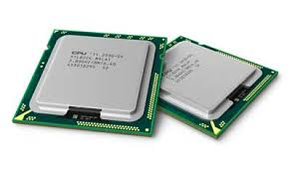
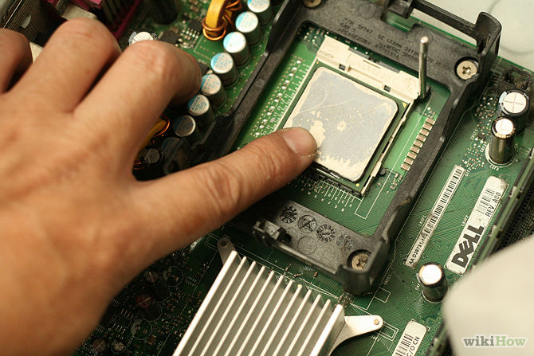
Central Processing Unit (CPU)
The Central Processing Unit (CPU) is located inside the system unit. The CPU, also referred to as the central processor or processor, is the „brain‟ of the computer.
The speed of the CPU is measured in (MHz) or gigahertz (GHz). 1MHz is equal to 1 million cycles per second. 1GHz is equal to 1 billion cycles per second

Slide 10
Memory Units
Bit – short for Binary Digit, is the smallest unit of information on the computer. A single bit can hold only one of two values: 0 or 1. A group of eight bits (e.g. 1011 0010) make up one byte.
Byte (B) - is the amount of storage needed to store one character (e.g. a, c, +, =, %, 8). So, for instance, a computer with 32,000 bytes of memory can store up to 32,000 characters in its memory. Large amounts of memory are indicated in terms of kilobytes, megabytes and gigabytes.
Kilobyte (KB) – is equivalent to 1024 bytes.
Megabyte (MB) – is equivalent to 1024×1024 bytes (or 1,048,576B). Five hundred (500) pages of double-spaced text occupy about 1MB of space.
Gigabytes (GB) – is equivalent to 1024×1024×1024 bytes (or 1,073,741,824B). Hard-disks (discussed later) have storage capacities measured in terms of GB (200-320GB).
Terabyte (TB) – is equivalent to 1024×1024×1024×1024 bytes (or 1,099,511,627,776B).

Slide 11
Memory
consists of electronic components( refers to physical devices) that store instructions waiting to be executed by the processor
There are two types of memory:
1. Random Access Memory (RAM)
2. Read Only Memory (ROM)

Slide 12
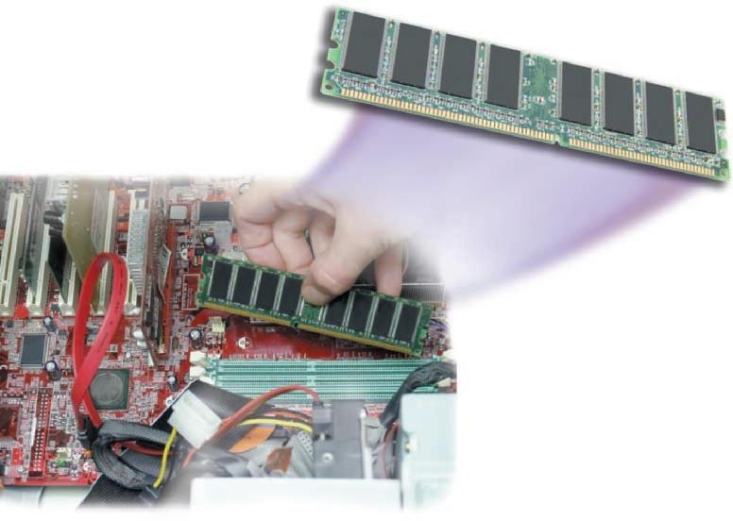
Random Access Memory :
Holds data and program instructions temporarily.
The contents of RAM are lost when the power is turned off.
The contents of RAM can be read and written.

Slide 13
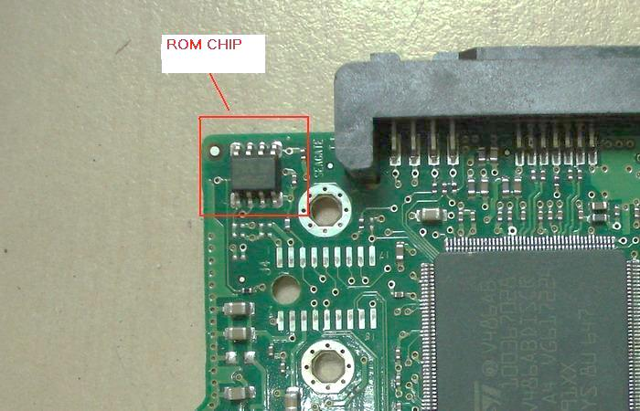
Read Only Memory (ROM):
Stores program instructions to start computer (booting).
The contents of ROM are not lost when the power is turned off.
The contents of ROM can be read but not written.

Slide 14
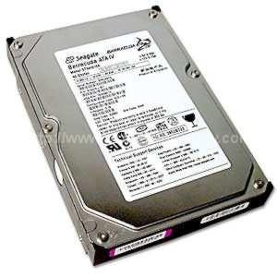
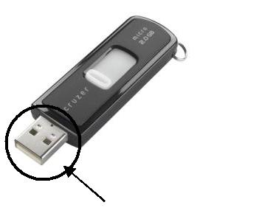
Storage Devices
1-Hard disk
Data on the disk surface is recorded on tracks.
Each disk has a set number of tracks. from 100 to over 10,000 tracks on the disk.
2-USB flash drive
USB flash drives are small and easy to carry around. They can store large amounts of data (up to 256GB). USB flash drives connect to the computer through USB ports.

Slide 15
3-Optical Disk
-CD-ROM (Compact Disk – Read-only memory) – is an optical disk containing data, which has been written and can be read through the use of a laser beam. types of optical disks include CD-R and CD-RW.
1-CD-R (CD-Recordable) - disks can be written to once. Data on CD-R disks can be read but cannot be modified or deleted.
2-CD-RW (CD-Rewritable) - disks can be erased and written to over and over again.
-DVD (Digital Video Disk) - disks are very similar to CD-ROMs but they can store much more data than CDs. DVDs have storage capacities which range from 4.7GB to 17GB.

Slide 16
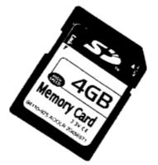
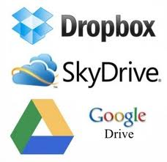
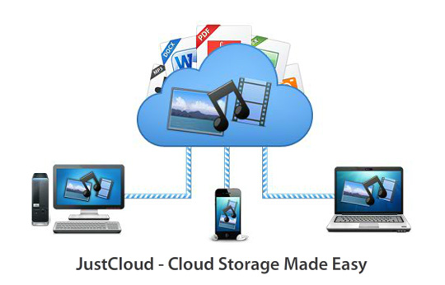
4-Memory card –
is a compact disk used to store digital data. Memory cards are typically used with digital cameras, smartphones etc.
5-Online file storage –
is an Internet service that one can use to store personal files for personal backup of files. Users can upload their files and share them publicly or keep them password-protected.

Slide 17
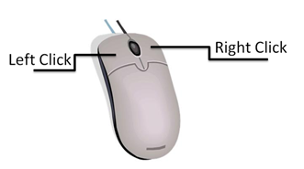
Input Devices
1-Mouse
a device that controls the movement of the cursor or pointer on a display screen. The mouse may contain up to three push buttons each of which has a different functions.
Click (Left): to Select file ,folder or programs.
D-Click (Left): to open file ,folder or programs.
Right Click : to show list of commands.
Drag and Drop : to move file ,folder or painting.

Slide 18
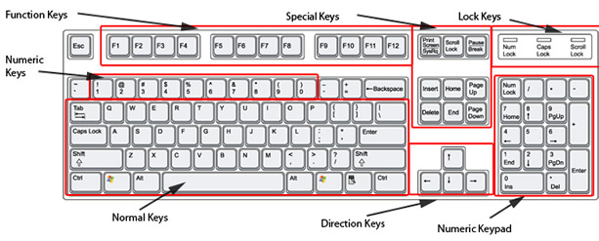
2-Keyboard –
contains a set keys that enable you to enter data in the computer. The keys on computer keyboards are often classified as follows:
- Alphanumeric keys - letters and numbers
-Punctuation keys - comma, period, semicolon etc.
-Special keys - function keys, control keys, arrow keys, Caps Lock key etc.

Slide 19
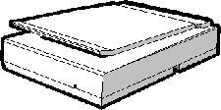
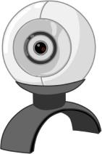
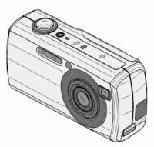
Trackball
Scanner
Touchpad
Joystick
Web camera
Digital camera
Microphone

Slide 20
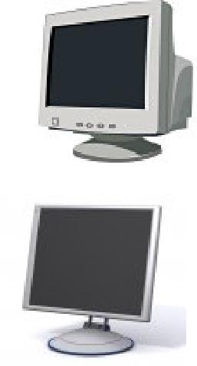
Output Devices
1-Monitor –
also known as the display screen, video display or visual display unit (VDU), is the most common output device. Monitors can have different screen sizes e.g. 14”-, 15”-, 17”-, 19”- and 21”-inch.
There are two main categories of monitors:
1-Cathode-ray tube (CRT) monitors
2-Liquid Crystal Display (LCD)

Slide 21
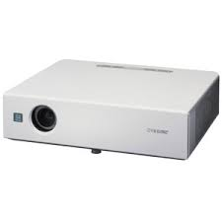
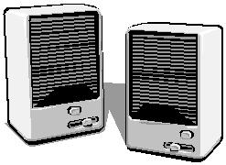
2-Printers
there are three categories of printers: dot-matrix, inkjet and laser printers.
Dot-matrix printer
Inkjet printer
Laser printer
3-Projector(Datashow)
4-Speakers
5-Headphones

Slide 22
SOFTWARE
All software can be divided into two categories
1-Systems software
is a program that controls the computer and enables it to run applications software .Systems software allows the computer to manage its internal resources (disks, monitor, keyboard, and printer).
System software like :
MS Windows
Macintosh Operating System (Mac OS)
Linux
Unix
Android
IOS

Slide 23
Applications software
Word-processing programs (e.g. MS Word, Writer)
Spreadsheet programs (e.g. MS Excel, Calc
Database programs (e.g. MS Access, Base)
Presentation graphics programs (e.g. MS PowerPoint)
Photo editing programs (e.g. MS PhotoEditor, Adobe PhotoShop)
Internet Web Browsers (e.g. MS Internet Explorer, Mozilla Firefox, Opera)
Communications software (e.g. MS Outlook, yahoo massenger)

