Slide 1
Design of Retaining Wall

Slide 2
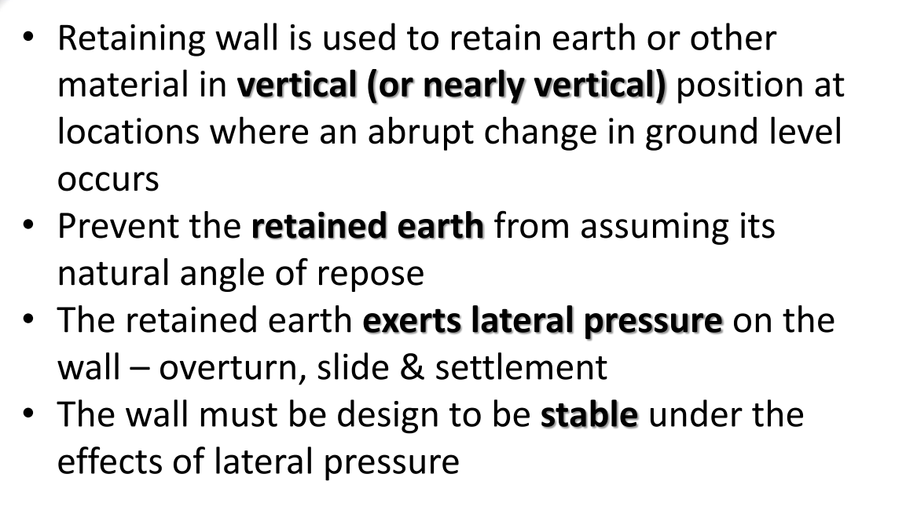
Introduction

Slide 3
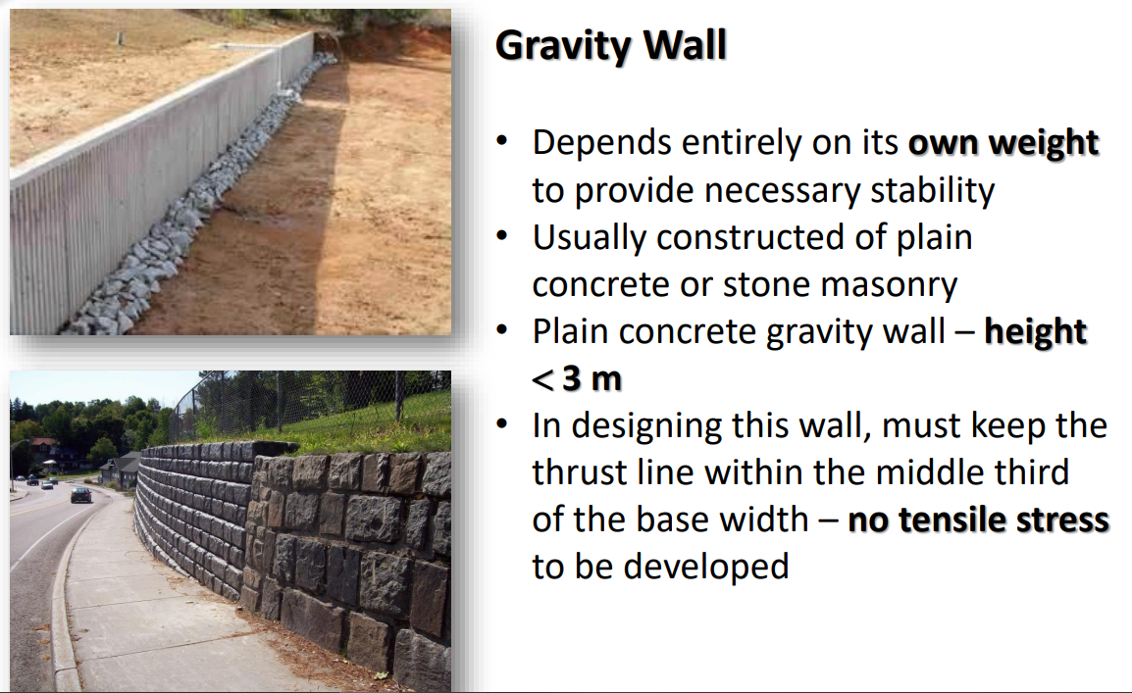
Types of Retaining Walls

Slide 4
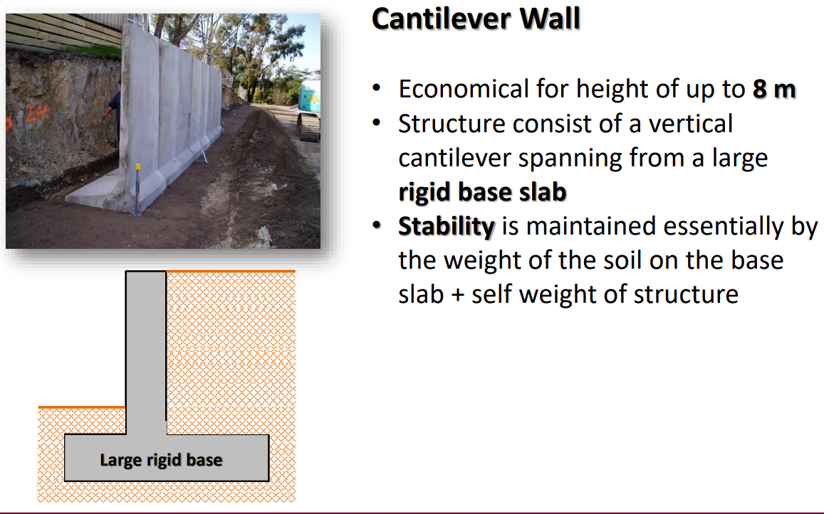
Types of Retaining Walls

Slide 5
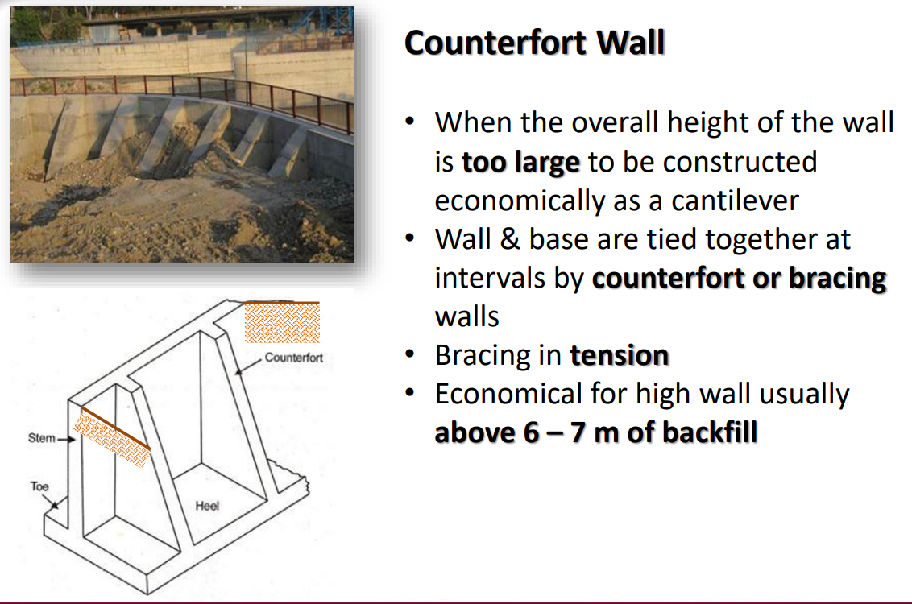
Types of Retaining Walls

