Slide 1
Wastewater Management as a Part of solution for Water Resources Problem In Erbil City

Slide 2
Introduction In Erbil City, municipal wastewater (WW) disposed to the natural environment and in some cases it uses for irrigation directly without any treatment processes. Untreated WW caused problems for the environment, people health, and the water resources. Variation in water quantity and quality are other complications of water sources in Erbil City, Kurdistan Region-Iraq. WW management was not applied efficiently in the area as well. The aim of this research was to study WW management in Erbil City, water resources difficulties and providing suitable solution for the water resources problems

Slide 3
Data on Erbil municipal WW (EMWW) features were collected and analyzed for the current study during a period of four months, beginning in October 2022 and ending in March 2023.Twelve EMWW quality indicators were gathered, organised, and contrasted with WW disposal criteria. The following significant measurements were taken into account: pH, E C (µs/cm), TDS, Chloride, TS, T.Alkalinity, T. Acidity, COD and Color

Slide 4
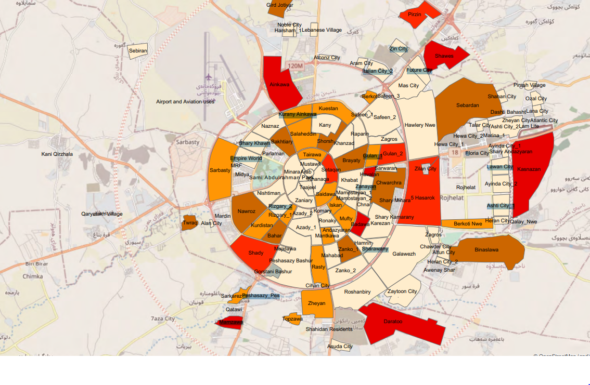
The results show that Erbil's WW can be recycled and used for fountains and irrigation of some crops and agriculture, thus reducing the use of fresh water in the city, including well and Greater Zab water . resulting in expanding groundwater storage. Therefore, treatment procedures are necessary before wastewater is released into the environment or used for irrigation. Furthermore, the criteria for irrigation purposes were compared with the quality of raw wastewater samples.

Slide 5
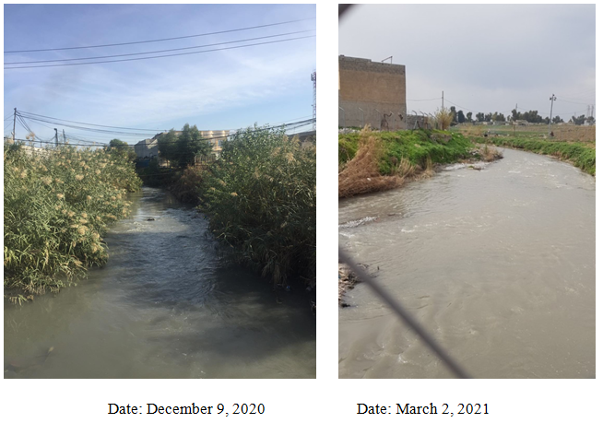
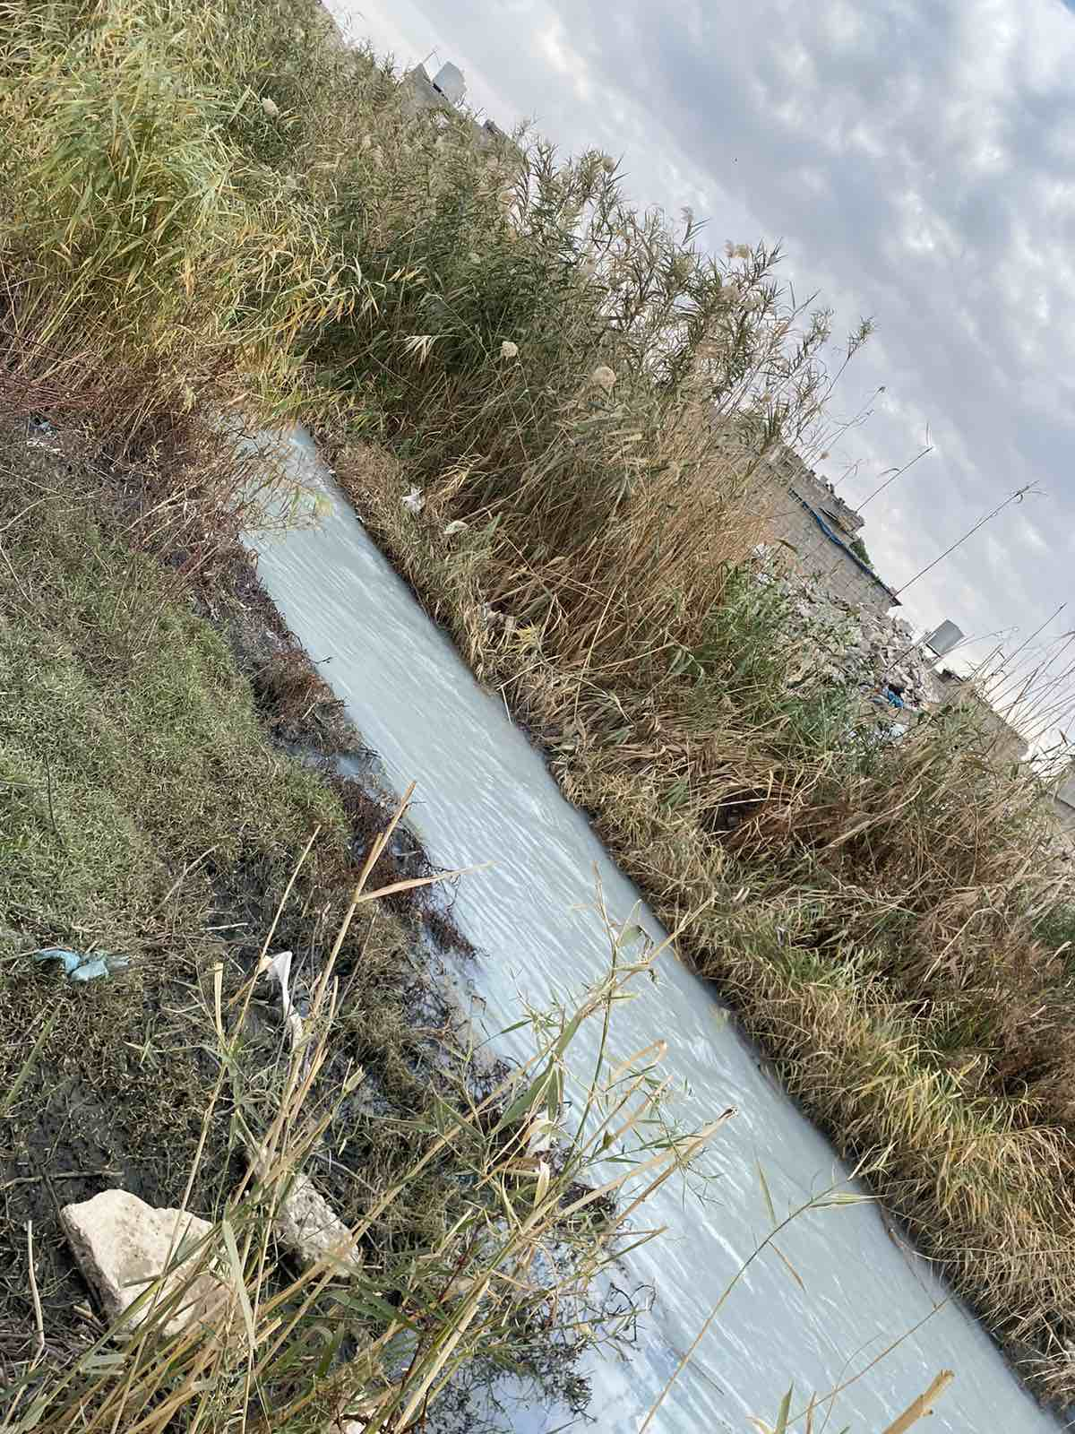
Wastewater Management
As shown in Figure, the main WW canal in Erbil City is located at Sarkarezan Q., which is on Erbil-Makhmur Main Road. The effluent stream extends for more than 50 km, passing through several farmlands and villages, until discharging into the Greater Zab River. EMWW at Sarkarezan Q. typically consists of WWs produced at homes, businesses, restaurants, hotels, car washes, the north industrial area, universities, schools, places of worship, governmental and administrative buildings, private sector homes and buildings, washings, infiltration, and water supply system losses, Figure 2. During wet seasons, storm water is additionally blended with MWWs, which reduces the concentration of pollutants

Slide 6
Table(1) Characteristics of Wastewater at Sarkarezan Q. in Erbil City

Slide 7
Conclusions
In conclusion, the study analyzed that the shed light on the potential of wastewater reuse for irrigation in Erbil city. The findings indicate that wastewater can be effectively treated and used for irrigation purposes without posing significant health and environmental risks. However, further investigations are necessary to explore the long-term effects of wastewater irrigation on soil quality, crop yields, and human health. Additionally, the implementation of proper wastewater treatment systems and the establishment of stringent regulatory frameworks are critical for ensuring the safe and sustainable reuse of wastewater in agricultural practices.

Slide 8
Thank you

