Slide 1
Improvement of Erbil City Environment and Increasing Irrigated Areas through Simulated Hydraulic Design from Greater-Zab River Water

Slide 2
INTRODUCTION
Climate change, drought years, industrialization and oil production, investment, increase number of vehicles, air-conditioning systems, private electric generators and projects impacted on the Erbil City Environment. Green and planted areas were decreased; while desertification, groundwater problem and temperature increased. The objectives of the present research were to improve environment, increasing irrigated, groundwater table and tourist areas, and decreasing flood in Erbil City.

Slide 3
To conduct the research, design of pumping station, pipe lines, ponds and artificial channels for conveying raw water from Greater-Zab River (GZR) to the surrounded areas of Erbil City was studied.
. Surveying data were collected through site visits to the selected areas.
Hydraulics design for the pumping station, pipe line, ponds and the channels were carried out.

Slide 4
Simulated Hydraulic Design

Slide 5
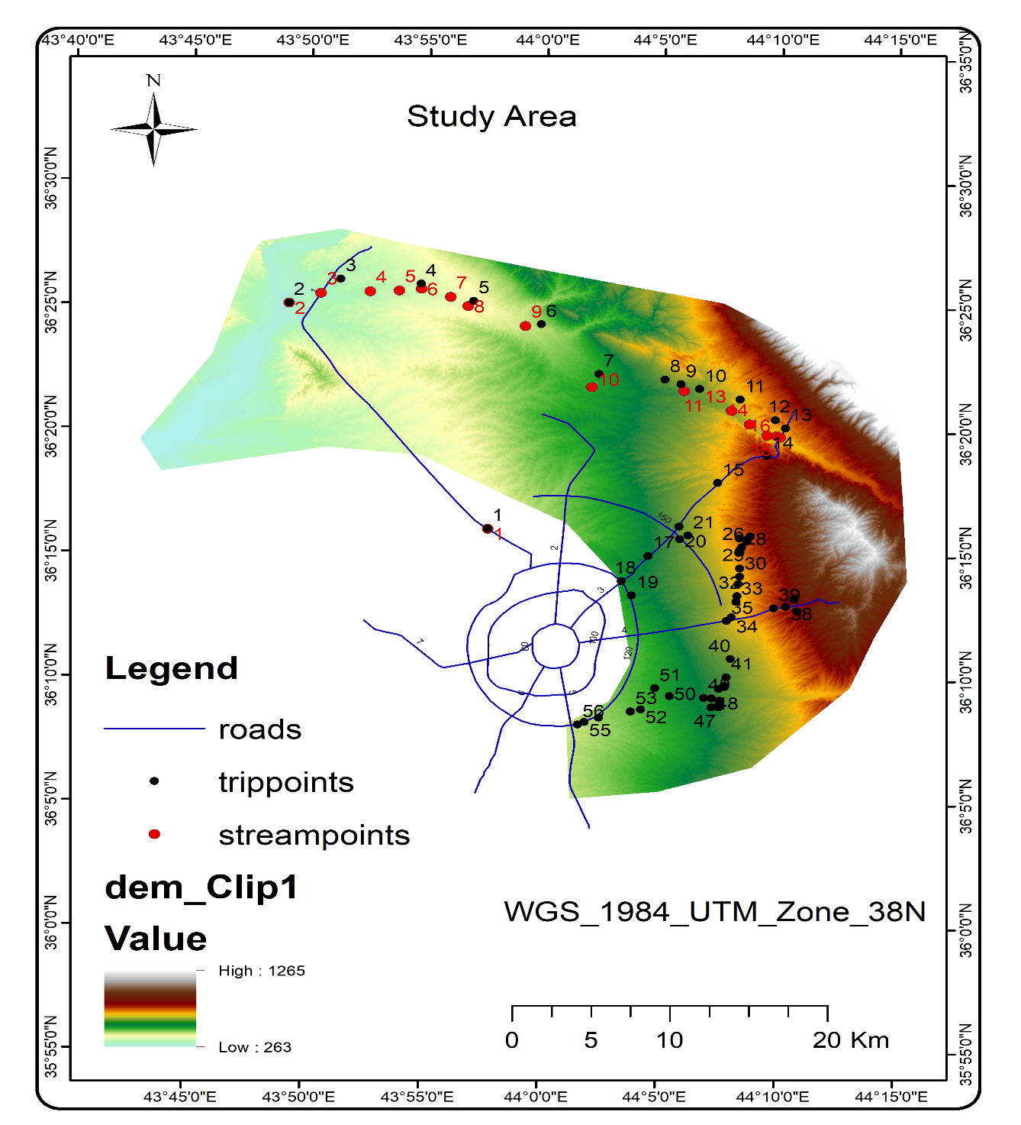
DEM of study area, main roads and all collected data using GIS software

