Slide 1
Approaching Poetry (3rd year students)
Bandar A. Muhammed
Salahaddin University – Erbil
College of Education
English Department
2022 - 2021

Slide 2
Objectives
The aims are to:
1. Learn language (vocabulary) through poetry
2. Practice speaking / writing
3. Analyze poems(explanation)
4. Reflect on the topic

Slide 3
How I teach:
Language (definition/meaning)
Read a poem (together)
Analyze together
Talk about the structure of poems
Take notes
Review

Slide 4
What Students need to do:
Attend classes
Listen
Practice
Ask questions
Answer questions
Do homework

Slide 5
An introduction
Why we study poetry at college?

Slide 6
Analysis of poems (1)
The poet
The age (century)
The title
People in the poem (any?)
Time (any?)
Theme
Summary of the poem
Poetic devices

Slide 7
An example
The Road not Taken
By Robert Frost

Slide 8
The Road not Taken Robert Frost (Modern)
Two roads diverged in a yellow wood, And sorry I could not travel both And be one traveler, long I stood And looked down one as far as I could To where it bent in the undergrowth;

Slide 9
I shall be telling this with a sigh Somewhere ages and ages hence: Two roads diverged in a wood, and I — I took the one less traveled by, And that has made all the difference.

Slide 10
Homework
Read the poem aloud several times
Record your voice

Slide 11
Review
Study poetry for critical thinking/being independent
Poetry has content and structure (meaning and form)
The central theme (topic) is important
The people
The figurative language
Symbolism

Slide 12
Analysis of poems (1)
The poet
The age (century)
The title
People in the poem (any?)
Time (any?)
Theme
Summary of the poem
Poetic devices

Slide 13
Then took the other, as just as fair, And having perhaps the better claim, Because it was grassy and wanted wear; Though as for that the passing there Had worn them really about the same,

Slide 14
And both that morning equally lay In leaves no step had trodden black. Oh, I kept the first for another day! Yet knowing how way leads on to way, I doubted if I should ever come back.

Slide 15
I shall be telling this with a sigh Somewhere ages and ages hence: Two roads diverged in a wood, and I — I took the one less traveled by, And that has made all the difference.

Slide 16
Writing
Write the summary of the meaning of the poem
What is the them?
What are some symbols in the poems?

Slide 17
Review (week 3)
Poetry helps critical thinking
Poems have content and structure
Symbolism: one thing in the poem refers to another thing outside the poem
Metaphor: two objects are likened to each other
Simile: two things are likened to each other with the use of (as, like … etc).

Slide 18
Review (4 minutes)
What are the two components of poems?
What do we need to know to analyze a poem?
What are the differences between (symbolism, metaphor, simile)?
What is (Alliteration) and (rhyme scheme)?

Slide 19
Review
The road not taken (by Robert Frost)
Hope is the thing with feathers (by Emily Dickson)
Starry night (by Anne Sexton)
Write whatever you remember (in 3 minutes)

Slide 20
4. A Question Robert Frost
A voice said, Look me in the stars
And tell me truly, men of earth,
If all the soul-and-body scars
Were not too much to pay for birth.

Slide 21
Basics of poetry (Bandar A. Muhammed) review April, 2020
Poetry helps critical thinking development
It is also a way to learn about other languages and cultures.
Poems are the product of interplay between form and content.
For analysis, we need to focus on form and content.

Slide 22
What do we need for poem analysis?
The poet
The age (century)
The title
People in the poem (any?)
Time (any?)
Theme
Summary of the poem
Poetic devices

Slide 23
Review
What had impact on the poem (caged bird)?
Who are the main characters in (caged bird)?
what do (Caged bird) and (free bird) symbolize?
What is the theme of (the road not taken)?
What does (Road) symbolize?

Slide 24
Review
Then took the other, as just as fair, And having perhaps the better claim, Because it was grassy and wanted wear; Though as for that the passing there Had worn them really about the same,
Summary, rhyme, alliteration

Slide 25
Review
The caged bird sings
with a fearful trill
of things unknown
but longed for still
and his tune is heard
on the distant hill
for the caged bird
sings of freedom.
Summary, rhyme, symbols

Slide 26
Review
Interplay of content and structure
Theme
Summary
Structure
The road not taken
Caged bird
remember

Slide 27
Remember Christina Rossettee
Sonnet
Octave
Remember
Silent land
Counsel
Sestet
Forget / sad
Prefer (forget and be happy than remember and be sad)

Slide 28
Key words

Slide 29
Symbols
Silent land
Sigh
Eye of heaven
Roads
Look at

Slide 30
Personification
Examples

Slide 31
Answer in brief
Iambic
Alliteration
Sonnet
pentameter

Slide 32
Key words remember

Slide 33
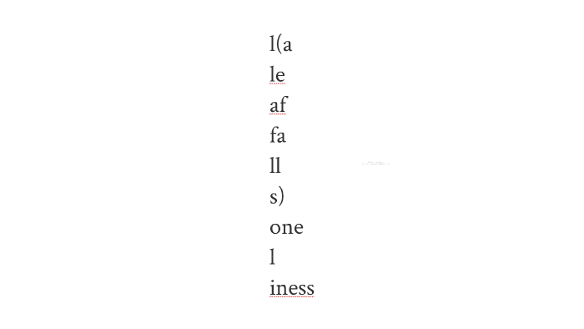
ee cumming

