Slide 1
Kurdistan Regional Government-Iraq
Ministry of Higher Education and Scientific Research
Universy of Salahaddin – Hawler
College of Engineering
Department of Civil Engineering
Mathematic-II
Fall Semester
Academic year (2023-2024)
Four hours per week
Five Credits
Prepared by: Barzan Omar, M.Sc.
Email: barzan.mawlood@su.edu.krd

Slide 2
Chapter 1Transcendental Functions
1.1 Inverse Functions
Definition Inverse Function Suppose that $f$ is a one-to-one function on a domain $D$ with range $R$. The inverse function $f^{−1}$ is defined by $$f^{−1}\left(a\right)=b if f\left(b\right)=a$$ The domain of $f^{−1}$ is $R$ and the range of $f^{−1}$ is $D$.
The $(−1)$in $f^{−1}$ is not an exponent: $f^{−1}(x)$ does not $1/{f(x)}$.
The symbol $f^{−1}(x)$ for the inverse of $f$ is read $"f inverse“$.
Composing a function and its inverse has the same effect as doing nothing.
$$\left(f^{−1}∘f\right)\left(x\right)=x$$
$$\left(f∘f^{−1}\right)\left(x\right)=x$$
Only one-to-one functions can have an inverse, for the others may be as inverse function with restricted.

Slide 3
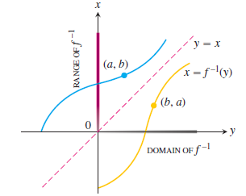
Chapter 1Transcendental Functions
1.1 Inverse Functions
To find the inverse for a function:
Solve the equation $y=f(x)$ for $x$. This gives a formula $x=f^{−1}(y)$ where $x$ is expressed as function of $y$.
Interchange $x$ and $y$, obtaining a formula $y=f^{−1}(x)$ where $f^{−1}$ is expressed in the conventional format with $x$ as independent variable and $y$ as dependent variable.

Slide 4
Chapter 1Transcendental Functions
1.1 Inverse Functions
Theorem 1 The Derivative Rule for Inverses If $f$ has an interval $I$ as domain and $f’(x)$exists and is never zero on $I$, then $f^{−1}$ is differentiable at every point in its domain. The value of ${\left(f^{−1}\right)}^{′}$at a point $b$ in the domain of $f^{−1}$ is the reciprocal of the value of$f’$at the point $a=f^{−1}\left(b\right):$ $${\left(f^{−1}\right)}^{′}(b)=\frac{1}{f^{′}\left(f^{−1}(b)\right)}$$ Or $${\left.\frac{df^{−1}}{dx}\right|}_{x=b}=\frac{1}{{\left.\frac{df}{dx}\right|}_{x=f^{−1}(b)}}$$

Slide 5
Chapter 1Transcendental Functions
1.2 Natural Logarithm (ln)
What is Logarithm?
The logarithm to the base $b$ of the variable $y$ is defined as the power to which you would raise $b$ to get $y$. If the logarithm to the base $b$ of $y$ is equal to $x$, then $b$ raised to the $x$ power will give you the value $y$. So $\log_{b}{(y)}=x$ is defined to be the inverse function $y=b^{x}$
Invented by John Napier
$\log_{b}{(y)}=x$ is pronounces $“log−base−b− of y equals x”$
Logarithm may be defined to any base.
The logs most often encountered are the logarithm to the base $10$ which is called the common logarithm.
The logarithm with base e ($e = 2.718281828…$) which is called the natural logarithm $y=\log_{e}{(x)}=\ln{x}$.
Is equivalent to
Is equivalent to

Slide 6
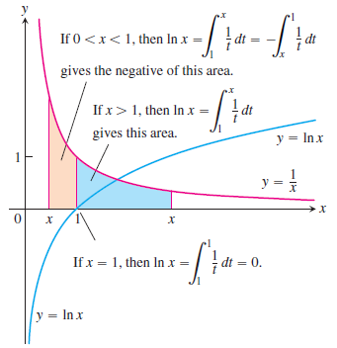
Chapter 1Transcendental Functions
1.2 Natural Logarithm (ln)
Definition The Natural Logarithm Function $$\ln{x}=\int_{1}^{x}{\frac{1}{t} dt} x>0$$
Definition The number e The number $e$ is that number in the domain of the natural logarithm satisfying $$\ln{(e)}=1$$
The logarithm with base $e$ ($e = 2.718281828459045$) which is called the natural logarithm.
The definition means that $e$ is the unique number with the property that the area of the region bounded by the parabola $y = 1/x$, $x−axis$, and the vertical lines $x = 1$and $x = e$is $1$.
Its domain is $(0, ∞),$and its range is $(−∞, ∞).$

Slide 7
Chapter 1Transcendental Functions
1.2 Natural Logarithm (ln)
1.2.1 The Derivative of $y=\ln{x}$
For every positive value of $x$
Example:

Slide 8
Chapter 1Transcendental Functions
1.2 Natural Logarithm (ln)
1.2.2 The Properties of Logarithm
Theorem 2 Properties of Logarithms For any numbers $a>0$ and $x>0$, the natural logarithm satisfies the following rules:
$$1. Product Rule:$$ | $$\ln{ax}=\ln{a}+\ln{x}$$
$$2.Quotient Rule:$$ | $$\ln{\frac{a}{x}}=\ln{a}−\ln{x}$$
$$3.Reciprocal Rule:$$ | $$\ln{\frac{1}{x}}=−\ln{x}$$
$$4.Power Rule:$$ | $$\ln{x^{r}}=r\ln{x}$$

Slide 9
Chapter 1Transcendental Functions
1.2 Natural Logarithm (ln)
1.2.3 The Integral of $\int{\left(1/u\right)} du$
If u is a differentiable function that is never zero, $$\int{\frac{1}{u} du}=\ln\left|u\right|+C$$
Example:

Slide 10
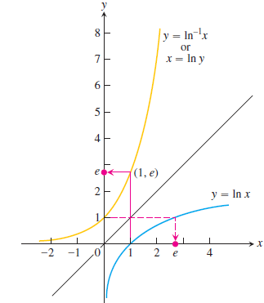
Chapter 1Transcendental Functions
1.3 Exponential Function
Taking the inverse for the function
Draw the graphs of the functions
The function ${\ln{ }}^{−1}x$ is also called $exp⁡x$.
If $x = 1$
So
We can raise the number $e$ to a rational power $x$, $y=e^{x}$.
The domain $is (−∞, ∞).$The range is $(0, ∞).$
$\lim_{x→∞}{e^{x}=∞}$ and $\lim_{x→−∞}{e^{x}=0}$

Slide 11
Chapter 1Transcendental Functions
1.3 Exponential Function
We can simplify
Since $\ln{x}$ and $e^{x}$ are inverse of one another.
Definition The Natural Exponential Function For every real number $x$, $e^{x}={\ln{ }}^{−1}x=exp x$.
Inverse Equations for $e^{x}$ and $\ln{x}$ For every real number $x$, $e^{x}={\ln{ }}^{−1}x=exp x$. $$e^{\ln{x}}=x \left(all x>0\right)$$ $$\ln\left(e^{x}\right)=x \left(all x\right)$$

Slide 12
Chapter 1Transcendental Functions
1.3 Exponential Function
Theorem 3 Laws of Exponents for $e^{x}$ For all numbers $x$, $x_{1}$ and $x_{2}$, the natural exponential $e^{x}$ obeys the following laws:
$$1.$$ | $$e^{x_{1}}∙e^{x_{2}}=e^{x_{1}+x_{2}}$$
$$2.$$ | $$e^{−x}=\frac{1}{e^{x}}$$
$$3.$$ | $${\frac{e^{x_{1}^{ }}}{e^{x_{2}^{ }}}}=e^{x_{1}−x_{2}}$$
$$4.$$ | $${\left(e^{x_{1}^{ }}\right)}^{x_{2}}=e^{x_{1}^{ }x_{2}^{ }}={\left(e^{x_{2}^{ }}\right)}^{x_{1}}$$
Example:

Slide 13
Chapter 1Transcendental Functions
1.3 Exponential Function
1.3.1 The Derivative and Integral of $e^{x}$
If $u$ is any differentiable function of $x$, then $$\frac{d}{dx}e^{u}=e^{u}\frac{du}{dx}.$$
$$\int{e^{u}}du=e^{u}+C.$$
Example:

Slide 14
Chapter 1Transcendental Functions
1.4 The Function of $y=a^{x}$
Definition General Exponential Functions For any numbers $a>0$ and $x$, the exponential function with base $a$is $$a^{x}=e^{x\ln{a}}$$
Example:

Slide 15
Chapter 1Transcendental Functions
1.4 The Function of $y=a^{x}$
1.4.1 The Derivative of $a^{u}$
Definition General Exponential Functions If $a >0$ and $u$ is a differentiable function of $x$, then $a^{u}$ is a differentiable function of $a$ and $${\frac{d}{dx}a}^{u}=a^{u}\ln{a}\frac{du}{dx}$$
Example:

Slide 16
Chapter 1Transcendental Functions
1.4 The Function of $y=a^{x}$
1.4.2 The Integral of $a^{u}$
$$\int{a^{u}}du=\frac{a^{u}}{\ln{a}}+C.$$
Example:

Slide 17
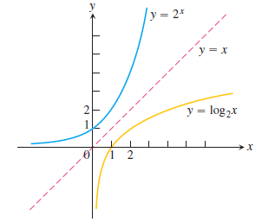
Chapter 1Transcendental Functions
1.5 Ordinary Logarithm (Logarithm with base a) $y=\log_{a}{x}$
Definition $\log_{a}{x}$ For any positive number $a≠1$, $\log_{a}{x}$ is the inverse function of $a^{x}$
Inverse Equations for $a^{x}$ and $\log_{a}{x}$ For any positive number $a≠1$, $$a^{\log_{a}{x}}=x (x>0)$$ $$\log_{a}{(a^{x})}=x (all x)$$

Slide 18
Chapter 1Transcendental Functions
1.5 Ordinary Logarithm (Logarithm with base a) $y=\log_{a}{x}$
Evaluation of
$$\log_{a}{x}=\frac{1}{\ln{a}}⋅\ln{x}=\frac{\ln{x}}{\ln{a}}$$
7.5.1 Derivative and Integrals involving of
$${\frac{d}{dx}\left(\log_{a}{x}\right)}=\frac{1}{\ln{a}}⋅\frac{1}{u} \frac{du}{dx}$$

Slide 19
Chapter 1Transcendental Functions
1.5 Ordinary Logarithm (Logarithm with base a) $y=\log_{a}{x}$
Properties of
H.W: Evaluate
H.W: Find $x$, if

Slide 20
Chapter 1Transcendental Functions
1.6 Base 10 Logarithm
It is often called common Logarithm.
Earthquake intensity is often reported on the Logarithmic Richter Scale
where:
a: Amplitude of the ground motion in microns at the receiving station.
T: The period of the seismic wave in second.
B: An empirical factor

Slide 21
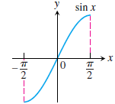
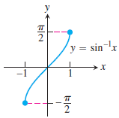
Chapter 1Transcendental Functions
1.7 Inverse Trigonometric Functions
Inverse trigonometric functions arise when we want to calculate angles from side measurements in triangles.
The six basic trigonometric functions can be one-to-one by restricting their domains. For example we can make the sine function one-to-one by restricting its domain to the domain, $[{−π}/2, π/2]$so that it has an inverse $\sin^{−1}{x}$.
Similar domain restrictions can be applied to all six trigonometric functions.

Slide 22
Chapter 1Transcendental Functions
1.7 Inverse Trigonometric Functions
Similar domain restrictions can be applied to all six trigonometric functions.
These equations are rea $“ y equals the arcsine of x”$or $“y equals arcsine x”$and so on.

Slide 23
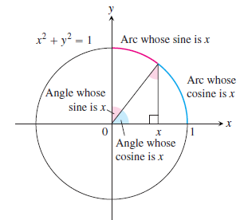
Chapter 1Transcendental Functions
1.7 Inverse Trigonometric Functions
The Arcsine Function
This figure gives a geometric interpretation of $y=\sin^{−1}{x}$ and $y=\cos^{−1}{x}$.
The length of curve for the unit circle is $s=rθ$.
Function | Domain | Range

Slide 24
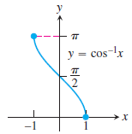
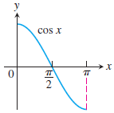
Chapter 1Transcendental Functions
1.7 Inverse Trigonometric Functions
Function | Domain | Range

Slide 25
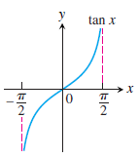
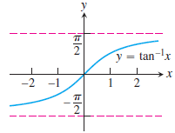
Chapter 1Transcendental Functions
1.7 Inverse Trigonometric Functions
Function | Domain | Range

Slide 26
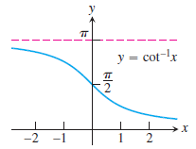
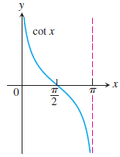
Chapter 1Transcendental Functions
1.7 Inverse Trigonometric Functions
Function | Domain | Range

Slide 27
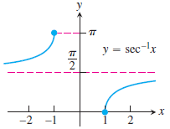
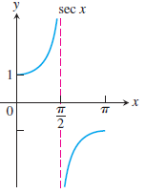
Chapter 1Transcendental Functions
1.7 Inverse Trigonometric Functions
Function | Domain | Range

Slide 28
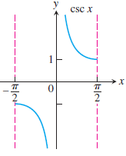
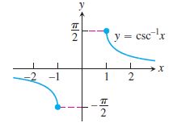
Chapter 1Transcendental Functions
1.7 Inverse Trigonometric Functions
Function | Domain | Range

Slide 29
Chapter 1Transcendental Functions
1.7 Inverse Trigonometric Functions
Right-triangle interpretation

Slide 30
Chapter 1Transcendental Functions
1.7 Inverse Trigonometric Functions
Right-triangle interpretation

Slide 31
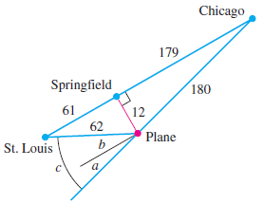
Chapter 1Transcendental Functions
1.7 Inverse Trigonometric Functions
Example: During an airplane flight from Chicago to St. Louis the navigator determines that the plane is $12 mi$off course, as shown in Figure. Find the correction angle
Solution: The correction angle is the angle of $a$ plus angle of $b$

Slide 32
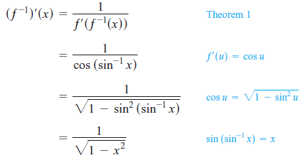
Chapter 1Transcendental Functions
1.7 Inverse Trigonometric Functions
1.7.1 Derivative of The Inverse Trigonometric Functions
According to the Theorem 1 for derivative of inverse function, we can make the derivative of the inverse trigonometric functions.
The derivative of $y=\sin^{−1}{u}$

Slide 33
Chapter 1Transcendental Functions
1.7 Inverse Trigonometric Functions
Derivative | Differential

Slide 34
Chapter 1Transcendental Functions
1.7 Inverse Trigonometric Functions
1.7.1 Derivative of The Inverse Trigonometric Functions
Example:
Identities
Note

Slide 35
Chapter 1Transcendental Functions
1.7 Inverse Trigonometric Functions
1.7.2 Integral Formula

Slide 36
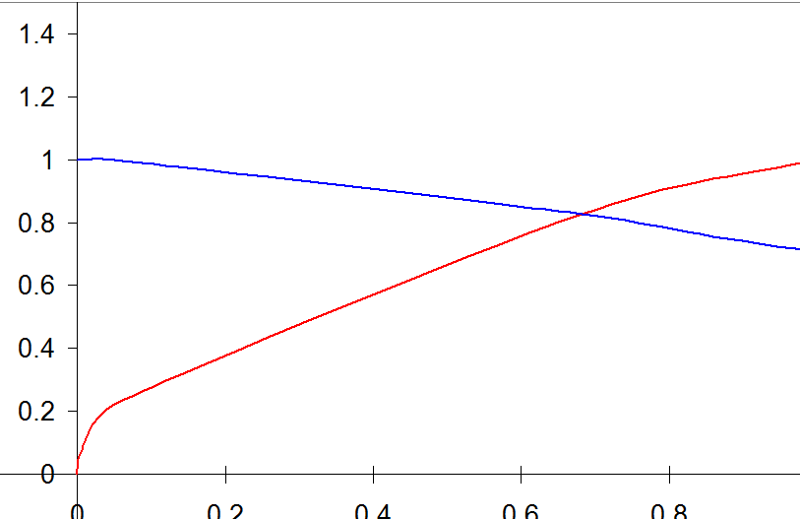
Chapter 1Transcendental Functions
1.7 Inverse Trigonometric Functions
Example: Find the volume of solid generated by revolving the region bounded by $y−axis$, $y=x/{\sqrt{x}}$, $y=1/{\sqrt{1+x^{2}}}$ , about $x−axis$.
Solution:
1- Sketch the solid and typical cross-section
2- The volume

Slide 37
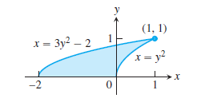
Chapter 1Transcendental Functions
1.7 Inverse Trigonometric Functions
problem: Find the volume of solid generated by revolving the region bounded about

Slide 38
Chapter 1Transcendental Functions
1.7 Inverse Trigonometric Functions
problem: Find the volume of solid generated by revolving the region bounded by
and the curve about x = -1.

Slide 39
Chapter 1Transcendental Functions
1.8 Hyperbolic Functions
The hyperbolic functions are formed by taking combinations of the two exponential functions $e^{x}$ and $e^{−x}$.
They simplify many mathematical expressions, important in applications, for instance in problems such as computing the tension in a cable suspended by its two ends, as in an electric transmission line and in finding solutions to differential equations.
the exponential function $e^{x}$ can be written as follow:
So the first part is called the hyperbolic cosine
The second part is called the hyperbolic sine
The notation $cosh⁡x$ is often read “kosh $x$,” and $sinh⁡x$ is pronounced as if spelled “cinch $x$,”.

Slide 40
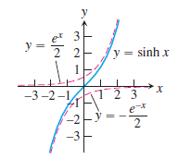
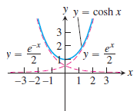
Chapter 1Transcendental Functions
1.8 Hyperbolic Functions
The Six Basic Hyperbolic Functions
1. Hyperbolic sine of x:
1. Hyperbolic cosine of x:

Slide 41
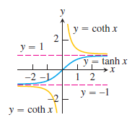
Chapter 1Transcendental Functions
1.8 Hyperbolic Functions
The Six Basic Hyperbolic Functions
3. Hyperbolic tangent of x (Tanch, Tsan, or Tank):
4. Hyperbolic cotangent of x (Coth):

Slide 42
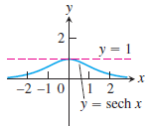
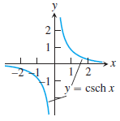
Chapter 1Transcendental Functions
1.8 Hyperbolic Functions
The Six Basic Hyperbolic Functions
5. Hyperbolic secant of x (Seech):
6. Hyperbolic cosecant of x (Kisch):

Slide 43
Chapter 1Transcendental Functions
1.8 Hyperbolic Functions
Identities for hyperbolic functions

Slide 44
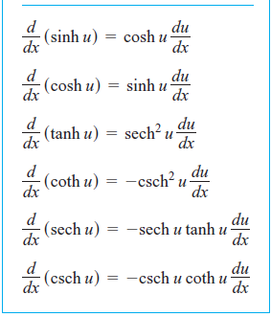
Chapter 1Transcendental Functions
1.8 Hyperbolic Functions
1.8.1 Derivative of Hyperbolic Functions

Slide 45
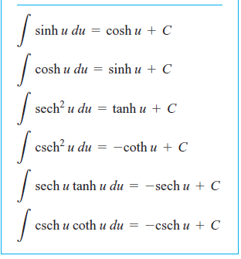
Chapter 1Transcendental Functions
1.8 Hyperbolic Functions
1.8.2 Integral Formula for Hyperbolic Functions

